Slide 1
Software testing
Michal Tichý
Riganti s.r.o. edu@tichymichal.net

Slide 2
Is testing even worth it?

Slide 3
When to write tests?
Long term projects
Critical infrastructure (code which can cause harm,…)
Applications where manual testing would be complicated. (code which is not run frequently,…)
Applications with known acceptance criteria.
When the tests are part of the contract/assignment (for example, project for ICS!)

Slide 4
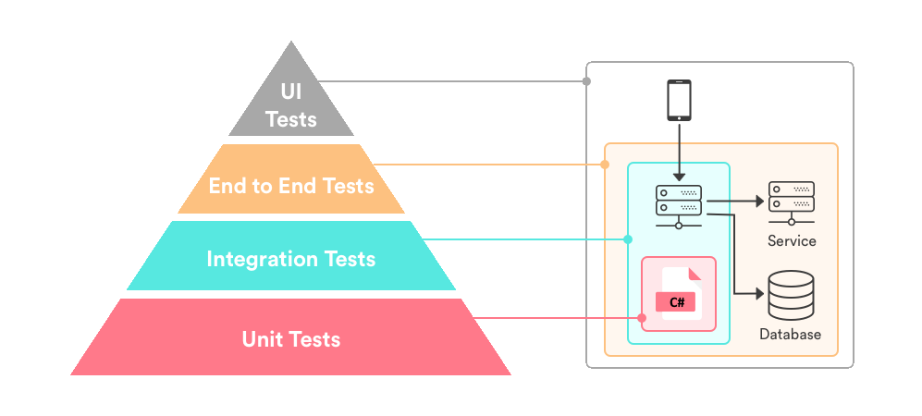
When to choose what type of tests?
Also
Performance tests
Resilience tests
Acceptance tests
Accesibility tests …

Slide 5
Am I writing a good unit tests?
Tests should be isolated and repeatable, without relying on test order.
Never test multiple things.
AAA rule
Every unit test should consist of these parts:
Arrange: Setup environment for the test.
Act: Perform the operation which we want to test.
Assert: Check if the end state is same as expected one.
Avoid testing external dependencies together with your code.

Slide 6

Creating test project
Basic tests
Parametrized tests
Skipping tests
Test setup / arrange
Non shared fixture
Class shared fixture
Group shared fixture

Slide 7
xUnit summary
YOU CAN USE WHATEVER TEST FRAMEWORK YOU WANT IN YOUR PROJECT
AAA => Arange, Act, Assert
XUNIT
[Fact] – Marks a test method
[Theory] – Marks a test method with parameters => runs test several times with different parameters.
Constructor – Runs before every test case. Same is true for Dispose.
IClassFixture – Allows sharing context between tests in the same class. Fixture is injected into constructor.

Slide 8

Tests for “real” application
How to choose test scenarios
isSame vs isEqual
Overflow / Underflow
Code coverage
Live tests

Slide 9
Calculator tests summary
You should test normal conditions AND extreme conditions.
Use IsSame only when you want to check if the object is the same => references points to the exactly same place.
For checking if the “content” is same use IsEqual.
Having code coverage 100% does not mean than your code is bug free.

Slide 10
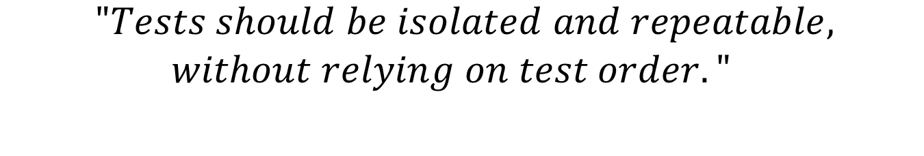

Avoiding pitfalls of testing database depended code
$$\begin{matrix} "Tests should be isolated and repeatable, \\ without relying on test order."\end{matrix}$$
Database should be in the same state before and after test.
$$⇓$$
 | Cleaning up after each test | Restore database from backup | In Memory Database
Overhead | ✔ - SMALL | ❌ - EXTREME | ✔ - SMALL
Need to revert any modifications | ❌ - YES | ✔ - NO | ✔ - NO
Same behavior as real database. | ✔ - YES | ✔ - YES | ❌ - NO
Support for concurrent test runs | ❌ - NO | ❌ - NO | ✔ - YES

Slide 11

Database fixture
Setting up in memory database
Basic database tests

Slide 12
Database tests summary
When testing database depended code always check that database is in the same state after the test as before.
For most scenarios is best to replace real database with InMemory variant.
InMemory database can have different behavior in complex usecases.

Slide 13
Testable code
Testable code refers to the loosely coupled code where code does not directly depend on internal/external dependencies, so we can easily replace the real dependencies.

Slide 14
How to write testable code
Inversion of Control (IoC) and Dependency injection (DI) are your friends.
When all dependencies are provided via constructor or property injection than you can replace them with fakes/mocks.
Avoid using static classes. Replacing dependency on static class is hard.

Slide 15
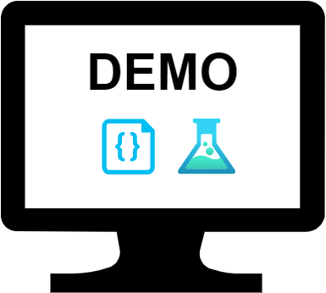
Why is this code so hard to test.
How to make this code testable.

Slide 16
Testable code summary
Think twice before using new().
Use dependency injection.
Avoid static classes.

Slide 17
Continous Integration
New code is integrated into main branch often.
All changes are automatically tested.
Continous Delivery / Deployment
New versions are automatically created.
Possibility to automatically deploy new version after each change.

Slide 18
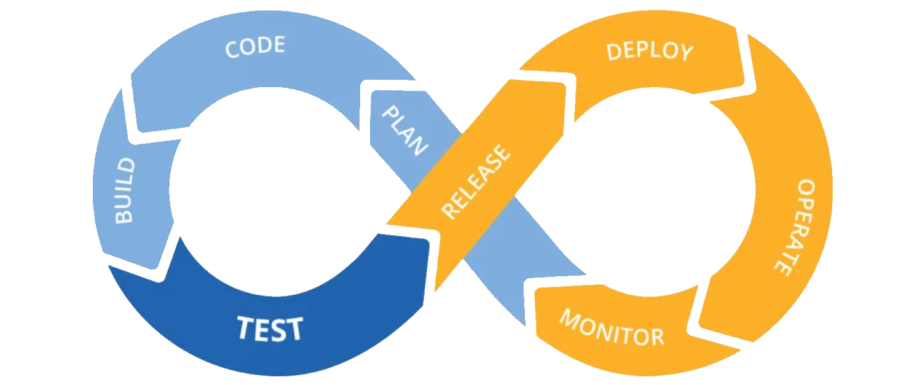
CI
CD
https://medium.com/microsoftazure/modern-development-creating-a-rest-api-via-ci-cd-and-back-866b3f9397d3

Slide 19

CI
Branch security
CI Pipeline
CD
Creating release
Application deployment

Slide 20
CI / CD summary
CI
Automatic builds and tests.
Enforces that version in repository is always in working state.
CD
Automatic build of new versions.
Automatic release of new versions.

