Slide 1
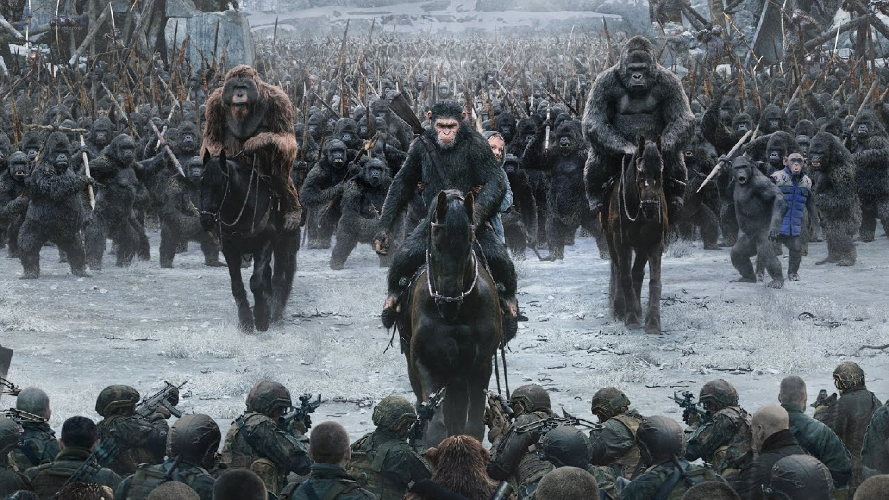

Classification
Apes
Together
strong

Slide 2
Agenda
Dataset overview
First models – logistic regression
Other algorithms – KNeighbours , Random Forest , Decision Tree
Oversampling
Models with oversampling

Slide 3
Dataset contents
Name | Content | Type
Elevation | Elevation in meters | Int
Aspect | Aspect in degrees azimuth | Int
Slope | Slope in degrees | Int
Horizontal/Vertical distance to hydrology | Horizontal and vertical distance to nearest surface water in meters | Int
Horizontal distance to roadways | Distance to nearest roadway in meters | Int
Hillshade at 9am/noon/3pm | Hillshade at selected hours at summer solstice ( 21st of June ) | Int
Horizontal distance to fire points | Horizontal distance to nearest wildfire ignition point in meters | Int
Wilderness area 1 – 4 | Wilderness area designation | Binary
Soil type 1 - 40 | Soil type designation | Binary

Slide 4
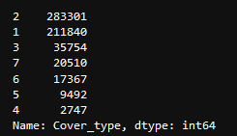
Value counts
// Tutaj wstawić output z kodu odnośnie ilości klas i troszeczkę omówić

Slide 5
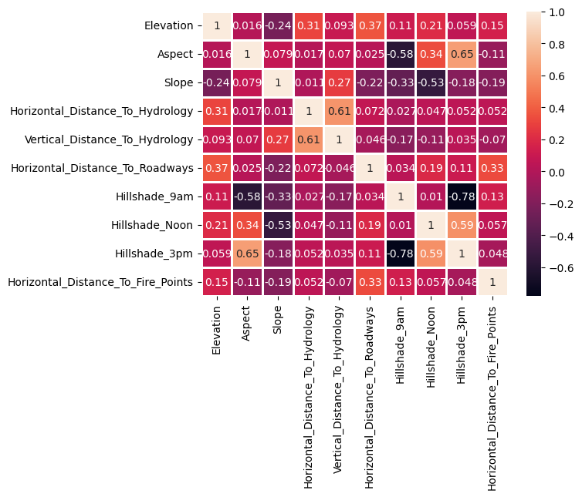
Data correlation
Correlation | Value
Hillshade 3pm Hillshade 9am | -0.78
Hillshade noon Slope | -0.53
Hillshade 9am Aspect | -0.58

Slide 6
Logistic regression
As is
Values normalized
Target encoding
Values were normalized to fit between 0 and 1
Data was prepared using target encoding.
No manipulation, model trained on data as it came

Slide 7
Conclusions
Logistic regression isn’t the best algorithm
Data manipulation didn’t help much
// Jakiś opis odnośnie tego
// Jakiś opis

Slide 8
Other algorithms we used
K-Neighbours
Random forest
Decision tree
// Classification raport here
// Classification raport here
// Classification raport here

Slide 9
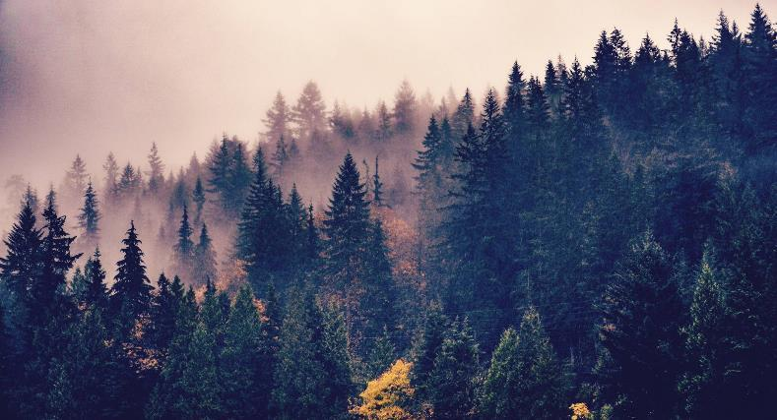
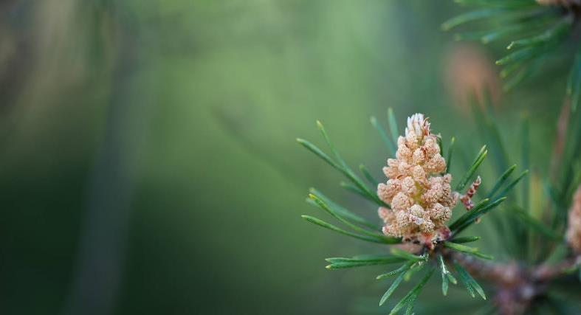
Summary
This three algorithms performed much better than logistic regression
Results are acceptable, but we could do better

Slide 10
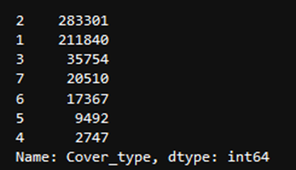
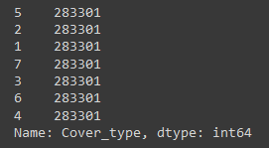
Oversampling
Oversampling is used to adjust the class distribution of data set. We use it here because class 1 and 2 consists of almost 90% of data set records.

Slide 11
KNeighbours classifier
Before oversampling
After oversampling
// Classification raport przed oversamplingiem
// Classification raport po oversamplingu

Slide 12
Random forest classifier
Before oversampling
after oversampling
// Classification raport przed oversamplingiem
// Classification raport po oversamplingu

Slide 13
Decision tree classifier
Before oversampling
after oversampling
// Classification raport przed oversamplingiem
// Classification raport po oversamplingu

Slide 14
Summary
Oversampling helped a lot in model training
Precision, recall and F-1 score stayed the same or fell for initially overpopulated classes, but it rose sharply for other ones
99% accuracy is good enough result to stop here

Slide 15
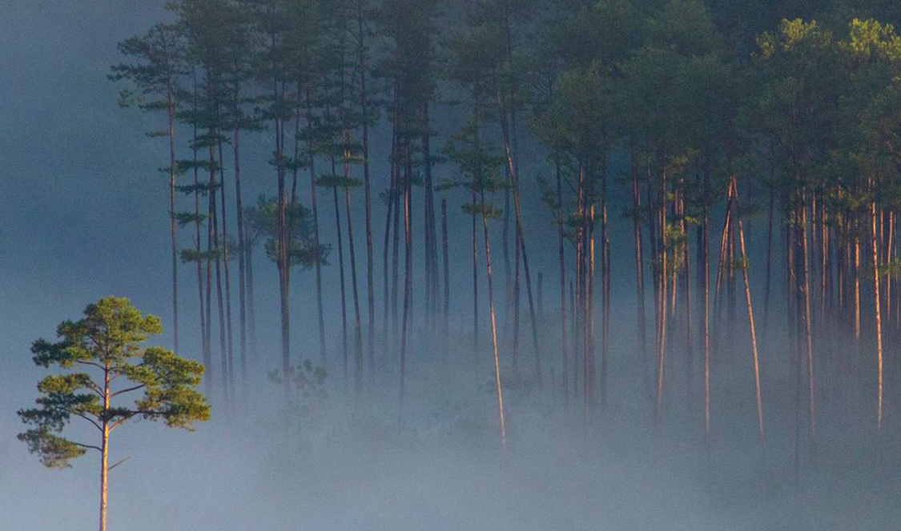
Dziękujemy
APES
TOGETHER
STRONG

