Slide 1
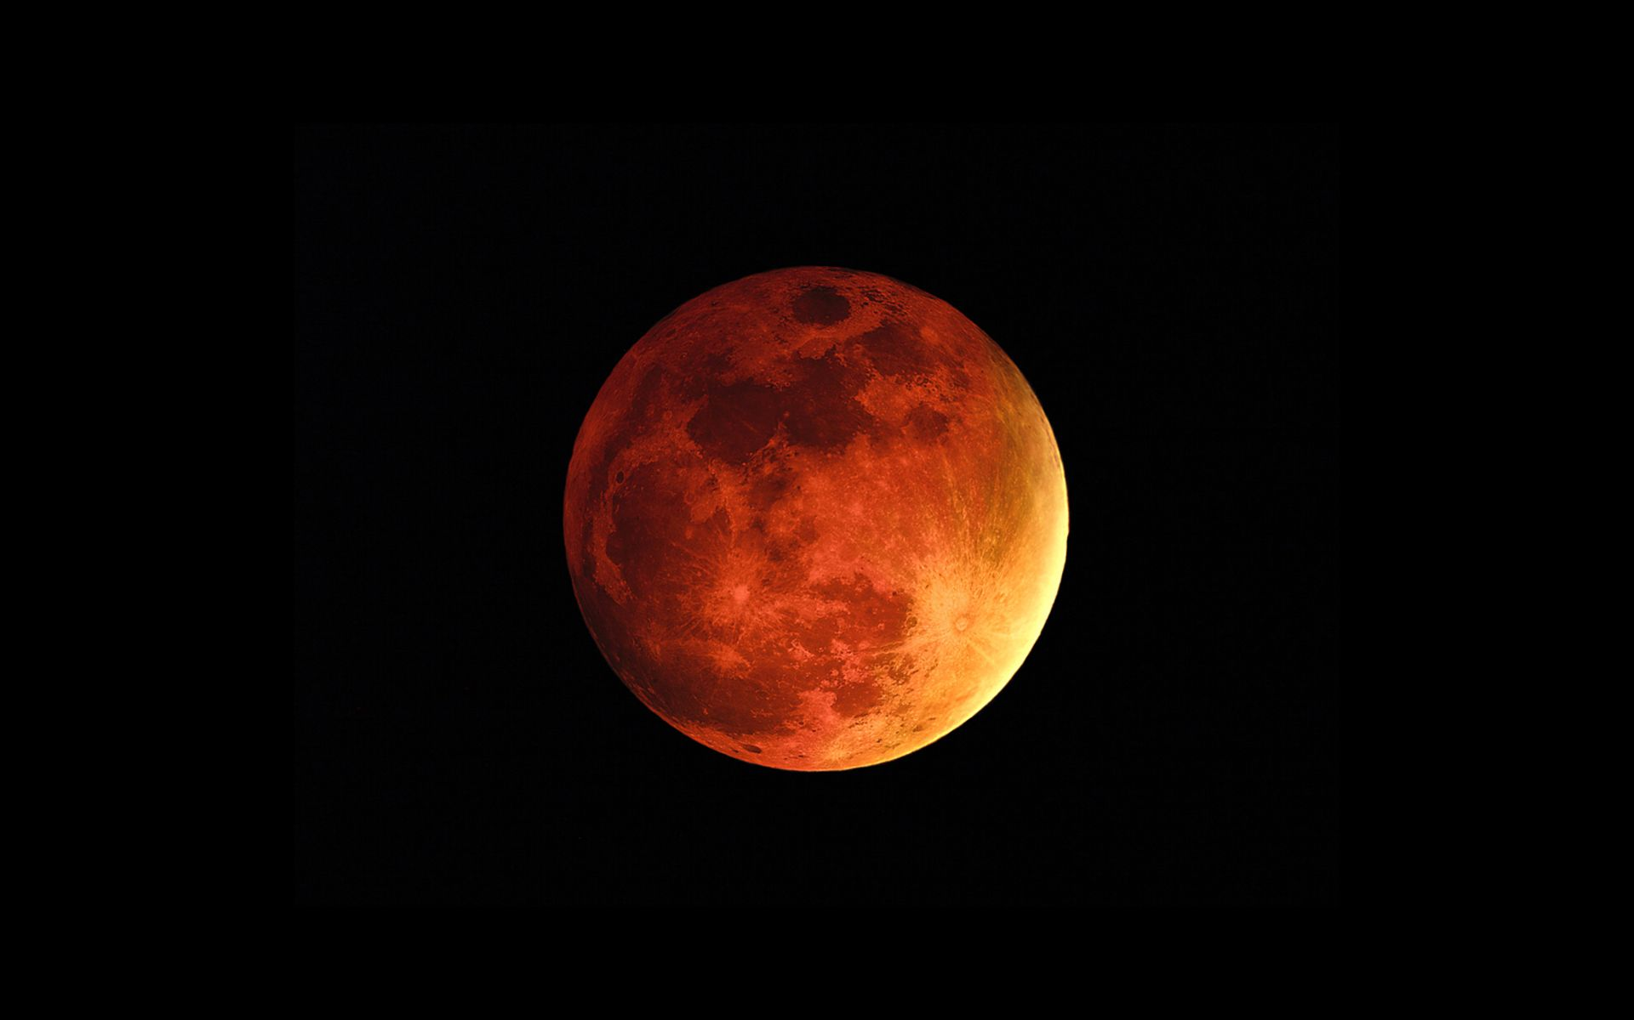
MARS EXPRESS SPACECRAFT
Tymoteusz Białkowski
Michał Machowski
Radosław Szydłowski

Slide 2
Agenda
Data overview
Data preparation
First model
Second model
Normal regression models

Slide 3
Dataset Context
Dataset presents the data from Mars Express Spacecraft, which is orbiting around Mars since 2003. MEX is powered by electricity generated by solar panels, which could be stored for later use during eclipses. Thermal system of the spaceship ,which consists of heaters supplied by 33 power lines, consume significant amount of energy depending on instrument used at a given moment and outer condition of the spacecraft. Energy consumption needs to be estimated in advance, because thermal system is autonomous. By doing so we can estimate how much power is left for scientific purposes

Slide 4
Dataset Breakdown
Dataset consists of 5 types of variables:
Energy influx – variables from this category contain information regarding solar energy incidents on panels and other information related to that e.g angle towards Sun or eclipses
Flight time-line – variables containing pointing events happening at given time
Detailed mission operation plan – variables containing time in minutes since last command to the various subsystems and time since last activity of tchem
Additional positional data – variables containing positional information like distance from Mars to Earth , value of solar constant etc.
Power lines – variables containing information on amount of electrical current running through given power line in given time point

Slide 5
Data preparation
In order to prepare the dataset to predict the data we did the following:
Interpolate missing data
Remove highly correlated features
Division into timeseries
Resampling

Slide 6
interpolation
In the data there were some values that were missing, mainly due to issues with MEX – Earth communication. In order to compensate for that, we decided to use interpolation to fill those data.

Slide 7
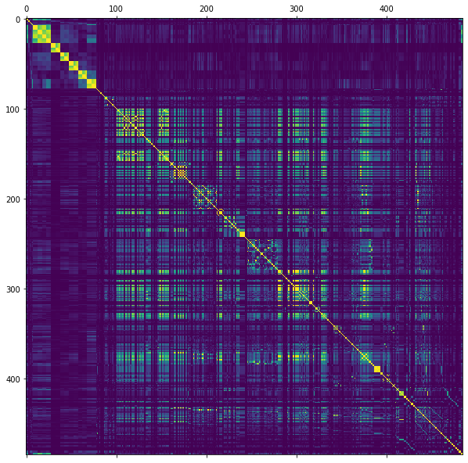
Correlation
In order to optimise the algorithm and remove the features which bring little to no new information, we decided to remove highly correlated values. After few experiments we decided to remove features, which were correlated by more than 0.75. This reduced the amount of features roughly in half

Slide 8

First model
For our first model we decided to use model which took information about target values from the previous day, and values from 2, 4 and 8 days earlier
Model was training for around 4 – 5 hours , but the result wasn’t very promising

Slide 9

second model
For this model, we tried reducing the amount of retained information to just six previous hours.
Model was training for around an hour, and it produced better results than the first one

Slide 10
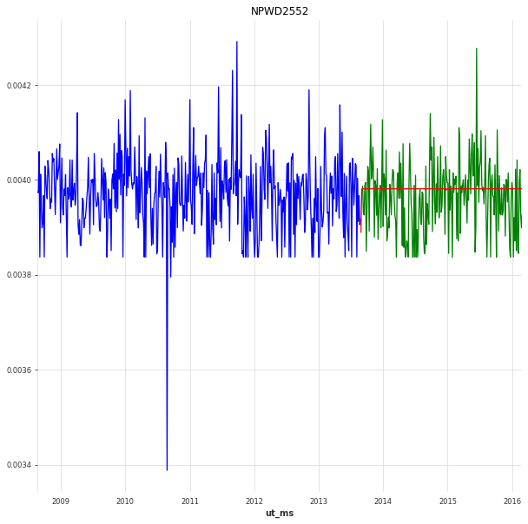
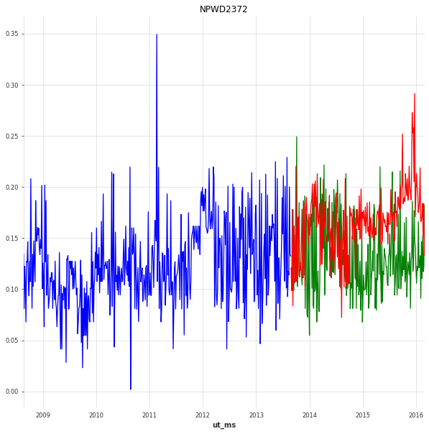
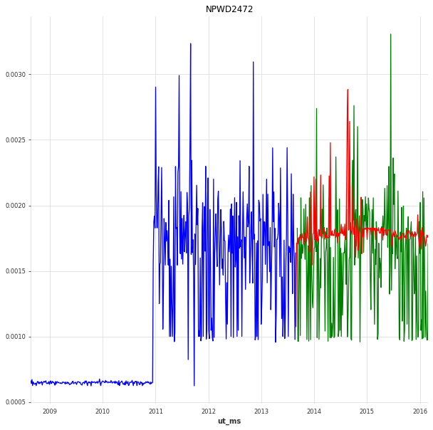
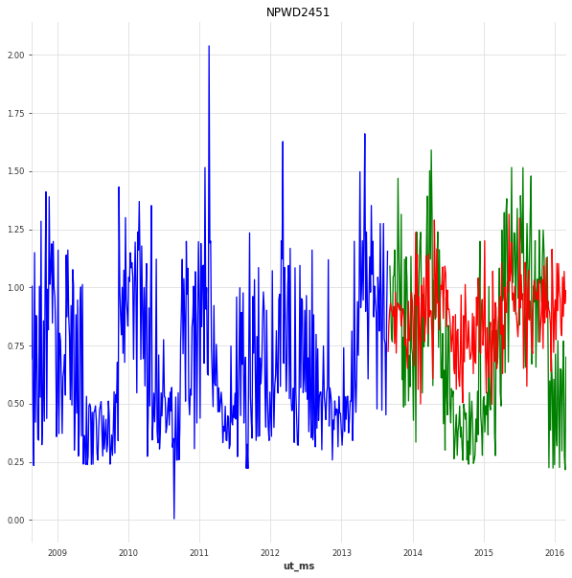

Slide 11
Normal regression
These models didn’t take for consideration that data presented were correlated with time. We don’t suggest to the model that previous values should influence the future ones.
Model | Mean absolute error | Root mean square error
Random forest | 0.03306 | 0.09552
XGBoost | 0.02971 | 0.08390
LightGBM | 0.02883 | 0.08422

Slide 12
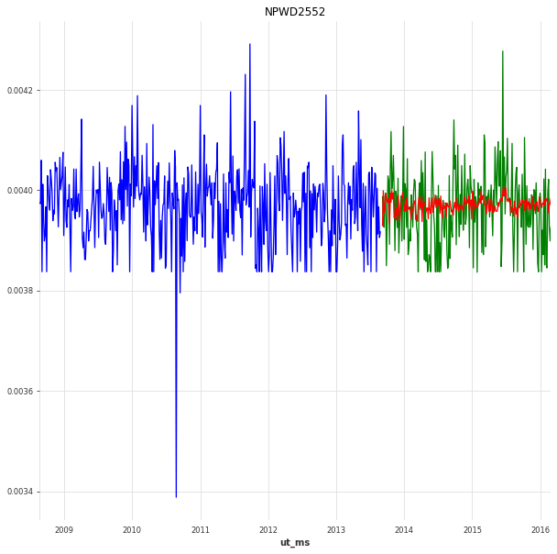
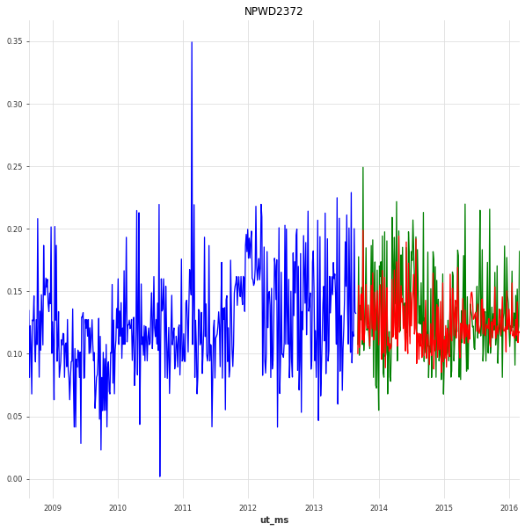
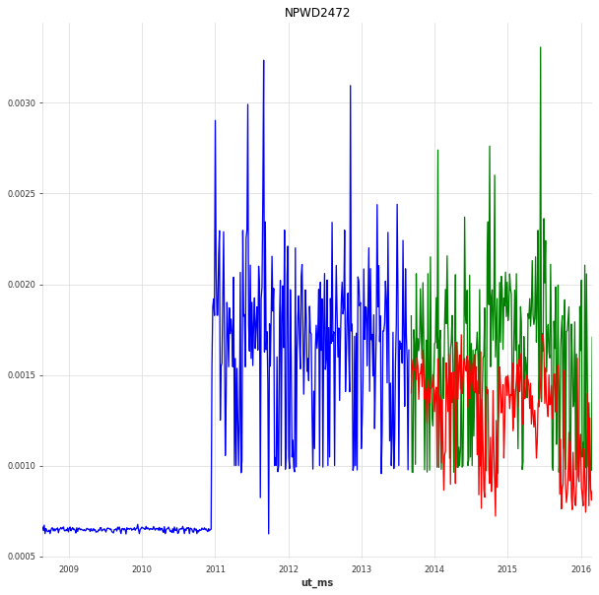
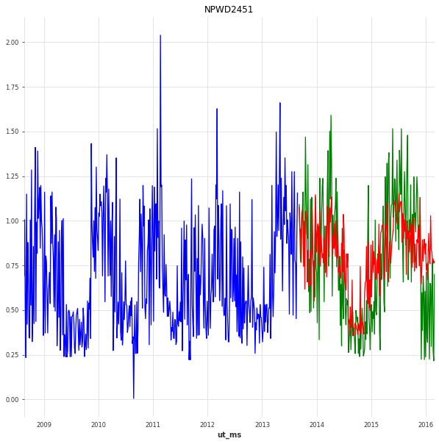

Slide 13
Thank you for your attention

