Slide 1


Bringing structure into data processing work-flows for MAgPIE
David M Chen, Kristine Karstens,
Miodrag Stevanović, Jan Philipp Dietrich et al.
MAgPIE training workshop,MADRAT tutorial 11-12-2020

Slide 2
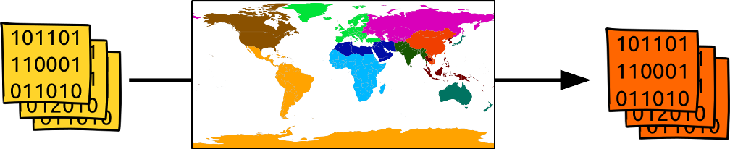
The problem
Preparing input data for the model
2

Slide 3
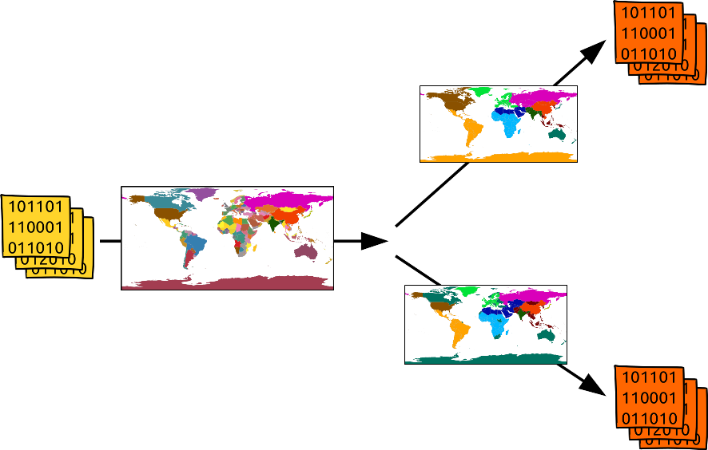
Our attempt to solve it
The MADRaT framework
3

Slide 4
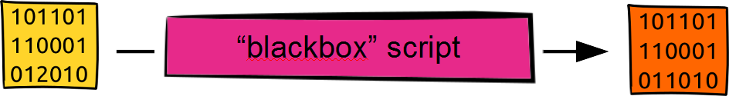
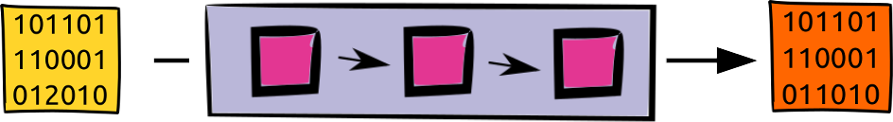
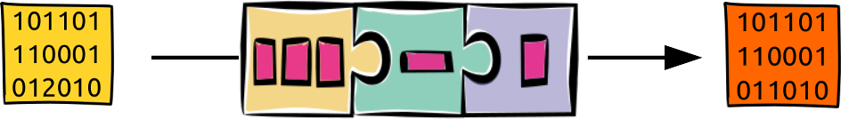
Our attempt to solve it
4

Slide 5

The derived framework
Download data (downloadSource)
Read data and convert to standardized data format
Bring data to desired regional resolution
5

Slide 6
The derived framework
Calculate required data
Filtering of data
Merging of data from different data sources
Data harmonization
Provide spatial aggregation (e.g. weights)
6

Slide 7
The derived framework
Collecting data sets
Coordinate packaging of aggregated data
7

Slide 8
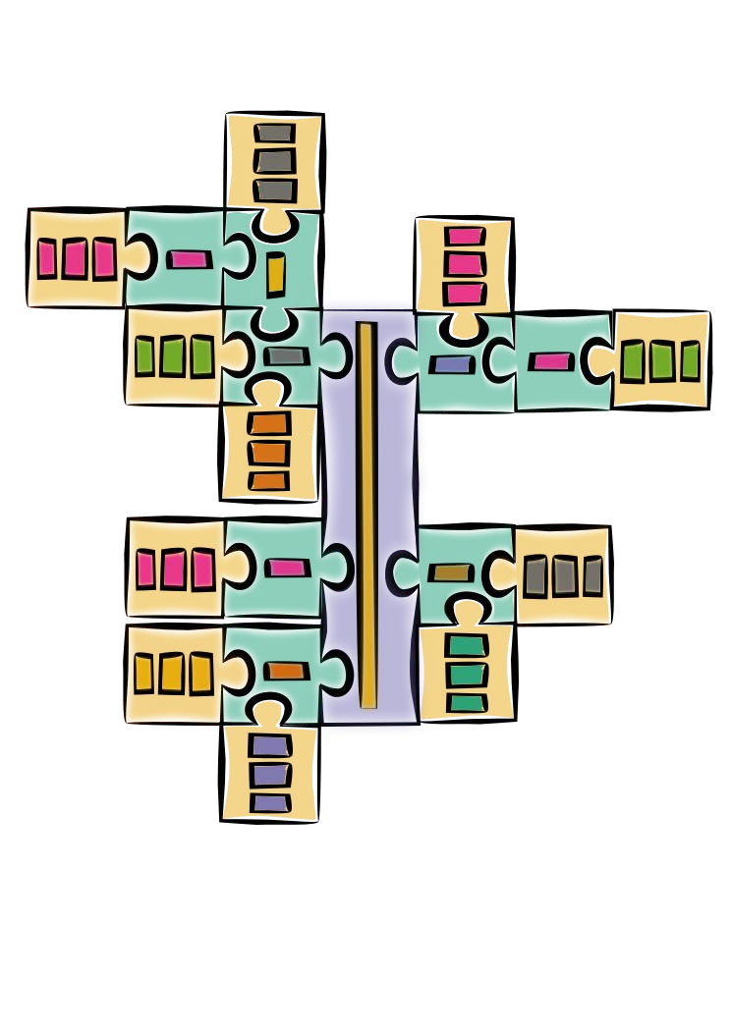
The derived framework
8

Slide 9

The derived framework
9

Slide 10

The derived framework
10

Slide 11
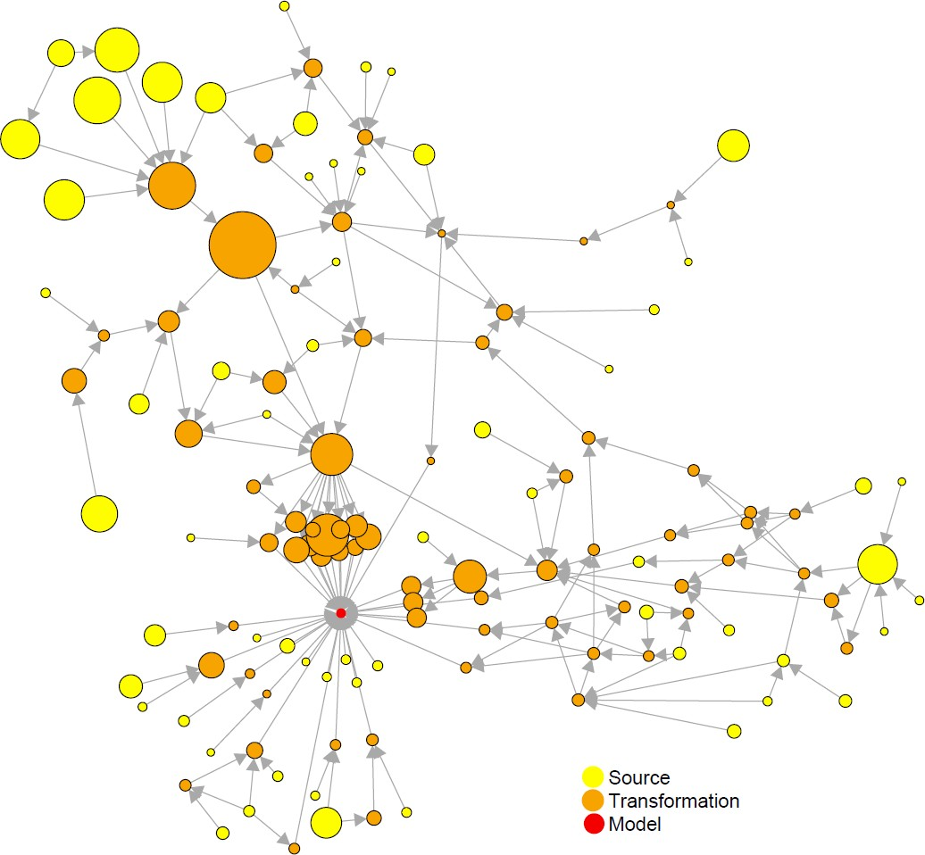
Unanticipated side effects
A lot of low hanging fruits:
Meta-data generation
Sanity checks
Data processing networks
Data caching
Structured log file
User report faster development
Broader usage than planned
Change in focus:
Spatial aggregation → reproducibility and transparency
11

Slide 12
MADRaT
“May All Data be Reproducible and Transparent”
R package
License: BSD2
Git: https://github.com/pik-piam/madrat
CRAN: https://CRAN.R-project.org/package=madrat
Contact: dietrich@pik-potsdam.de
12

Slide 13
Magclass Objects
Basic element in MADRaT: MAgPIE objects
Array consisting of 3 dimensions:
1st dim: Spatial
2nd dim: Temporal
3rd dim: Data
13

Slide 14



MADRaT Cheat Sheet library(madrat)
Magclass: Magpie Objects
MADRaT Workflow
Array with 3 Dimensions
Magclass Basics
Further documentation in ?magclass::function()
1: Spatial
Cellular
59199 cells
Country
249 ISO3
Region
12 Magpie Regions
2:Temporal
Years
1965-2150
Call with:
char “y1965”
OR
int 1965
3: Data
Subdimensions
concatenated with “.”
Avoid using “.”
in naming
as.magpie() | Converts (tidy) dataframe to magclass
fulldim() | List of all dimension names
getRegions() | Vector of object regions
getYears() | Vector of years as char or int class
getNames() | Vector of names of data
INPUT DATA
downloadSource(“SourceX”)
readSource(“SourceX”, convert=TRUE)
FALSE
“onlycorrect”
convertSource(“SourceX”)
correctSource(“SourceX”)
Magpie Object
CALCULATIONS
calcOutput(“calcY”, aggregate=TRUE)
FALSE
RETRIEVE
fullMAgPIE(revision=12, mainfolder="pathtowhereallfilesarestored")
MODEL INPUT
Metadata documentation
MADRaT Config
## See config settings
library(madrat)
getConfig()
## Turn Cache on
setConfig(forcecahe=TRUE)
# NOTE: Running a function with cache on and an existing cache file means further developments will not appear in results ##
## Get Mappings folder
getConfig(“mappingfolder”)
## Change region mapping
setConfig(regionmapping=“new_mapping.csv”)
Useful magclass Functions
Spatial
toolCountryFill() | Fills in/matches incomplete country dimension with NA / given value
toolAggregate() | Weighted aggregation, mapping file needed
toolCountry2isocode | Converts country names to ISO3 code
Temporal
time_interpolate() | Linearly interpolates values between years
toolHoldConstant() | Hold values constant for given years
toolHoldConstantBeyondEnd() | Extend magpie object to 2150, holding missing years constant
Data Analysis
mbind() | bind 2 magpie objects along a dim, like abind
add_columns() | Add new column to a given dimension “dim”
add_dimension() | Add new dimension, with name of first column in new dim
calibrate_it() | Calibrate one dataset to another over time, using set functions
dimOrder() | Re-order dimensions
dimSums | Very useful! Sum over dims and sub-dimensions
magpply() | Like apply family of functions, to replace loops
read.magpie() | Read magpie .mz files
write.magpie() | write a magpie object ot file, various file formats incl. ncdf4
Madrat caches
functions for efficient re-calculation
Link a Package to MADRaT
Save the code below as madrat.R in R folder of package
#' @importFrom madrat vcat toolCodeLabels
#' @importFrom digest digest
.onLoad <- function(libname, pkgname){
madrat::setConfig(packages=c(madrat::getConfig("packages"),pkgname), .cfgchecks=FALSE, .verbose=FALSE)
# add labels for common ctype selections
labels <- NULL
for(t in c("c","n","h")) {
ncells <- c(seq(10,90,10),seq(100,900,100),seq(1000,10000,1000))
for(n in ncells) {
tmp <- paste0(t,n)
labels[tmp] <- digest::digest(list(ctype=tmp),"md5")
}
}
toolCodeLabels(add=labels)
}
#create an own warning function which redirects calls to vcat (package internal)
warning <- function(...) vcat(0,...)
# create a own stop function which redirects calls to stop (package internal)
stop <- function(...) vcat(-1,...)
# create an own cat function which redirects calls to cat (package internal)
cat <- function(...) vcat(1,...)
• CC BY SA David M Chen • david.chen@pik-potsdam.de• https://github.com/magpiemodel/tutorials• package version 1.83.3 • Updated: 12.2020

Slide 15
Magclass Exercise
load madrat in R via library(madrat)
population_magpie is automatically loaded by madrat
Assign it to pop by
pop <- population_magpie
Using magclass functions, answer these questions:
1. What is the global population in 2100 for scenario A2? B1?
2. How does is the population of Sub-Saharan Africa (AFR) as share of global total change over the years?
3. Get population values for the years 2046-2049 by linearly interpolating between 2045 and 2050 values.

Slide 16
Magclass Objects
Basic element in MADRaT: MAgPIE objects
Array consisting of:
3 dimensions (Subdimensions possible):
1st dim: Spatial
2nd dim: Temporal
3rd dim: Data
16

Slide 17
Magclass Cheat Sheet
General
fulldim() | List of all dimension names
getRegions() | Return vector of 1st dim (spatial) names
getYears()
getNames()
17

Slide 18
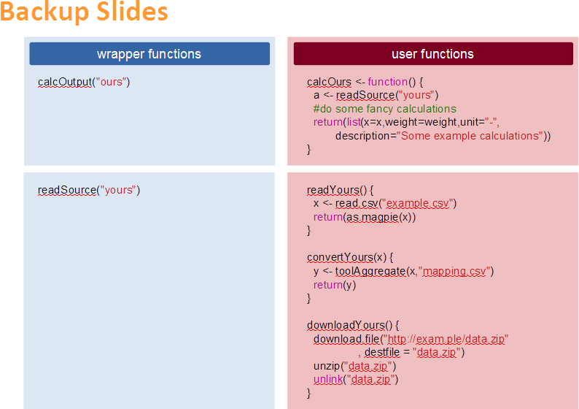
Name, Research Domain

Slide 19
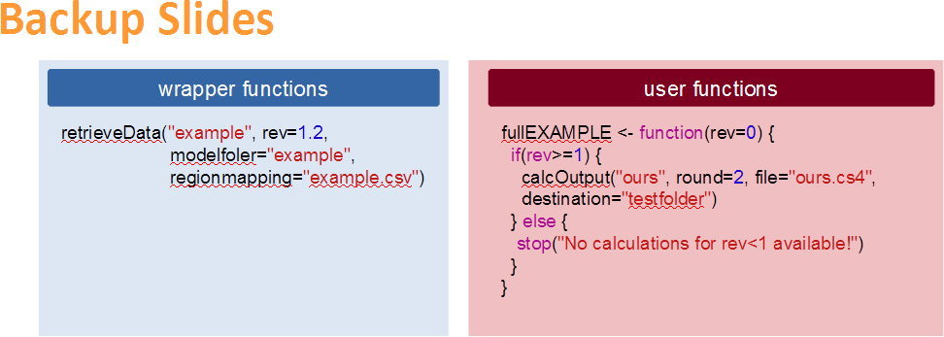
Name, Research Domain

Slide 20
MADRaT Workshop

Slide 21
MADRaT Workshop - Software requirements
R
https://www.r-project.org/
https://ftp.gwdg.de/pub/misc/cran/
Rstudio
https://www.rstudio.com/products/rstudio/download/
Libraries:
› install.packages("madrat")
› install.packages("magclass")

Slide 22
MADRaT Workshop – Setup
Load library and configure the madrat mainfolder:
> | library(madrat)
> | getConfig()
# | Initialize madrat | config with default settings..
# | madrat mainfolder | for data storage not set! Do you want to set it now? (y/n)
> # | y Please enter main | folder path: “~/inputdata”
# Directory does not exist. Should it be created? (y/n)
y
# Should this path be added to your global .Rprofile to be used permanently? (y/n)
y

Slide 23
MADRaT components: downloadSource()
Download the source data by using the wrapper function:
downloadSource("Tau", overwrite = TRUE)
madrat:::downloadTau # function ()
# {
# download.file("http://www.pik-potsdam.de/members/dietrich/tau-data.zip", # destfile = "tau-data.zip")
# unzip("tau-data.zip") # unlink("tau-data.zip") # }
# <environment: namespace:madrat>

Slide 24
MADRaT components: readSource()
I/III
Read the data available in the source.
x <- readSource(type="Tau", subtype="paper", convert=FALSE)
Three steps, i.e. three wrapper functions:
readSource()
reads the data in as a magclass object
correctSource()
(optional) removes duplicates, replacing NAs etc.
convertSource()
compatibility conversion for flexible aggregation (ISO country standard).

Slide 25
MADRaT components: readSource()
II/III
Develop the readSrouce() type function:
madrat:::readTau
# function(subtype = "paper") # {
# files <- c(paper = "tau_data_1995-2000.mz", historical = "tau_xref_history_country.mz")
# file <- toolSubtypeSelect(subtype, files) # x <- read.magpie(file)
# x[x == -999] <- NA
# return(x) # }
# <environment: namespace:madrat>
Read-in the data as a magclass object.
No other modifications are allowed.
Develop the correctSource(), in particular correctTau() function, if needed.

Slide 26
MADRaT components: readSource() III/III
Lastly, develop the convertSrouce() type function:
madrat:::convertTau # function (x)
# {
# tau <- x[, , "tau"]
# xref <- x[, , "xref"]
# xref[is.na(tau) | is.nan(tau)] <- 10^-10 # tau[is.na(tau) | is.nan(tau)] <- 1
# if (ncells(x) == 59199) {
# iso_cell <- sysdata$iso_cell # iso_cell[, 2] <- getCells(x)
# tau <- toolAggregate(tau, rel = iso_cell, weight = collapseNames(xref)) # xref <- toolAggregate(xref, rel = iso_cell)
# }
# tau <- toolCountryFill(tau, fill = 1, TLS = "IDN", HKG = "CHN", # SGP = "CHN", BHR = "QAT")
# xref <- toolCountryFill(xref, fill = 0, verbosity = 2) # return(mbind(tau, xref))
# }
# <environment: namespace:madrat>
Fill out the missing ISO-country data: toolCountryFill()

Slide 27
MADRaT components: calcOutput()
Extract information form a given source of data.
x <- calcOutput(“TauTotal”, aggregate=FALSE, supplementary=FALSE)
madrat:::calcTauTotal # function ()
# {
# tau <- readSource("Tau", "paper")
# x <- collapseNames(tau[, , "tau.total"])
# weight <- collapseNames(tau[, , "xref.total"])
# return(list(x = x, weight = weight, min = 0, max = 10, unit = "1", # description = "Agricultural Land Use Intensity Tau",
# note = c("data based on Dietrich J.P., Schmitz C., Müller C., Fader M.,
# Lotze-Campen H., Popp "Measuring agricultural land-use intensity - A global # analysis using a model-assisted approach", "Ecological Modelling, Volume 232, # 10 May 2012, Pages 109-118, ISSN 0304-3800, 10.1016/j."preprint
.
.
.
# doi = "10.1016/j.ecolmodel.2012.03.002"))) # }
# <environment: namespace:madrat>

Slide 28
MADRaT components: retrieveData()
Prepare a dataset from a collection of data.
retrieveData("example", rev=1)
madrat:::fullEXAMPLE # function (rev = 0)
# {
# writeLines("This is a test", paste0(getConfig("outputfolder"), # "/test.txt"))
# file2destination("test.txt", "testfolder") # if (rev >= 1) {
# calcOutput("TauTotal", years = 1995, round = 2, file = "fm_tau1995.cs4", # destination = "testfolder/input")
# }
# }
# <environment: namespace:madrat>
Creates a log file
Creates a tgz packaged compressed data
Puts the data in the “output” directory in the defined madrat mainfolder.

Slide 29
Use own functions with MADRaT
Source your own function in the global environment setConfig(globalenv=TRUE):
library(madrat)
# add global environment to madrat search path
setConfig(globalenv=TRUE)
# define simple calc-function
calcPi <- function() {
out <- toolCountryFill(NULL,fill=pi)
return(list(x=out,
weight=out, unit="1",
description="Just pi"))
}
# rund calcPi through wrapper function calcOutput
calcOutput("Pi")
same procedure also for all other MADRaT functions: downloadXYZ, readXYZ, correctXYZ, convertXYZ and fullXYZ.

Slide 30
Advanced: Create MADRaT-based R-package
The following lines of code should be added as madrat.R to the R folder of the package:
### madrat.R
#' @importFrom madrat vcat
.onLoad <- function(libname, pkgname){
madrat::setConfig(packages=c(madrat::getConfig("packages"),pkgname),
.cfgchecks=FALSE, .verbose=FALSE)
}
#create an own warning function which redirects calls to vcat (package internal)
> # | warning <- function(...) vcat(0,...) create a own stop function which redirects calls to | stop (package internal)
> | stop <- function(...) vcat(-1,...)
# | create an own cat function which redirects calls to | cat (package internal)
> | cat <- function(...) vcat(1,...)
.onLoad - the package is linked to madrat as soon as it is loaded.

