Slide 1
Fruit classification Biologically Inspired Artificial Intelligence
Michał Lenort
Jakub Gil

Slide 2
Our topic
The goal of the project is to create a model that recognize fruits and vegetables in pictures.
The dataset used to train the model came from kaggle.com
The dataset contains 90483 images, of which 67692 are the training set and 22688 are the test set.

Slide 3
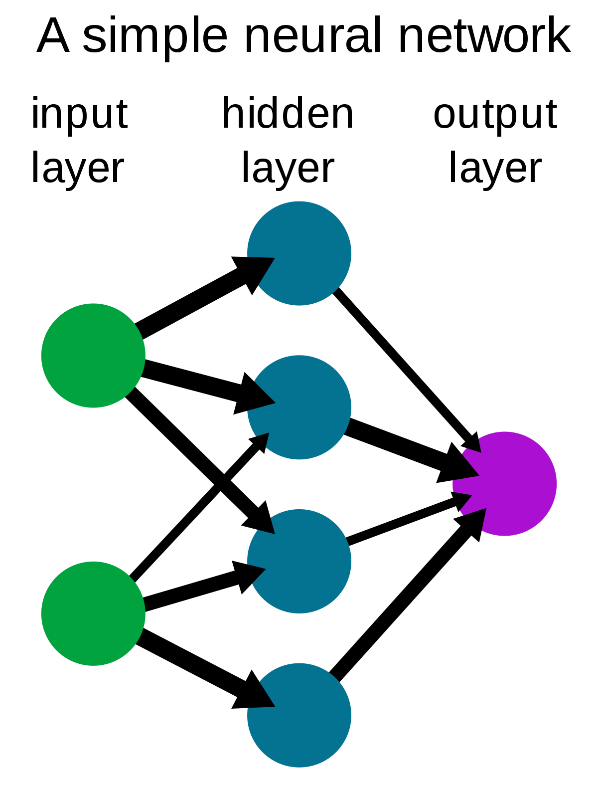
What is neural network
Computational model inspired by the human brain
Interconnected nodes (neurons) organized into layers
Neurons receive input signals, perform calculations, and produce output signals
Learning through adjusting connection strengths (weights) based on training data
Excels at pattern recognition, classification, regression, and decision-making
Used in image/speech recognition, natural language processing, autonomous vehicles, etc.
Deep learning refers to neural networks with multiple hidden layers
Learns hierarchical representations of data
Powerful tool for solving complex problems through learning from data and generalizing from examples.

Slide 4
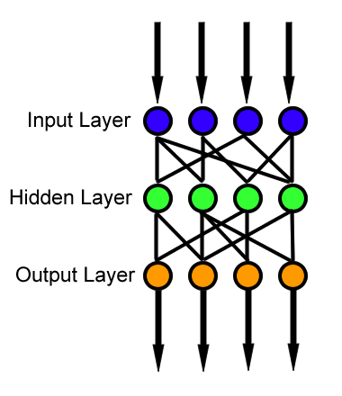
Feedforward Neural Networks
Input Layer:
Receive the raw pixel values of the input image.
Each neuron in the input layer represents a specific pixel or a feature derived from the image.
Hidden Layers:
Introduce complexity and non-linear transformations to the input data.
Output Layer:
Provide the final classification or prediction.
The number of neurons in the output layer corresponds to the number of distinct classes or categories in the image classification problem.
The output neuron with the highest activation represents the predicted class.

Slide 5
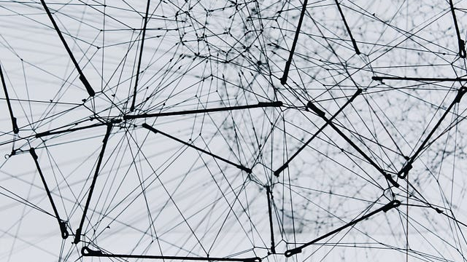
FNN Training process for image classification
Data Preparation
Data Split
FNN Initialization
Forward Propagation
Loss Calculation
Backpropagation
Iterative Process
Evaluation and Testing
Feedback and Optimization
Practical Use

Slide 6
Dataset properties
The total number of images: 90483.
Training set size: 67692 images
Test set size: 22688 images
The number of classes: 131
Image size: 100x100 pixels

Slide 7

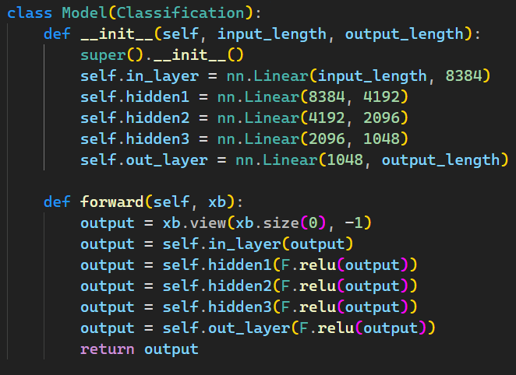
Model architecture

Slide 8
Model architecture
Input layer (self.in_layer): It takes an input of size input_length and linearly transforms it into a space of size 8384.
First hidden layer (self.hidden1): It takes an input of size 8384 and linearly transforms it into a space of size 4192. Then, a ReLU activation function is applied.
Second hidden layer (self.hidden2): It takes an input of size 4192 and linearly transforms it into a space of size 2096. Then, a ReLU activation function is applied.
Third hidden layer (self.hidden3): It takes an input of size 2096 and linearly transforms it into a space of size 1048. Then, a ReLU activation function is applied.
Output layer (self.out_layer): It takes an input of size 1048 and linearly transforms it into a space of size output_length. Then, a ReLU activation function is applied.

Slide 9
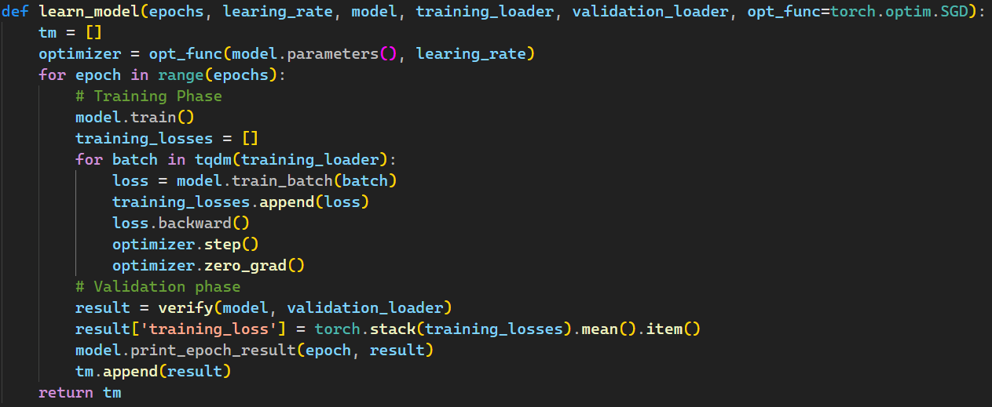
Training function

Slide 10
Optimizers
Stochastic Gradient Descent (SGD) - This is a basic optimizer that updates network weights based on the gradient of the loss function for single samples. Despite its simplicity, SGD can be effective in many cases, especially with properly selected batch size and learning rate.
Adam - Adam (Adaptive Moment Estimation) is a popular optimizer that combines momentum and RMSprop methods. It uses gradient moment estimation and second gradient moment estimation to adaptively adjust the learning rate for each parameter. Adam tends to work well on a wide variety of problems and does not require too many hyperparameters.

Slide 11
Optimizers
Adagrad - Adagrad (Adaptive Gradient) is an optimizer that adjusts the learning rate for each parameter based on the sum of squares of previous gradients. It is effective in cases where some parameters are more important than others.
RMSprop - RMSprop (Root Mean Square Propagation) is an optimizer that calculates the moving average of the squares of the prior gradients to adjust the learning rate. This helps equalize learning steps for different parameters.
Adadelta - Adadelta is an optimizer that uses an estimate of the mean squares of gradient updates to adjust the learning rate. This optimizer does not require setting a global learning rate.

Slide 12
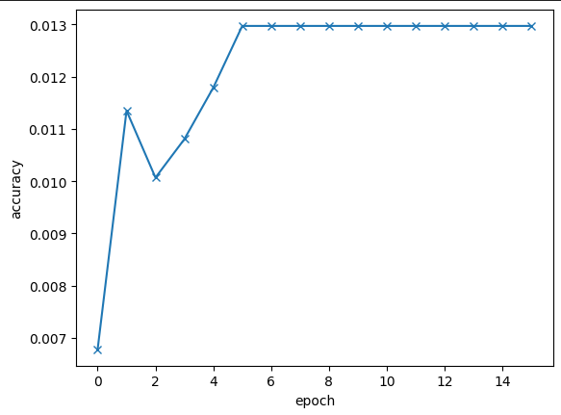
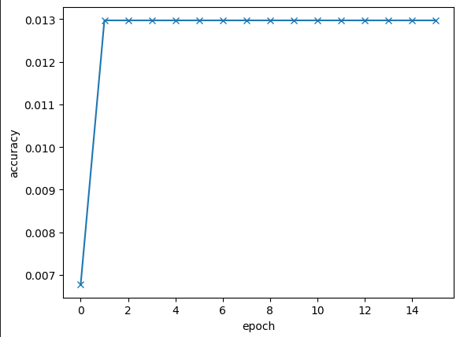
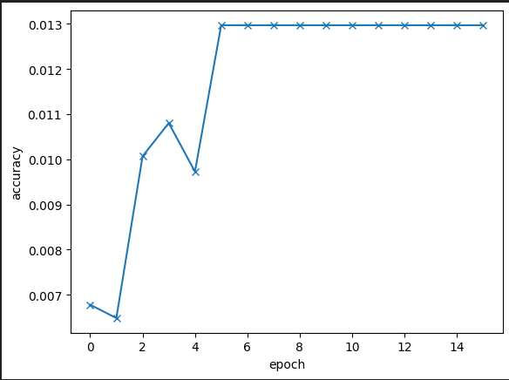
Impact of optimizer on accuracy
Adam – 1.44 %
Adagrad – 1.44 %
RMSprop – 1.44 %

Slide 13
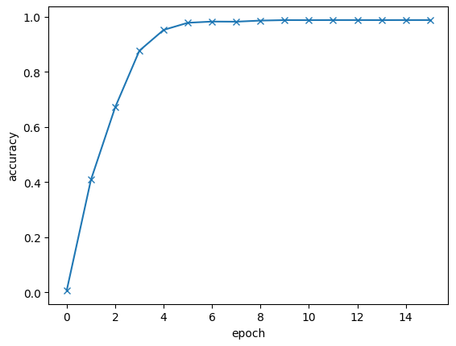
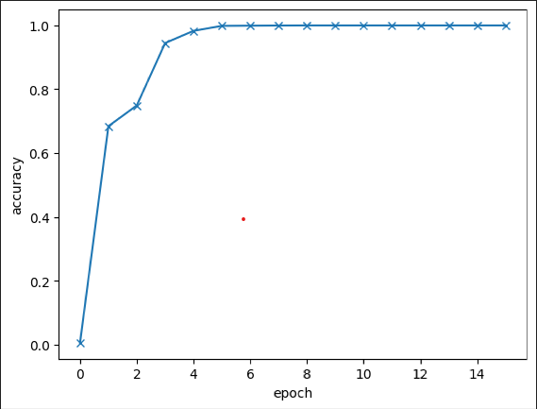
Impact of optimizer on accuracy
Adadelta – 88.91%
SGD – 93.44%

Slide 14
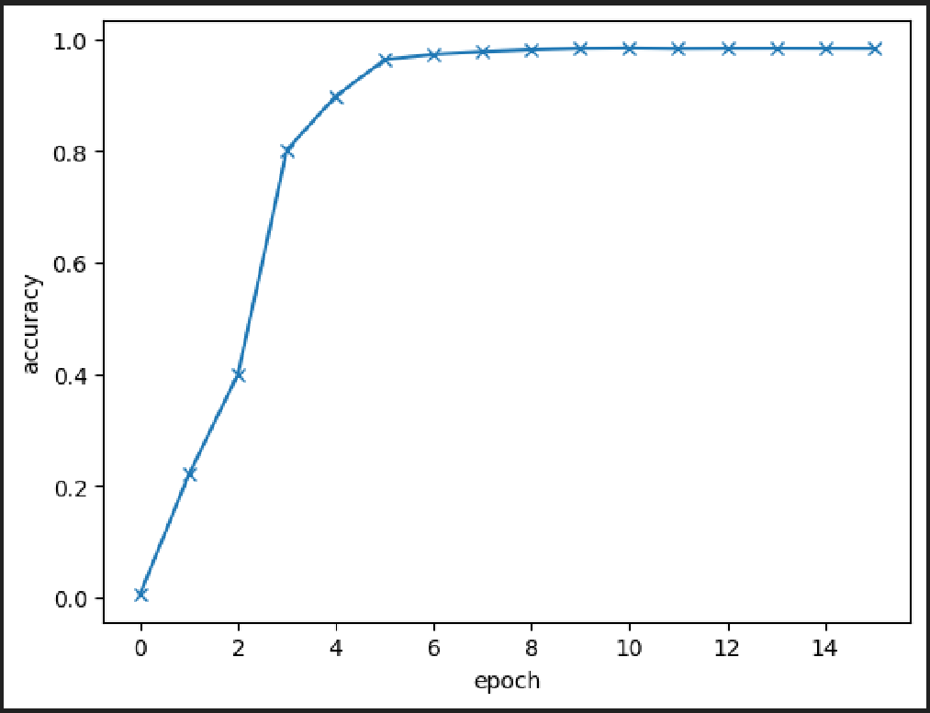
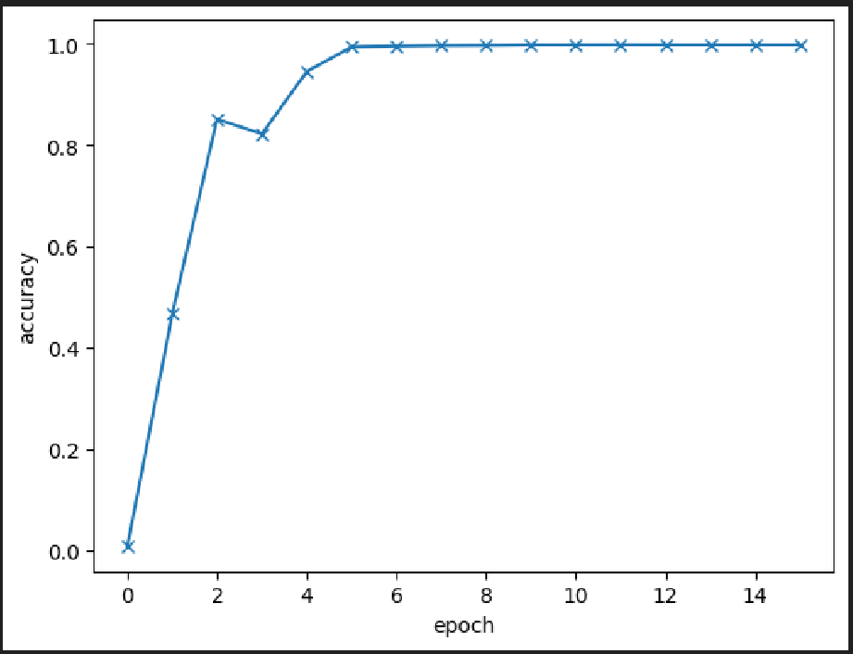
Impact of image size on accuracy
50 x 50 – 91.63 %
75 x 75 – 90.99 %

Slide 15
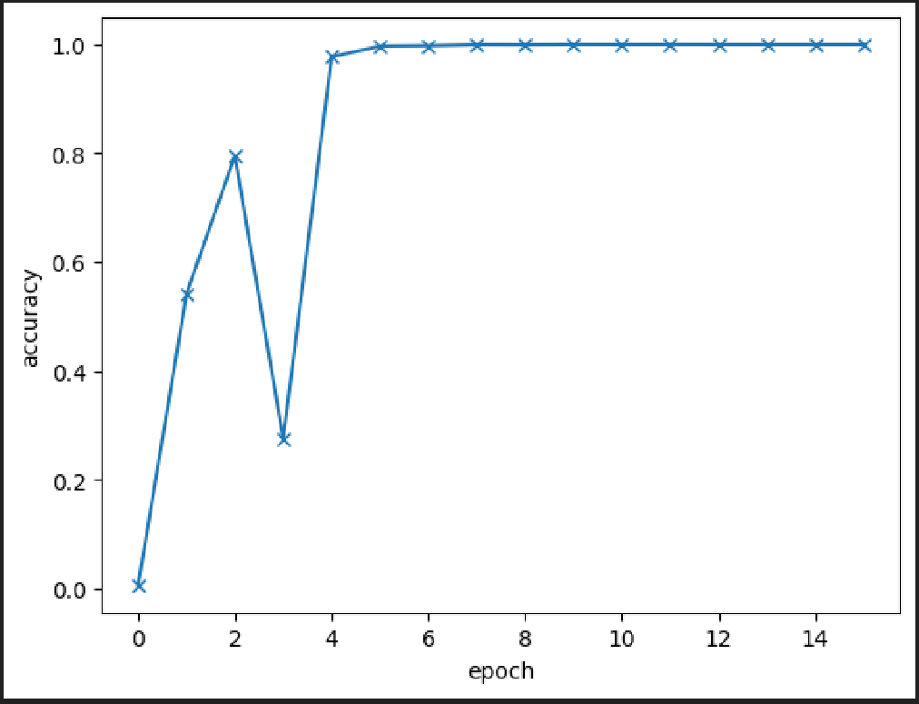
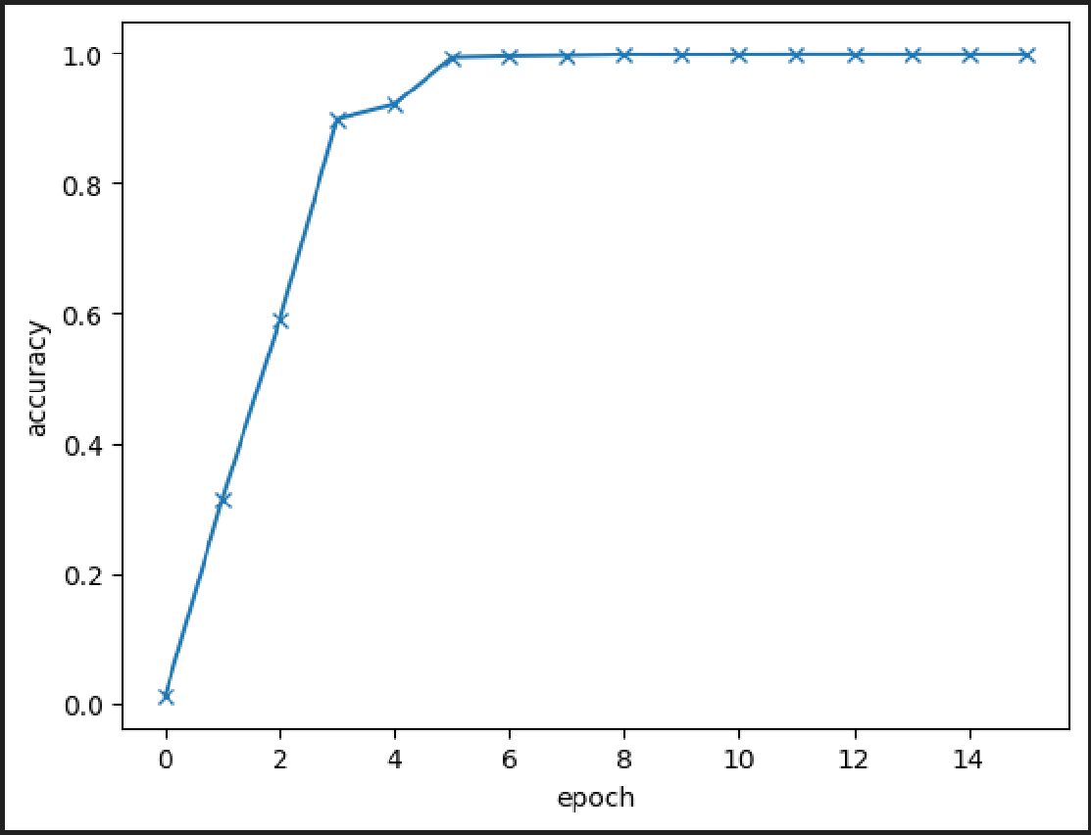
Impact of image size on accuracy
100 x 100 – 91.6 %
125 x 125 – 91.12 %

Slide 16
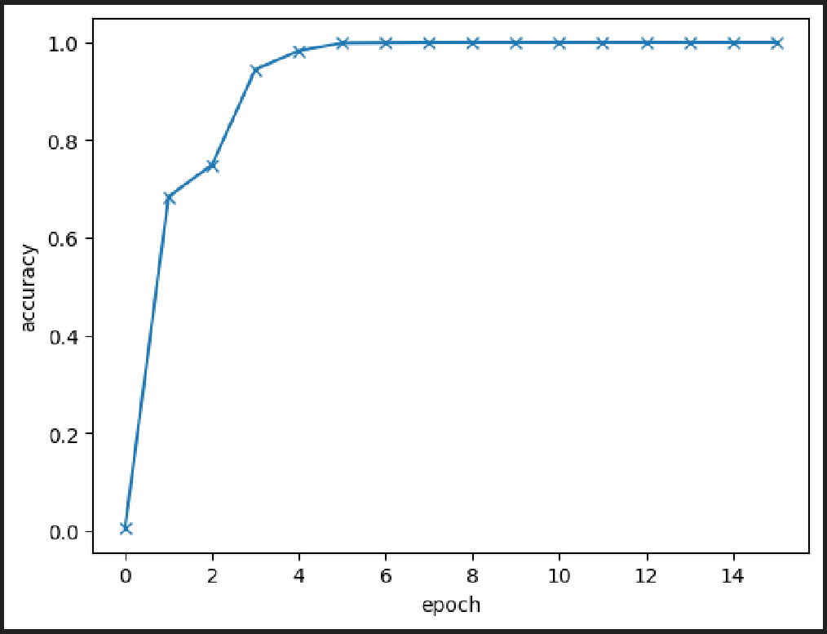
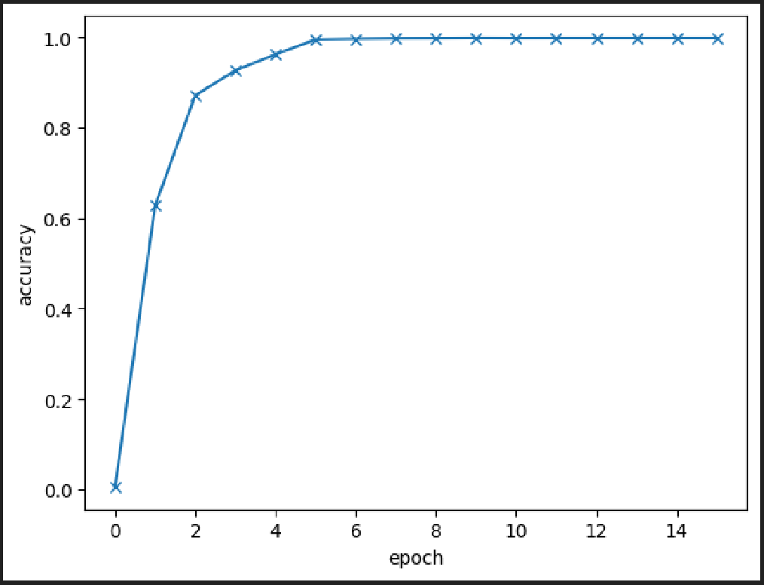
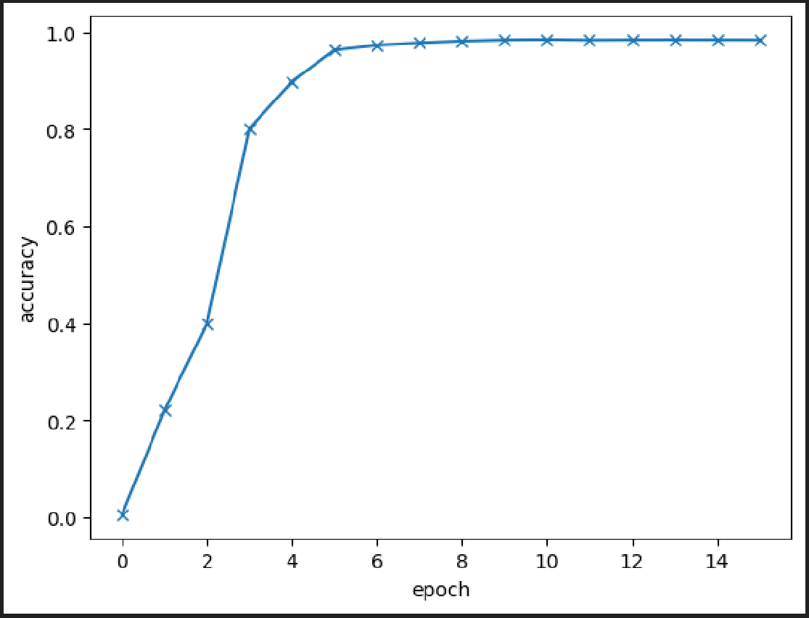
Impact batch size on accuracy
Batch_size = 32 – 93.44%
Batch_size = 64 – 91.63%
Batch_size = 128 – 87.52%

Slide 17
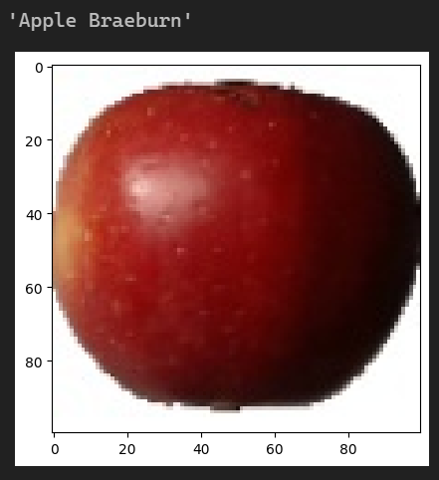
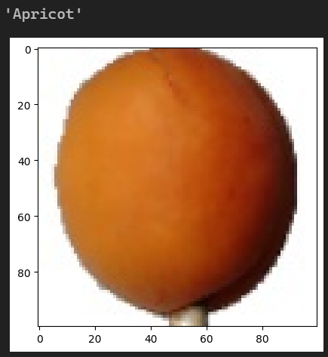
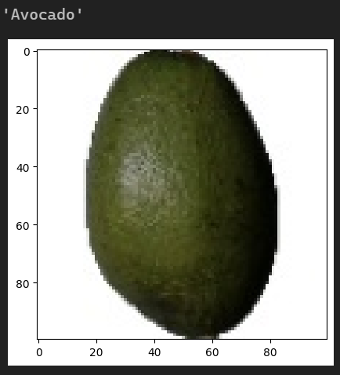
Tests

Slide 18
Conclusions
A Feedforward Neural Network (FNN) is one of the basic types of neural networks that are used to solve classification problems. An FNN consists of layers of neurons in which the signal flows in only one direction, from the input layer to the output layer, without cycles.
Parameter selection has a key role in training a neural network. In our project, the key parameter turned out to be the size of the batch, the reduction of which improved the efficiency of the network by 2%.
The size of the images has little effect on the effectiveness of the neural network.
Choosing the right optimizer is also key. The SGD optimizer is by far the best choice for FNNs, as it is the only one that provides effective training for this network.

Slide 19
Summary
This project allowed us to learn the basics of Machine Learning technology. We learned how to easily and effectively create a neural network to classify a large data set. This project also allowed us to get acquainted with the basics of the Python language, and the Pytorch library, which greatly facilitates the creation of Neural Networks by providing ready-made tools.
Summarizing, Machine Learning technology plays a crucial role in the modern world, becoming an integral part of many fields and sectors of the economy. Its importance stems from the ability to automatically extract knowledge, generate precise forecasts, and make intelligent decisions based on vast amounts of data.

Slide 20
Source
www.kaggle.com
https://towardsdatascience.com/machine-learning-basics-part-1-a36d38c7916
en.wikipedia.org/wiki/Feedforward_neural_network
https://deepai.org/machine-learning-glossary-and-terms/feed-forward-neural-network

Slide 21
THE END

