Slide 1
DiscerdDB

Slide 2
What is DataBase?
In computing, a database is an organized collection of data stored and accessed electronically. Small databases can be stored on a file system, while large databases are hosted on computer clusters or cloud storage. The design of databases spans formal techniques and practical considerations including data modeling, efficient data representation and storage, query languages, security and privacy of sensitive data, and distributed computing issues including supporting concurrent access and fault tolerance.

Slide 3
What is MySQL?
MySQL is an open-source relational database management system (RDBMS). Its name is a combination of "My", the name of co-founder Michael Widenius's daughter, and "SQL", the abbreviation for Structured Query Language. A relational database organizes data into one or more data tables in which data types may be related to each other; these relations help structure the data. SQL is a language programmers use to create, modify and extract data from the relational database, as well as control user access to the database. In addition to relational databases and SQL, an RDBMS like MySQL works with an operating system to implement a relational database in a computer's storage system, manages users, allows for network access and facilitates testing database integrity and creation of backups.

Slide 4
What is Primary Key in a table
In the relational model of databases, a primary key is a specific choice of a minimal set of attributes that uniquely specify a tuple in a relation. Informally, a primary key is "which attributes identify a record," and in simple cases constitute a single attribute: a unique ID. More formally, a primary key is a choice of candidate key; any other candidate key is an alternate key.

Slide 5
What is Foreign Key
A foreign key is a set of attributes in a table that refers to the primary key of another table. The foreign key links these two tables. Another way to put it: In the context of relational databases, a foreign key is a set of attributes subject to a certain kind of inclusion dependency constraints, specifically a constraint that the tuples consisting of the foreign key attributes in one relation, R, must also exist in some other relation, S, and furthermore that those attributes must also be a candidate key in S. In simpler words, a foreign key is a set of attributes that references a candidate key. For example, a table called TEAM may have an attribute, MEMBER_NAME, which is a foreign key referencing a candidate key, PERSON_NAME, in the PERSON table. Since MEMBER_NAME is a foreign key, any value existing as the name of a member in TEAM must also exist as a person's name in the PERSON table; in other words, every member of a TEAM is also a PERSON.

Slide 6
What is Many to Many relationship
A many-to-many relationship occurs when multiple records in a table are associated with multiple records in another table. For example, a many-to-many relationship exists between customers and products: customers can purchase various products, and products can be purchased by many customers.

Slide 7
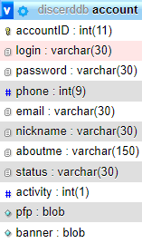
account table:
account table is one of two most important tables in whole database because everything is based on those two tables.
`accountID` Primary key of the table
`login` It's not the same thing as nickname, login as the name suggests is used to log into the account
`password` a password required to log into the account
`phone` phone number, optional form of verification
`email` email is required for logging in as verification and anti-bot defence
`nickname` displays as your profile name and may repeat itself for many users
`aboutme` description under the profile
`status` optional custom status information
`activity` describes account activity status as shown: 1-Online, 2-Do not disturb, 3-Idle, 4-Offline
`pfp` stores the profile picture
`banner` stores a banner that is shown behind profile picture

Slide 8

group:
group table is made for group conversations of three or more people. Group conversations aren't as customizable as servers
`groupID` Primary Key of the table
`group_name` stores name of the group
`group_icon` stores icon of the group

Slide 9
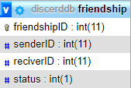
friendship:
friendship table is used as many to many relation between two users.
`friendshipID` Primary key of the table
`senderID` foreign key to account table, defines account that sent invite
`reciverID` foreign key to account table, defines account that received invite
`status` is status of friendship: 0 for requested, 1 for accepted, 2 for rejected, 3 for unfriended and 4 for blocked

Slide 10
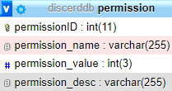
permission:
permission table is used for customizing permissions and privileges of different roles and/or persons on different channels
`permissionID` Primary key of the table
`permission_name` Used to store permission names and distinguish them from one another
`permission_value` Stores state of permission: 0 for permission turned off, 1 for undefined and 2 for turned on

Slide 11
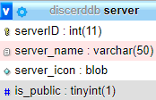
server:
server table is the second most important table right next to account table, as whole project is based around making custom community servers
`serverID` Primary key of the table
`server_name` Stores name of the server
`server_icon` Stores customizable icon of the server
`is_public` Describes publicity of the server: 0 for private (requires an invite) and 1 for public

Slide 12
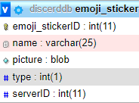
emoji_sticker:
emoji_sticker table allows users to add custom emojis and stickers to their servers
`emoji_stickerID` Primary key of the table
`name` Stores name of the emoji/sticker that allows the usage of emoji/sticker
`picture` Stores picture for emoji/sticker
`type` Defies if it's an emoji (value 0) or a sticker (value 1)
`serverID` foreign key to server table, shows on which server the emoji/sticker is used

Slide 13
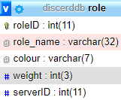
role:
role table lets users create and customize roles: their names, colours and permissions
`roleID` Primary key of the table
`role_name` Customizable name of the role
`colour` Display colour of the role
`weight` number indicating the height of the category relative to others
`serverID` foreign key to server table, shows on which server the role is used

Slide 14

role_permission:
role_permission table is a many to many relationship between those two tables
`role_permissionID` Primary key of the table
`roleID` foreign key to role table
`permissionID` foreign key to permission table

Slide 15
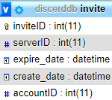
invite:
invite table allows to create invites to the server
`inviteID` Primary Key of the table
`serverID` Foreign key to server table, to what server does the invite refer
`expire_date` date when invite will expire
`create_date` creation date of invite
`accountID` Foreign key to account table, shows account that created the invite

Slide 16
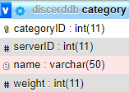
category:
category table allows creation of categories that divide voice and text channels into organized groups
`categoryID` Primary key of the table
`serverID` Foreign key to server table, on which server is the category
`name` name of the category
`weight` number indicating the height of the category relative to others

Slide 17

category_permission:
category_permission table is a many to many relationship between those two tables
`category_permissionID` Primary key of the table
`categoryID` foreign key to category table
`permissionID` foreign key to permission table

Slide 18
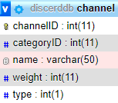
channel:
channel table allows users to create earlier mentioned text and voice channels
`channelID` Primary key of the table
`categoryID` foreign key to category table, under which category the channel is
`name` name of the channel
`weight` number indicating the height of the channel relative to others
`type` differences between voice and text channels (0 for voice and 1 for text)

Slide 19

channel_permission:
channel_permission table is a many to many relationship between those two tables
`channel_permissionID` Primary key of the table
`channelID` foreign key to channel table
`permissionID` foreign key to permission table

Slide 20
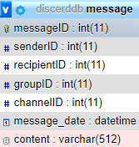
message:
message table allows to send messages on server text channels as well as in groups or direct messages
`messageID` Primary Key of the table
`senderID` Foreign key to account table, who sent the message
`recipientID` Foreign key to account table, who received the message
`groupID` Foreign key to group table, to what group the message was sent
`channelID` Foreign key to channel table, to what channel the message was sent
`message_date` date the message was sent
`content` content of the message

Slide 21
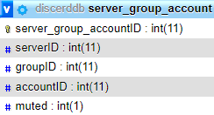
server_group_account:
server_group_account table serves the purpose of connecting users to servers and groups
`server_group_accountID` Primary Key of the table
`serverID` Foreign key to server table, to what server is the account linked
`groupID` Foreign key to group table, to what group is the account linked
`accountID` Foreign key to account table, what account is being linked
`muted` Is the server/group muted (0 for no and 1 for yes)

Slide 22

role_account:
role_permission table is a many to many relationship between those two tables
`category_permissionID` Primary key of the table
`roleID` foreign key to role table
`permissionID` foreign key to permission table

Slide 23

personal_permission:
personal_permission table allows users to give specific account specific privilege or take it away
`personal_permissionID` Primary key of the table
`accountID` foreign key to account table
`permissionID` foreign key to permission table

Slide 24
Sources:
https://en.wikipedia.org/wiki/Database Slide 2
https://en.wikipedia.org/wiki/MySQL Slide 3
https://en.wikipedia.org/wiki/Primary_key Slide 4
https://en.wikipedia.org/wiki/Foreign_key Slide 5
https://fmhelp.filemaker.com/help/18/fmp/en/index.html#page/FMP_Help/many-to-many-relationships.html Slide 6
By Mateusz Simkiewicz, Michał Wieczorek, Szymon Kulej.

