Slide 1

Performance Evaluation of Computer Systems and Networks
AA 2025 - 2026
Fragmenting Wireless Link
Mykhaylo Semenyshen
Tommaso Ottali
Luca Di Gasparro

Slide 2
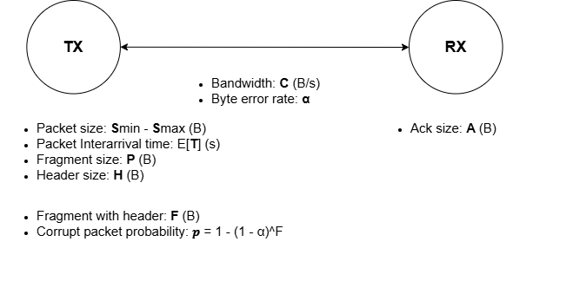
Introduction
Transmitter divides packets into fragments of size P and adds a header of size H
Wireless link: fragments of size F = H + P are transmitter at C B/s with a byte error rate
Receiver considers packets corrupt with probability
p = 1 – (1 - α)^{F} and responds with ACK/NACK
Objectives
Find optimal value of P that minimizes:
End-to-End delay of reassembled packets
System utilization
Estimate optimal buffer size of real transmitter
Assess fairness of system
Key performance indices
Factors
End-to-end packet delay
Fragments in queue
System utilization
P – Fragment size
α – Byte Error rate

Slide 3
Model, Assumption and Implementation
Model
The system is modeled as a M/G/1 system with group arrivals due to fragmentation
Assumptions
Fragmentation and reassembly delays are negligeable
System has infinite queue
Implementation
OMNET++
Simple modules: Tx and Rx
Custom messages exchanged using sendDirect()

Slide 4
Scenarios
Bluetooth Industrial
Context: Predictive maintenance (Vibration analysis)
Traffic: Large packets (FFT data), High Noise environment
Bluetooth Audio Streaming
Context: Streaming (AAC)
Traffic: Medium packet size, Low Noise
Bluetooth Sensors
Context: Wearable IMUs
Traffic: Small packets, Medium-High Noise (Body shadowing)

Slide 5
Verification and Validation
Internal Consistency:
Little’s Law: E[N] = λE[R] and E[Nq] = λE[W].
Utilization: ρ = λE[ts]
Additivity of mean: E[R] = E[W] + E[ts] and E[N] = E[Nq] + ρ.
Flow consistency: ɣ = λ (throughput equals arrival rate)
Degeneracy Tests:
α = 0: no retransmissions
α = 1: zero throughput
P = 10kB: zero throughput
Consistency:
Double packet size and double inter-arrival time: same throughput
Continuity:
Small input perturbations: inter-arrival time, packet size, byte error rate
Small output variations: mean delay, throughput
Discrepancies with theoretical model:
Errors < 5% in scenarios with high fragmentation
Exception: Sensors scenario (mean fragments per packet = 1.5)
Error up to 70% in waiting time
Why? Head-of-Line blocking: full-sized fragments block small tail fragments
Theoretical model assumes “average” fragments, missing heterogeneity

Slide 6
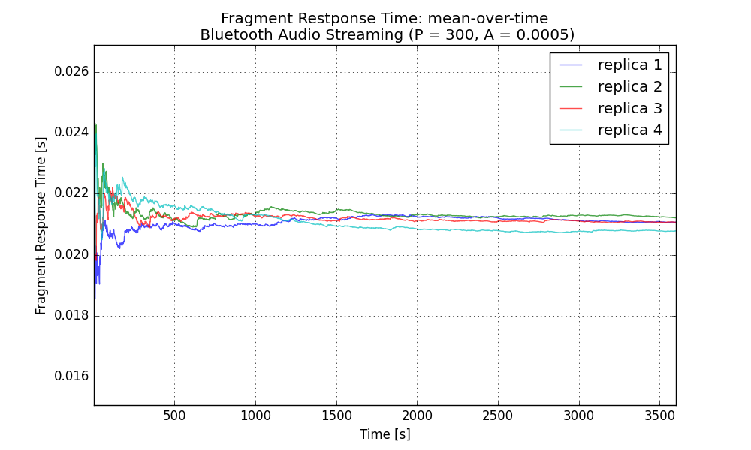
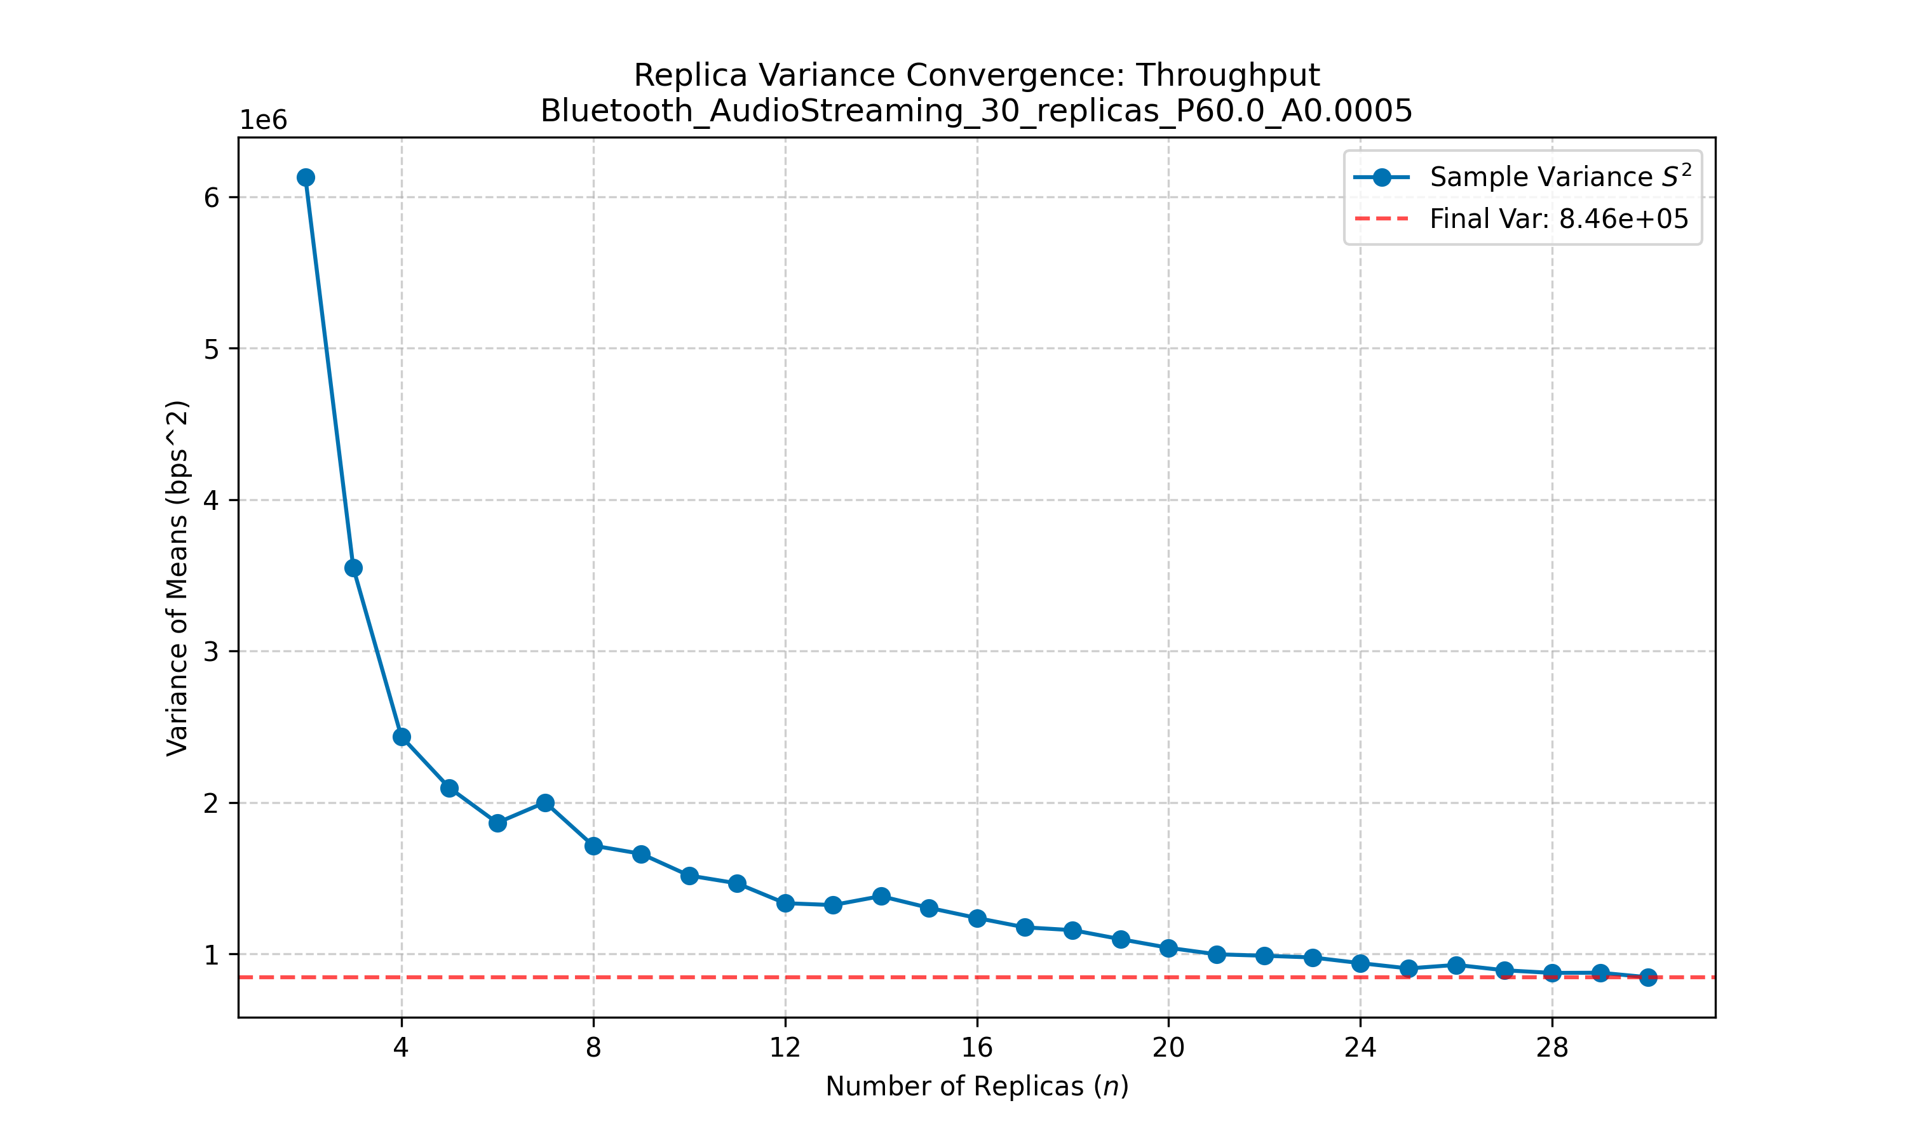
Data Analysis Methodology
Statistical robustness
30 replicas with different RNG seeds
3 separate RNG for each simulation
95 % confidence intervals
Warm-up time estimation
Variance convergence check

Slide 7
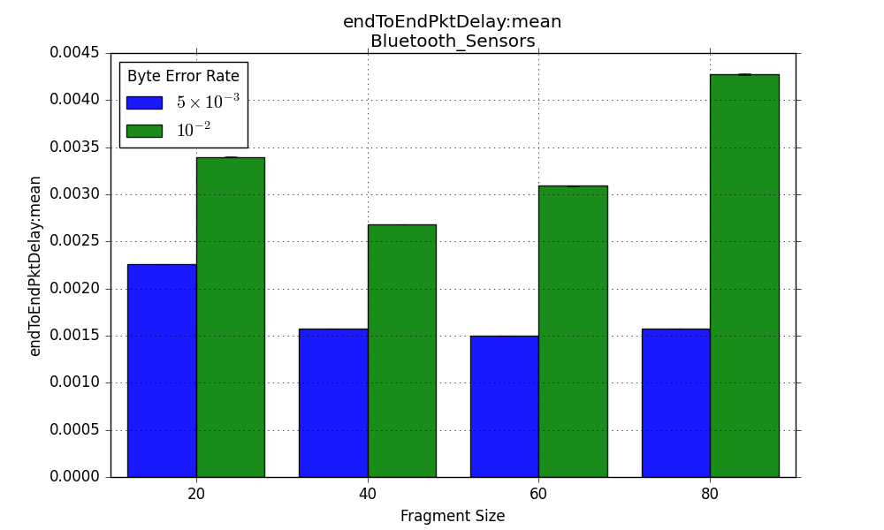
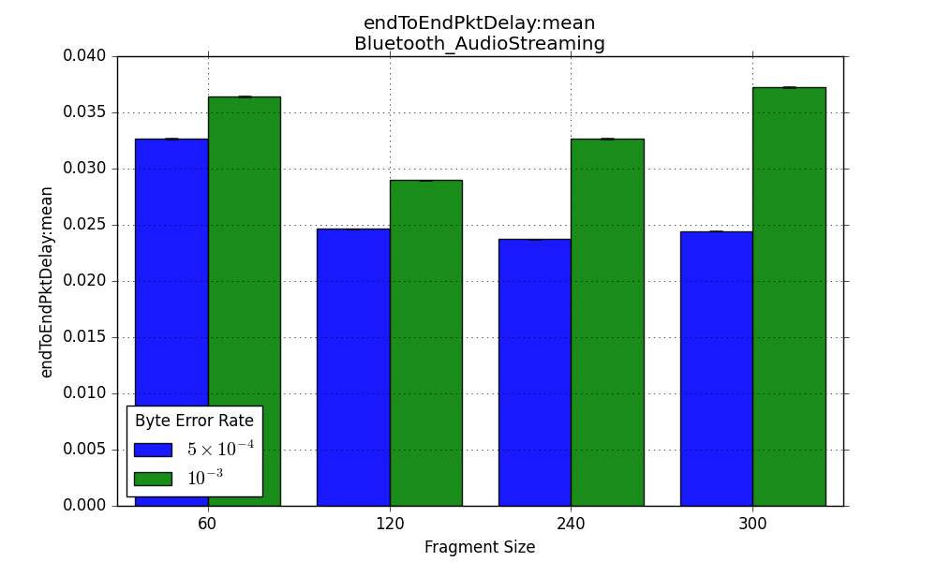
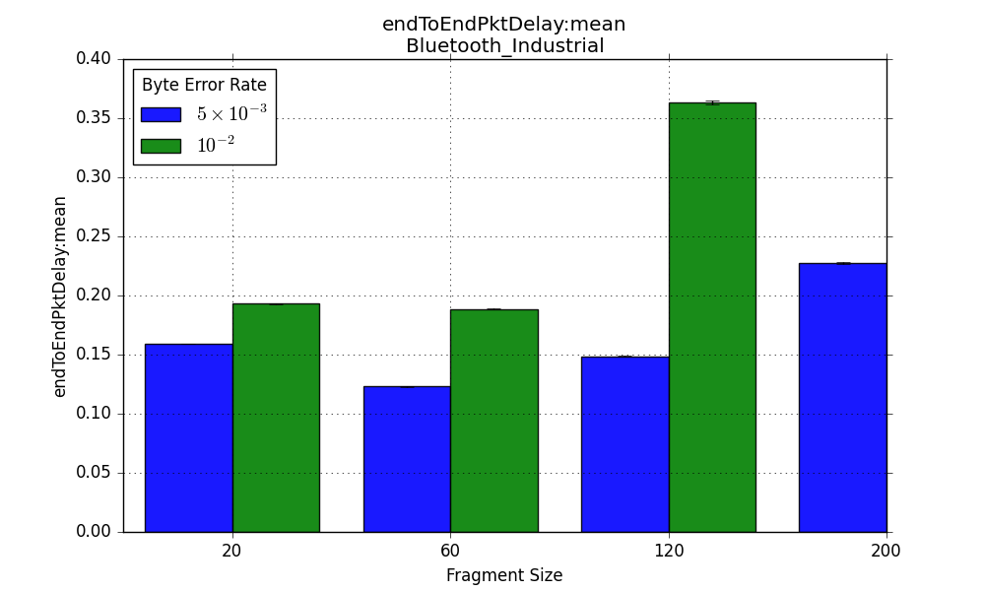
End-to-End Delay (1/2)
Results:
Expected ‘U’ shape
Utilization:
Analog results
Before saturation:
Header and protocol overhead dominate
At saturation:
Optimal balance
After saturation:
Retransmissions dominate

Slide 8
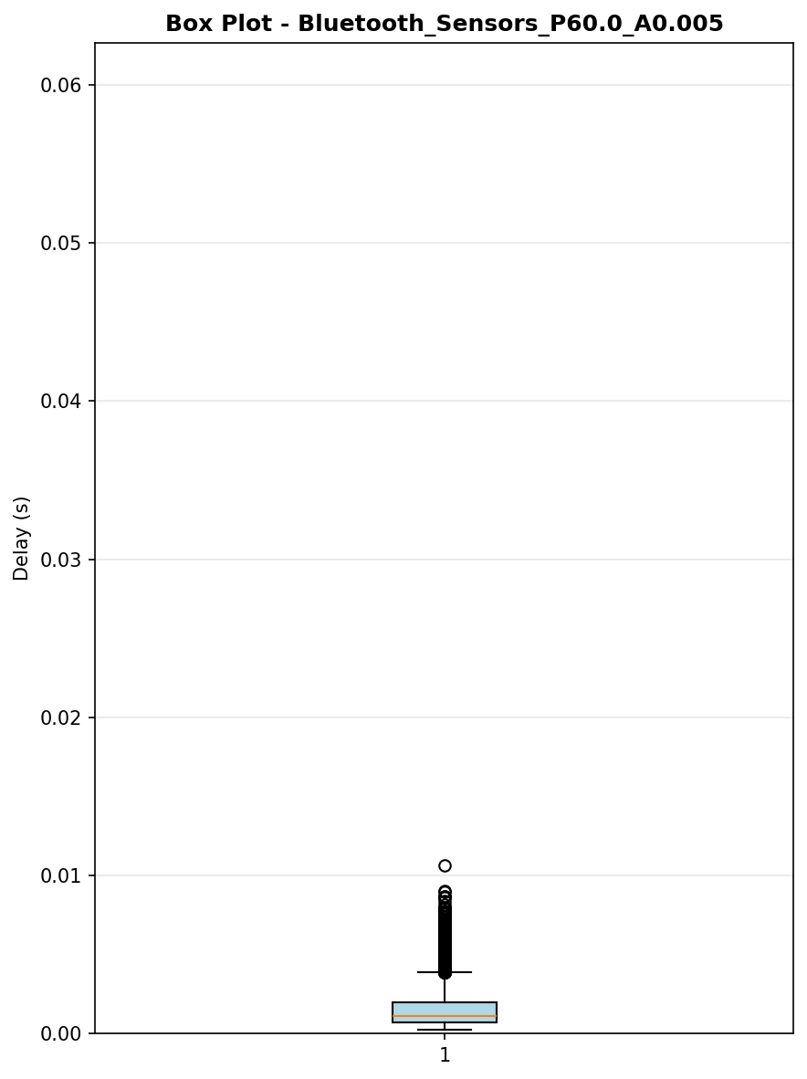
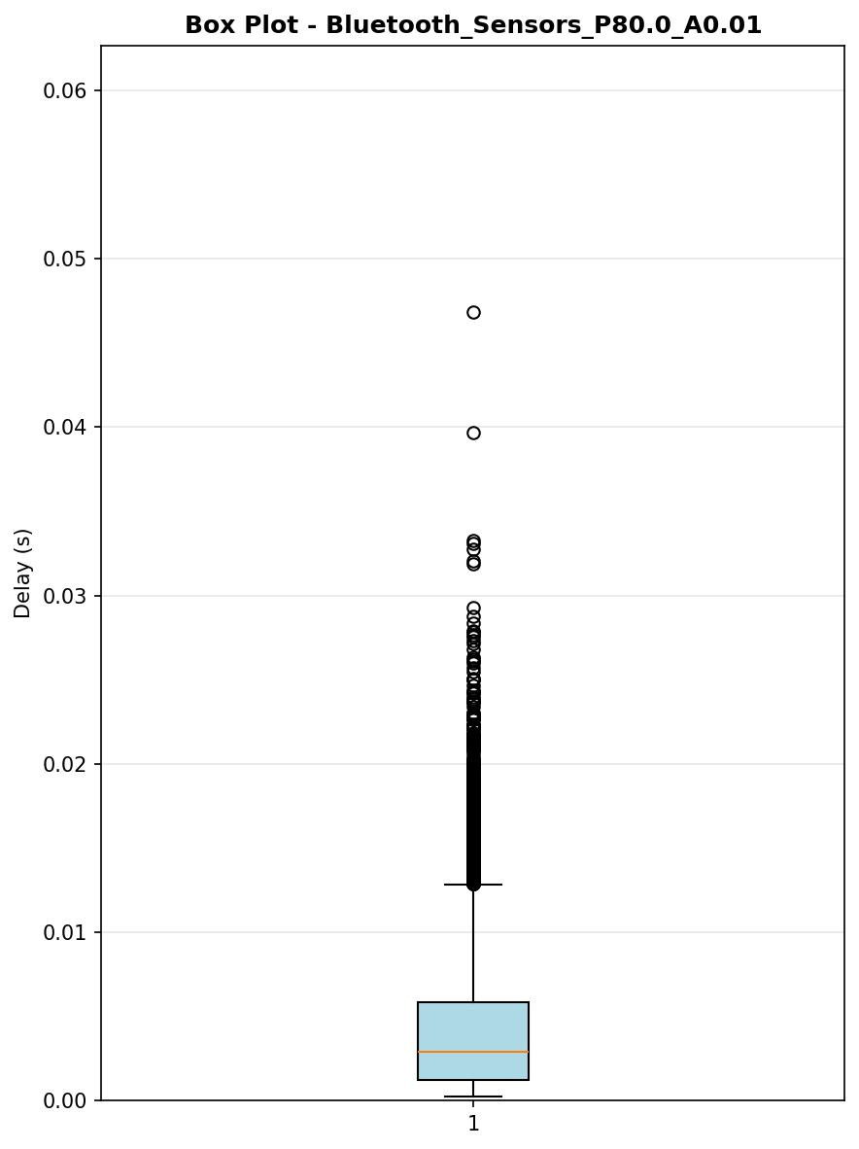
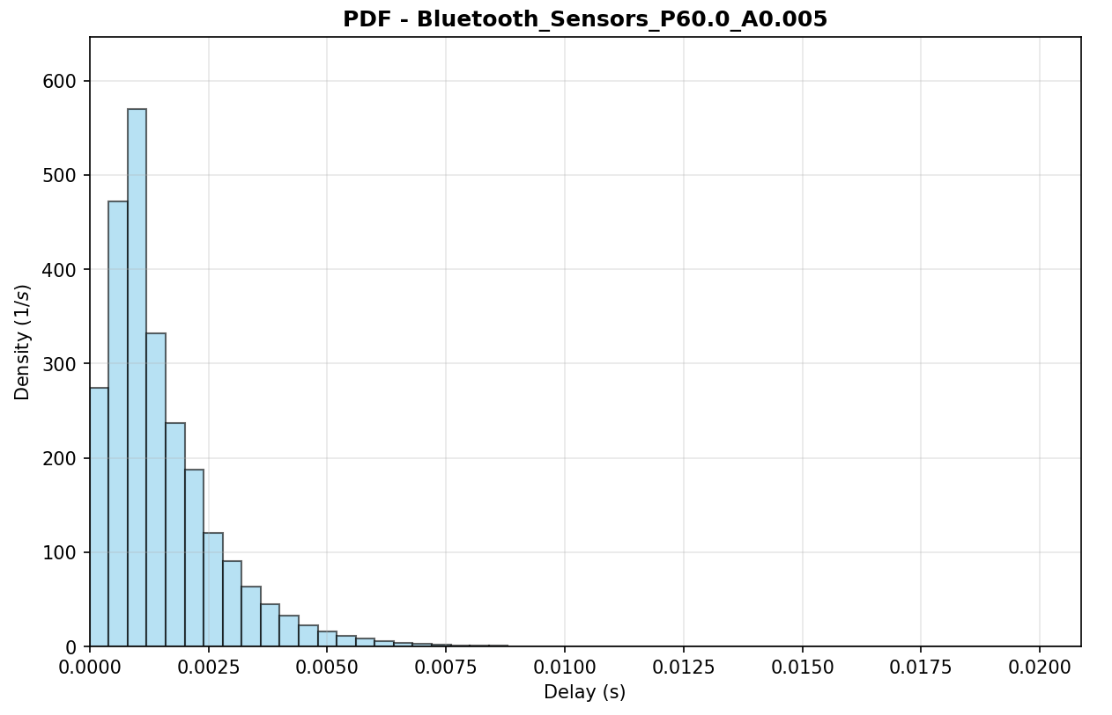
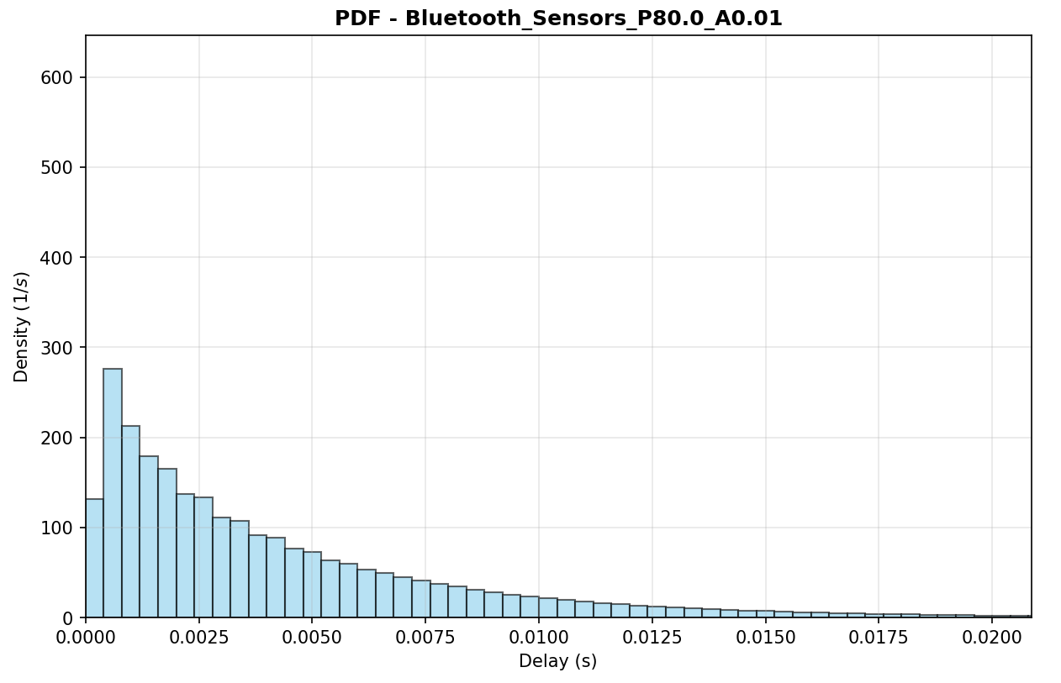
End-to-End Delay (2/2)
Sensors: optimal low noise
Sensors: worst high noise

Slide 9
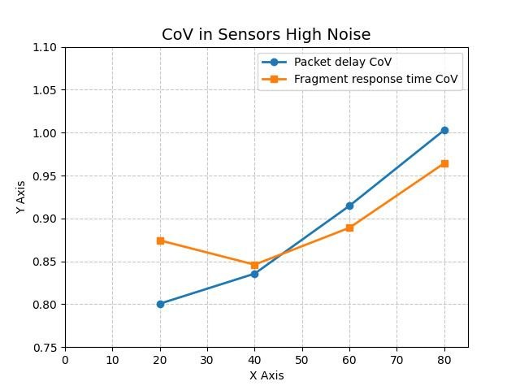
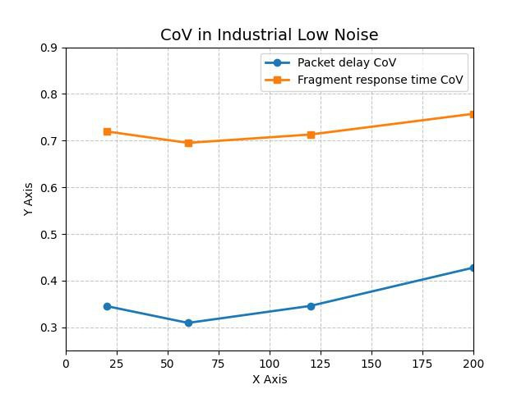
Fairness and Predicatibility
Insight:
Trade-off: optimizing protocol efficiency through increased fragment size (P) beyond saturation inevitably compromises system delay predictability
More accentuated in noisy environments.
Sensors:
Packet level predictability (Cov) and fairness (Gini) always decrease with increasing P
Small Fragment number: no statistical smoothing
Industrial and Streaming:
U shape predictability and fairness with increasing P
Large Fragment number: statistical smoothing

Slide 10
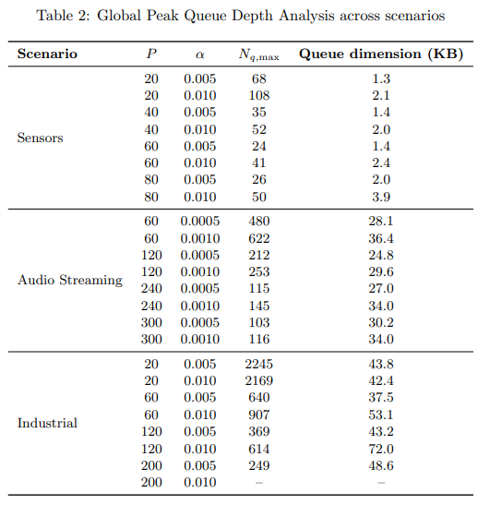
Buffer Size Estimation
Bluetooth Industrial
50 – 80 kB
Feasible for modern sensors
Legacy or Ultra-low-power may experience buffer overflow
Bluetooth Audio Streaming
30 – 40 kB
Stable queue size easily manageable by audio streaming applications
Bluetooth Sensors
2 – 4 kB
Reference sensors would experience no buffer space issues

Slide 11
Conclusions
U-shaped performance:
Optimal P balances protocol overhead vs. retransmissions
Noise matters:
High-error environments shift optimum to smaller P
Fragmentation regime matters:
Low fragmentation: Protocol efficiency gains come at the cost of delay predictability

