Slide 1
KING COUNTY HOUSING — EXPLORATORY DATA ANALYSIS
Finding the Right Home
for Thomas Hansen
A data-driven recommendation on affordability, neighborhood, and timing
By Micheal Eshak Friday, 18.09.2026
Prepared for Thomas Hansen | Home Buyer Client Review

Slide 2
AGENDA
What we'll cover today
01
Meet the client
02
Our data & approach
Who am I ?
Who Thomas Hansen is and what he needs ?
What we analyzed and how, in plain terms
03
Can he afford it?
04
Which neighborhood?
Matching budget to family size
Finding "nice" and family-friendly, within budget
05
When should he buy?
06
Insights & recommendations
Does timing change the price?
Our concrete advice for Thomas
2

Slide 3
OUR CLIENT
Meet Thomas Hansen
Micheal Eshak
Who am I?
Data analyst
● I'm analyzing the King County housing dataset
THE TWO QUESTIONS HE NEEDS ANSWERED
● Where should he look? (Location)
THOMAS HANSEN
Who is my client?
Home Buyer
● When should he buy? (Timing)
● A family of 7 — 2 parents and 5 kids
● Working with a tight budget ("no money")
● Wants a nice, family-friendly, socially connected neighborhood
To answer both, we turned to the actual record of
home sales across King County — not guesswork.
3

Slide 4
METHODOLOGY
Our data & approach
21,596
70
13
home sales analyzed
neighborhoods (zip codes)
covered
months of sales data
(May 2014 – May 2015)
HOW WE GOT TO OUR ANSWERS
● Started with real King County home-sale records — prices,
location, size, condition, and sale dates
● Cleaned the data: fixed an obvious data-entry error and
handled a small number of missing values sensibly
● Translated Thomas's needs into three concrete, testable
questions (next slides)
● Backed every answer with the actual sales numbers, not
assumptions
OUR THREE QUESTIONS
● Can Thomas afford a home big enough for his family?
● Which neighborhood is both “nice” and family-friendly,
within his budget?
● Is there a better or worse time of year to buy?
4

Slide 5
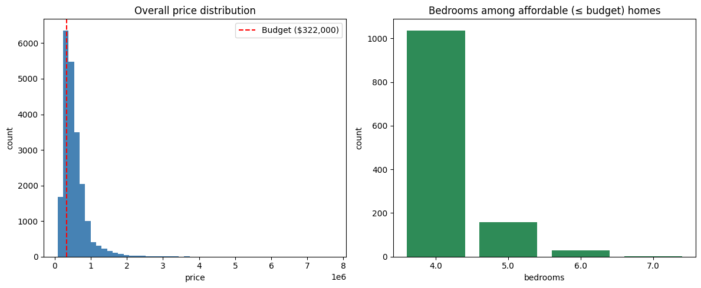
QUESTION 1 — FEASIBILITY
Can Thomas afford a home big enough for his family?
We set his budget at the bottom 25% of all sale
prices — a strict reading of “no money.”
1,227
homes with 4+ bedrooms
within that budget
$322K
budget ceiling
(25th percentile of price)
5.7%
of all King County sales
fit his needs
Answer: Yes — a family of 7 is realistically housed within this budget in King County.
5

Slide 6
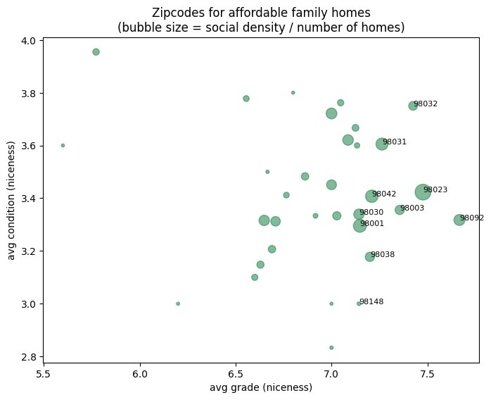
QUESTION 2 — LOCATION
Which neighborhood is both “nice” and family-friendly?
Among the affordable, family-sized homes, we grouped
by neighborhood and looked for areas that combine:
● “Social density” — lots of other similarly affordable,
family-sized homes nearby
● “Niceness” — above-average home condition and
build quality (grade)
READING THE CHART
● Bigger bubble = more affordable family homes nearby
● Further right / up = better condition and build quality
● Two zip codes stand out: 98023 and 98092
6

Slide 7
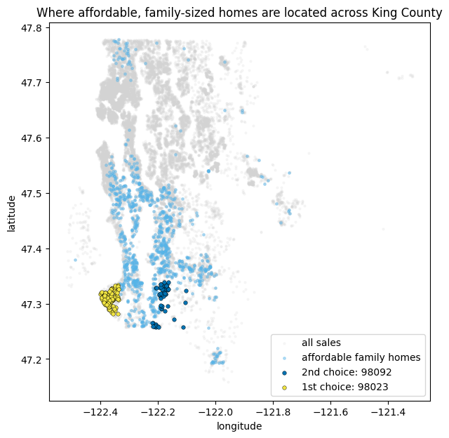
QUESTION 2 — LOCATION
Where these homes sit — and our top pick
★ 1ST CHOICE — ZIP CODE 98023
● 130 affordable, family-sized homes — by far the most
of any neighborhood
● Lower average price: $267,500
● Better average condition: 3.4 / 5
● Build quality (grade): 7.5 / 13
2ND CHOICE — ZIP CODE 98092 (backup)
● Highest average build quality (grade): 7.7 / 13
● But only 63 qualifying homes — far fewer choices
● Higher average price: $281,000
7

Slide 8
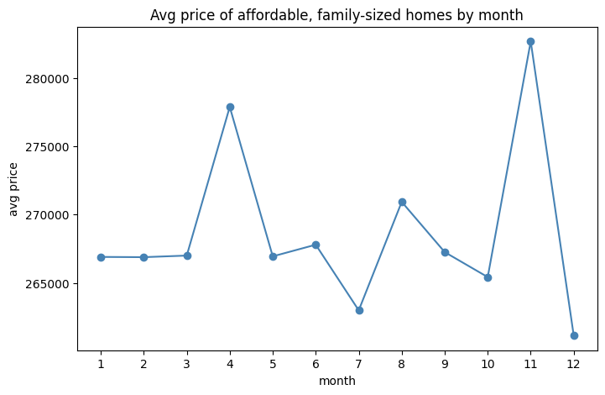
QUESTION 3 — TIMING
Is there a better time of year to buy?
We tracked the average price of affordable, family-
sized homes month by month across the year.
8%
price swing across the
entire year — fairly flat
Dec
cheapest month
(avg. $261,149)
Nov
priciest month
(avg. $282,673)
Answer: Timing barely moves the needle — location matters far more than the calendar.
8

Slide 9
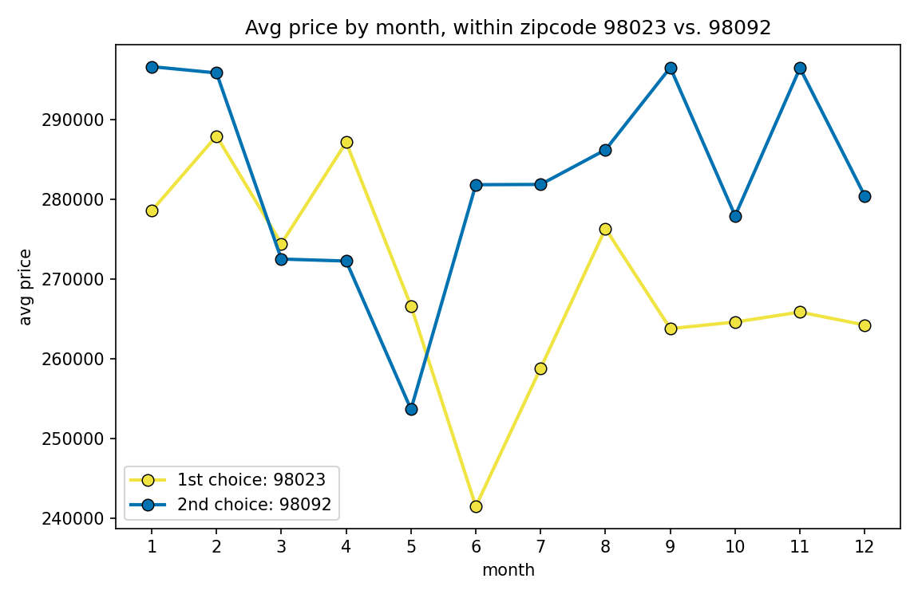
QUESTION 3 — TIMING
Does the pattern hold within each zipcode?
★ ZIP CODE 98023
● ~17% price swing across the year
● Cheapest month: June (avg $241,512)
● Priciest month: February (avg $287,922)
ZIP CODE 98092 (backup)
● ~15% price swing across the year
● Cheapest month: May (avg $253,667)
● Priciest month: January (avg $296,612)
Answer: Each zipcode has its own seasonal pattern — the countywide “December is cheapest” doesn’t apply to 98023 or 98092 specifically.
9

Slide 10
SUMMARY
Key insights
Feasibility
1
Even on a strict budget, there are 1,227 homes with 4+ bedrooms available — a family of 7 is realistically housed in King County.
Location
2
Zip code 98023 stands out with the most affordable, family-sized homes of any neighborhood, at a price well under budget, with above-average condition and quality.
98092 is a strong backup.
Timing
3
The ~8% swing is a county-wide average — 98023 and 98092 actually move 15–17% individually.
Location, not the calendar, should still drive the decision.
10

Slide 11
OUR RECOMMENDATION
What we recommend for Thomas
1
Start the search in zip code 98023 first — it offers the best mix of affordability, family-home availability, and community density.
2
Keep zip code 98092 as a backup — slightly higher average build quality, but fewer homes on the market and a higher price.
Don't over-optimize for timing — within either zipcode, month-to-month swings (15–17%) are still smaller than what separates a home that fits his needs from one that doesn’t.
Let location drive the decision.
3
4
If flexible on timing, use the zipcode-specific pattern, not the countywide one:
prices tend to be lowest around June in 98023, and around May in 98092 — not December.
11

Slide 12
Thank you
Questions & discussion
Full analysis: 04_eda.ipynb | King County Housing EDA — ds-eda-project-template
12

