Slide 1


Final Project : Airbnb Earnings Optimization
Michel Brun
FEB, 11th | PARIS

Slide 2

Data Preparation
Machine Learning
Visualization & Presentation
Data Collection - Data sources
EDA
Data Cleaning
Encoding
Supervised ML :
Features Selection
Regressor & Classifier
Hyperparamaters tuning
Unsupervised ML :
Kmeans, OPTICS, DBScan
NLP :
Tokenization, StopWords(French & English, Nouns), WordNetLemmatizer
Folium (Map clusters)
Tableau
Pivot Table
Streamlit

Slide 3
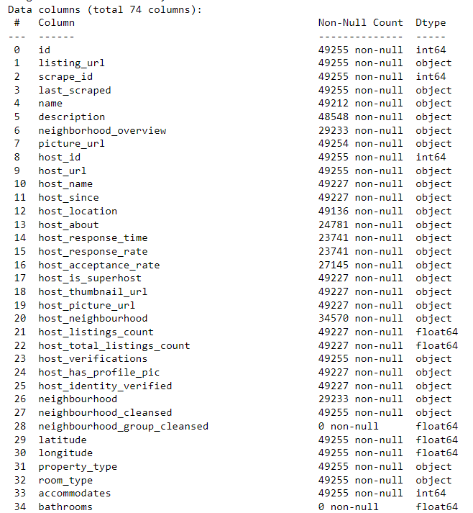
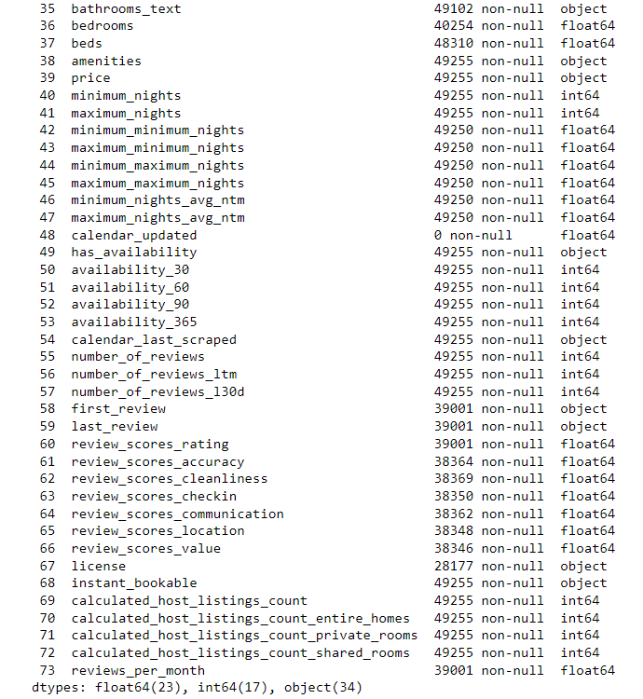
Data Preparation

Slide 4
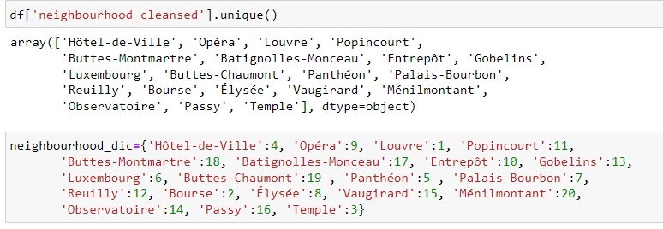
Data Preparation

Slide 5
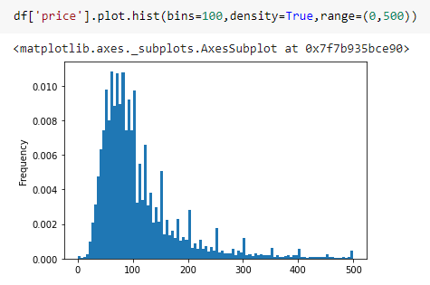
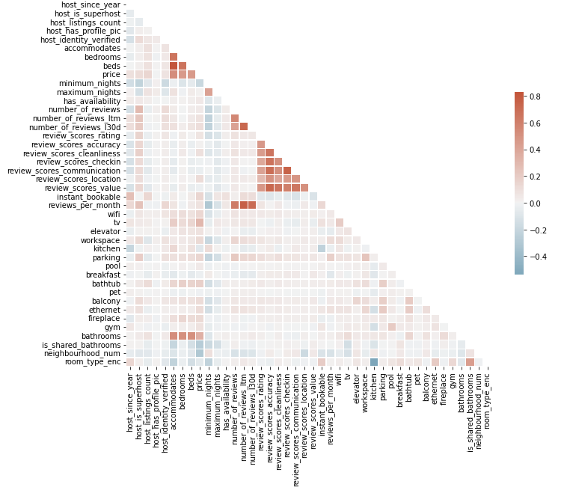
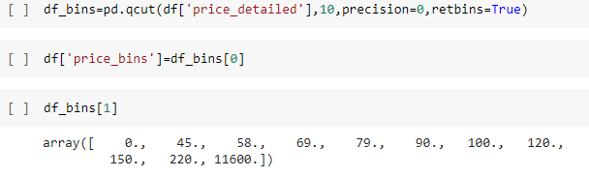
ML Supervised

Slide 6
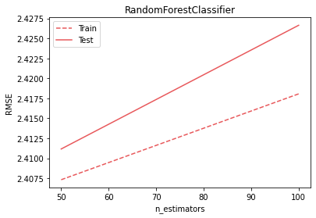
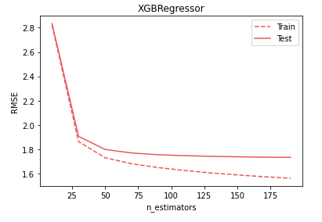
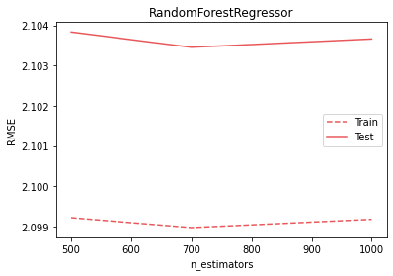
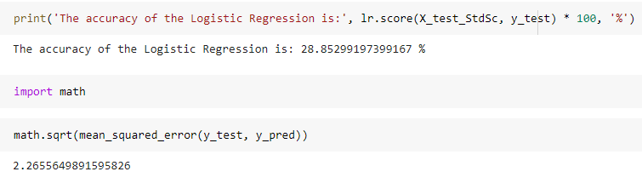
ML Supervised

Slide 7
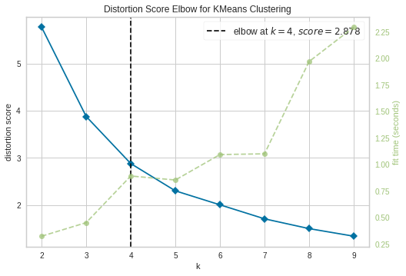
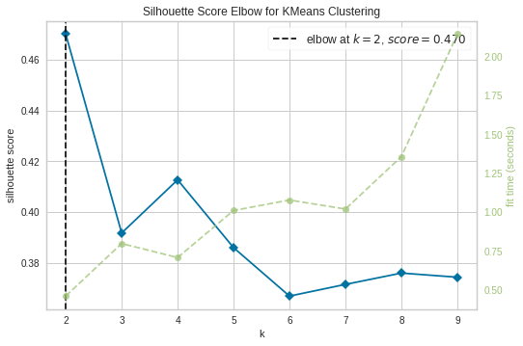
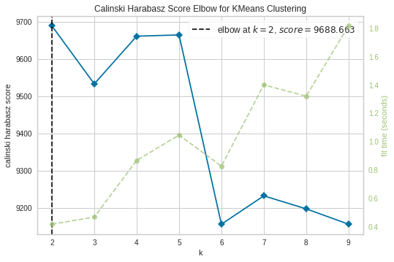

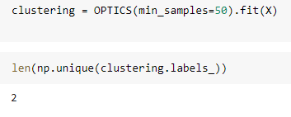
ML Unsupervised

Slide 8
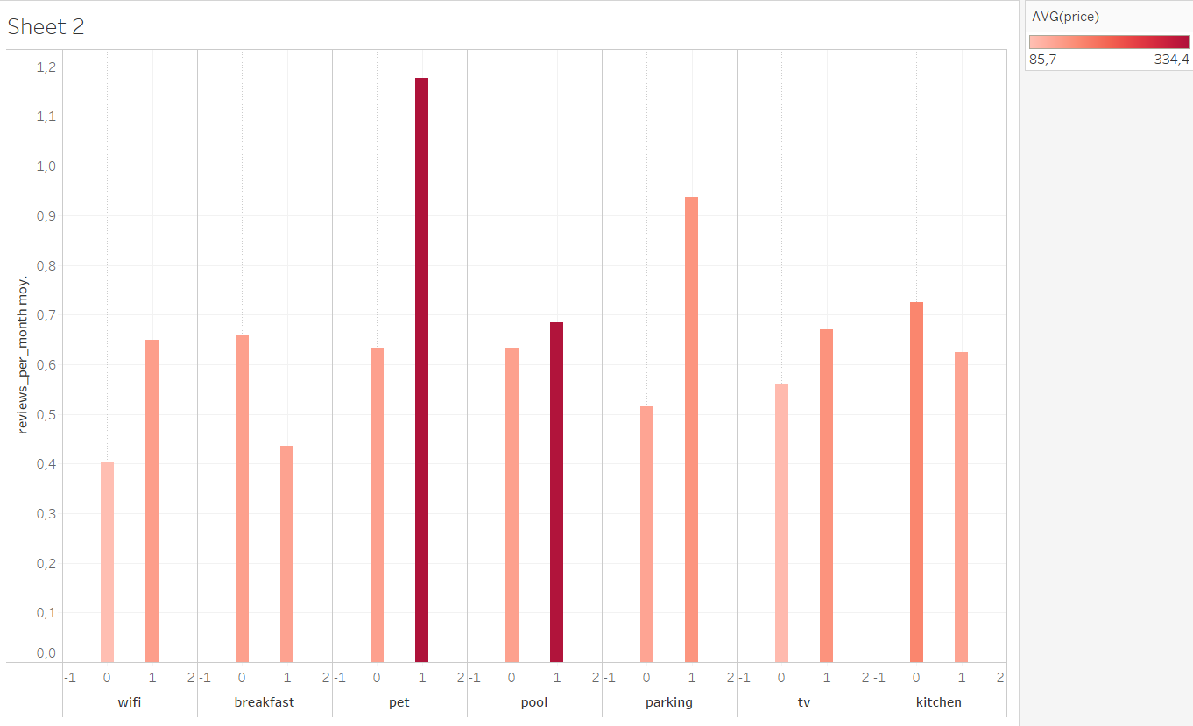
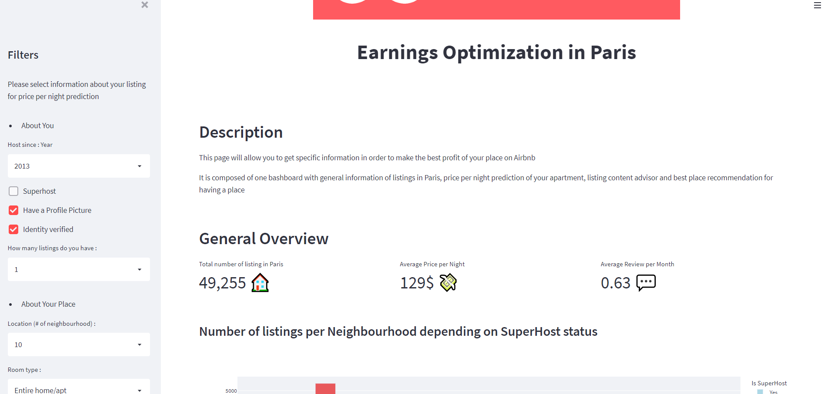
Data Vizualization & Dashboard

Slide 9
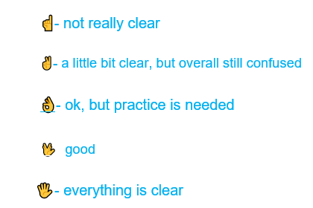
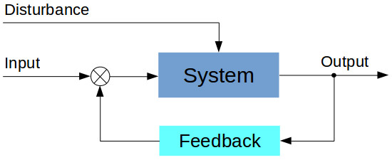
Closed-loop feedback control system

