Slide 1
E-ink room reservation display
Stijn Declerck, Michel Dequick,
Baptiste Pattyn, Ine Vanderhaeghe

Slide 2

Introduction
Ine Vanderhaeghe

Slide 3
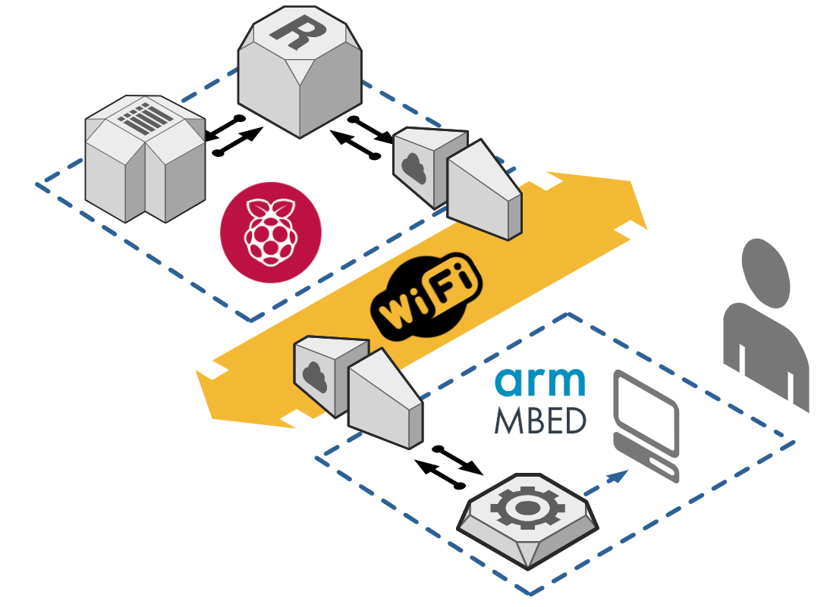
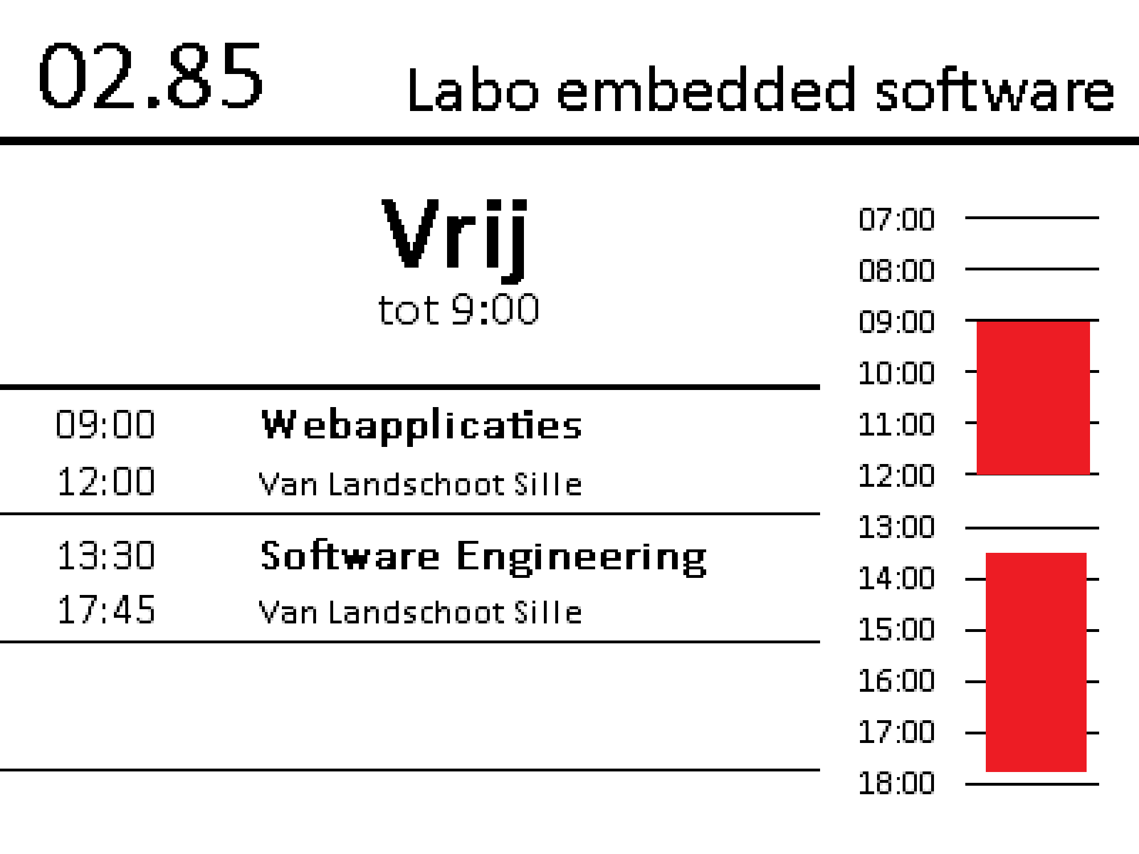
Introduction
Concept art by Mr. Van Landschoot

Slide 4

SQL Database
Baptiste Pattyn

Slide 5
Situation
SQL Database
Database Hierarchy
Webserver
Communicatie
Wifi Access Point
JSON Parsing
E-Paper Display: Specs
E-Paper Display: Implementation

Slide 6
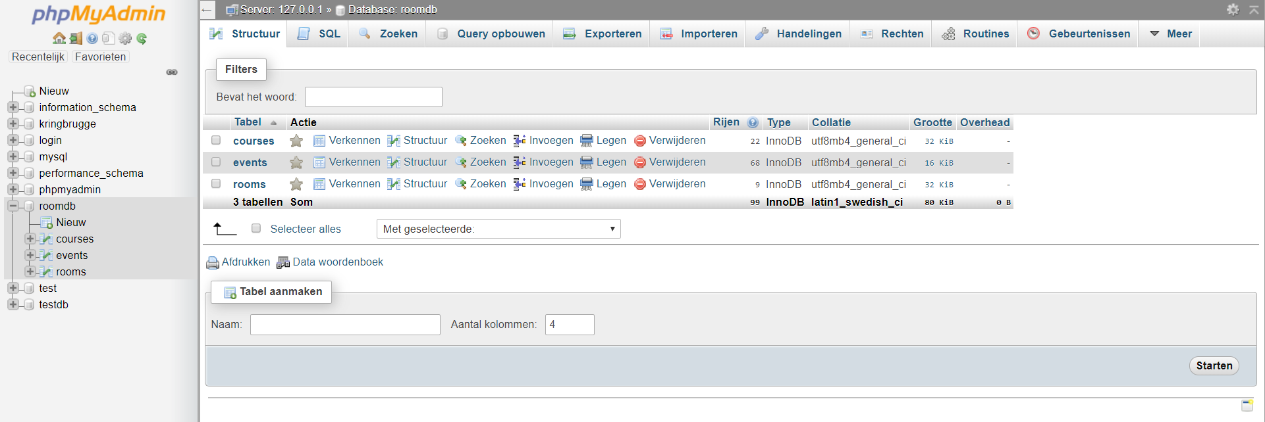
SQL Database
PHPMyAdmin
Software tool geschreven in PHP
Beheer van MySQL databases
Online GUI
Easy to use

Slide 7
Database Hierarchy
Ine Vanderhaeghe

Slide 8
Situation
SQL Database
Database Hierarchy
Webserver
Communicatie
Wifi Access Point
JSON Parsing
E-Paper Display: Specs
E-Paper Display: Implementation

Slide 9
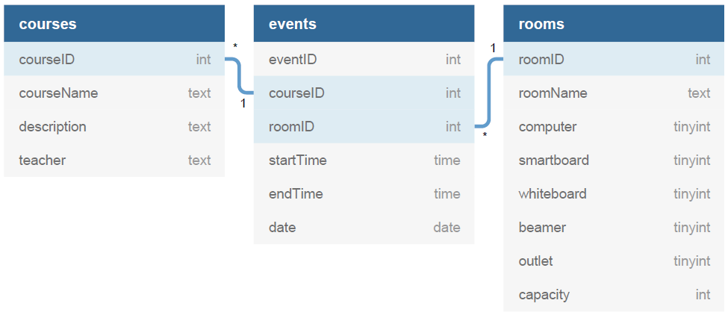
Databank

Slide 10

Webserver
Baptiste Pattyn

Slide 11
Situation
SQL Database
Database Hierarchy
Webserver
Communicatie
Wifi Access Point
JSON Parsing
E-Paper Display: Specs
E-Paper Display: Implementation

Slide 12
Webserver
Apache 2.4 server
Ondersteunt PHP en HTML
Communicatie met SQL database
GET request om data op te halen
<IP-address>/E-ink-room/roominfo.php?roomName=03.01
Verwerken van de request:
Verbinden met database
Ophalen van gegevens:
roomID
events voor opgegeven roomID
Data wordt in arrays gepusht
course info (teacher, description en course name)
Room object aanmaken en attributen vullen
Omzetten naar JSON

Slide 13
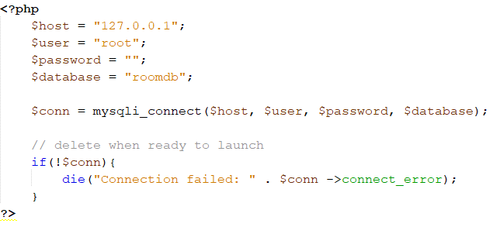
Webserver
dbConnect.php

Slide 14
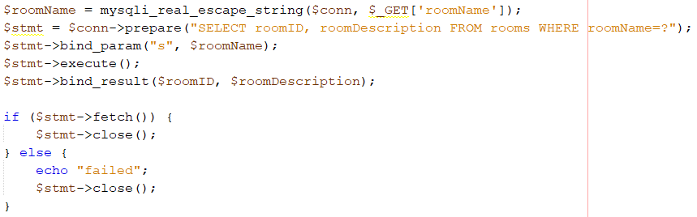
Webserver
Info uit de database halen via SQL commando’s
Sanitize input string
Prepare statement
Bind parameters
Execute statement
Bind results
Fetch results
Close statement

Slide 15
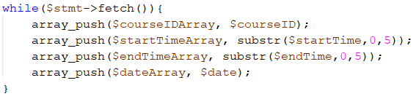
Webserver
Aangepaste fetch bij meerdere resultaten

Slide 16
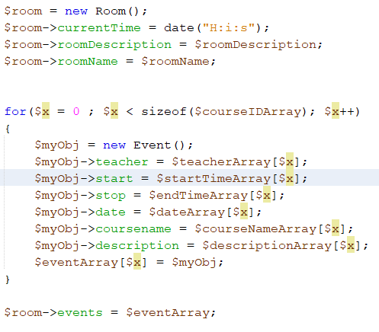
Webserver
Aanmaken room object en attributen toekennen

Slide 17

Communicatie
Stijn Declerck

Slide 18
Situation
SQL Database
Database Hierarchy
Webserver
Communicatie
Wifi Access Point
JSON Parsing
E-Paper Display: Specs
E-Paper Display: Implementation

Slide 19


Communicatie

Slide 20
Communicatie
- init () → verbinding maken met raspberry pi
- get () → GET request versturen
→ json_string ontvangen
"GET http://172.16.102.148/roominfo.php?roomName=02.85 HTTP/1.1\r\nHost: http://172.16.102.148\r\nConnection: close\r\n\r\n“

Slide 21
Communicatie
HTTP/1.1 200 OK
Date: Tue, 21 May 2019 06:38:06 GMT
Server: Apache/2.4.25 (Raspbian)
Set-Cookie: PHPSESSID=2qnnn1tlno980hr1abhuoq49f3; path=/
Expires: Thu, 19 Nov 1981 08:52:00 GMT
Cache-Control: no-store, no-cache, must-revalidate
Pragma: no-cache
Vary: Accept-Encoding
Content-Length: 276
Connection: close
Content-Type: text/html; charset=UTF-8
{"currentTime":"08:38:06","roomDescription":"Labo Mbedded ontwerp","roomName":"02.85","events":[{"teacher":"Espeel Ludovic,Lannoo Jonas","start":"08:15","stop":"17:45","date":"2019-04-03","coursename":"Projectlab bachelor elektronica-ICT","description":"B-KUL-B3390N"}]}
▒/~▒x)^▒C
▒?gu֛▒*▒▒N\U▒ޝ▒m▒8"▒▒uA▒l▒
J▒▒

Slide 22

Wifi Access Point
Baptiste Pattyn

Slide 23
Situation
SQL Database
Database Hierarchy
Webserver
Communicatie
Wifi Access Point
JSON Parsing
E-Paper Display: Specs
E-Paper Display: Implementation

Slide 24
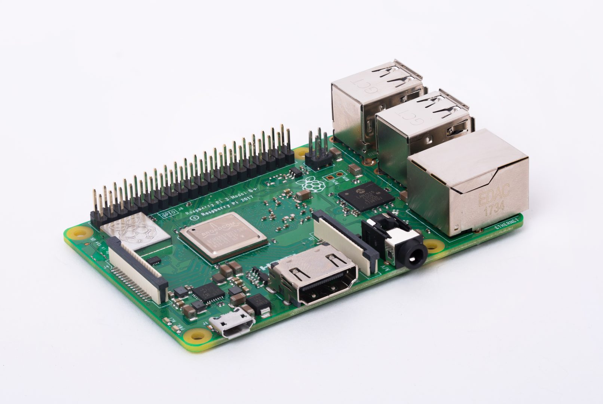

Wifi Acces Point (WAP)
Raspberry Pi Model 3 b+
Twee services:
Hostapd
Opzetten van het access point
SSID en wachtwoord vastleggen
Dnsmasq
DHCP server (Dynamic Host Configuration Protocol)
Kent dynamisch IP adressen toe
Range 192.168.0.11-192.168.0.30

Slide 25

JSON Parser
Michel Dequick

Slide 26
Situation
SQL Database
Database Hierarchy
Webserver
Communicatie
Wifi Access Point
JSON Parsing
E-Paper Display: Specs
E-Paper Display: Implementation

Slide 27
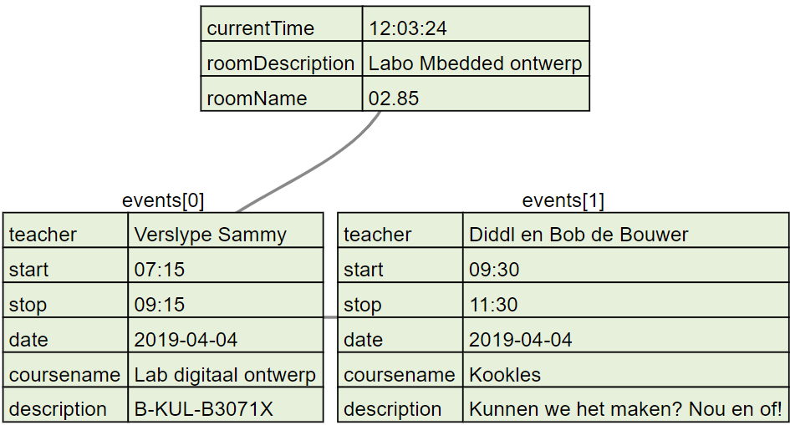
JSON Composition

Slide 28

JSON Parsing
MbedJSONValue json;
parse(json, JSON_STRING); std::string room_name = json[ROOM_NAME_ID].get<std::string>(); std::string event_name = json[EVENTS][0][EVENT_NAME].get<std::string>();
Notes:
Offline compiler profile uses GCC-98 witch does not support MbedJsonlib

Slide 29

E-Paper Display: specs
Ine Vanderhaeghe

Slide 30
Situation
SQL Database
Database Hierarchy
Webserver
Communicatie
Wifi Access Point
JSON Parsing
E-Paper Display: Specs
E-Paper Display: Implementation

Slide 31
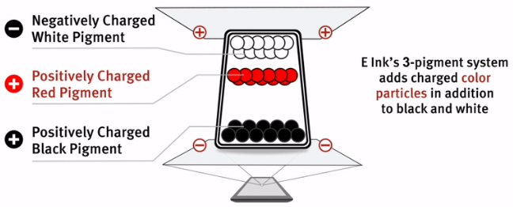
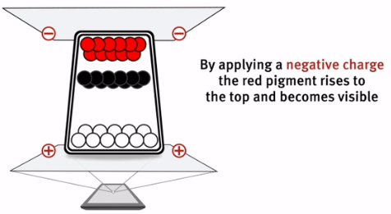
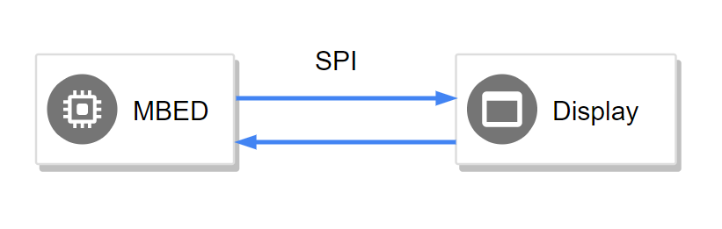
E-ink display

Slide 32
E-Paper Display
Michel Dequick

Slide 33
Situation
SQL Database
Database Hierarchy
Webserver
Communicatie
Wifi Access Point
JSON Parsing
E-Paper Display: Specs
E-Paper Display: Implementation

Slide 34



E-Paper Display
Steps taken:
Ported Arduino library to MBED
Issues: Big frame buffer causing stack overflow
Solution: Partial frame render/update (smaller frame buffer)
Issues: DrawChar() method does not work properly
Solution: Rewrote pointer based character-lookup
Wrote wrapper for library to interface with JSON
No major issues
Merge project with master branch
No major issues

Slide 35
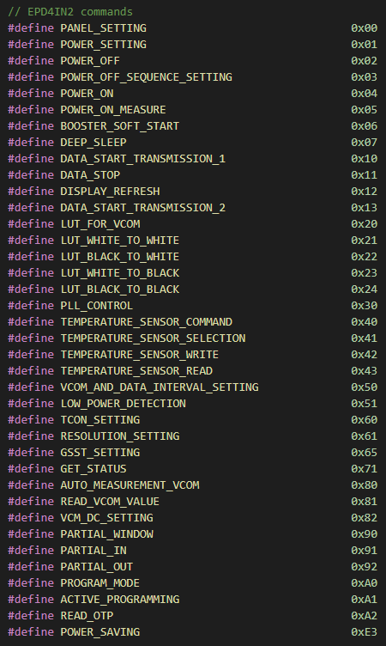
E-Paper Display
Inner working:
Display initialization:
Soft start
Power on
Settings
Display frame
Set partial frames
Draw S-RAM (frame buffer)
Sleep
Notes:
4 delen van het scherm

Slide 36
E-Paper Display
User interface
Room location
Current room status
Future events
Graphical time table
Notes:
4 delen van het scherm

Slide 37
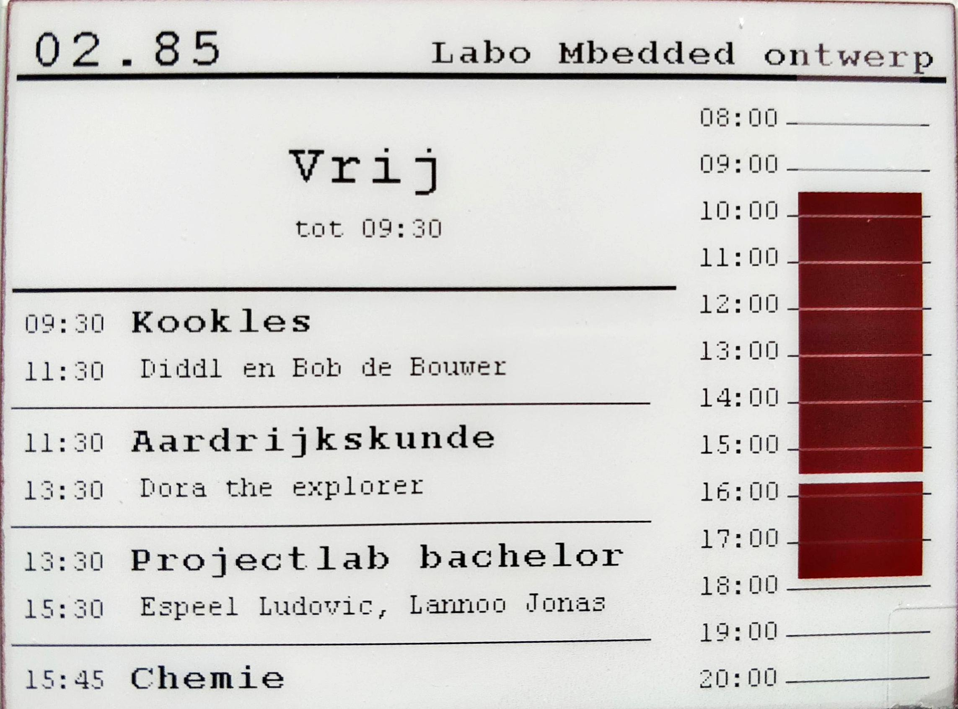
E-Paper Display
Concept
Result
Notes:
4 delen van het scherm

Slide 38

DEMO

Slide 39
Test out our datadase
Connect to our network
SSID: teamzoepertoff
Key: stijnkanniks
Browse to “http://172.16.102.217/roominfo.php”

Slide 40

Questions

