Slide 1
E-ink room reservation display
Baptiste Pattyn, Michel Dequick,
Stijn Declerck, Ine Vanderhaeghe

Slide 2
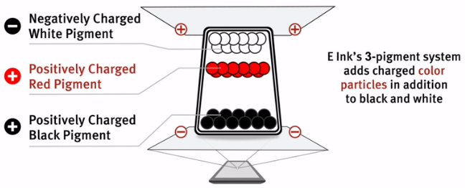
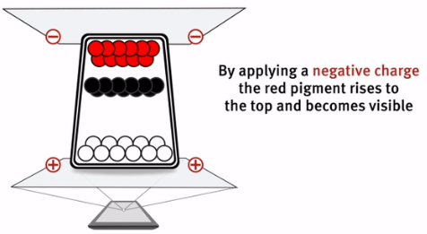
E-ink display

Slide 3
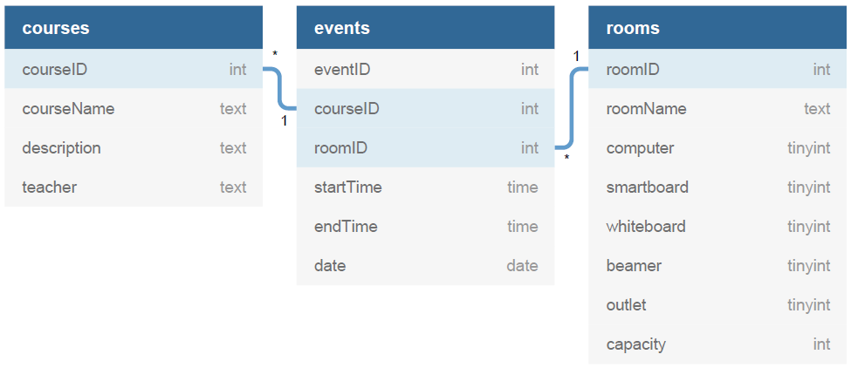
Databank

