Slide 1
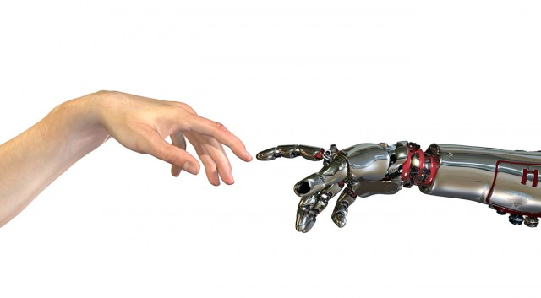
Machine Learning
2. regressie en graduele afdaling

Slide 2
ml:regressie

Slide 3
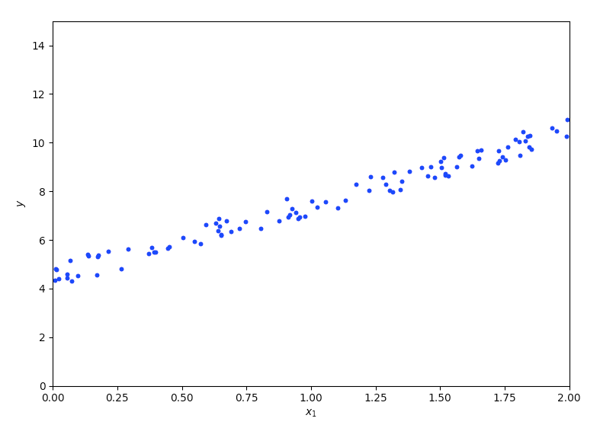

Slide 4
$$y=4+3x$$

Slide 5
7
6
5
4
3
2
1
1
2
3
4
5
6
7
8
9
10
11

Slide 6

lijn L1
7
lijn L2
6
5
4
3
2
1
1
2
3
4
5
6
7
8
9
10
11

Slide 7
lijn L1
7
$$y=x$$
lijn L2
6
5
$$y=3+\frac{x}{4}$$
4
3
2
1
1
2
3
4
5
6
7
8
9
10
11

Slide 8
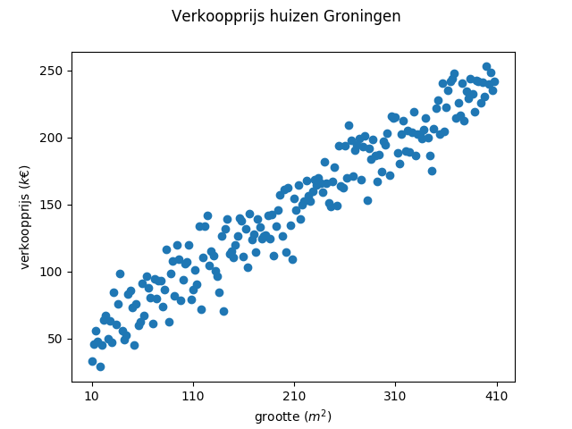

Slide 9
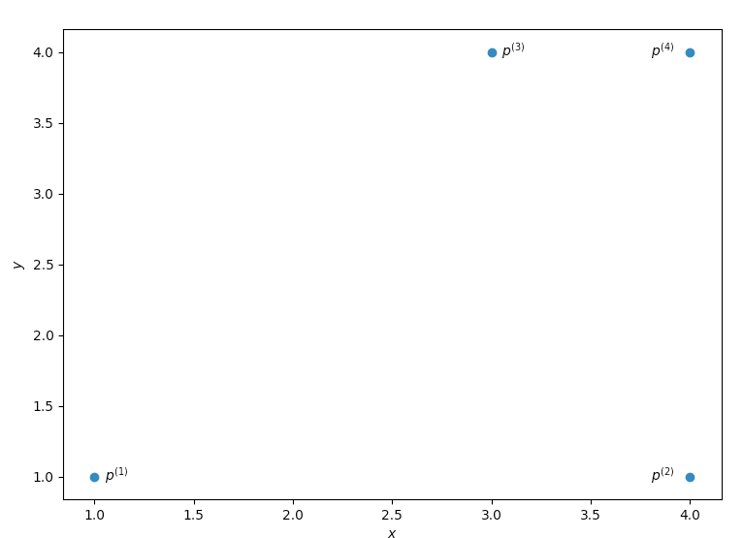

Slide 10
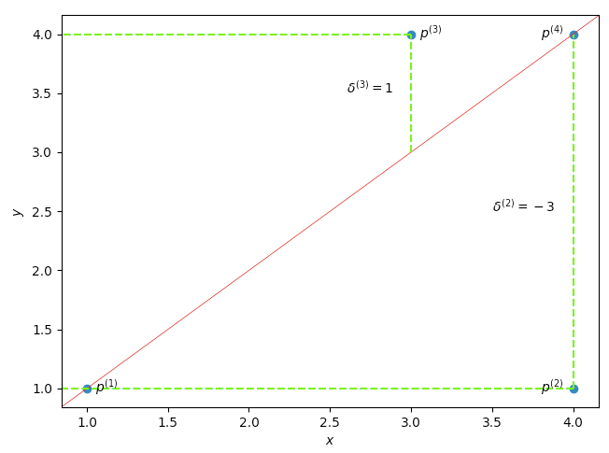

Slide 11
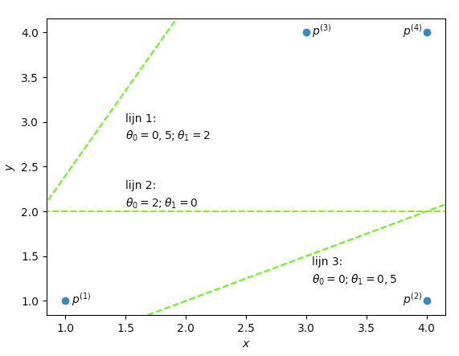

Slide 14
$$J(θ)=\frac{1}{m}\overset{m}{\underset{i=1}{∑}}(h_{θ}(x^{(i)})-y^{(i)})^{2}$$

Slide 15
ml:meerdere eigenschappen

Slide 17
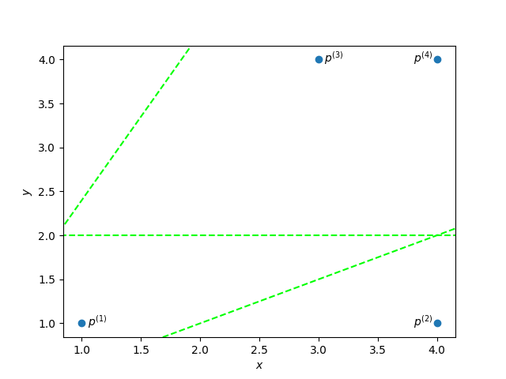
$$h_{1}(x)=\frac{1}{2}+2x$$
$$i$$
$$x^{(i)}$$
$$y^{(i)}$$
$$h_{1}(x^{(i)})$$
$$δ^{(i)}$$
$$1$$
$$1$$
$$1$$
$$2$$
$$4$$
$$1$$
$$3$$
$$3$$
$$4$$
$$4$$
$$4$$
$$4$$
$$h_{2}(x)=2+0x$$
$$h_{3}(x)=0+\frac{1}{2}x$$

Slide 18
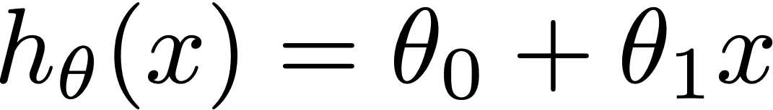

Slide 19
grootte (m²)
verkoopprijs (€)
127
101
120
135
183
180
96
70
160
…
279.500
195.000
167.500
290.000
534.500
315.000
189.000
115.000
449.000
…

Slide 20
grootte (m²)
aantal kamers
tuin
energielabel
verkoopprijs (€)
127
101
120
135
183
…
3
2
2
4
3
…
j
n
j
j
n
…
A
C
B
C
D
…
279.500
195.000
167.500
290.000
534.500
…
notatie-afspraken
$$m$$
aantal observaties
$$n$$
aantal eigenschappen (per observatie)
$$x^{(i)}$$
observatie nummer i
$$x_{j}^{(i)}$$
eigenschap j van observatie nummer i
$$y^{(i)}$$
actuele waarde van observatie i
$$θ_{j}$$
factor waarmee waarde van feature j moet worden vermenigvuldigd

Slide 21
$$h_{θ}(x)=θ_{0}+θ_{1}x$$
$$h_{θ}(x)=θ_{0}+θ_{1}x_{1}+θ_{2}x_{2}+θ_{3}x_{3}+θ_{4}x_{4}$$

Slide 22
$$X$$
$$θ$$
$$\left[\begin{aligned}θ_{0} \\ θ_{1} \\ θ_{2} \\ θ_{3} \\ θ_{4}\end{aligned}\right]$$
$$\left[\begin{matrix}127 & 3 & j & A \\ 101 & 2 & n & C \\ 120 & 2 & j & B \\ 135 & 4 & j & C \\ 183 & 3 & n & D\end{matrix}\right]$$

Slide 23
Intermezzo: vermenigvuldigen van matrices met vectoren
$$A=\left[\begin{matrix}1 & 3 & 2 \\ 4 & 0 & 1\end{matrix}\right]$$
$$B=\left[\begin{aligned}1 \\ 0 \\ 5\end{aligned}\right]$$

Slide 24
$$X$$
$$θ^{T}$$
$$\left[\begin{matrix}1 & 127 & 3 & j & A \\ 1 & 101 & 2 & n & C \\ 1 & 120 & 2 & j & B \\ 1 & 135 & 4 & j & C \\ 1 & 183 & 3 & n & D\end{matrix}\right]$$
$$\left[\begin{matrix}θ_{0} & θ_{1} & θ_{2} & θ_{3} & θ_{4}\end{matrix}\right]$$

Slide 25
$$J(θ)=\frac{1}{2m}\overset{m}{\underset{i=1}{∑}}(h_{θ}(x^{(i)})-y^{(i)})^{2}$$
$$h_{θ}(x^{(i)})=θ^{T}x^{(i)}$$

Slide 26
ml:ordinary least square

Slide 27
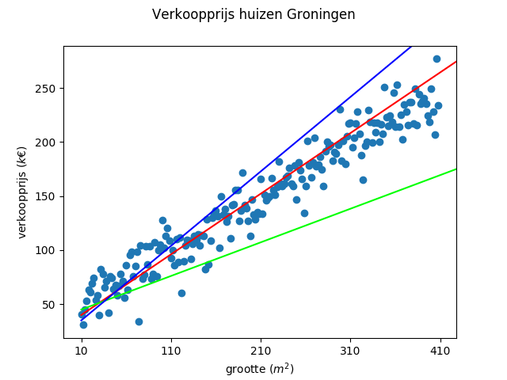
$$J(θ)=\frac{1}{2m}\overset{m}{\underset{i=1}{∑}}(h_{θ}(x^{(i)})-y^{(i)})^{2}$$

Slide 28
Ordinary Least Square (OLS)
$$θ=(X^{T}⋅X)^{-1}⋅X^{T}⋅y$$
theta = np.linalg.inv(X.T.dot(X)).dot(X.T).dot(y)
https://en.wikipedia.org/wiki/Ordinary_least_squares

Slide 29
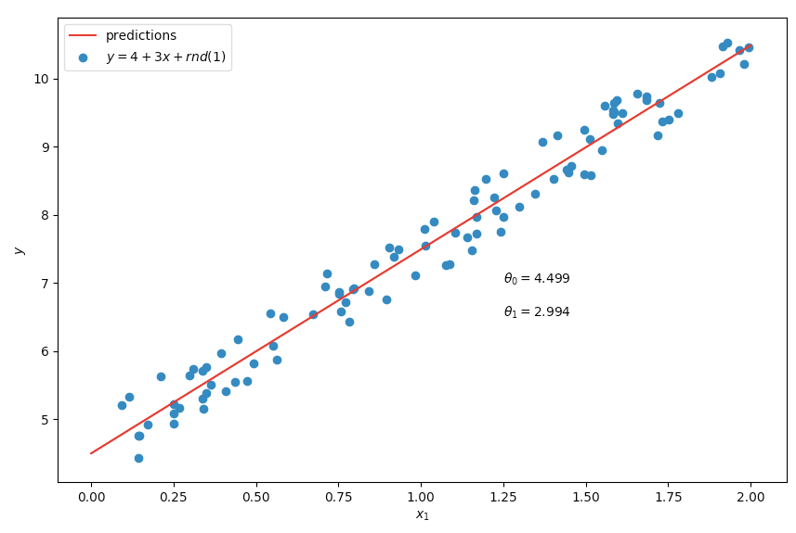
naar Géron 2017, pp 108ff.

Slide 30
ml:gradient descent

Slide 31
6
5
→
4
$$J(θ_{1})$$
3
2
1
1
2
3
4
5
6
7
8
9
10
11
$$θ_{1}$$
→

Slide 32
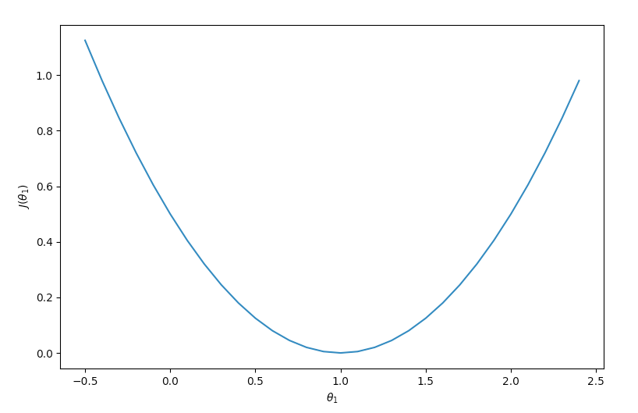

Slide 33
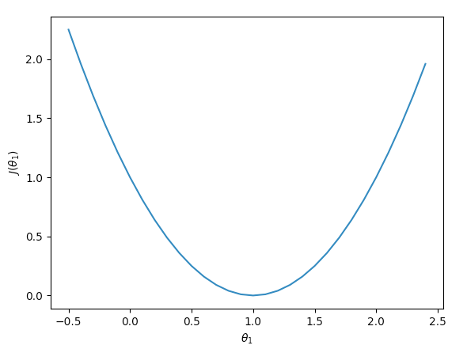
$$y=\frac{1}{2}(1-x)^{2}$$

Slide 34
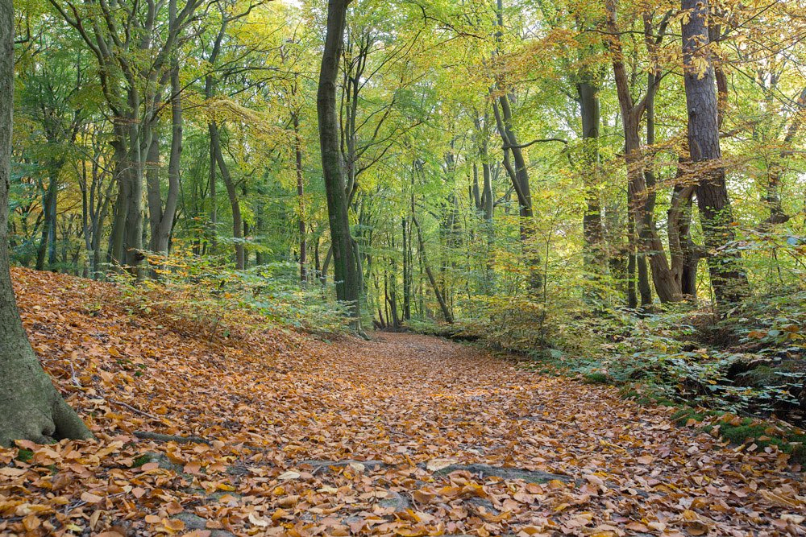
http://www.tuinposter.nl/herfst/

Slide 35
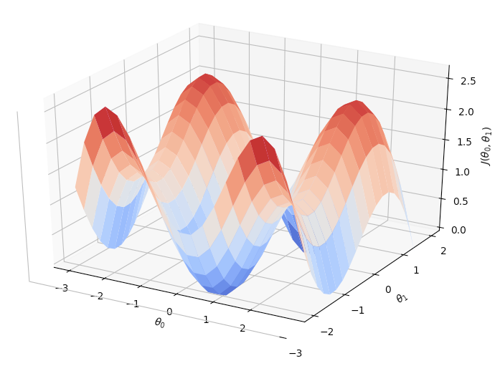

Slide 36
$$J(θ)=\frac{1}{2m}\overset{m}{\underset{i=1}{∑}}(h_{θ}(x^{(i)})-y^{(i)})^{2}$$
$$h_{θ}(x)=θ_{0}x_{0}+θ_{1}x_{1}+θ_{2}x_{2}+…+θ_{n}x_{n}$$

Slide 37
$$θ_{j}:=θ_{j}-α\frac{∂}{∂θ_{j}}J(θ)$$

Slide 38
$$θ_{j}:=θ_{j}-α\frac{∂}{∂θ_{j}}J(θ)$$
$$=θ_{j}-α\frac{1}{m}\overset{m}{\underset{i=1}{∑}}(h_{θ}(x^{(i)})-y^{(i)})x_{j}^{(i)}$$

Slide 39
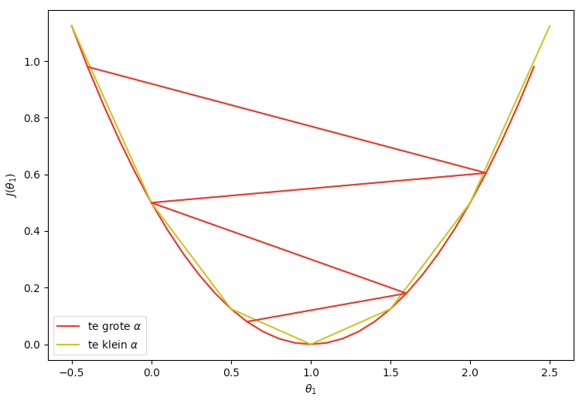

Slide 40
update alle
herhaal totdat een minimum bereikt is:
$$θ_{j},j=1,j=2,…,j=n$$
$$θ_{j}:=θ_{j}-α\frac{∂}{∂θ_{j}}J(θ)$$
$$:=θ_{j}-α\frac{1}{m}\overset{m}{\underset{i=1}{∑}}(h_{θ}(x^{(i)})-y^{(i)})x_{j}^{(i)}$$

Slide 41


Slide 42
grafiek G1
grafiek G2
7
6
5
y
4
3
2
1
1
2
3
4
5
6
7
8
9
10
11
X

Slide 43
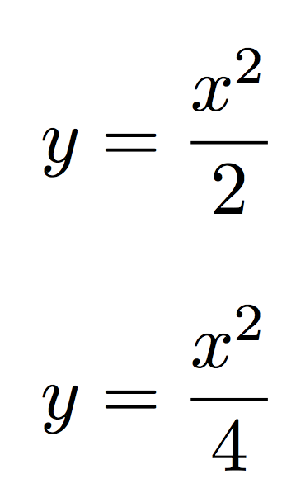
grafiek G1
grafiek G2

