Slide 1
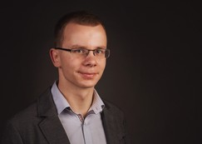


Stefan Mehner BTU Cottbus-Senftenberg
Research and Coding Interests
Virtualization in IoT
Software-defined Networking
Container (LXC, Docker)
Python, C++
Wish List of Hackathon Topics
Practical experience with RIOT and protocol implementation
Open for new ideas
Background
Early stage researcher
Working in SICIA (Security Indicators for Critical Infrastructure Analysis)
Co-Founder of Cheeezbude in 03/2017
GI-Dagstuhl Seminar 17303, July 23-28, 2017
IoT Hackathon: From Research to Practice
Notes:
<Foliennummer>

