Slide 1
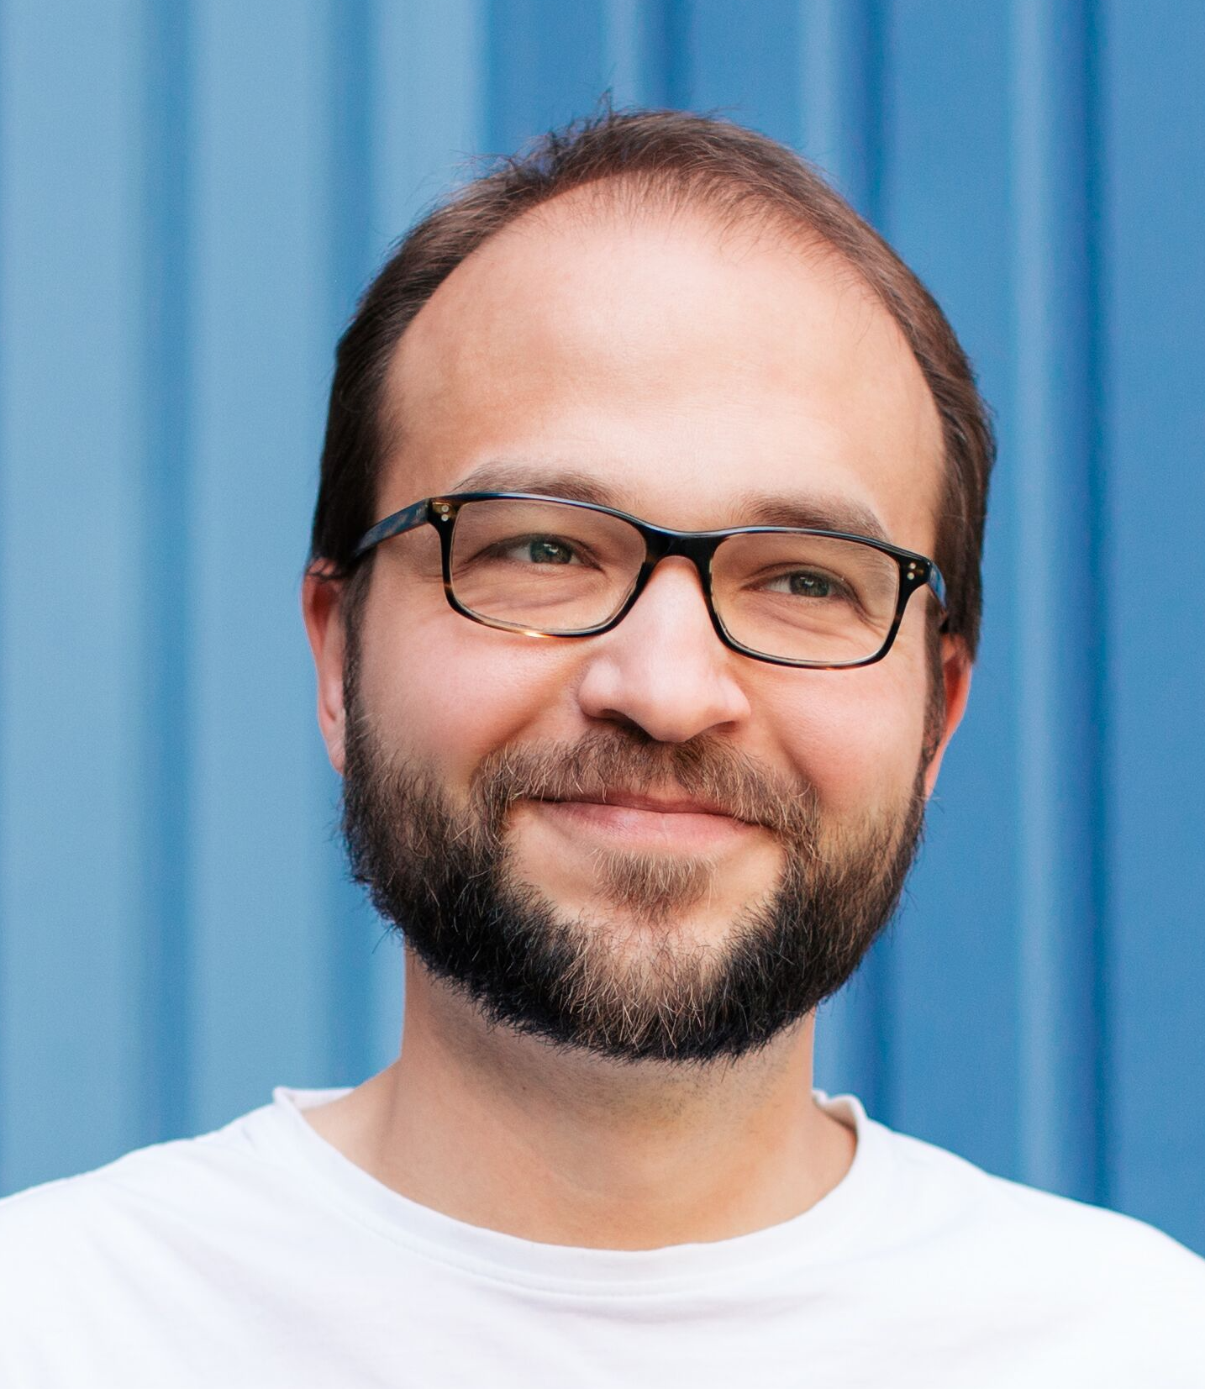
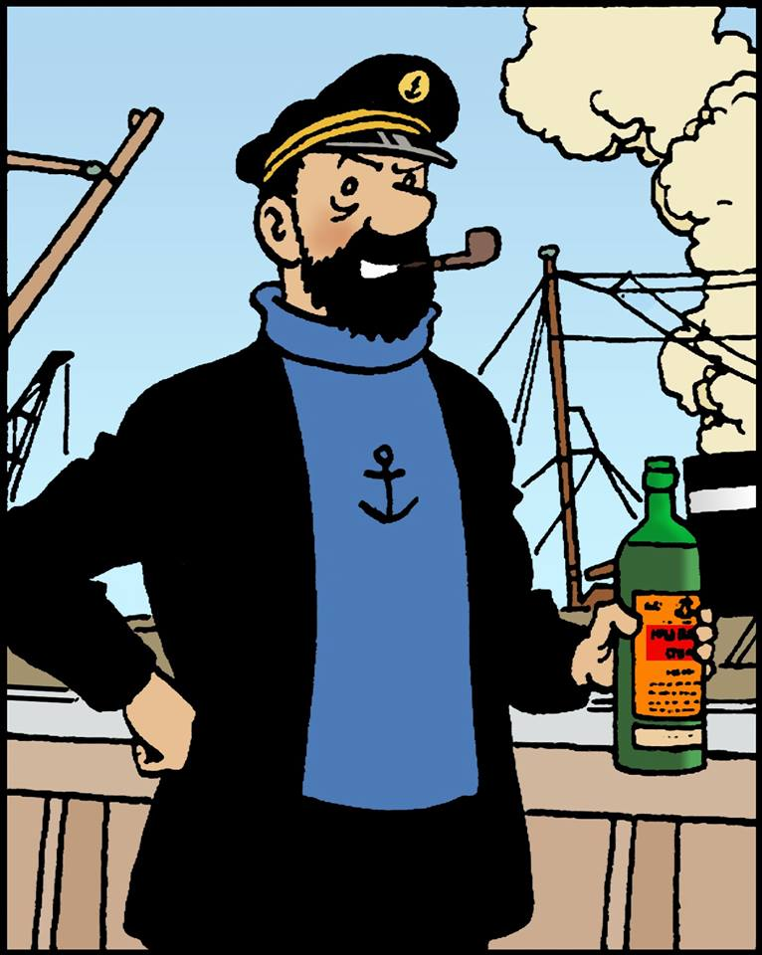




Michael Frey MSA Safety
<Photo>
Research and Coding Interests
{Configuration, Management, Security} in ICN
6TiSCH, Semantic Interference, Self-Organizing Systems, Routing
Network Simulators, Testbed(s)
C, C++, Python, Java, R
Wish List of Hackathon Topics
{Management, Security} in ICNs
6TiSCH <3 ICN
Discussions on
DDS vs ICN
approaches to “prioritized” traffic in ICN
GI-Dagstuhl Seminar 17303, July 23-28, 2017
IoT Hackathon: From Research to Practice

