Slide 1
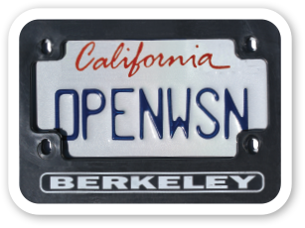

Topic: TiSCH for RIOT reloaded
MVP:
Final goal:
RIOT HAL
sock
sock
OpenWSN
(6TiSCH)
EUI64
GNRC
UDP
Timer (periph/rtt)
802.15.4
LED & Debug Pins
802.15.4-TSCH
netdev
netdev
GI-Dagstuhl Seminar 17303, July 23-28, 2017
IoT Hackathon: From Research to Practice

