Slide 1
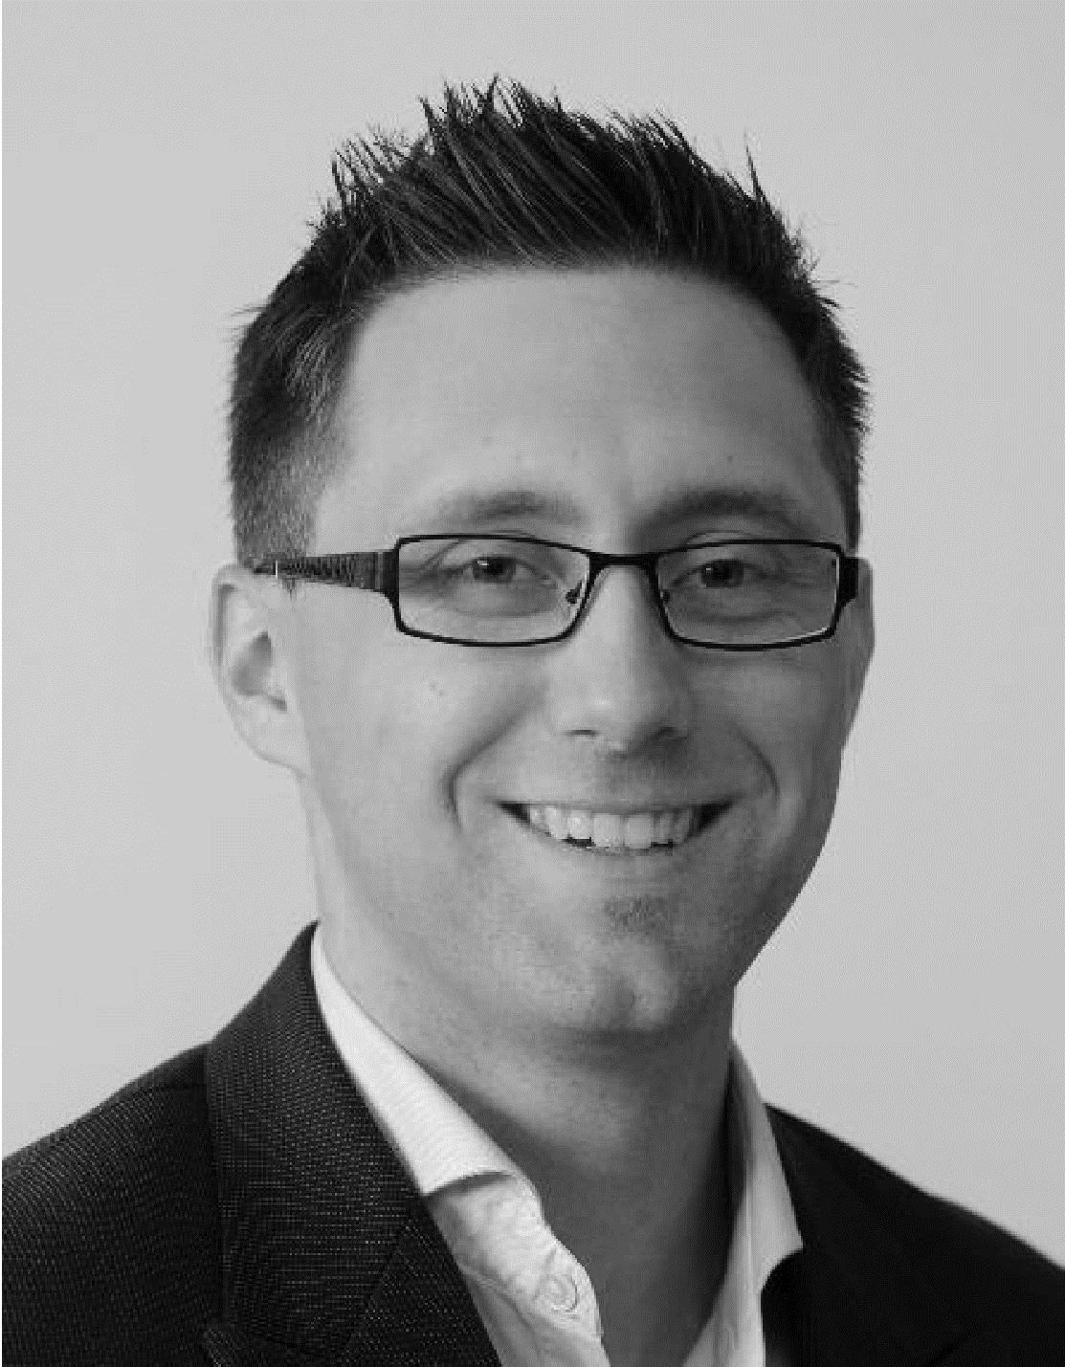

Dennis Grewe University Koblenz-Landau / Robert Bosch GmbH
Research and Coding Interests
Information-centric networking for networked vehicle environments
Services/functions for proactive information sharing in vehicle environments (edge computing / unikernels)
C/C++, Java, JavaScript
Wish List of Hackathon Topics
… all ICN topics
ICN/IoT infrastructure deployment, especially ICN for vehicular networks (Car2I, Car2Car)
802.11p patch on Jetways
IDE extensions, tooling, …
Background
“Truth can only be found in one place: the code.” – Robert C. Martin
ICN-based market place, ICN + MEC for vehicle networks
GI-Dagstuhl Seminar 17303, July 23-28, 2017
IoT Hackathon: From Research to Practice

