Slide 1
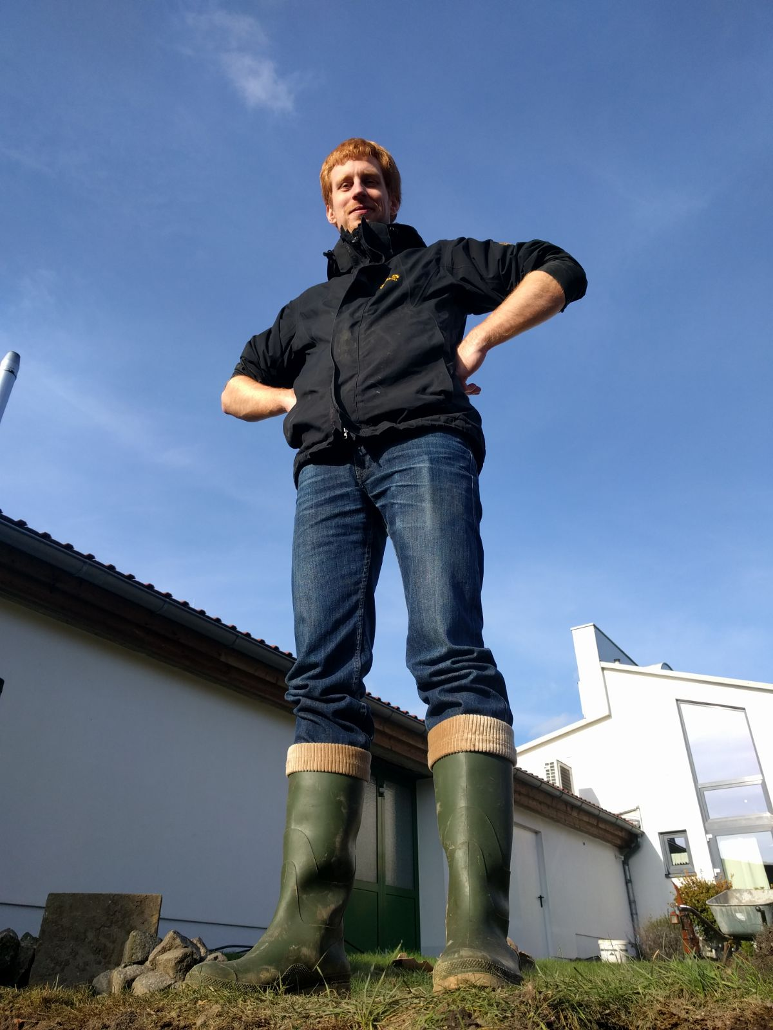

Robert Hartung TU Braunschweig
Research and Coding Interests
Adaptive WSNs
Energy (consumption & production)
Temperature & others influences
Reliability and efficiency
COOJA & Temp. Chamber
Wish List of Hackathon Topics
Simulation of RIOT (Cooja?)
RIOT: Atmega & Low-power
Simulations
RPL protocol + OF
CI + Tests
Background
Potatos (PotatoNet, PotatoMesh, PotatoScope, …)
Low-Level Hardware & Testing
GI-Dagstuhl Seminar 17303, July 23-28, 2017
IoT Hackathon: From Research to Practice
Notes:
1

