Slide 1
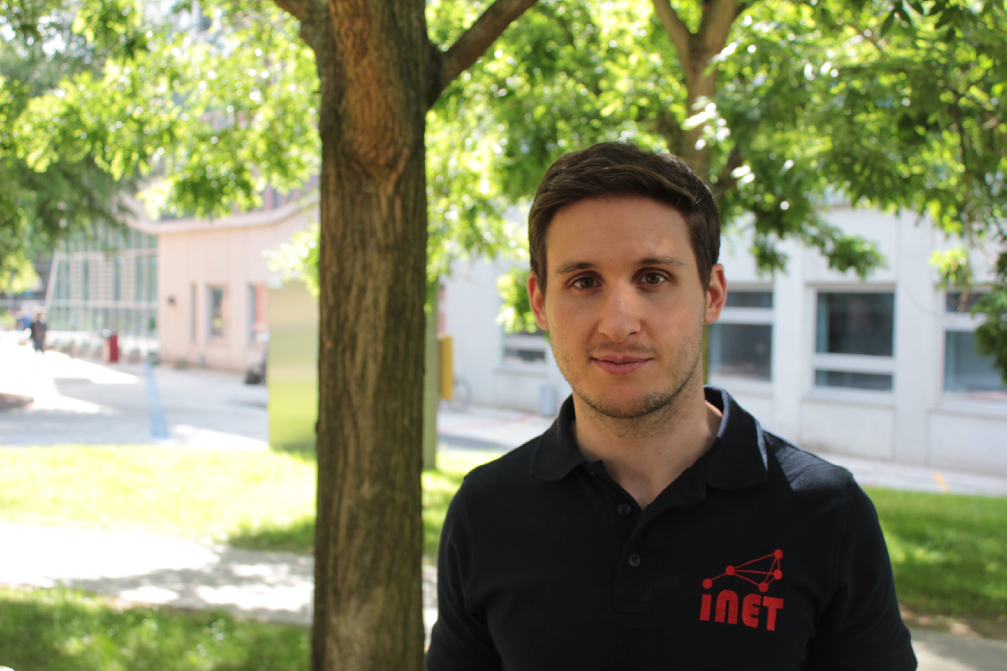

Cenk [dʒɛnk] Gündoğan Hamburg University of Applied Sciences
Research and Coding Interests
RIOT
IoT Protocols
Information-Centric Networking
ICN in IoT
Wish List of Hackathon Topics
CCN IoT adaptation layer
Header compression
Fragmentation
Bootstrapping
Prototype in RIOT + CCN-Lite
Background
MSc. Computer Science (FUB ‘16), researcher at HAW since then
Curious about minimalistic system setups and … literature.
“The true delight is in the finding out rather than in the knowing.” — Isaac Asimov
GI-Dagstuhl Seminar 17303, July 23-28, 2017
IoT Hackathon: From Research to Practice
Notes:
<number>

