Slide 1
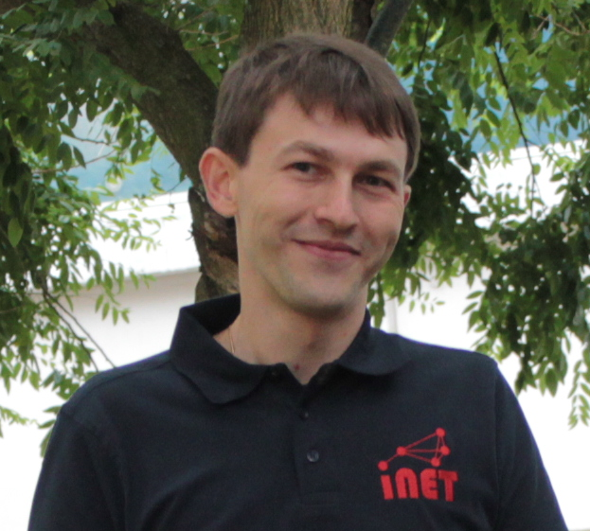

Dimitri Nahm Hamburg University of Applied Sciences
Research and Coding Interests
Wireless Firmware Update
Bootloader
Update architecture
Manifest format
Wish List of Hackathon Topics
Bluetooth Stack for RIOT
Radio driver
Implementation
Background
I am an “Information and Electrical” engineer who tries his luck in informatics
GI-Dagstuhl Seminar 17303, July 23-28, 2017
IoT Hackathon: From Research to Practice

