Slide 1
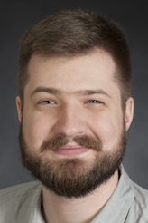

Balazs Faludi Universität Basel
Research and Coding Interests
Content Centric Networking (CCN-lite)
Named Function Networking
State management of computations in NFN
Timeout prevention of long running in-network computations
Wish List of Hackathon Topics
Continue work on optimizing CCN/NDN packet format for RIoT
Event/callback system in CCN-lite for easier integration
Other RIoT related improvements to CCN-lite?
Background
Master’s thesis: In-Network State Management of Long Running Computations (NFN)
Currently a research assistant working on CCN-lite and NFN
GI-Dagstuhl Seminar 17303, July 23-28, 2017
IoT Hackathon: From Research to Practice

