Slide 1
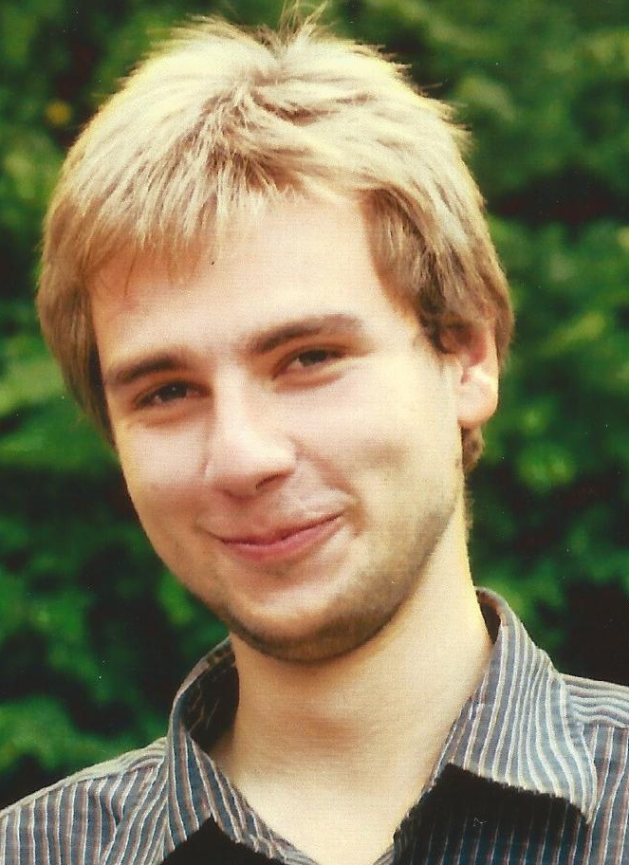

Michał Król
University College London
Research and Coding Interests
IoT
Routing (mobility and group communication)
Security (DNS + TOR)
ICN
FANETs
Wish List of Hackathon Topics
Unikernels
Security
Data Access control
Blockchain + smart contracts
Background
Really not sure what to put here
Hopefully, I’ll spend one minute on previous sections
GI-Dagstuhl Seminar 17303, July 23-28, 2017
IoT Hackathon: From Research to Practice
Notes:
<number>

