Slide 1
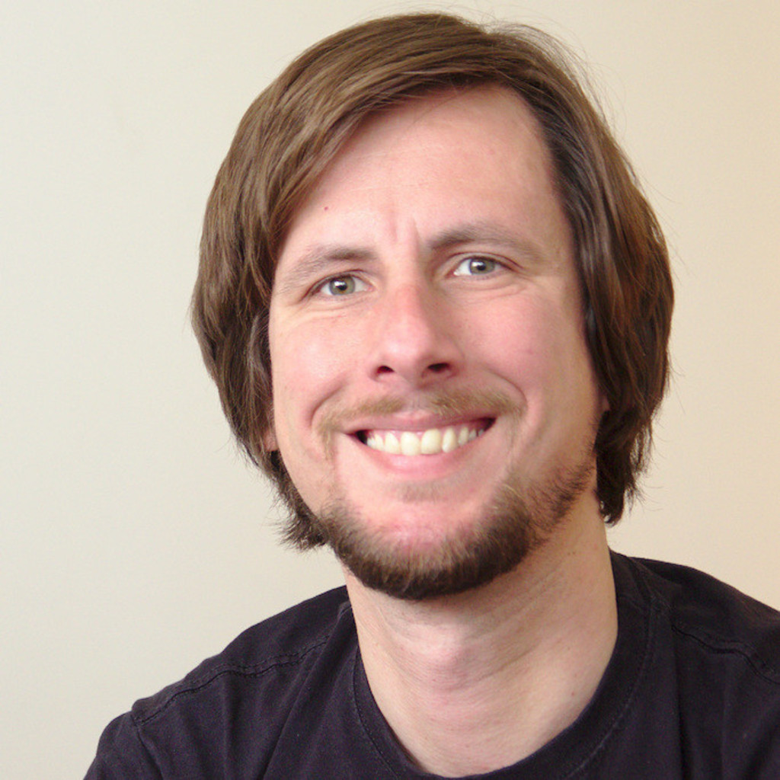

Oliver “Oleg” Hahm Zühlke Engineering/RIOT
<Photo>
Research and Coding Interests
Network protocols, implementations, and interoperability in constrained nodes networks
IoT software platforms
Information-centric networking
Wish List of Hackathon Topics
Naming schemes in IoT-ICN
C++-readiness:
How C++-ready is RIOT?
How IoT-ready is C++?
ICN meets TiSCH
Background
From Practice to Research – and back again
Enabling Energy Efficient Smart Object Networking at Internet Scale Oliver Hahm, PhD Thesis, Université Saclay-Paris
GI-Dagstuhl Seminar 17303, July 23-28, 2017
IoT Hackathon: From Research to Practice

