Slide 1



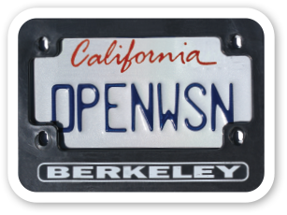

Topic: TiSCH for RIOT reloaded
MVP:
RIOT HAL
Root node sends enhanced Beacons (synchronization)
Branching can be hard
sometimes
Initialization can be painful
RIOT scheduler
OpenOS scheduler (tasks)
802.15.4 scheduling via interrupts
-> short term: remove OpenOS scheduler
-> long term: RIOT scheduler
sock
OpenWSN
(6TiSCH)
EUI64
UDP
UART
Timer (periph/rtt)
802.15.4
LED & Debug Pins
netdev
GI-Dagstuhl Seminar 17303, July 23-28, 2017
IoT Hackathon: From Research to Practice

