Slide 1

Kickstart your applications with Spring Boot

Slide 2
Ingredients of a Spring web application
WAR
Maven project
DispatcherServlet
Web.xml
Servlet Container
Handlers / interceptors
AppServer

Slide 3
Goal of SpringBoot
Get up-and-running as quickly as possible
Automatically configure Spring where possible (but get out of the way when config diverges from defaults)
Provide common non-functional features (embedded servers, metrics, externalized config)
Absolutely NO code generation / Spring Roo-like functionality!

Slide 4

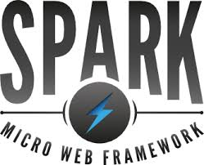


Slide 5


Slide 6
Converting a Vanilla Spring app to SpringBoot
Convert to executable WAR with SpringbootServletInitializer
Move web content to /public or /static
web.xml:
Replace servlets with ServletRegistrationBean @Bean
Replace filters with FilterRegistrationBean @Bean
…but there’s no “magic recipe” for all existing Spring apps

