Slide 1


Backend workshop
Q U A R K U S

Slide 2
Why Quarkus?
Compile-time dependency injection
Cloud-native
Built from the ground up with microservices in mind
Streamlined for 80% of use cases, flexible for the remaining 20%
Ability to compile to native images using GraalVM
Based on MicroProfile standards (metrics, config, resilience, etc)

Slide 3

Getting started
https://code.quarkus.io/

Slide 4
Starting the app
mvn compile quarkus:dev
Enables live coding

Slide 5
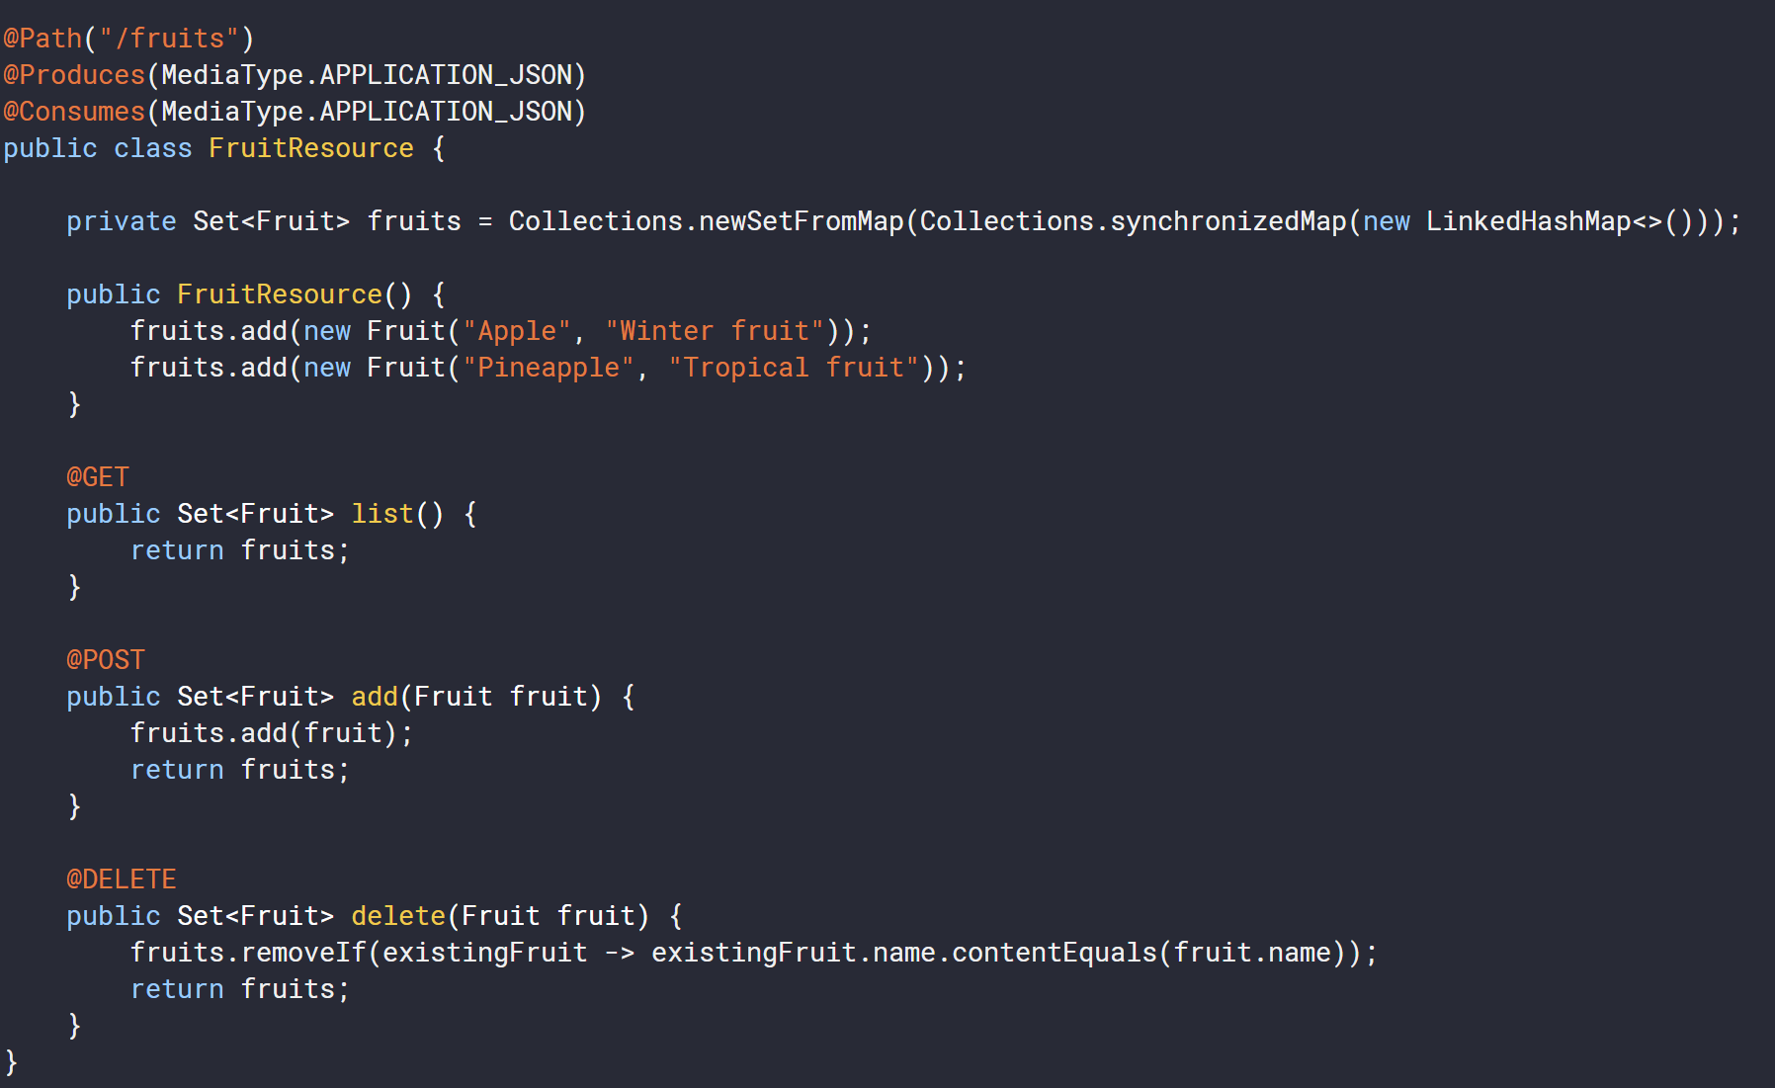
Controller

Slide 6
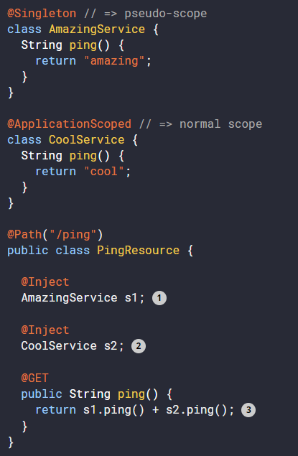
CDI
@Singleton is injected on startup
@ApplicationScoped is injected lazily, by proxy
@Dependent
@ApplicationScoped
@Singleton
@RequestScoped
@SessionScoped

Slide 7
Configuration
Everything is in application.properties
quarkus.http.port=9090
#override for “dev” profile
%dev.quarkus.http.port=8181
by default Quarkus has three profiles, although it is possible to use as many as you like.
The default profiles are:
dev - Activated when in development mode (i.e. quarkus:dev)
test - Activated when running tests
prod - The default profile when not running in development or test mode

Slide 8
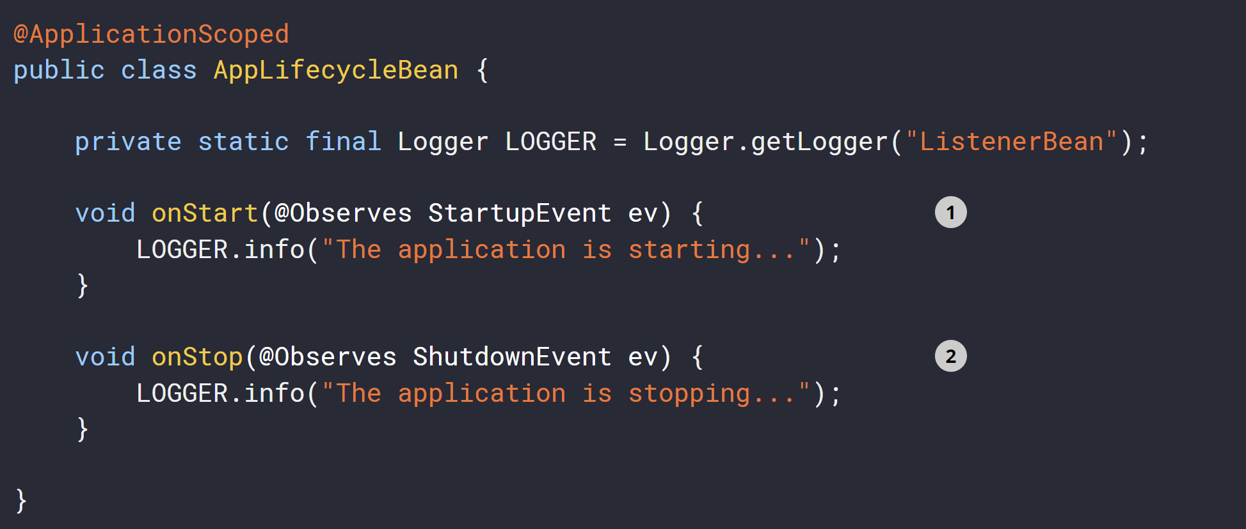
Application start and stop events

Slide 9
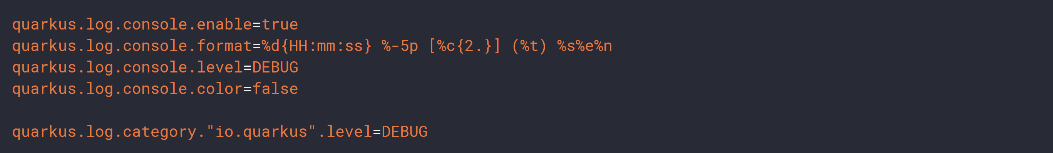
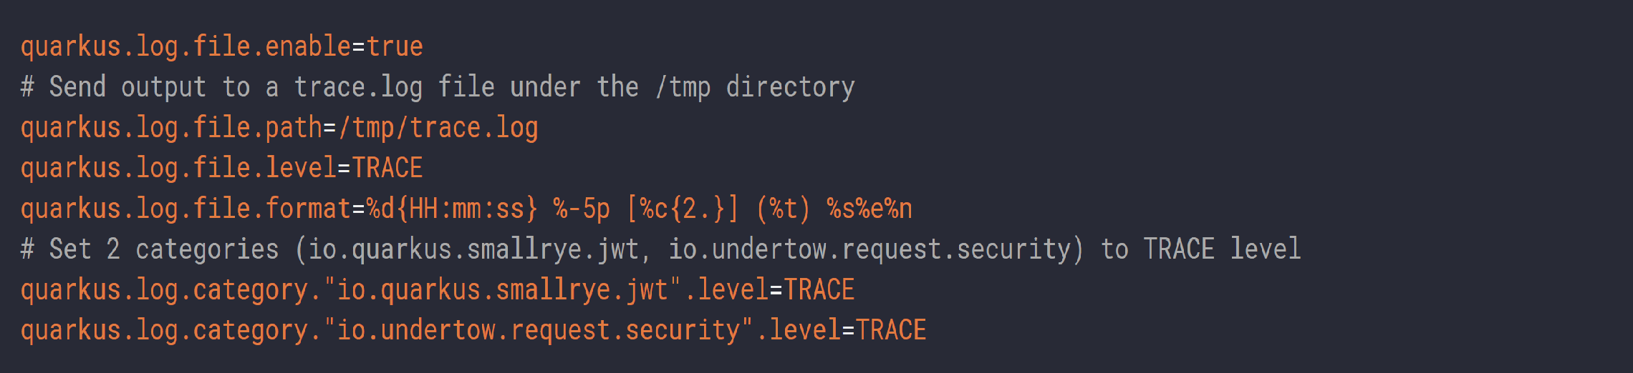
Configuring Logging
console
File-based

Slide 10
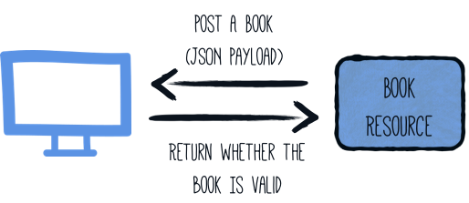
Validation

Slide 11
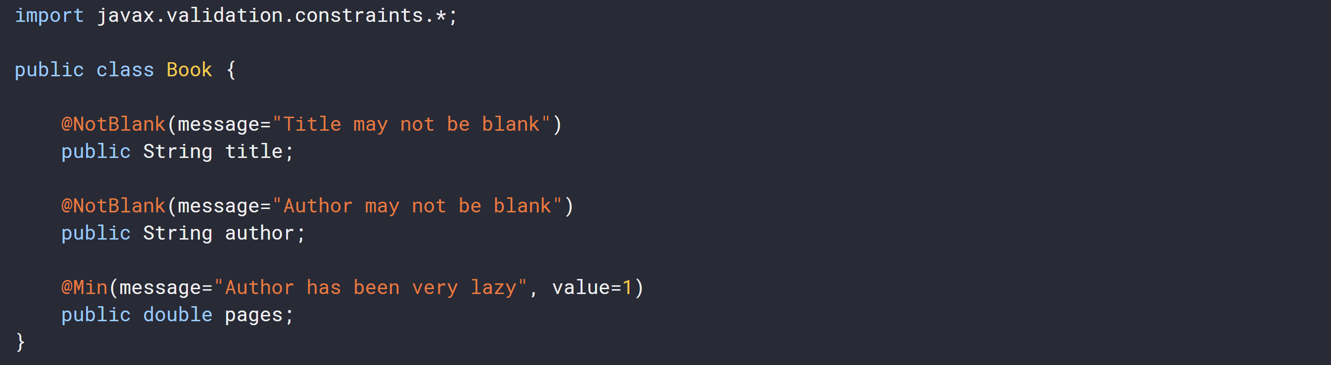
Validation
Model validation

Slide 12
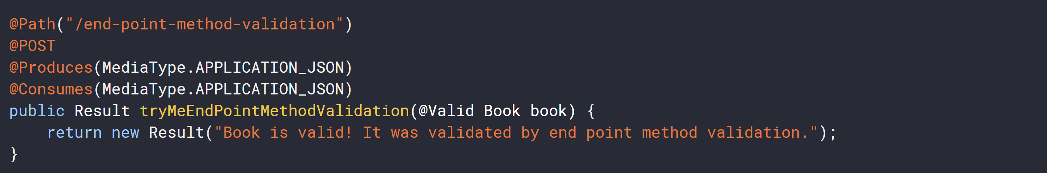
Validation
Validation on REST endpoint

Slide 13
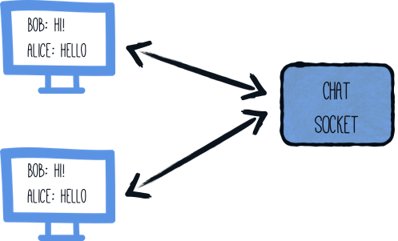
Websockets

Slide 14
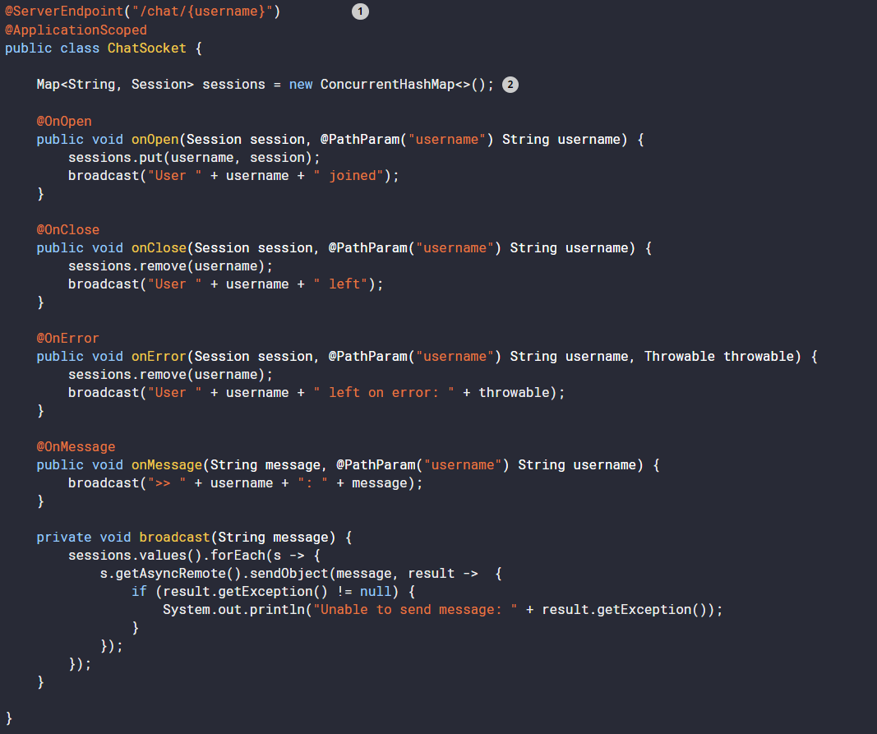
Websockets

Slide 15
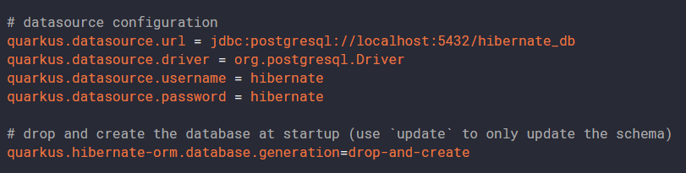
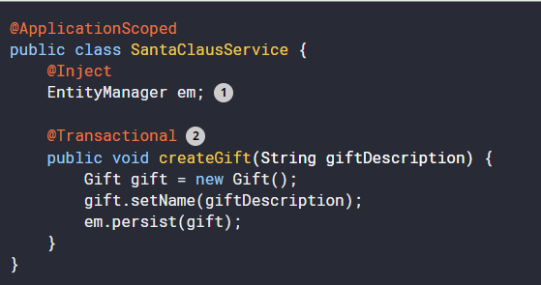
Persistency – ORM with JPA

Slide 16
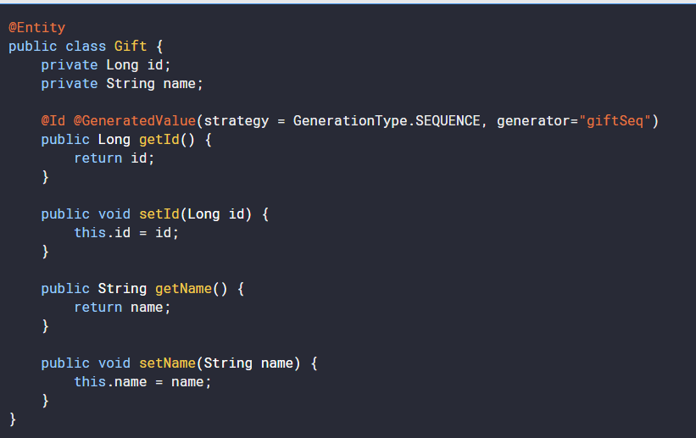
Persistency – ORM with JPA

Slide 17
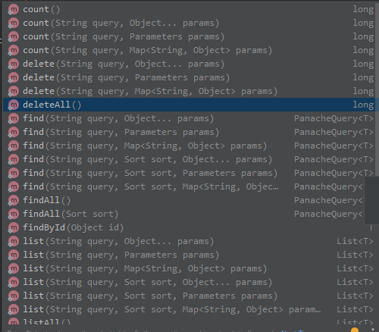
Improved persistency with Panache
@Entity public class Conference extends PanacheEntity { private String name; public String getName() { return name; } public void setName(final String name) { this.name = name; }
@Singleton public class ConferenceRepository implements PanacheRepository<Conference> { public Conference findByName(String name) { return find(“name”, name).firstResult(); } }

Slide 18
Eclipse MicroProfile
https://microprofile.io/

Slide 19
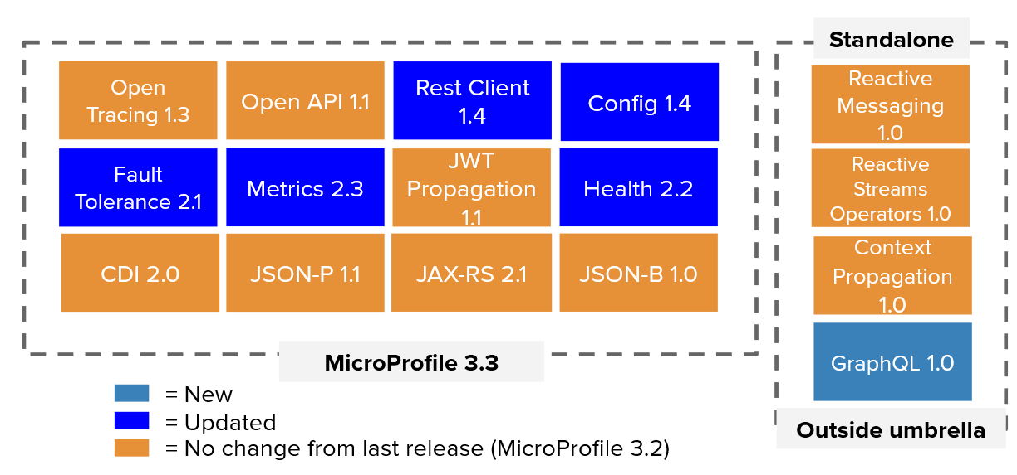
Eclipse MicroProfile Specification 3.3

Slide 20
Config
@ConfigProperty(name = "greeting.message")
String message;
application.properties
# Your configuration properties
greeting.message = hello
@ConfigProperties(prefix = "greeting")
public interface GreetingConfiguration {
@ConfigProperty(name = "message“, defaultValue=“john”)
String message();

Slide 21
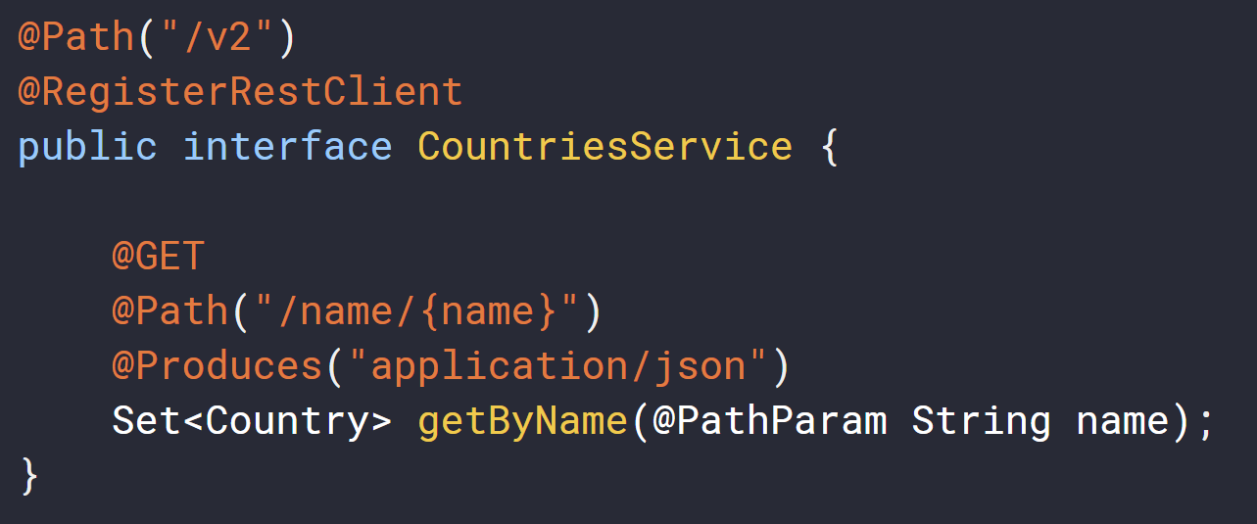
REST Client
# Your configuration properties
org.acme.restclient.CountriesService/mp-rest/url=https://restcountries.eu/rest
org.acme.restclient.CountriesService/mp-rest/scope=javax.inject.Singleton

Slide 22
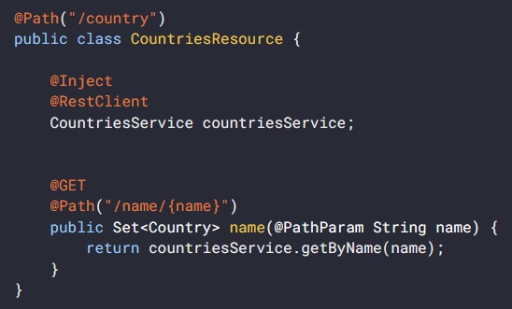
REST Client

Slide 23
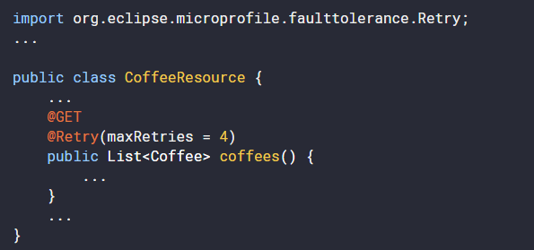
Fault Tolerance
Retry

Slide 24
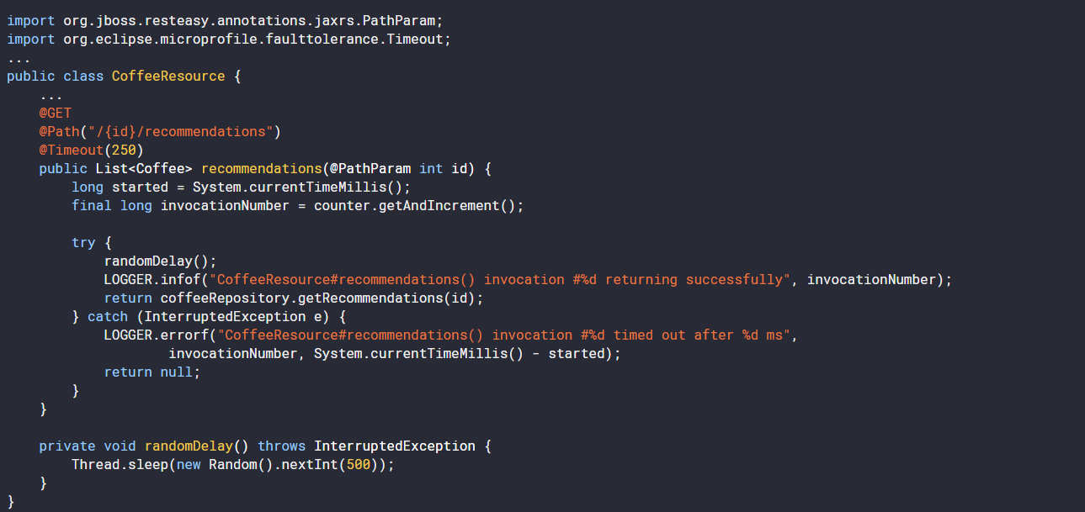
Fault Tolerance
Timeout

Slide 25
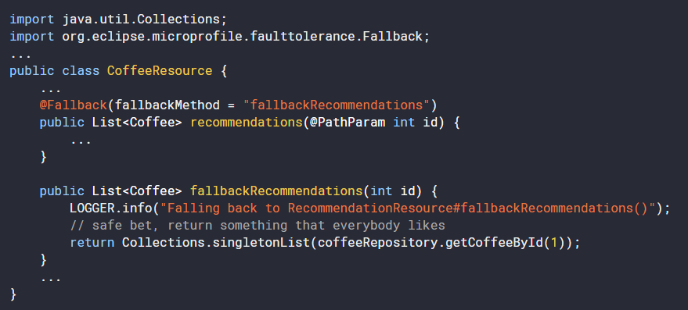
Fault Tolerance
Fallback

Slide 26
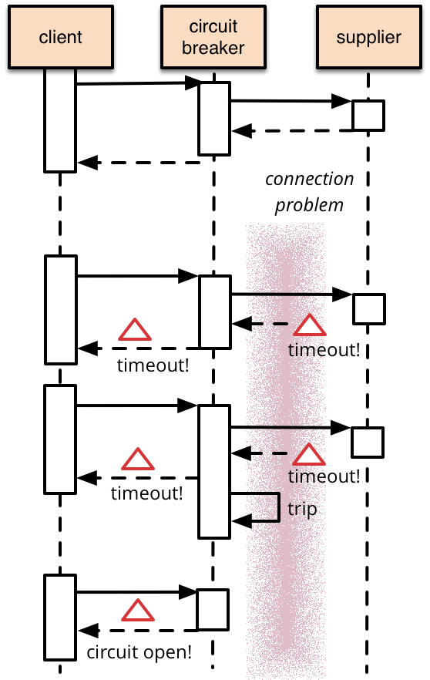
Fault Tolerance
Circuit breaker

Slide 27
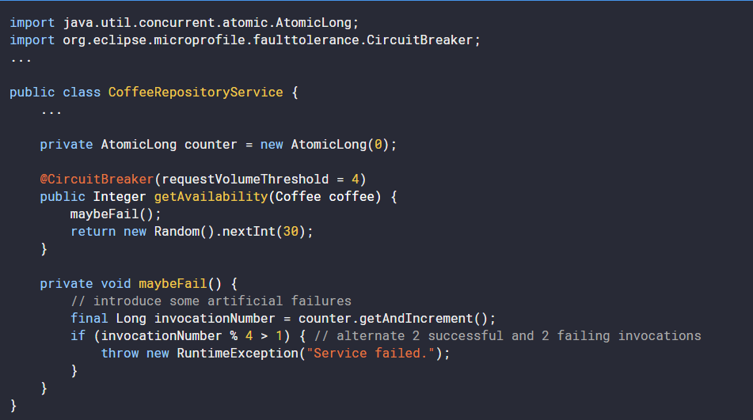
Fault Tolerance
Circuit breaker

Slide 28
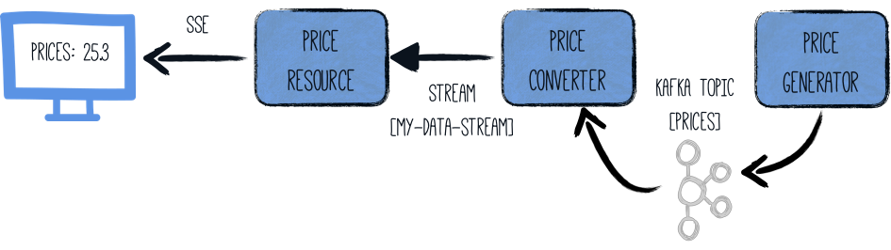
Reactive Messaging

Slide 29
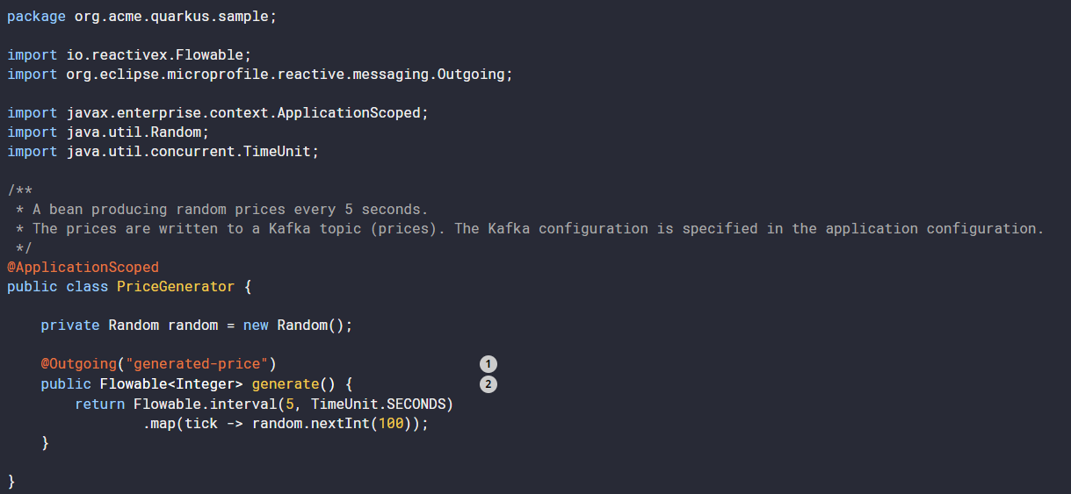
Reactive Messaging - Outgoing

Slide 30
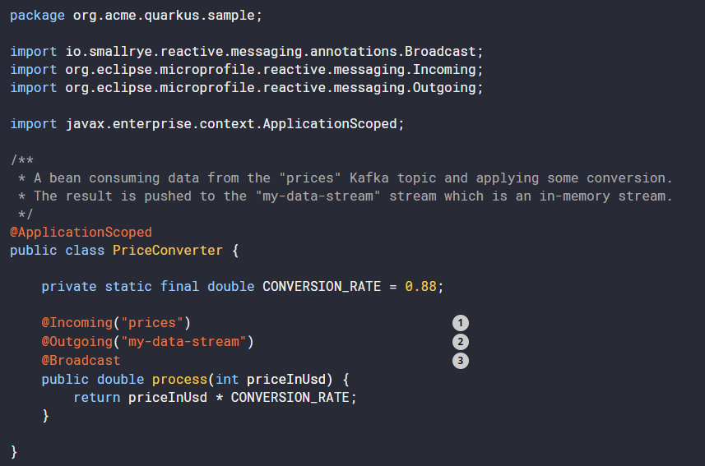
Reactive Messaging – Incoming

Slide 31
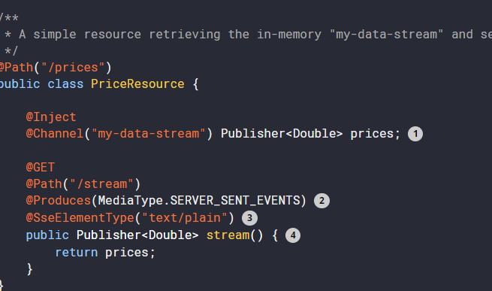
Reactive Messaging – Publisher

Slide 32
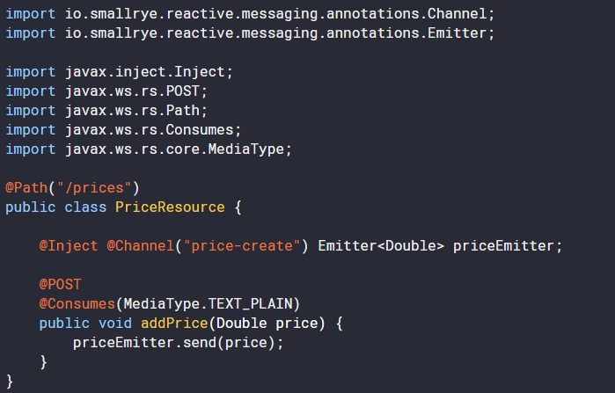
Reactive Messaging – Emitter

Slide 33
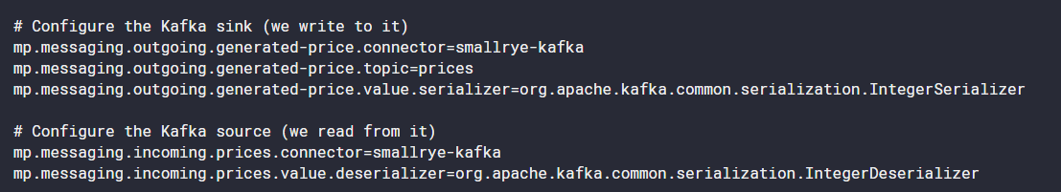
Reactive Messaging - Apache Kafka config

Slide 34
Health
Standard when importing smallrye-health dependency
/health/live - The application is up and running.
/health/ready - The application is ready to serve requests.
/health - Accumulating all health check procedures in the application.

Slide 35
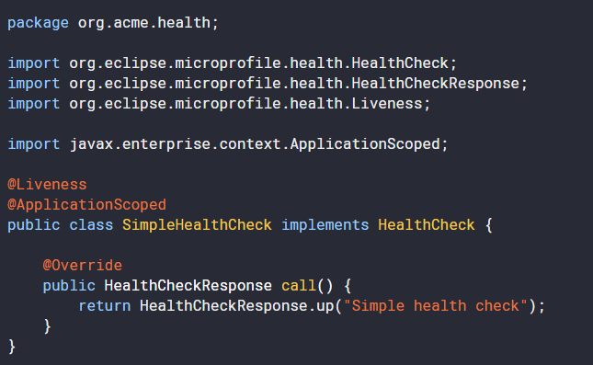
Health
Create your own health endpoint (shows up on health/live but not on health/ready)

Slide 36
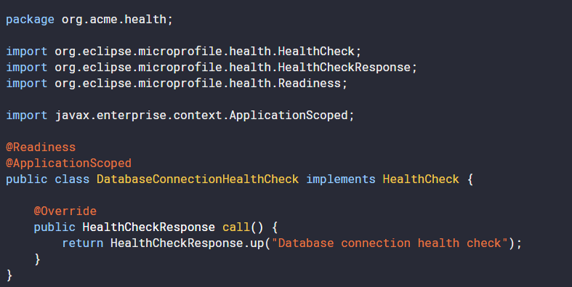
Health
Readiness Endpoint

Slide 37
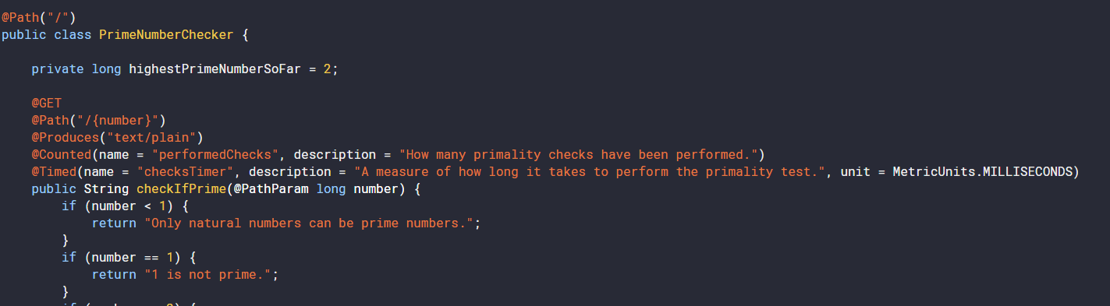
Metrics
Exposed on /metrics/application

Slide 38
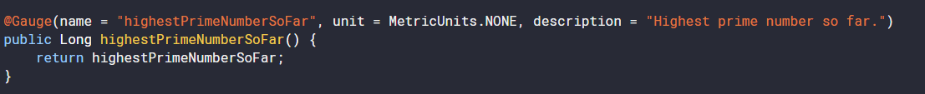
Metrics
Exposed on /metrics/application
Gauge – custom metric

Slide 39
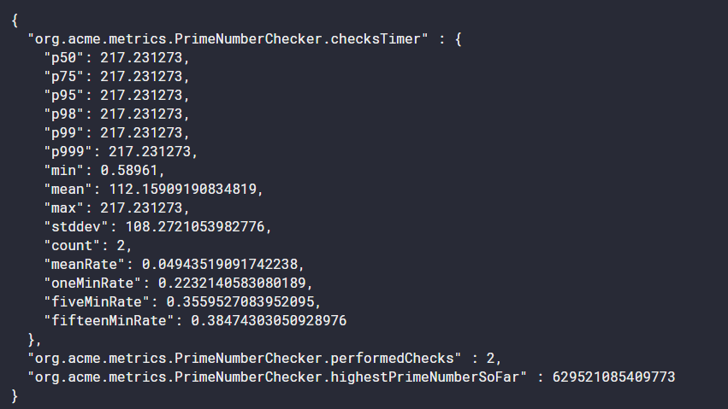
Metrics
http://localhost:8080/metrics/application

Slide 40
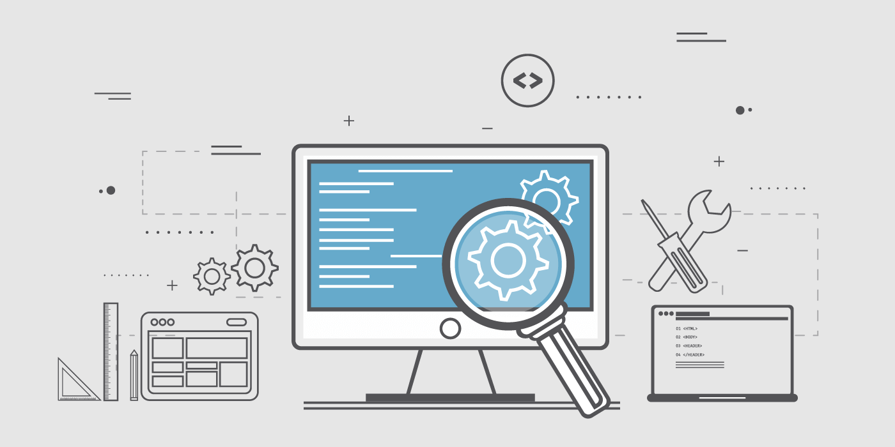
Testing

Slide 41
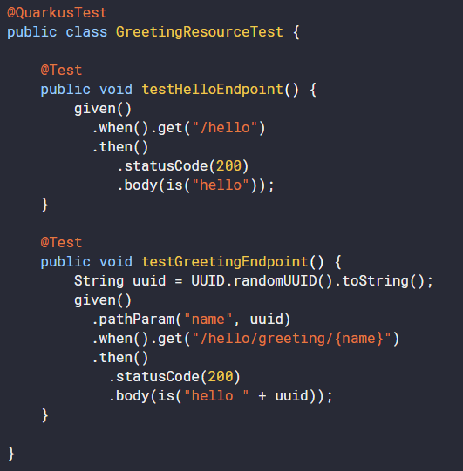
Testing
Spins up complete Quarkus application
Way faster than Spring Boot IT tests
application.properties
quarkus.http.test-port=xxxx / 0

Slide 42
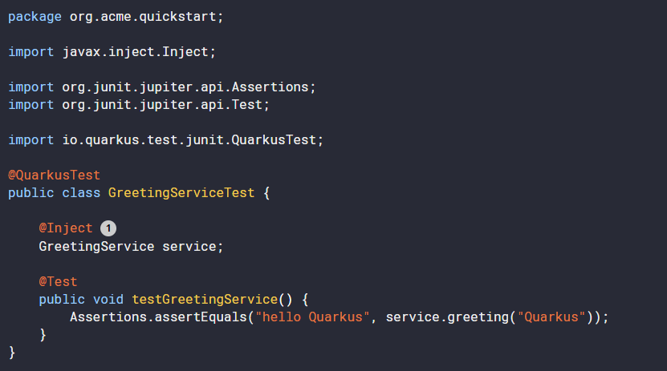
Testing
Injecting beans into your tests

Slide 43
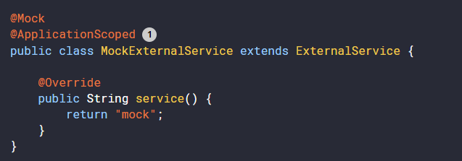
Testing
Mocking beans

Slide 44
Testing
Using helper resources
@QuarkusTestResource(TestResource.class) @QuarkusTest public class MyIntegrationTest {
public class TestResource implements QuarkusTestResourceLifecycleManager { @Override public Map<String, String> start() { } @Override public void stop() {
… } }
Start() returns a map of system properties that should be set

Slide 45

Building native images

Slide 46
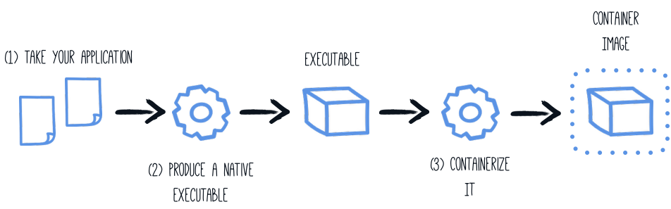
Building native images
2
./mvnw package -Pnative -Dquarkus.native.container-build=true
3
docker build -f src/main/docker/Dockerfile.native -t quarkus/myapp .
Run with:
docker run -i --rm -p 8080:8080 quarkus/myapp

Slide 47
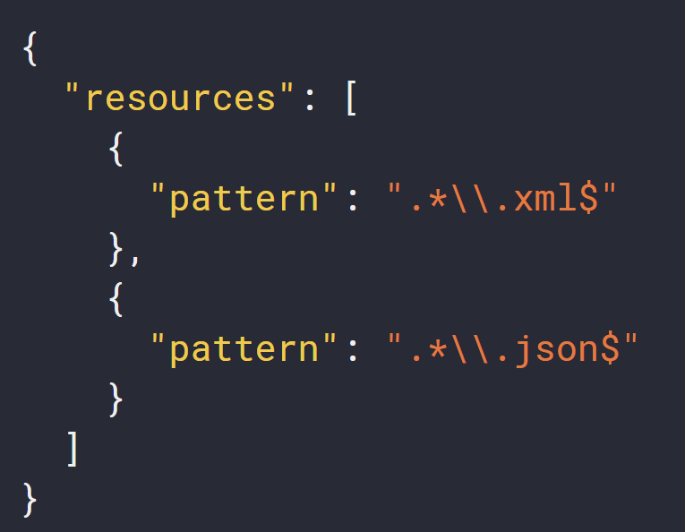
Building native images – including resources
src/main/resources/resource-config.json
application.properties
quarkus.native.additional-build-args =-H:ResourceConfigurationFiles=resources-config.json

Slide 48
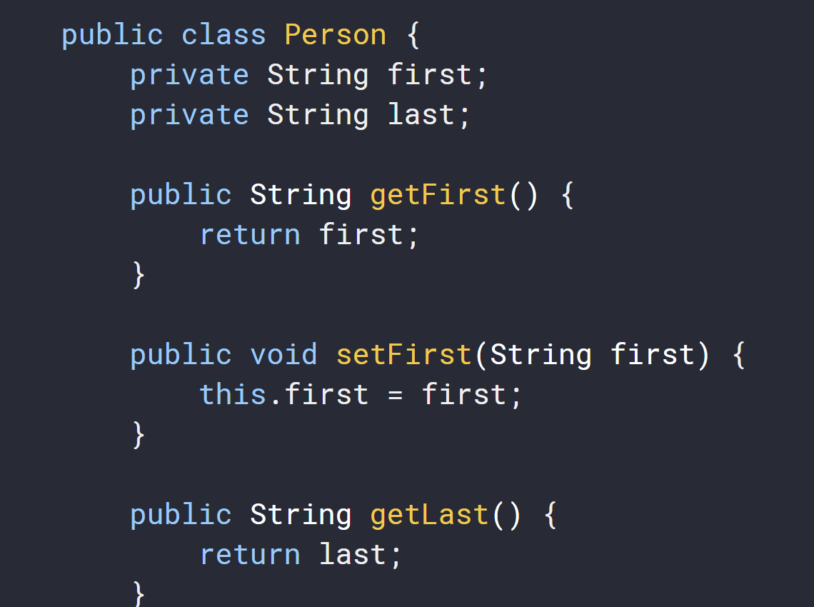
Building native images – register for reflection
GraalVM works on “closed-world” assumption

Slide 49
Building native images – register for reflection
Exception handling request to /person: org.jboss.resteasy.spi.UnhandledException: javax.json.bind.JsonbException: Can't create instance of a class: class org.acme.jsonb.Person, No default constructor found
Solution:
@RegisterForReflection
public class Person {
}

Slide 50

Assignment

