Slide 1


Slide 2

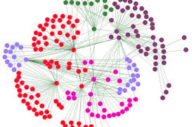
Microservices are great…
Until you realize all the other
it takes to run them

Slide 3

Microservice “tax”
Configuration management
Service discovery & registration
Fault handling
Authentication & authorization
….

Slide 4

What is Spring Cloud?
Toolset to quickly build common patterns in distributed systems
Eg. Microservices
Configuration management
Service discovery & registration
Circuit breakers
Intelligent routing
Micro proxy
Control bus
….

Slide 5

Today we are going to look closer
to the following patterns and how
they are implemented in Spring Cloud
Configuration management
Service discovery & registration
Circuit breakers
Intelligent routing
Micro proxy

Slide 6

Configuration management
Microservices should have a central place for fetching their
configuration
Spring Cloud Config Server
Separate “micro” service
YAML or properties file
Works repository-based
Super simple client

Slide 7
Spring cloud config server
Spring Boot
App
GET config
Config Server
(spring boot app)
Git
Repo
reads
Spring Boot
App
GET config

Slide 8
How to set up a ConfigServer
Create new Spring Boot Application
Add spring-cloud-config-server to the pom
@EnableConfigServer
Set cloud.config.server.git.uri to git repo, fe: file://c:/my-config-repo
Files in repo correspond to service, fe:
echo-service.properties
responds to spring boot app with
spring.application.name=
echo-service

Slide 9
Using the config server as a client
Add spring-cloud-starter-config to pom
Set spring.application.name to match property file
Of course, there’s a bootstrap issue here. Config url must be known
first. Default is localhost:8888, otherwise specify in
bootstrap.properties (read in before application.properties)

Slide 10
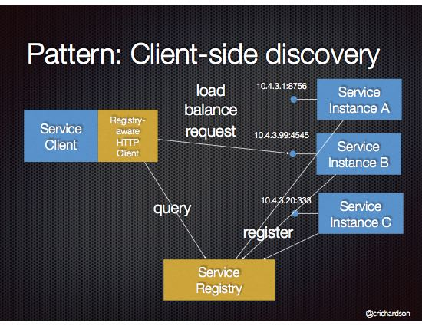
Service discovery & registration

Slide 11

Setting up a service registry
Spring cloud supports Service Registry Eureka Server (Netflix implementation of a service registry) out-of-the-box
Create new SpringBoot application
Add spring-cloud-starter-eureka-server to the pom
@EnableEurekaServer
Specify server.port in application.properties
….and you’re done…. Default monitoring is on localhost:{port}

Slide 12
Registering a client on Eureka
Add spring-cloud-starter-eureka to your pom
Add spring.application.name to your properties
Add @EnableEurekaClient to your service
This will register the service to the eureka server
Now other services will be able to find your service
eureka.client.healthcheck.enabled=true will set up keepalive mechanism so Eureka can monitor instances

Slide 13
There’s a better way…
Add @EnableDiscoveryClient to your service
DiscoveryClient is a Spring abstraction on top of Eureka
@Autowired private DiscoveryClient discoveryClient; @RequestMapping("/service-instances2/{applicationName}") public List<ServiceInstance> serviceInstancesByApplicationName2(@PathVariable String applicationName) { List<ServiceInstance> serviceInstances = this.discoveryClient.getInstances(applicationName); System.out.println(serviceInstances.get(0).getUri()); return serviceInstances; }
Uri yields http://192.168.0.195:8080/, for example
It is up to this client to choose which service instance to use, however.

Slide 14
Of course, you still have to choose an instance yourself…
Can’t we let the service registry decide
which instance to return?

Slide 15
Using Ribbon as a client-side loadbalancer

Slide 16
Using Ribbon as a client-side loadbalancer
@RestController public class DistributedController { @Autowired @LoadBalanced private RestTemplate restTemplate; @RequestMapping("/distributed") public String getGreeting() { return restTemplate.getForObject("http://other-service/hello", String.class); } }
You need to configure a restTemplate @Bean with @LoadBalanced annotation as well

Slide 17
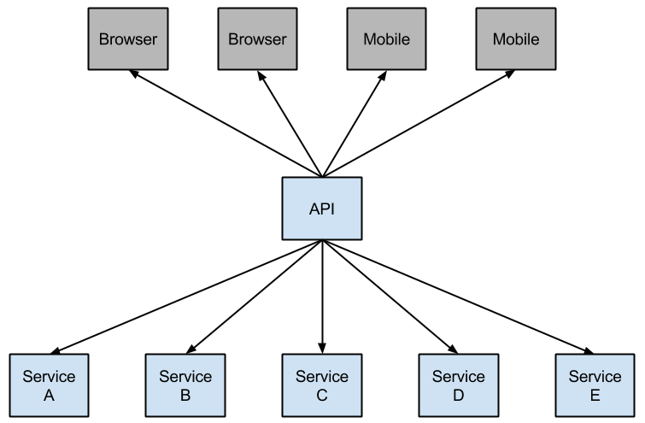
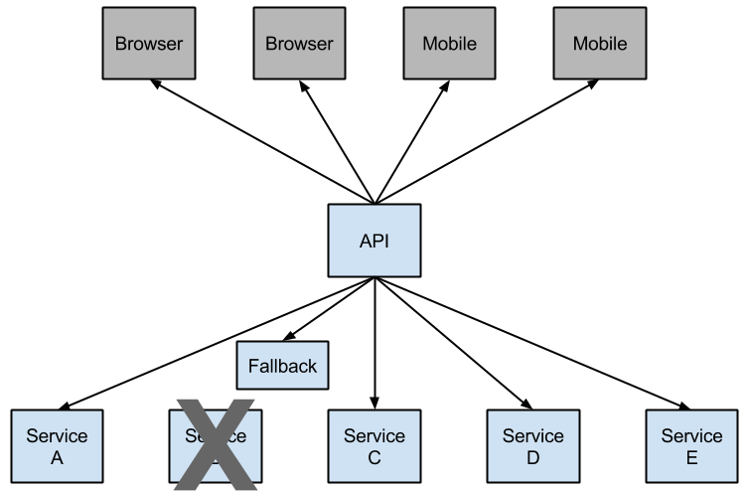
Circuit breakers
Pattern that protects your architecture from failures futher down the line

Slide 18
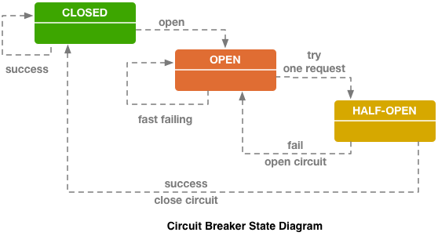
Circuit breaker

Slide 19
Using Circuit breakers
Use the Netflix Histrix library
Add @EnableCircuitBreaker to your springboot service
Use @HistrixCommand to open and close the circuit breaker
@Component public class StoreIntegration {
@HystrixCommand(fallbackMethod = "defaultStores")
public Object getStores(Map<String, Object> parameters) {
//do stuff that might fail
}
public Object defaultStores(Map<String, Object> parameters) {
return /* something useful */;
}

Slide 20
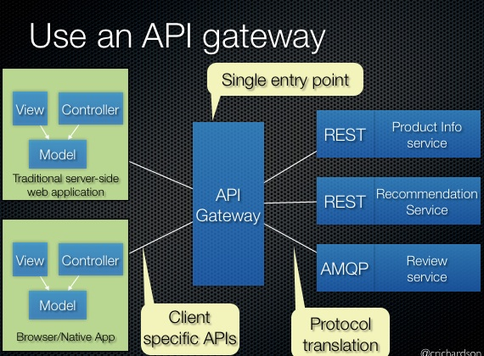
Routng and filtering
Integral part of microservice architecture
For example, /api/users is directed to your user microservice, and /api/shop to the shop service

Slide 21


Routing and filtering
Zuul

Slide 22
Zuul
Jvm-based router and server-side load balancer
Maps incoming urls to services (via server side discovery)
Uses Ribbon as a service discovery and Hystrix as a circuit breaker

Slide 23
How to set up Zuul
Create a new SpringBoot application
Add spring-cloud-starter-zuul to the pom
@EnableZuulProxy on main class
Configure routing in your application (properties/yaml)
zuul:
routes:
users:
path: /myusers/**
serviceId: users_service

Slide 24
Other components:
Spring Cloud Bus: lightweight message broker
Spring Sleuth: distributed tracing

Slide 25

Spring boot enables developers to get a Spring application up-and-running very quickly
Spring cloud leverages Spring Boot so common microservices patterns can be implemented easily

Slide 26

