Slide 1



Protein interactions and binding site properties
Allegra Via

Slide 2
Chapter 1: Introduction to Protein-ligand interactions
Principles of protein interactions and binding site properties (lecture)
Forces at play in protein interactions (lecture)
Chapter 2: Protein-protein docking
General principles and challenges of docking (lecture)
Protein-protein docking with ClusPro (tutorial)
ClusPro results analysis (tutorial)
Protein-protein interaction networks
Resources (databases) to study PPI (lecture)
Searching IntAct and STRING (tutorials)
Principles of graph theory and PPI networks (lecture)
Studying PPI with Cytoscape (tutorial)
Protein-small molecule interactions
Drugs and drug targets (lecture)
The drug development process and drug design(lecture)
Databases and tools to study protein-small molecule interactions (tutorial)

Slide 3
Forces at play in protein interactions and features of protein interaction interfaces

Slide 4
Energy and work are necessary to keep order
The entropy of the universe tends to grow
The formation of macromolecules is not an accidental
process but requires work
The synthesis of macromolecules needs energy
We measure the energy variations occurring during chemical reactions in terms of GIBBS FREE ENERGY, G.

Slide 5
Work and energy are necessary to keep order
G represents the “usable” energy of a system, i.e. the energy available to carry out work
G = H - TS
In particular, G is the thermodynamic quantity that can be used to determine the direction of a process

Slide 6
How?
The thermodynamic quantity used to determine the direction of a process is the Gibbs free energy G
Gibbs free energy is a state variable: it depends on the initial and final equilibrium states and not on the way in which the system acquired that states.
To decipher the direction of a process, we can look at its initial and final state, i.e. evaluate the free energy variation:
ΔG

Slide 7
G = H - TS
Biological systems are not isolated: they exist in a state of constant pressure and temperature
The free energy variation can be written in terms of enthalpy (H) and entropy (S) change at constant temperature.
ΔG = ΔH - TΔS
ΔH = Enthalpy variation. It represents the heat released or absorbed by the system in a reaction.
ΔS = Entropy variation. It represents the general tendency of a system to maximise its disorder.

Slide 8
Enthalpy H
Quantity of energy that a system can exchange with the environment
H = E + PV
Internal energy
of the system
pressure
volume
Biological systems are either solid or liquid. Therefore they do not usually undergo volume or pressure changes.
Biological systems are not isolated: they exist in a state of constant temperature and pressure.
ΔH ≈ ΔE

Slide 9
Internal energy E
E = U + K
Potential energy
Kinetic energy
Position energy: in a macromolecule the potential energy is the result of all field (electrostatic) effects of the atoms of the molecular system
It is the result of the molecular motions induced by the heat
Set of covalent and non-covalent interactions in a molecular system

Slide 10
ΔG = ΔH - TΔS
covalent bond breaking or making
Variation in the electrostatic or van der Waals interactions
Variations induced by the heat in the atomic motions
These variations at constant pressure entail heat transfer between the system and the environment. Therefore, we can write:
Q_{(p)} = ΔH ≈ ΔE
Therefore, at constant pressure and volume, the enthalpy variation coincides with both the heat and the variation of internal energy occurred during the process.
Q_{(p)} can be experimentally measured
ΔH > 0 in a reaction adsorbing heat
Conventionally
ΔH < 0 in a reaction releasing heat

Slide 11
Energy is released to make bonds. The enthalpy change is negative because the system is releasing energy when forming bond.
Energy is required to break bonds. The enthalpy change for breaking bonds is positive.
ΔH < 0
ΔH > 0

Slide 12
Summarising…
The variation of free energy can be written in terms of enthalpy (H) and entropy (S) changes at a constant temperature
ΔG = ΔH - TΔS
Enthalpy: amount of energy that a system can exchange with the environment
ΔH > 0 mainly corresponds to the rupture of favourable non-covalent bonds
ΔH = Q_{(p)} (measurable)
H = E + PV => ΔH ≈ ΔE
Formation or breaking of covalent bonds
Variations in the electrostatic or van der Waals interactions
Thermally induced changes in the atomic motions
ΔH = Change in enthalpy. It represents the general tendency to minimise the energy
ΔS = Entropy change. It represents the general tendency to maximise disorder

Slide 13
Entropy S
S = k_{B} lnω
ω = number of possible configurations of the system (microstates)
The number of possible states is inversely proportional to the system order
In classic thermodynamics, at constant temperature, entropy and enthalpy fulfill the following relation:
ΔH
Q_{(p)}
ΔS = =
T
T

Slide 14
Changes of G determine the direction of a process:
ΔG = 0 at the equilibrium
ΔG > 0 endergonic processes (requiring energy)
ΔG < 0 exergonic processes (releasing energy)
Spontaneous processes decrease their free energy

Slide 15
Example: what happens in protein folding?
In the process of folding of a polypeptide chain the increase in entropy of the solvent compensates the loss of entropy of the macromolecule, leading to a general increase in entropy of the system as a whole.
ΔG_{folding} = ΔH - TΔS
ΔH < 0 (formation of the electrostatic or van der Waals interactions )
TΔS_{conformational} < 0
TΔS_{hydrophobic effect}> 0

Slide 16
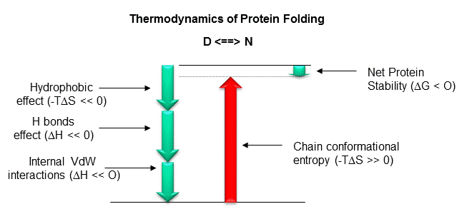

Slide 17
The driving force behind many events within the cell is represented by the increase in entropy generated in the water molecules when a reaction occurs

Slide 18
Entropy S
The number of possible states is inversely related to the order in the system. A highly ordered system can only access a few states while a disordered system can sample many
In the binding to a protein, the atoms of a ligand gradually become more confined and the entropy decreases.
However, the binding can occur thanks to the hydrophobic effect, which is accompanied by an increase in entropy of the solvent.

Slide 19
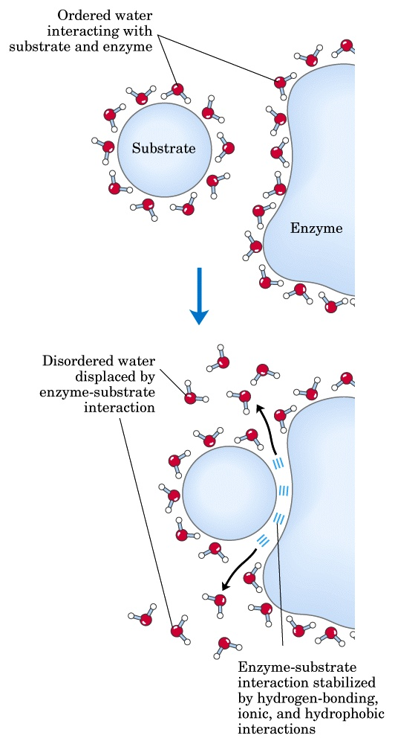
Protein-ligand interactions
ΔG = ΔH - TΔS
Ligand binding is driven by the hydrophobic effect and van der Waals interactions, whereas electrostatic interactions make them specific
PPI interfaces tend to be more hydrophobic than surfaces that do not participate in the binding
Studies on enzymes demonstrate the importance of the hydrophobic effect also in binding non-protein substrates

Slide 20
Protein-ligand interfaces Structure-function relationship
The ability of proteins to form biologically active complexes depends on the properties of their binding surfaces:
Size
Geometric compatibility
Chemical composition
Polarity
Atom packing efficiency
Hydrogen bond or salt bridge frequency
Number of buried water molecules
Interaction energy
Residue conservation
Types of secondary structures

Slide 21
Forces governing biomolecular recognition
Van der Waals
Electrostatics
Hydrophobic contacts
Hydrogen bonds
Salt bridges
All interactions act at short range → surface complementarity is needed for tight binding
Efrat Mashiach, http://bioinfo3d.cs.tau.ac.il/

Slide 22
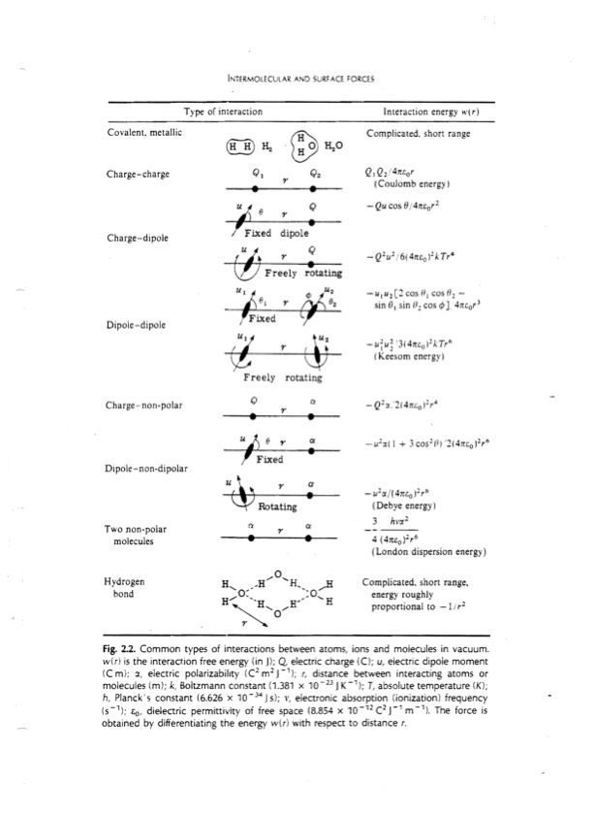

Slide 23
The Binding Site (BS)
Geometry alone is insufficient to recognise the correct ligand
The binding site-ligand match is based on: geometry and electrostatics
Geometric and electrostatic complementarity can be achieved using different BS architectures

Slide 24
Geometric complementarity
The geometrical match optimises all non-covalent interactions that mediate the binding
Short range and Van der Waals

Slide 25
Electrostatic complementarity
For example, when ligand carries an electric charge → The BS tends to contain the opposite charge
Electrostatic match increases binding specificity

Slide 26
PPI surface size
The area of PPI interfaces is large (1000 to 4000 Å²)
Standard-sized interfaces are 1200 to 2000 Å²
Short-lived and low-stability complexes -> smaller interfaces (1150–1200 Å²)
Protein-small molecule interaction surfaces have a smaller area (300 - 1000 Å²).

Slide 27
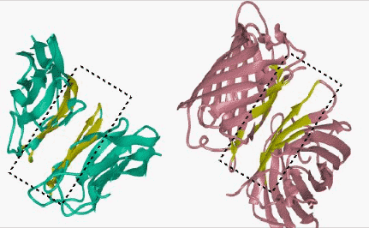
http://home.ku.edu.tr/~okeskin/INTERFACE/INTERFACES.html

Slide 28
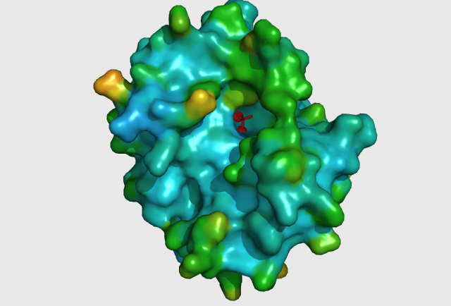
Protein-small molecule: small and deep depressions

Slide 29
Other PPI surface features
Flatter than that of other protein-ligand interfaces
Lack the grooves and pockets observed at the surfaces binding small molecules
Generally hydrophobic
Tighter atom packing
Lower polarity
Higher conservation (especially at the center of the interface)

Slide 30
Some more facts about PPIs
Transient interfaces differ from stable interfaces
Stable interfaces:
less planar
more hydrophobic
better geometric and electrostatic complementarity
Homodimeric interfaces resemble protein cores
Heterodimeric interfaces are more like regular (i.e. non-binding) surfaces

Slide 31
Specificity
Conferred by electrostatic interactions
Electrostatic interactions prevent aggregation (mediated by non-polar interactions)

Slide 32
Affinity
The affinity of PPI varies from millimolar to picomolar, depending on the type of interaction and signaling needed (Chen et al. Protein Sci. 2013)
Despite affinity varies over a wide range, proteins can maintain a high degree of specificity for their partners
Many proteins exhibit affinity for multiple partners (Reichmann et al. Curr. Opin. Struct. Biol. 2007) → hubs

Slide 33
Specificity
Fixed scaffold, change of loop structure (antibodies)
The ability to bind different partners → Low specificity
Different proteins can bind the same interface, each interacting with a different cluster of nonpolar residues OR
To the same highly flexible interface

Slide 34
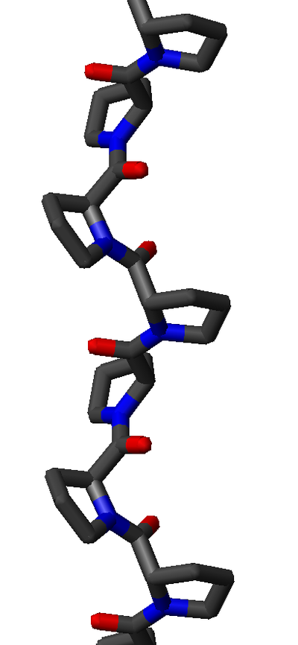
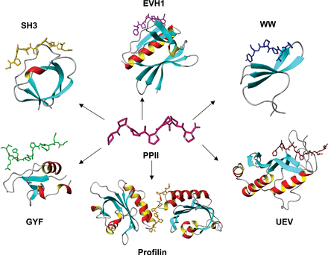
Polyproline type II helices

Slide 35
Protein-ligand binding energetics Protein-ligand affinities
Binding energies may range from -2.5 to -22 kcal/mol
Signal transduction networks -> weak interactions
Cofactor binding by enzymes (reversible but strong) -> -5.5 to -9.5 kcal/mol
Antibody-antigen: -8±3 kcal/mol
Receptor-hormone: -12 kcal/mol
Enzyme-inhibitor: -12±3 kcal/mol
Enzyme-transition state: -22±5 kcal/mol
Kuntz et al., 1999; Zhang&Houk, 2005

Slide 36
Hot spots
The protein-protein binding interface is heterogeneous
Only certain hydrophobic spots contribute to the free energy of binding and help to hold the two proteins together
Affinity seems to result from a small number of residues
Such residues are called hot spots
Hot spots are defined as residues whose replacement by alanine leads to an affinity/free energy change of at least 2 kcal/mol

Slide 37
Some fact about hot spots
Hot spots account for less than 50% of the contact area of PPI
Hot spots tend to be evolutionary conserved
Hot spots tend to appear as clusters at the interface
Some residues are found more frequently in hot spots (e.g., Phe, Tyr, Trp)
Hot spots are surrounded by energetically less important residues that probably separate/prevent bulk water from hot spots

Slide 38
Molecular structure of stable interactions (complexes): what information?
identification of interface residues/hot spots
details about the interface (solvent accessible surface area, shape, complementarity between surfaces, residue interface propensities, hydrophobicity, segmentation and secondary structure, and conformational changes on complex formation)
assignment of protein function
recognition of specific residue motifs

Slide 39
Check-point II
Go to the GDoc
Write a lecture summary, namely all you remember from the lecture.
You have access to the presentation, which means you can go through the slides to better remember and organise your thoughts
Homework: create a GDoc
name-surname-report
Use lecture summaries and further info you will collect from other sources to write the first part of your report
Paste the link to your Gdoc in the shared GDoc

Slide 40
And now…get down to business!

