Slide 1
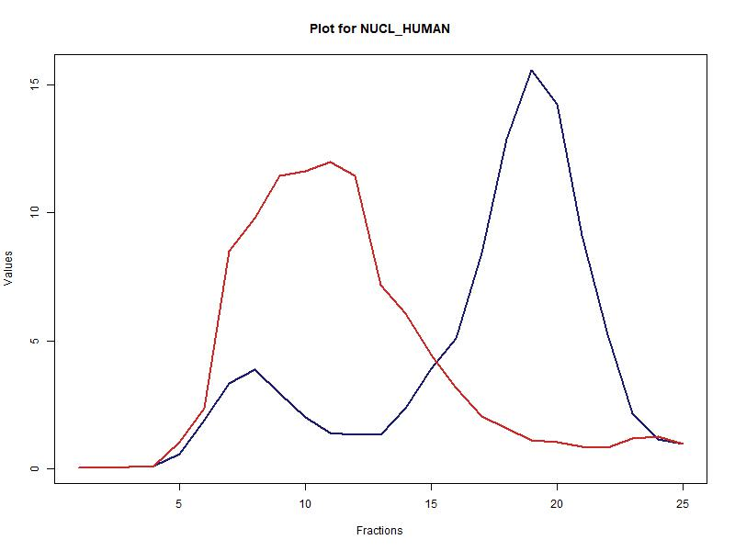
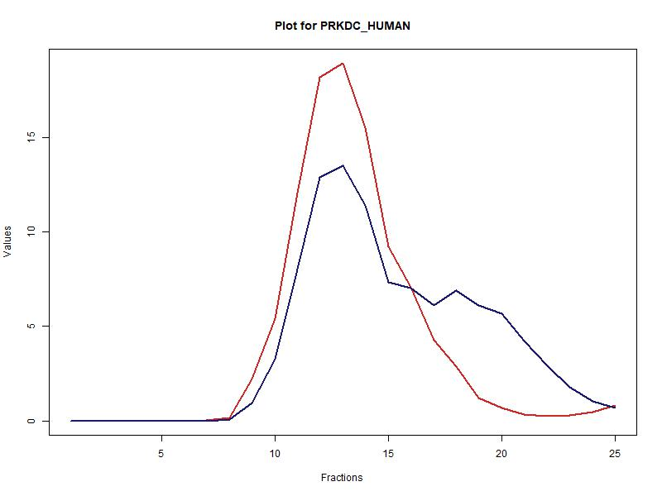
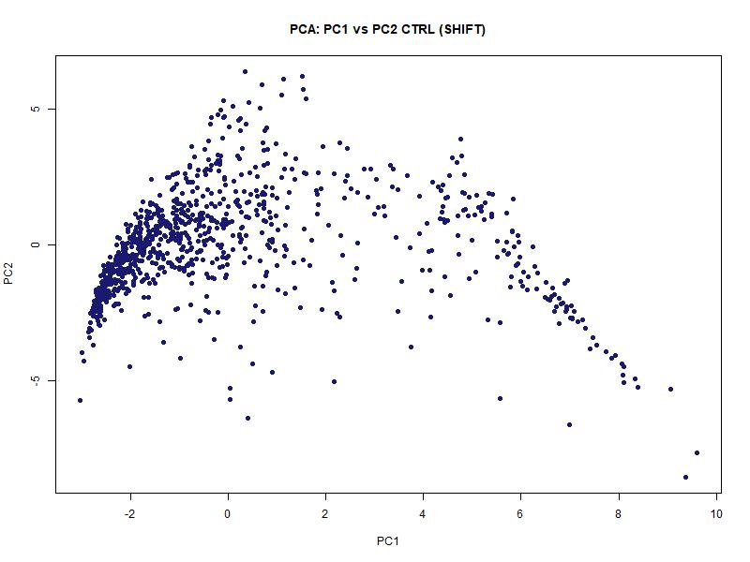
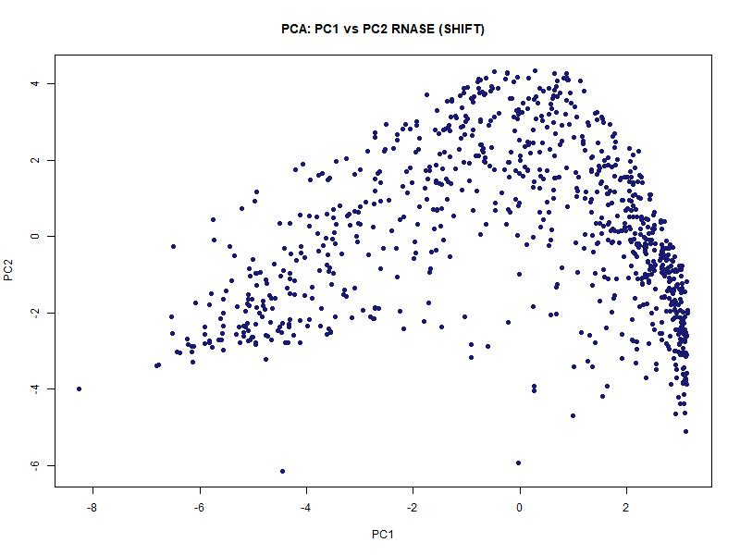
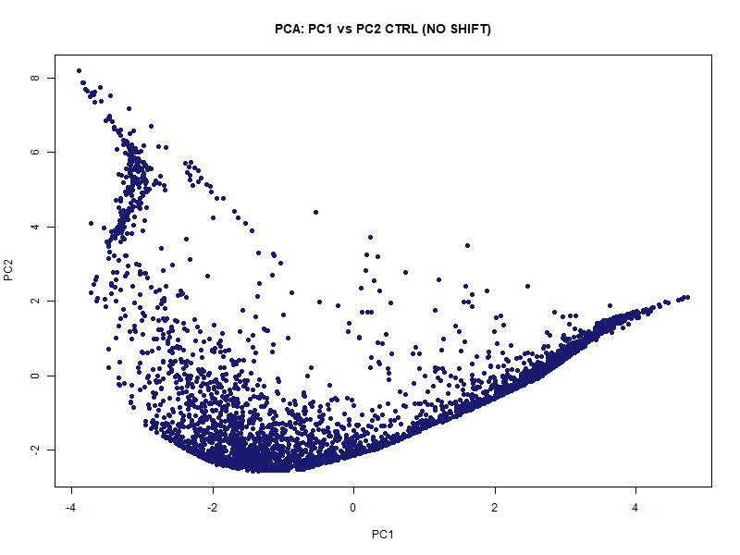
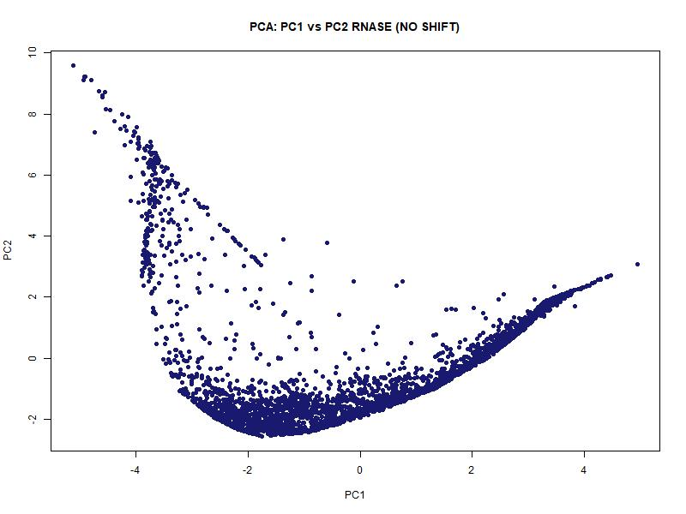
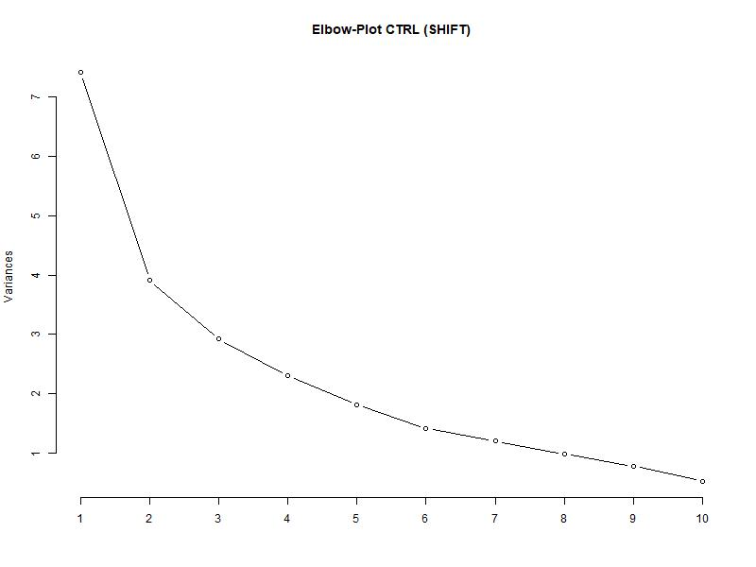
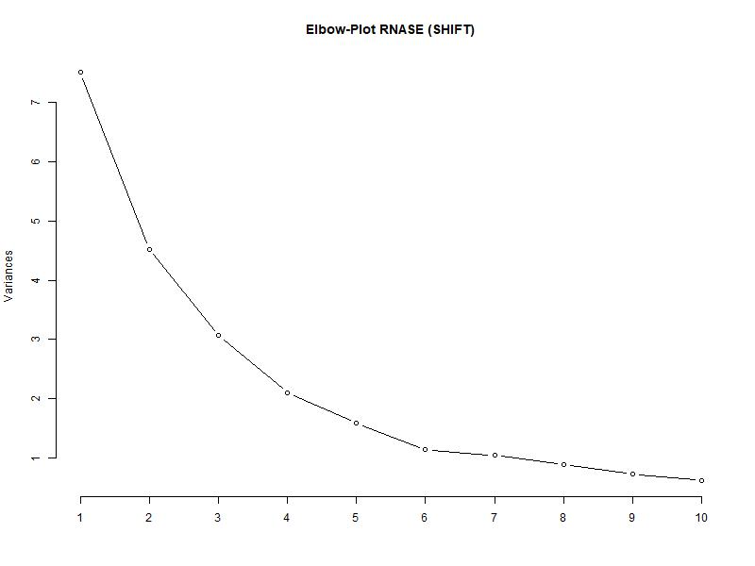
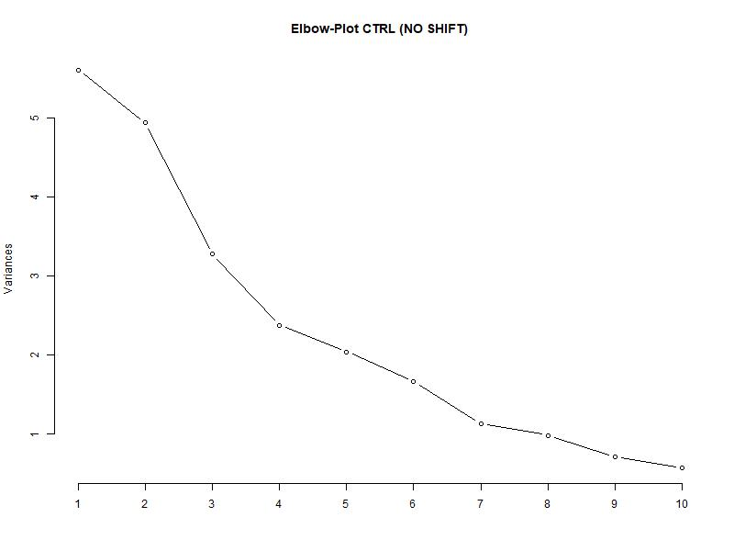
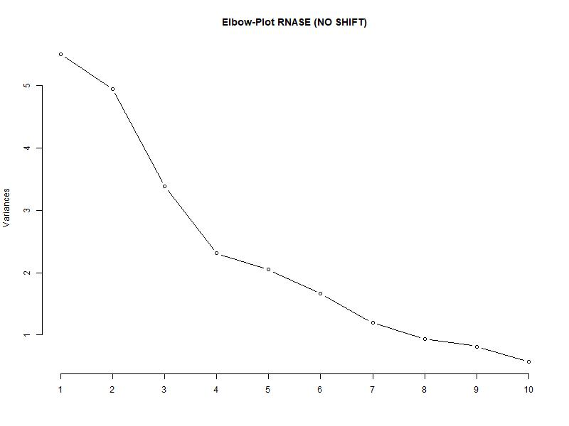
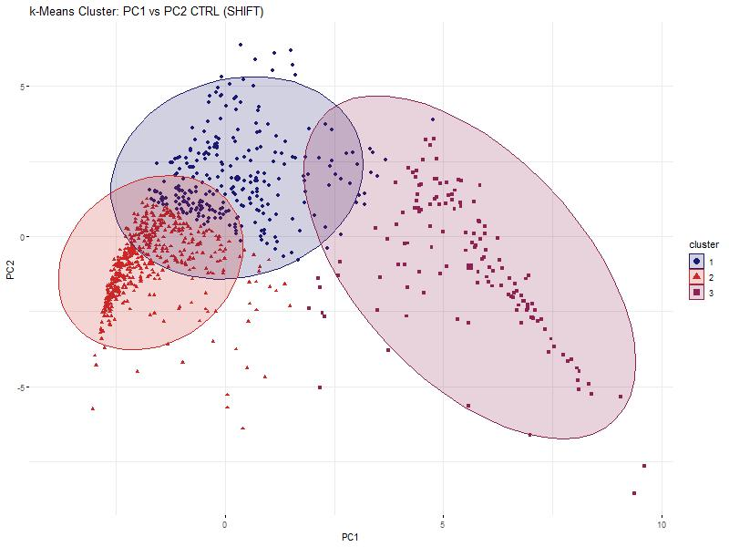
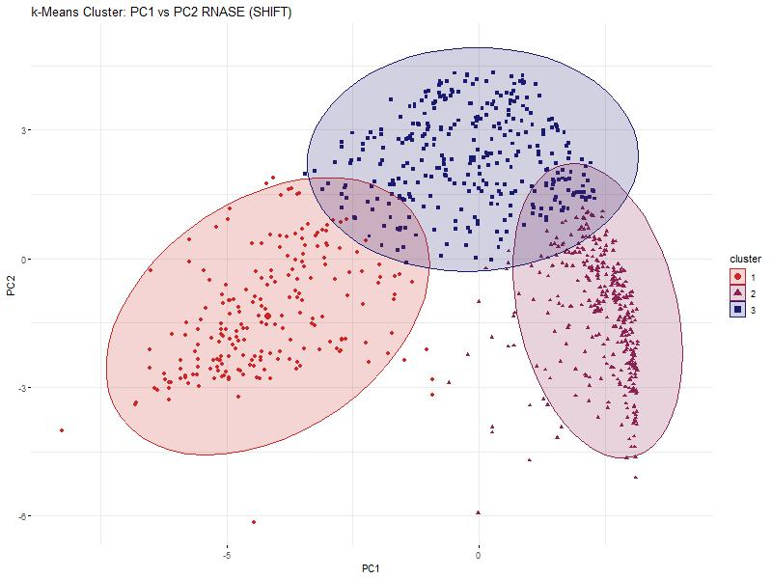
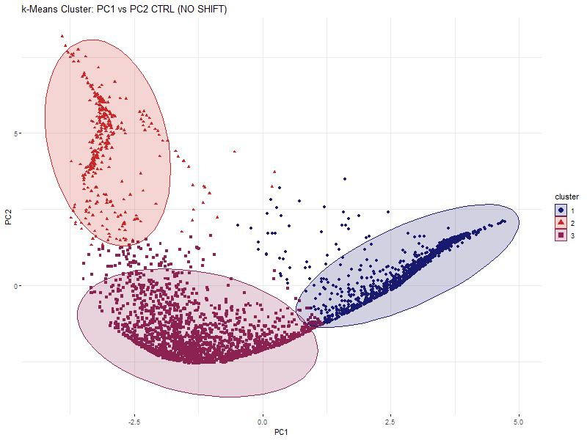
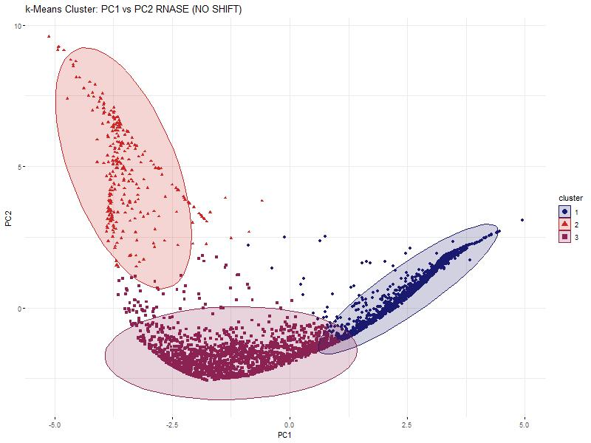

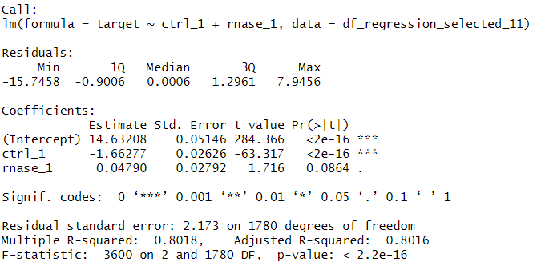
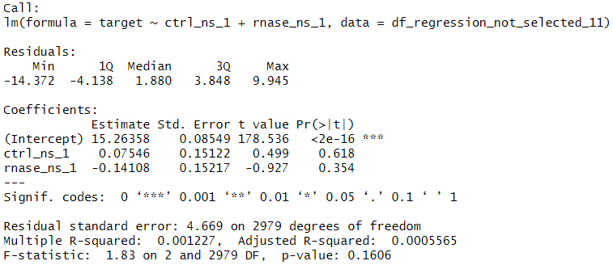

Hidden Alliances:
RNA-Dependent Protein Interactions
in Cancer Cells
Baureis, J., Ferdin, J., Nicklas, B., Wintel, L.
Data Analysis Project Molecular Biotechnology SS2025
1
Identifying RNA-Dependent Proteins from Proteomic Data
What Makes RNA-Dependent Proteins Worth Investigating?
Key Regulators: RBPs control RNA metabolism & gene expression.
Disease Links: Misregulation is tied to cancer & neurodegeneration.
Functional Clues: New RBPs hint at RNA’s role in specific pathways.
Interaction Networks: Mapping RNA-protein complexes reveals regulatory logic.
Molecular Insights: Deepens our understanding of cell cycle and cellular behavior.
1A
B
„We want to extract RNA-dependent proteins from proteomic screens”
„RNA-dependency = the proteins interactome depends on RNA“
Key Characteristics of Our Dataset
Our dataset was generated using the R-Deep approach
~5000 proteins in 25 fractions, RNASE vs. CTRL
Fig. 1 Plot of protein in data set. The data has been cleaned and normalized beforehand.
A) The protein NUCL_HUMAN is plotted. It is part of the selected proteins and shows a significant shift between RNASE and CTRL. B) The protein PRKDC_HUMAN is plotted and shows no significant shift.
2
Our Approach
1) Data preparation
Data cleanup
“Rearrange and reorder the columns to their treatment, replicate and fraction”
Normalization
2) Data exploration
Identification of maxima and shoulders
Selection criteria & Wilcoxon Test
Visualization for the order of selection criteria
Pie charts for selection results
3) Data reduction
PCR
k-means clustering
4) Data modelling
Linear Regression Analyses
5A
B
C
D
All proteins
Fig. 5 Principle Component Analyses and Elbowplots of the selected and the non-selected proteins. RNASE and CTRL are plotted separately for comparison.
A) PCA of the selected proteins. The data points of the RNASE compared to the CTRL make up an overall similar shape, but a shift is visible in the density of the points. B) PCA of the non-selected proteins. The points of the RNASE and CTRL form mostly the same structure. C) Elbow-Plot of the selected proteins. The knick of the elbow is at 3. D) Elbow-Plot of the non-selected proteins. The knick of the elbow is between 3 and 4. To compare selected and non-selected proteins, we decided to use 3 cluster in the kmeans clustering.
Center of Mass shift ≥ 3 fractions
Center of Mass shift < 3 fractions
Correlation value ≥ 0,7
Correlation value < 0,7
3
4
Discussion
Our Achievements
6A
B
Fig. 6 kmeans clustering of the selected and not-selected proteins
A) Shows the 3 clusters of the CTRL of the selected proteins. B) Shows the 3 clusters of the RNASE of the selected proteins. A significant shift in form and location of the clusters is noticeable. C) Shows the 3 clusters of the CTRL of the not-selected proteins. D) Shows the 3 clusters of the RNASE of the not-selected proteins. No shift in form and location is noticeable.
We found 951 different RNA dependent proteins and 3814 proteins that are not RNA dependent
Our selection criteria seem to work well for detecting RNA dependent proteins and they can be continued to be used in the future
The future will show, if one of our RNA dependent proteins is tied to cancer or included in another important pathway. All in all, it can be said that the further identification of RNA-dependent proteins continues to be of great relevance in cancer and basic research.
→ Wenn ihr mehr achievements findet, könnt ihr den letzten text auch rauslöschen.
C
D
Fig. 7 Linear regression analyses between the selected proteins and the not-selected proteins each, with global maxima of the selected CTRL proteins as target variable
A) The left regression analysis for the selected proteins describes the target variable well, the right analysis of the not-selected proteins does not. This proves, that there is a difference between the selected and not-selected proteins, and therefore, that the selection criteria worked.
5
References
7A
Sternburg et al., Global Approaches in Studying RNA-Binding Protein Interaction Networks, 2020, Trends in Biochemical Sciences.pdf
Caudron-Herger et al., R-DeeP Proteome-wide and Quantitative Identification of RNA-Dependent Proteins by Density Gradient Ultracentrifugation, 2019, Molecular Cell.pdf
Caudron-Herger et al., Identification, quantification and bioinformatic analysis of RNA-dependent proteins by RNase treatment and density gradient ultracentrifugation using R-DeeP-2020-Nature Protocols_1.pdf
Corley et al., How RNA-Binding Proteins Interact with RNA Molecules and Mechanisms, 2020, Molecular Cell.pdf
Rajagopal et al., An atlas of RNA-dependent proteins in cell division reveals the riboregulation of mitotic protein-protein interactions. Nat. Commun. 16, 2325 (2025).pdf

Slide 2
