Slide 1
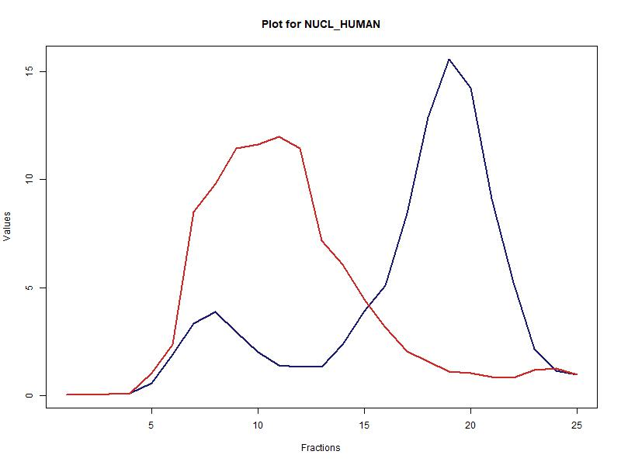
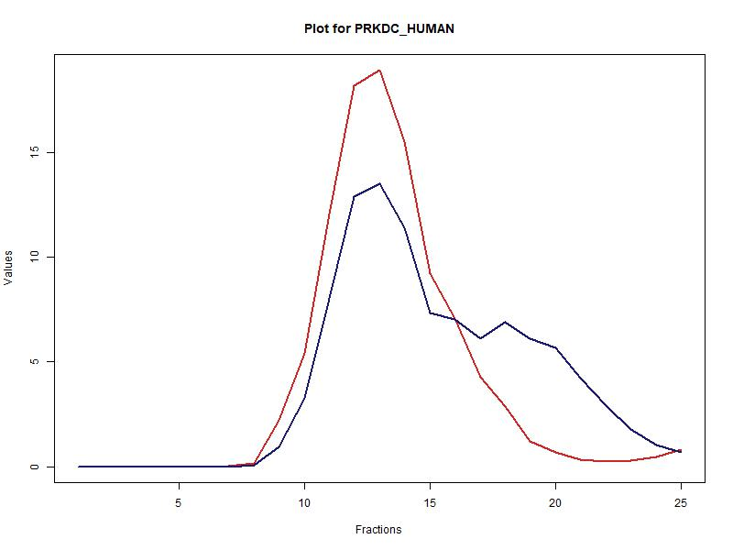
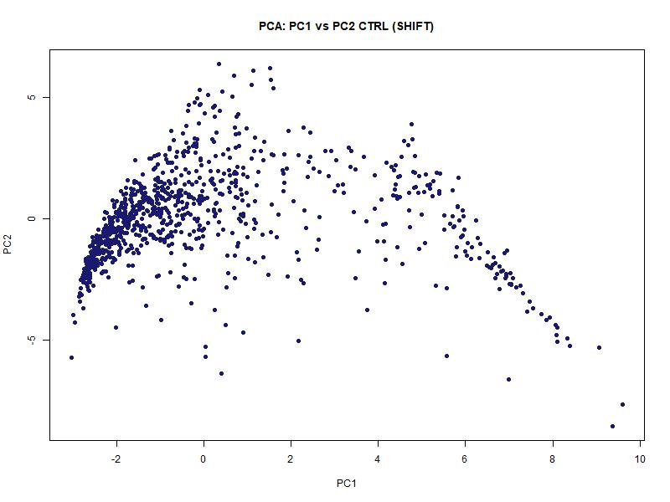
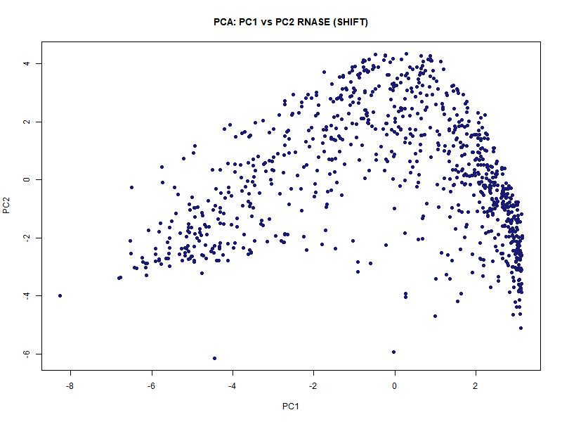
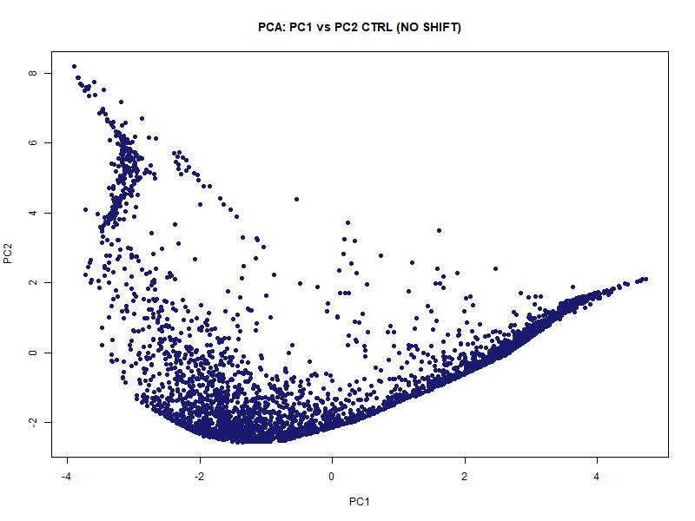
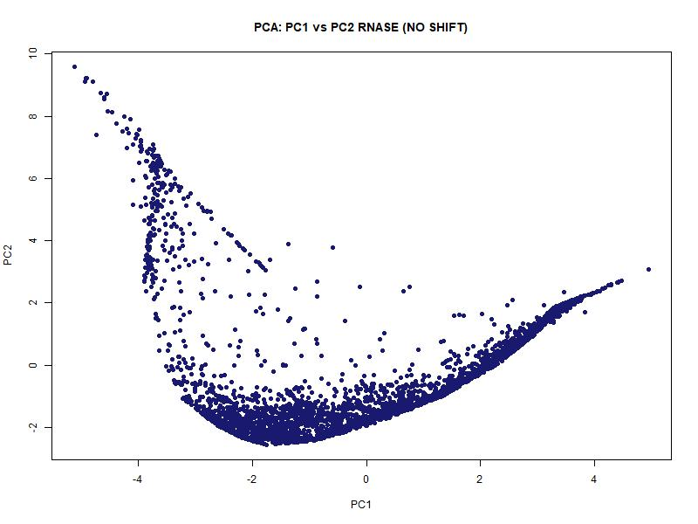
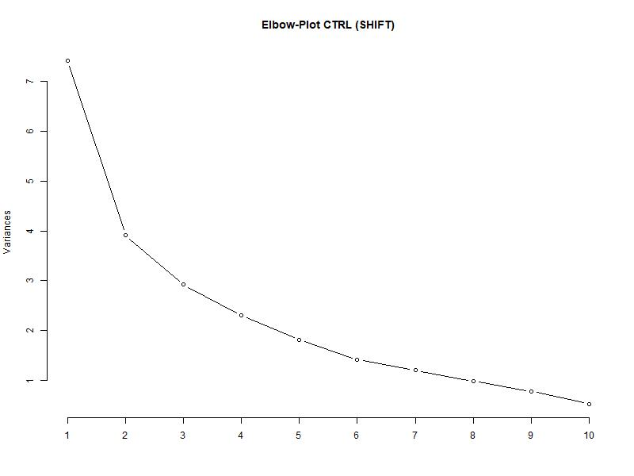
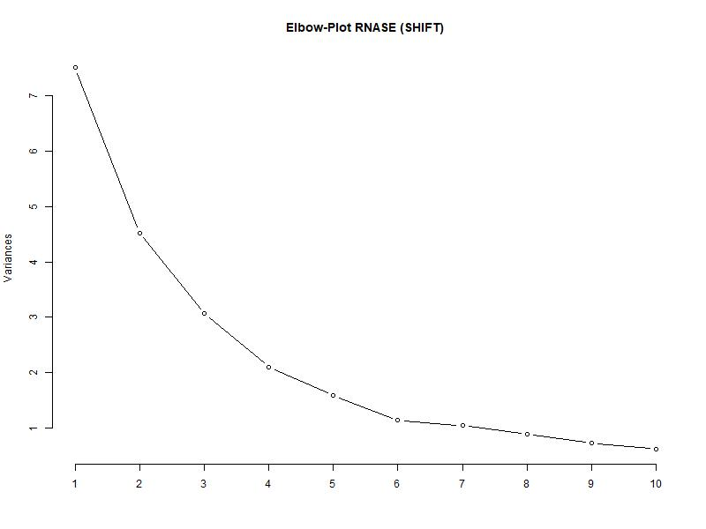
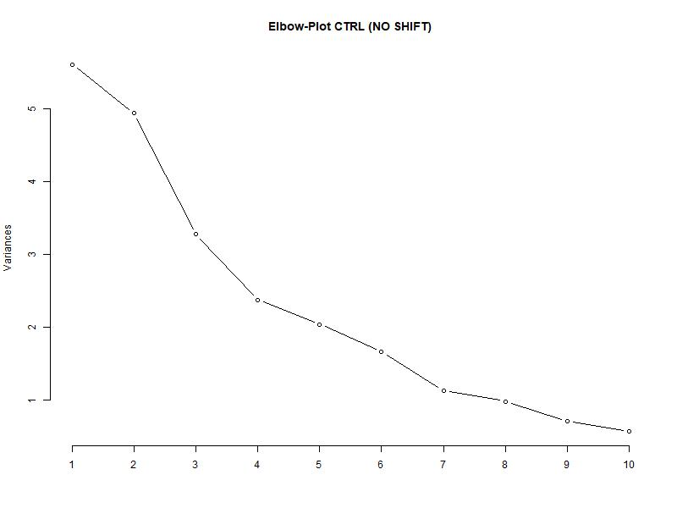
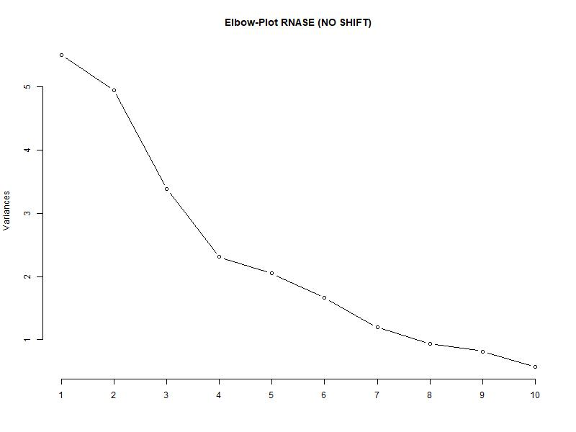
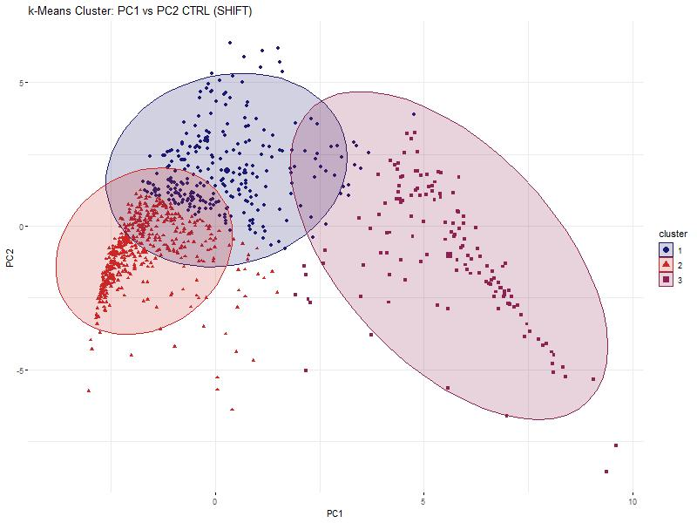
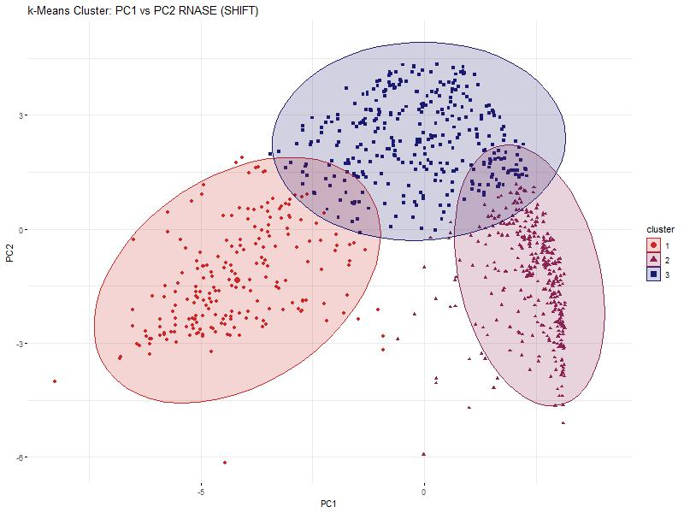
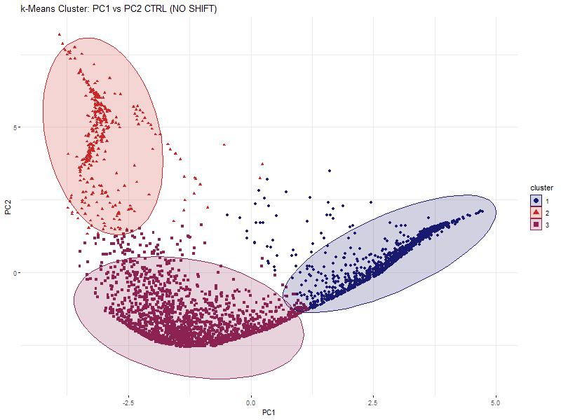
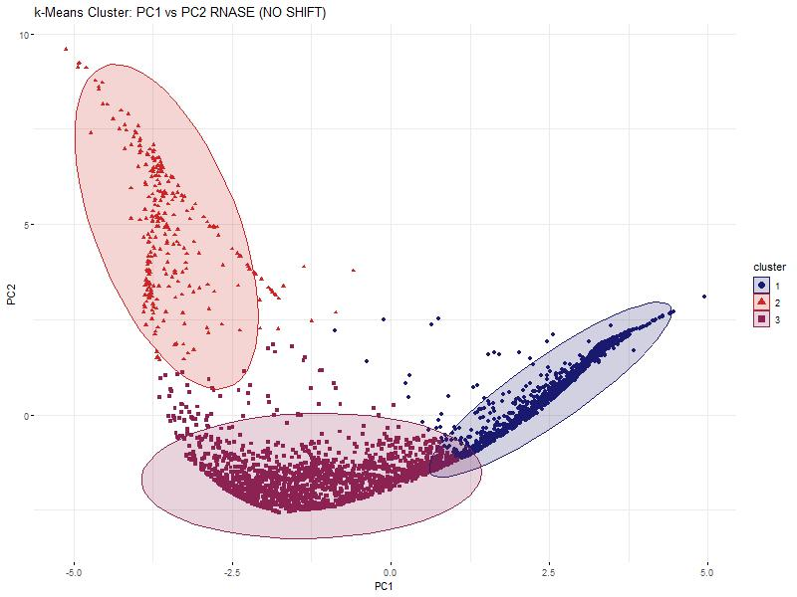

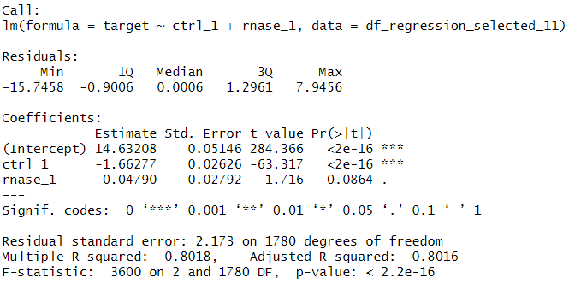
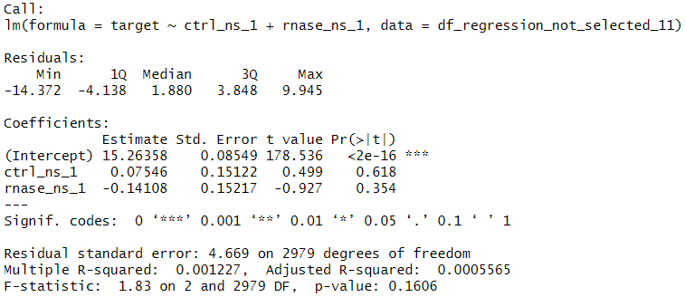

Hidden Alliances:
RNA-Dependent Protein Interactions
in Cancer Cells
Baureis, J., Ferdin, J., Nicklas, B., Wintel, L.
Data Analysis Project Molecular Biotechnology SS2025
1
Identifying RNA-Dependent Proteins from Proteomic Data
What Makes RNA-Dependent Proteins Worth Investigating?
Key Regulators: RBPs control RNA metabolism & gene expression.
Disease Links: Misregulation is tied to cancer & neurodegeneration.
Functional Clues: New RBPs hint at RNA’s role in specific pathways.
Interaction Networks: Mapping RNA-protein complexes reveals regulatory logic.
Molecular Insights: Deepens our understanding of cell cycle and cellular behavior.
A
B
„We want to extract RNA-dependent proteins from proteomic screens”
„RNA-dependency = the proteins interactome depends on RNA“
Key Characteristics of Our Dataset
Our dataset was generated using the R-Deep approach
~5000 proteins in 25 fractions, RNASE vs. CTRL
Fig. 1 Plot of proteins in data set. The data was cleaned and normalized
A) The protein NUCL_HUMAN is plotted which is part of the selected proteins and shows a significant shift between RNASE and CTRL. B) The protein PRKDC_HUMAN is plotted and shows no significant shift.
2
Our Approach
1) Data preparation
Data cleanup
“Rearrange and reorder the columns to their treatment, replicate and fraction”
Normalization
2) Data exploration
Identification of maxima and shoulders
Selection criteria & Wilcoxon Test
Visualization for the order of selection criteria
Pie charts for selection results
3) Data reduction
PCR
k-means clustering
4) Data modelling
Linear Regression
A
B
C
D
Fig. 5 Principle Component Analysis and Elbowplot of the selected proteins and the non-selected proteins. RNASE and CTRL are plotted separately to compare them.
A) PCA of the selected proteins. The points of the RNASE compared to the CTRL form similar plots, but a shift is visible in the density of the points. B) PCA of the non-selected proteins. The points of the RNASE and CTRL form mostly the same structure. C) Elbow-Plot of the selected proteins. The point of the elbow is at 3. D) Elbow-Plot of the non-selected proteins. The point of the elbow is between 3 and 4. To compare selected and non-selected proteins, we decidet to use 3 cluster in the kmeans.
3
4
Discussion
Our Achievements
A
B
Fig. 7 kmeans clustering of the selected and non-selected proteins
A) Shows the 3 clusters of the CTRL of the selected proteins. B) Shows the 3 clusters of the RNASE of the selected proteins. A significant shift in form and location of the clusters is noticeable. C) Shows the 3 clusters of the CTRL of the non-selected proteins. D) Shows the 3 clusters of the RNASE of the non-selected proteins. No shift in form and location is noticeable.
We found 951 different RNA dependent proteins and 3814 proteins that are not RNA dependent
Our selection criteria seems to be very robust for detecting RNA dependent proteins
The future will show, if one of our RNA dependent proteins is tied to cancer or included in another important pathway.
All in all, it can be said that the further identification of RNA-dependent proteins continues to be of great relevance in cancer and basic research.
→ Wenn ihr mehr achievements findet, könnt ihr den letzten text auch rauslöschen.
C
D
5
References
Sternburg et al., Global Approaches in Studying RNA-Binding Protein Interaction Networks, 2020, Trends in Biochemical Sciences.pdf
Caudron-Herger et al., R-DeeP Proteome-wide and Quantitative Identification of RNA-Dependent Proteins by Density Gradient Ultracentrifugation, 2019, Molecular Cell.pdf
Caudron-Herger et al., Identification, quantification and bioinformatic analysis of RNA-dependent proteins by RNase treatment and density gradient ultracentrifugation using R-DeeP-2020-Nature Protocols_1.pdf
Corley et al., How RNA-Binding Proteins Interact with RNA Molecules and Mechanisms, 2020, Molecular Cell.pdf
Rajagopal et al., An atlas of RNA-dependent proteins in cell division reveals the riboregulation of mitotic protein-protein interactions. Nat. Commun. 16, 2325 (2025).pdf
The regression analyses for the selected proteins describe the target variable (ctrl_selected$global_maximum) well.The regression analyses for the not-selected proteins describe its own target variable (ctrl_not_selected$global_maximum) also very well, in comparison to the selected proteins sometimes even better, as there are more proteins used in the model. However, the analysis for the not-selected proteins shows a bad fit for the selected target variable (ctrl_selected$global_maximum). This proves, that there is a difference between the selected and not-selected proteins, and therefore, that the selection criteria worked.

