Slide 1
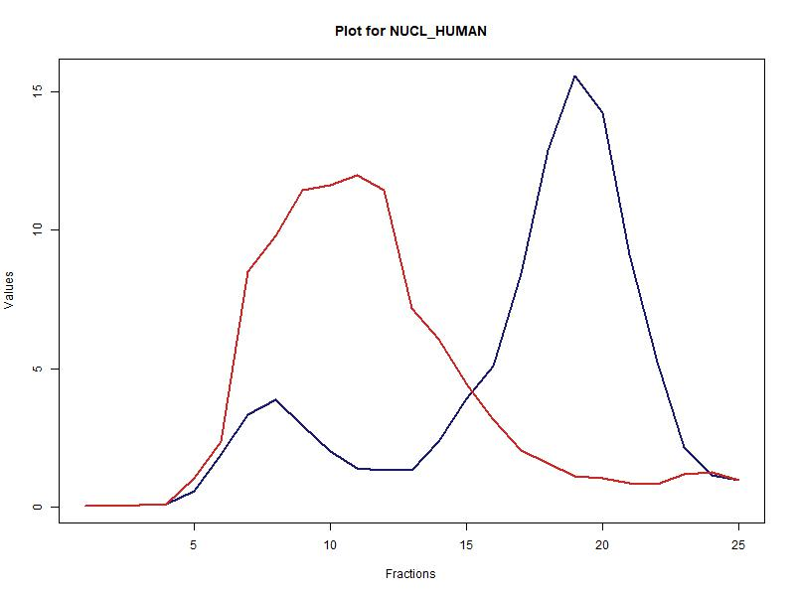
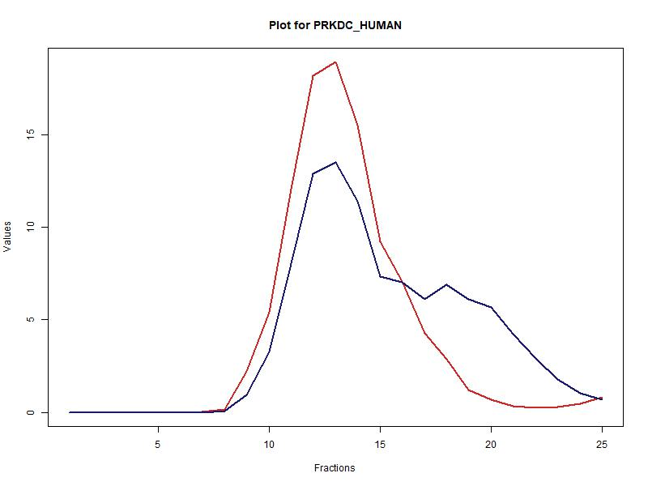
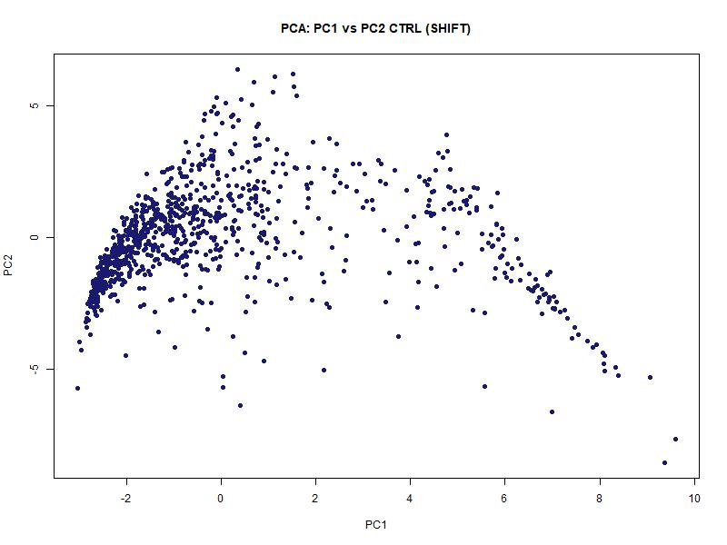
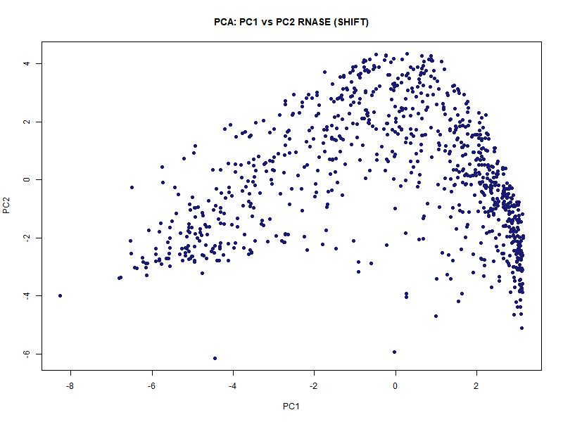
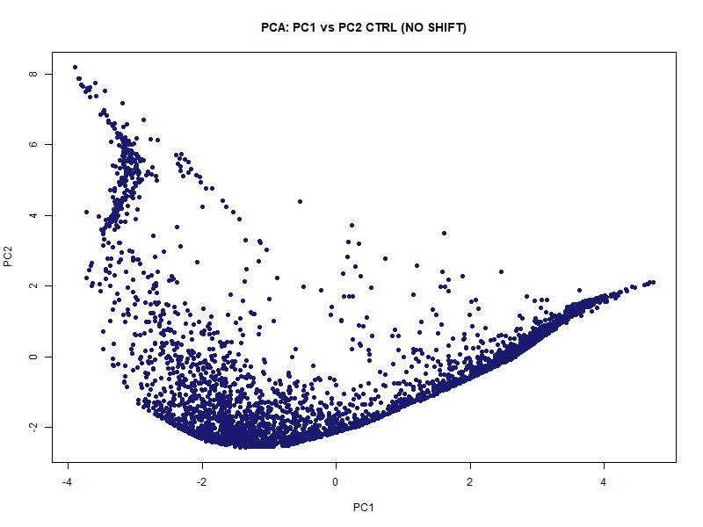
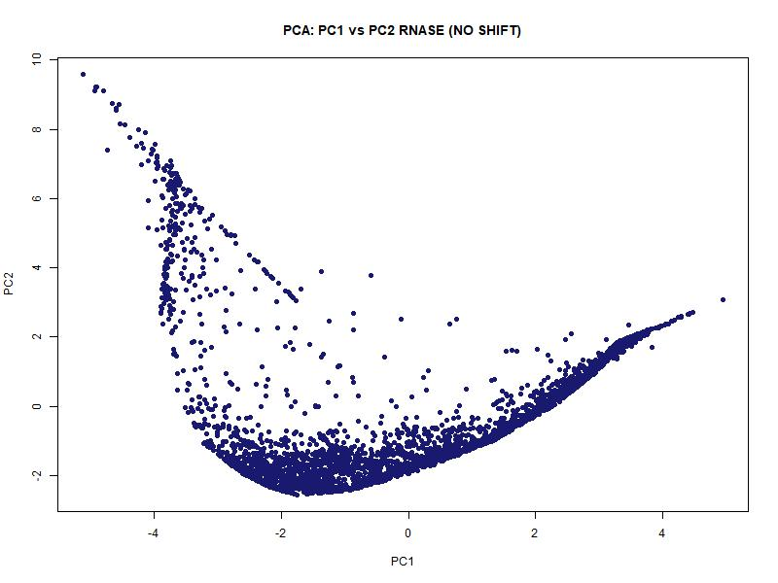
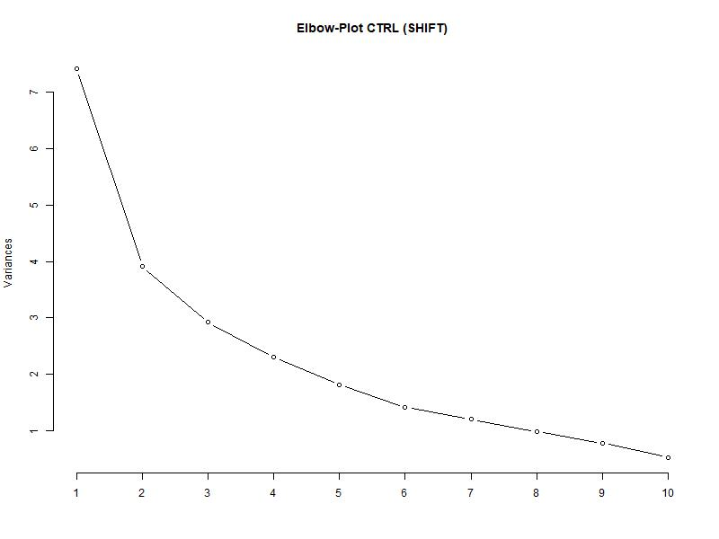
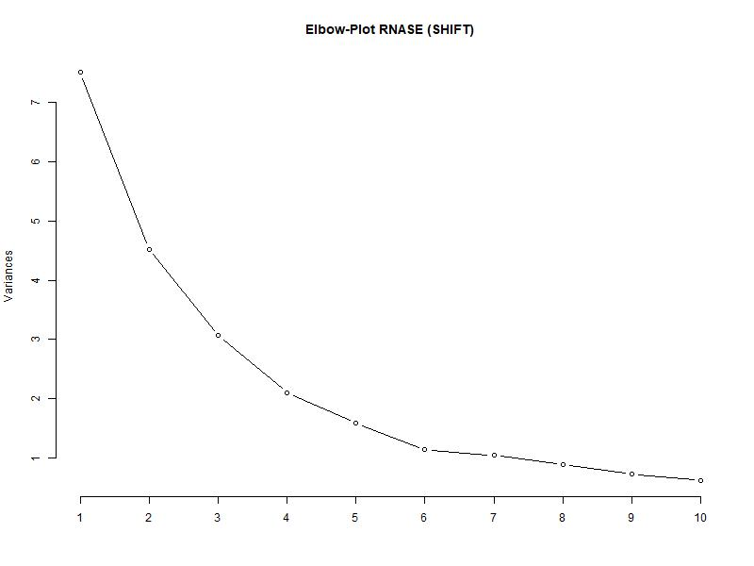
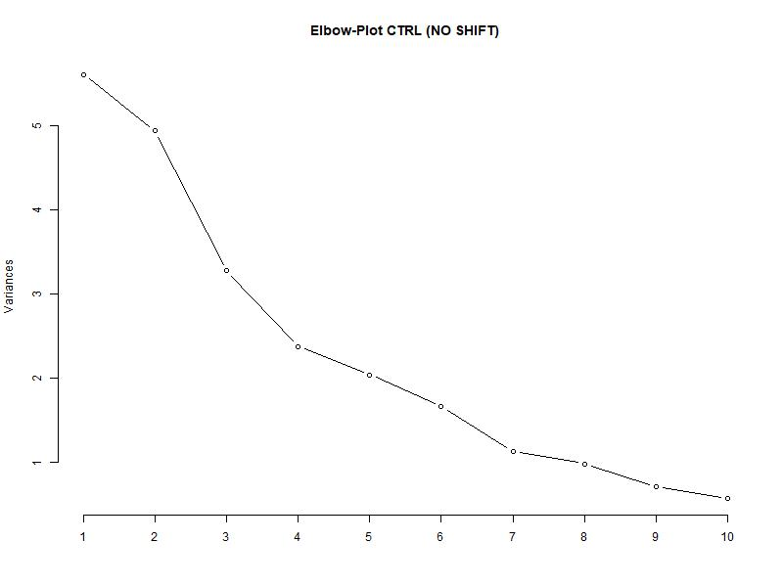
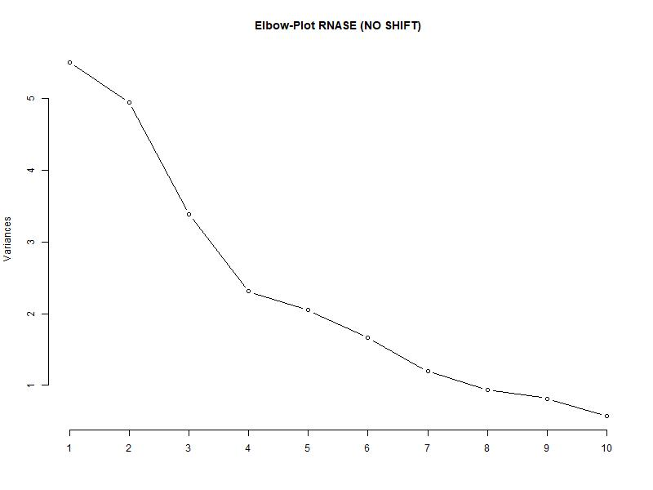
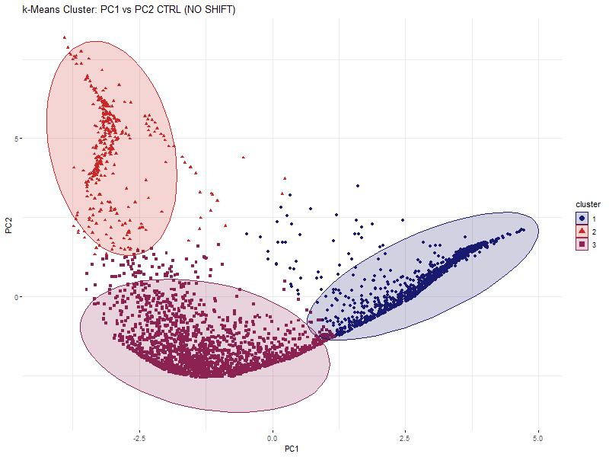
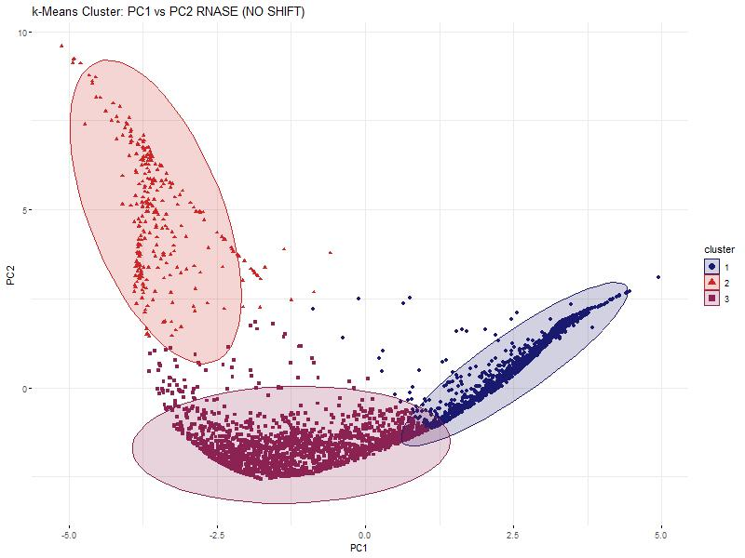
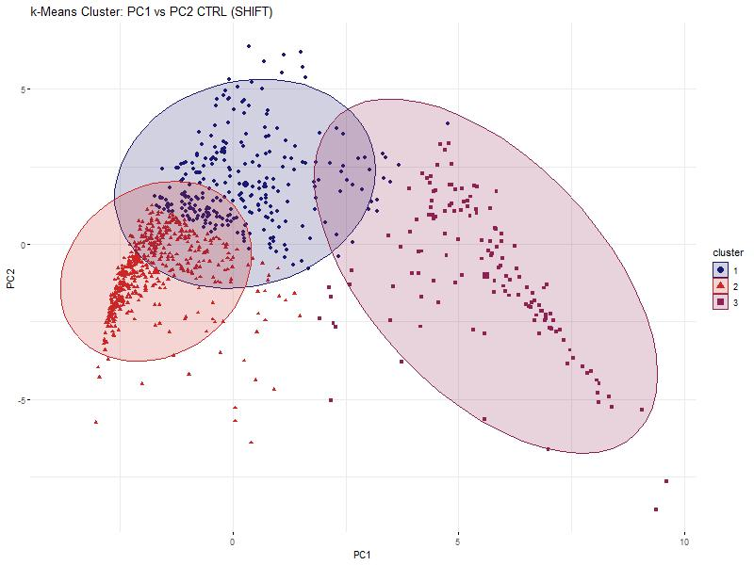
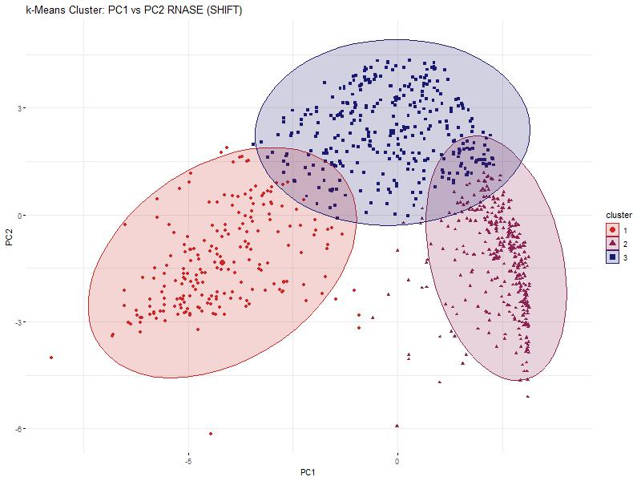

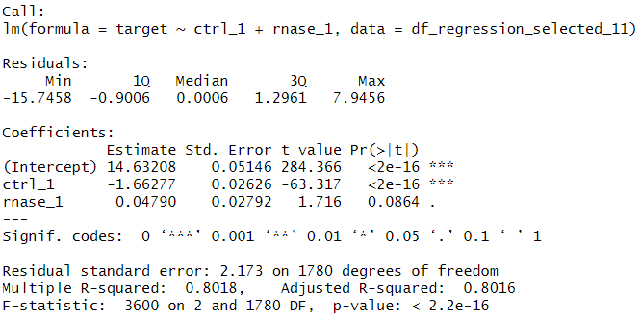
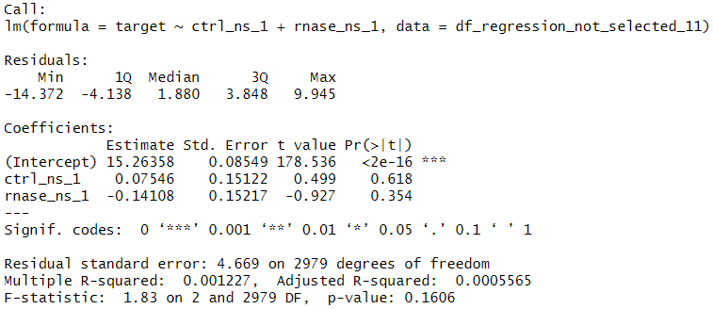

Hidden Alliances:
RNA-Dependent Protein Interactions
in Cancer Cells
Baureis, J., Ferdin, J., Nicklas, B., Wintel, L.
Data Analysis Project Molecular Biotechnology SS2025
1
Identifying RNA-Dependent Proteins from Proteomic Data
„We want to extract RNA-dependent proteins from proteomic screens”
„RNA-dependency = the proteins interactome depends on RNA“
What Makes RNA-Dependent Proteins Worth Investigating?
Key Regulators: RBPs control RNA metabolism & gene expression.
Disease Links: Misregulation is tied to cancer & neurodegeneration.
Functional Clues: New RBPs hint at RNA’s role in specific pathways.
Interaction Networks: Mapping RNA-protein complexes reveals regulatory logic.
Molecular Insights: Deepens our understanding of cell cycle and cellular behavior.
A
B
Key Characteristics of Our Dataset
Our dataset was generated using the R-Deep approach
~5000 Proteine in 25 Fraktionen, Rnase vs. CTRL
Dimensions
Fig. 1 Plot of proteins in data set. The data was cleaned and normalized
A) The protein NUCL_HUMAN is plotted which is part of the selected proteins and shows a significant shift between RNASE and CTRL. B) The protein PRKDC_HUMAN is plotted and shows no significant shift.
2
Our Approach
1) Data preparation
Data cleanup
“Rearrange and reorder the columns to their treatment, replicate and fraction”
Normalization
2) Data exploration
Identification of maxima and shoulders
Selection criteria & Wilcoxon Test
Visualization for the order of selection criteria
Pie charts for selection results
3) Data reduction
PCR
k-means clustering
4) Data modelling
Linear Regression
A
B
C
D
Fig. 5 Principle Component Analysis and Elbowplot of the selected proteins and the non-selected proteins. RNASE and CTRL are plotted separately to compare them.
A) PCA of the selected proteins. The points of the RNASE compared to the CTRL form similar plots, but a shift is visible in the density of the points. B) PCA of the non-selected proteins. The points of the RNASE and CTRL form mostly the same structure. C) Elbow-Plot of the selected proteins. The point of the elbow is at 3. D) Elbow-Plot of the non-selected proteins. The point of the elbow is between 3 and 4. To compare selected and non-selected proteins, we decidet to use 3 cluster in the kmeans.
3
4
Discussion
Our Achievements
A
B
Fig. 7
We found X proteins that ...
C
D
5
References
Sternburg et al., Global Approaches in Studying RNA-Binding Protein Interaction Networks, 2020, Trends in Biochemical Sciences.pdf
Caudron-Herger et al., R-DeeP Proteome-wide and Quantitative Identification of RNA-Dependent Proteins by Density Gradient Ultracentrifugation, 2019, Molecular Cell.pdf
Caudron-Herger et al., Identification, quantification and bioinformatic analysis of RNA-dependent proteins by RNase treatment and density gradient ultracentrifugation using R-DeeP-2020-Nature Protocols_1.pdf
Corley et al., How RNA-Binding Proteins Interact with RNA Molecules and Mechanisms, 2020, Molecular Cell.pdf

