Slide 1
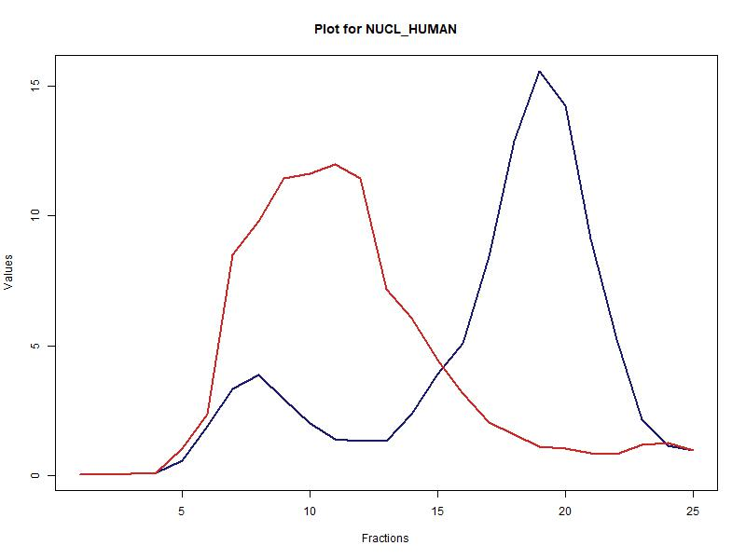
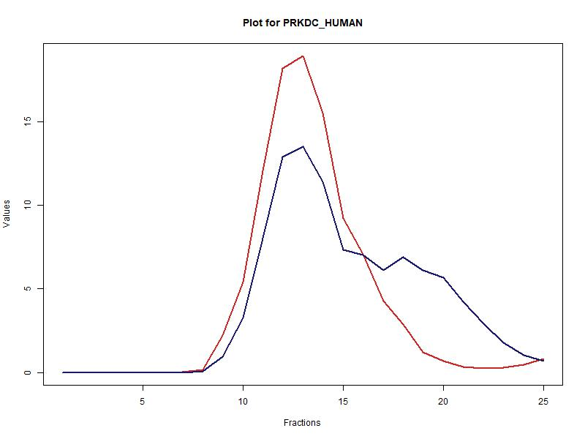
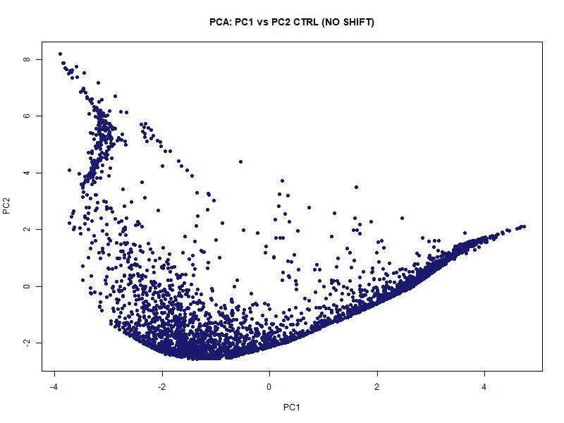
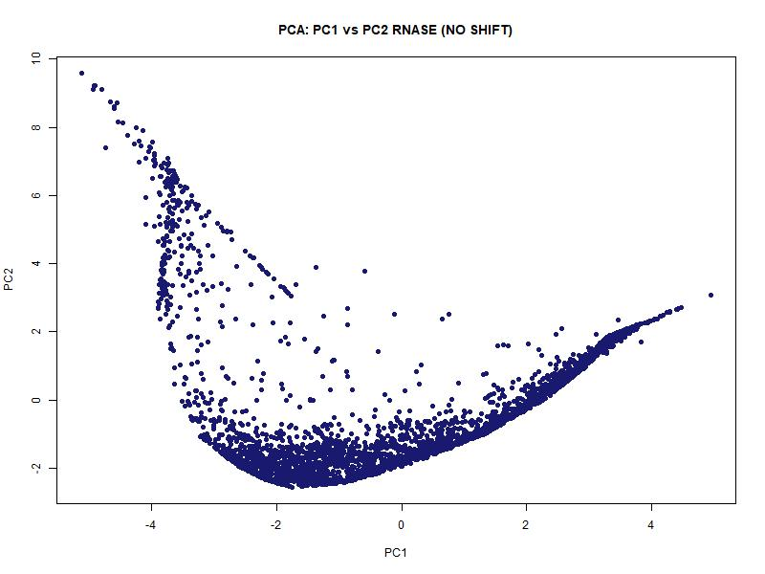
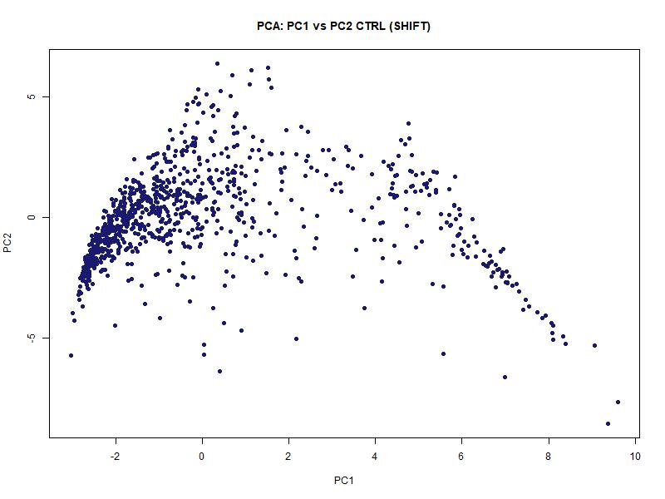
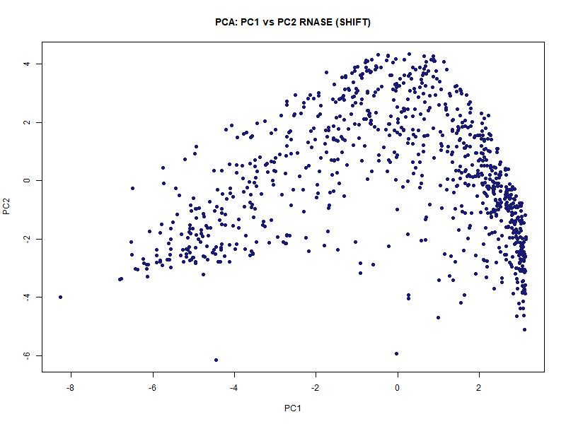
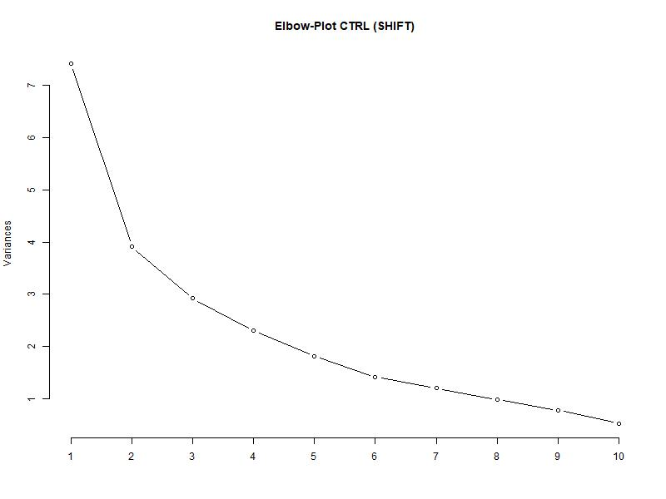
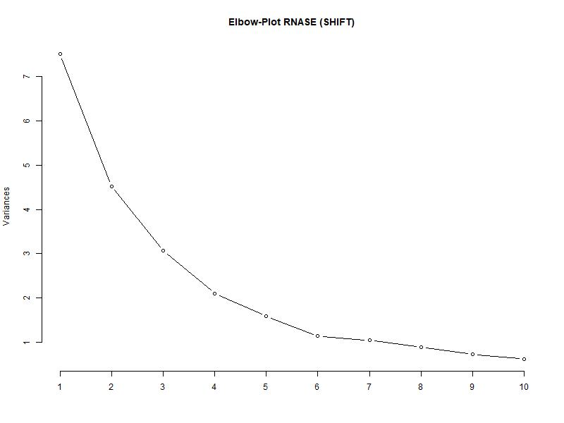
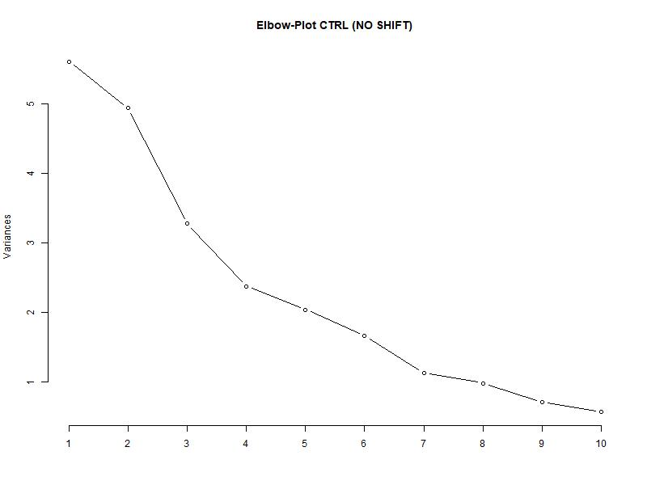
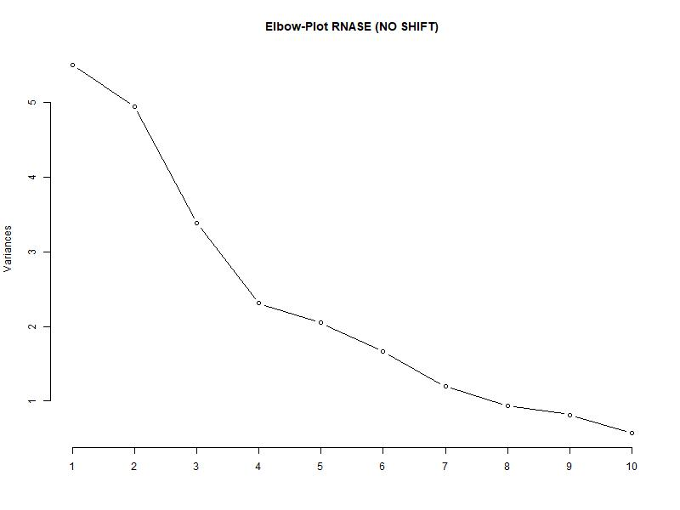
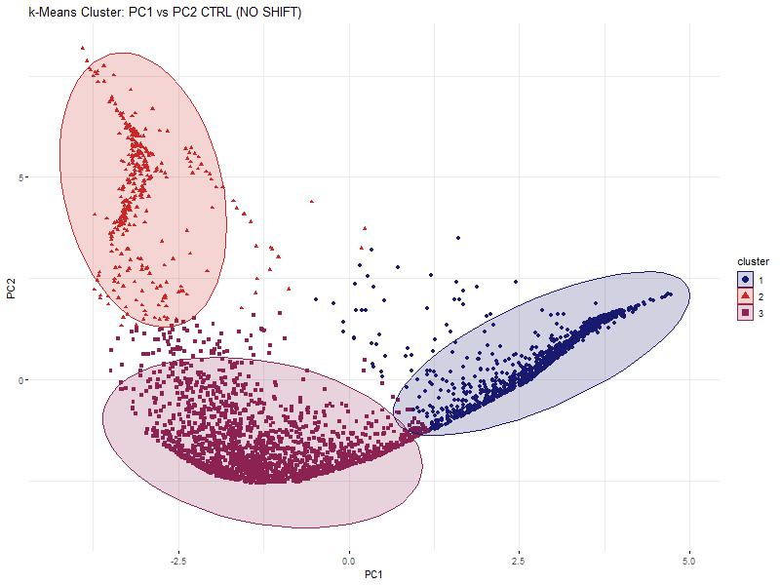
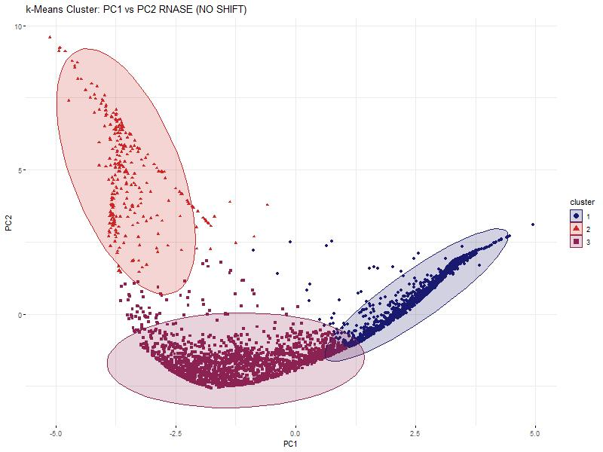
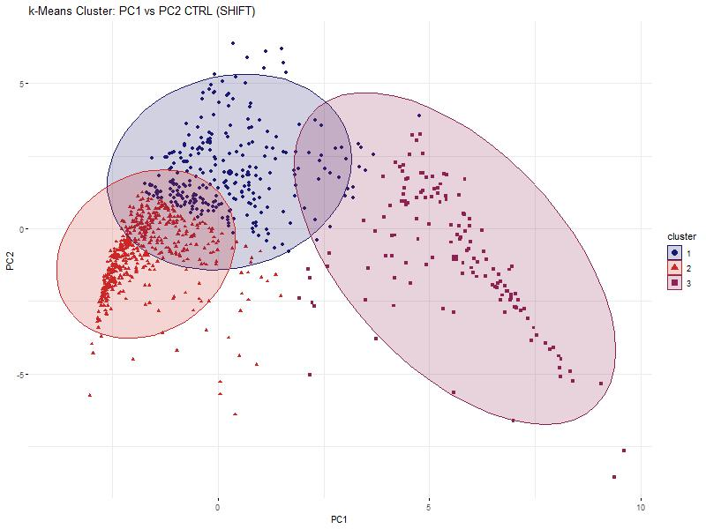
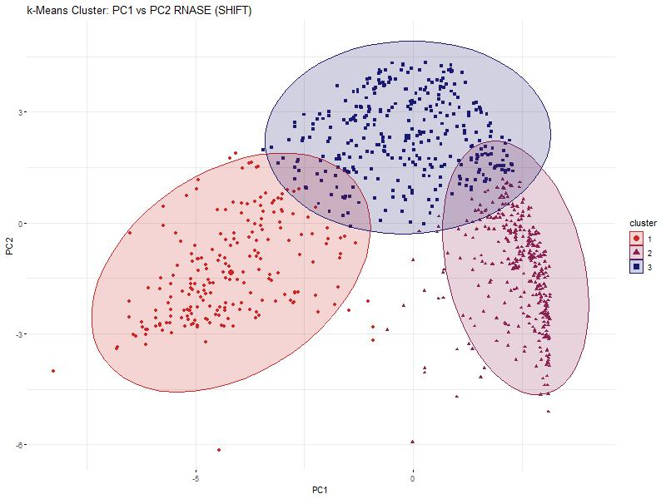


Hidden Alliances:
RNA-Dependent Protein Interactions
in Cancer Cells
Baureis, J., Ferdin, J., Nicklas, B., Wintel, L.
Data Analysis Project Molecular Biotechnology SS2025
1
Identifying RNA-Dependent Proteins from Proteomic Data
„We want to extract RNA-dependent proteins from proteomic screens”
„RNA-dependency = the proteins interactome depends on RNA“
What Makes RNA-Dependent Proteins Worth Investigating?
Key Regulators: RBPs control RNA metabolism & gene expression.
Disease Links: Misregulation is tied to cancer & neurodegeneration.
Functional Clues: New RBPs hint at RNA’s role in specific pathways.
Interaction Networks: Mapping RNA-protein complexes reveals regulatory logic.
Molecular Insights: Deepens our understanding of cell cycle and cellular behavior.
Key Characteristics of Our Dataset
Our dataset was generated using the R-Deep approach
~5000 Proteine in 25 Fraktionen, Rnase vs. CTRL
Dimensions
2
Our Approach
1) Data preparation
Data cleanup
“Rearrange and reorder the columns to their treatment, replicate and fraction”
Normalization
2) Data exploration
Identification of maxima and shoulders
Selection criteria & Wilcoxon Test
Visualization for the order of selection criteria
Pie charts for selection results
3) Data reduction
PCR
k-means clustering
4) Data modelling
Linear Regression
3
4
Discussion
Our Achievements
Critical review of our own results and methods (e.g., Selection criteria made us delete some RBPs. Why? What were their properties?)
Why do we find fewer proteins than Maïwen?
We found X proteins that ...
5
References
Sternburg et al., Global Approaches in Studying RNA-Binding Protein Interaction Networks, 2020, Trends in Biochemical Sciences.pdf
Caudron-Herger et al., R-DeeP Proteome-wide and Quantitative Identification of RNA-Dependent Proteins by Density Gradient Ultracentrifugation, 2019, Molecular Cell.pdf
Caudron-Herger et al., Identification, quantification and bioinformatic analysis of RNA-dependent proteins by RNase treatment and density gradient ultracentrifugation using R-DeeP-2020-Nature Protocols_1.pdf
Corley et al., How RNA-Binding Proteins Interact with RNA Molecules and Mechanisms, 2020, Molecular Cell.pdf

Slide 2
Hidden Alliances:
RNA-Dependent Protein Interactions
in Cancer Cells
Baureis, J., Ferdin, J., Nicklas, B., Wintel, L.
Data Analysis Project Molecular Biotechnology SS2025
1
Identifying RNA-Dependent Proteins from Proteomic Data
„We want to extract RNA-dependent proteins from proteomic screens”
„RNA-dependency = the proteins interactome depends on RNA“
What Makes RNA-Dependent Proteins Worth Investigating?
Key Regulators: RBPs control RNA metabolism & gene expression.
Disease Links: Misregulation is tied to cancer & neurodegeneration.
Functional Clues: New RBPs hint at RNA’s role in specific pathways.
Interaction Networks: Mapping RNA-protein complexes reveals regulatory logic.
Molecular Insights: Deepens our understanding of cell cycle and cellular behavior.
Key Characteristics of Our Dataset
Our dataset was generated using the R-Deep approach
~5000 Proteine in 25 Fraktionen, Rnase vs. CTRL
Dimensions
2
Our Approach
1) Data preparation
Data cleanup
“Rearrange and reorder the columns to their treatment, replicate and fraction”
Normalization
2) Data exploration
Identification of maxima and shoulders
Selection criteria & Wilcoxon Test
Visualization for the order of selection criteria
Pie charts for selection results
3) Data reduction
PCR
k-means clustering
4) Data modelling
Linear Regression
3
4
Discussion
Our Achievements
Critical review of our own results and methods (e.g., Selection criteria made us delete some RBPs. Why? What were their properties?)
Why do we find fewer proteins than Maïwen?
We found X proteins that ...
5
References
Sternburg et al., Global Approaches in Studying RNA-Binding Protein Interaction Networks, 2020, Trends in Biochemical Sciences.pdf
Caudron-Herger et al., R-DeeP Proteome-wide and Quantitative Identification of RNA-Dependent Proteins by Density Gradient Ultracentrifugation, 2019, Molecular Cell.pdf
Caudron-Herger et al., Identification, quantification and bioinformatic analysis of RNA-dependent proteins by RNase treatment and density gradient ultracentrifugation using R-DeeP-2020-Nature Protocols_1.pdf
Corley et al., How RNA-Binding Proteins Interact with RNA Molecules and Mechanisms, 2020, Molecular Cell.pdf

