Slide 1


RiboSix – AN RNA-BINDING PROTEIN STORY
The world of RBPs
In a small space called HeLa, there are many small molecules working together creating one unit. They are going through many seasons giving their all to make it work, but not necessarily everyone is working during every season. This is what makes living there for them so beautiful, after a lot of hard work many of them can gather their energy. One season is called mitosis and this is the season of our little protein RiboSix.
So, join us on his journey to discover the village of HeLa.
Our Goal: Hunting RNA-Binding Proteins in the Deep
During our project, our main goal was to identify all the RBPs in mitotic HeLa cells. For this, all proteins were fractioned once with RNase treatment and once without. The intensity of each proteins in 25 fraction was then analyzed by mass spectrometry in triplicates.
The gathered data was tested for reproducibility, cleaned up and characterized by their peak pattern. What was now the criteria we used to characterize a protein as an RBP?
We used a function used Centre of Mass (CoM) to have one specific value for every protein for both treatments. When the CoM showed a significant left shift from Ctrl to RNase, the protein was defined as an RBP.
Additionally, the identified RBPs were compared to RBPs of non-synchronized cells to identify the RBPs only active in mitosis. Furthermore, complexes of these RBPs were determined by clustering and a linear regression analysis was performed to predict molecular weight of the RBPs.
Reproducibility Analysis: Am I real?
Normalization: Finding the right fit for the day
- SD + Mean
Shift Analysis: Finding my species
Mitosis: Finding my home
Complexe Analysis: Finding Friends
Linear Regression: Determining my weight

Slide 2
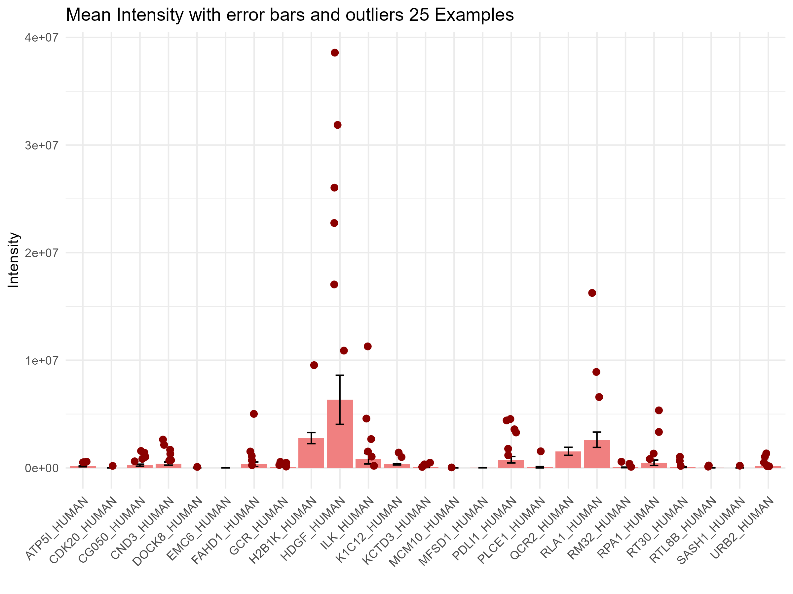
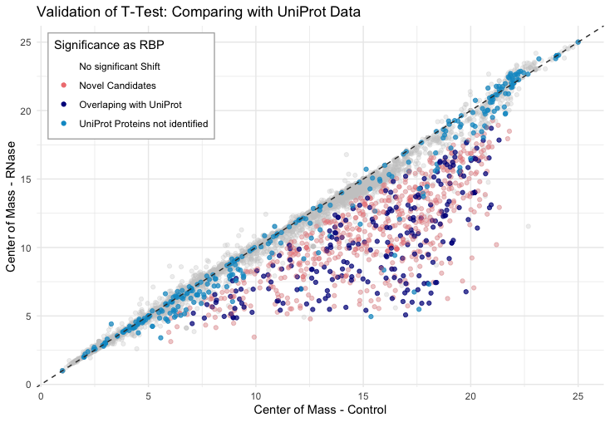
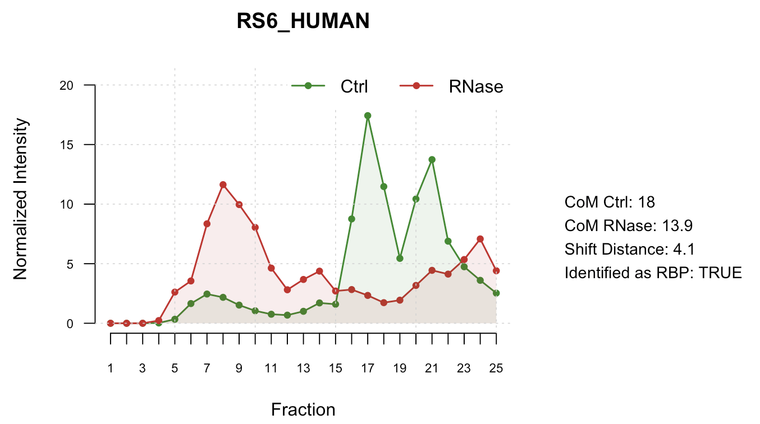
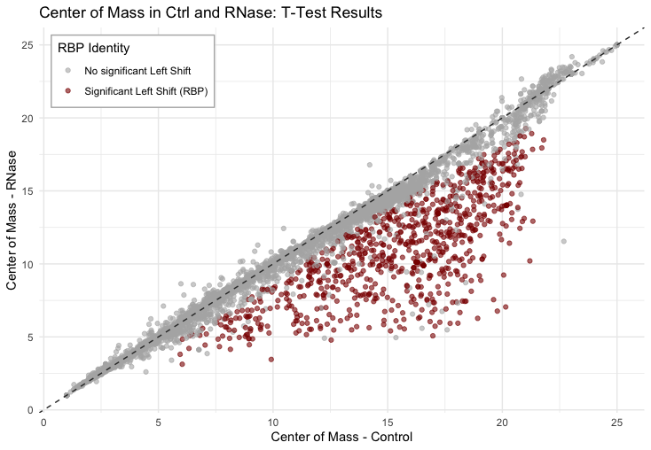
RiboSix –Story of an RNA-Binding Protein
Proteome-wide screen for RNA-dependent proteins particularly relevant in mitosis
The world of RBPs
In a small space called HeLa, there are many small molecules working together creating one unit. They are going through many seasons giving their all to make it work, but not necessarily everyone is working during every season. This is what makes living there for them so beautiful, after a lot of hard work many of them can gather their energy. One season is called mitosis and this is the season of our little protein RiboSix.
So, join us on his journey to discover the village of HeLa.
Our Goal: Hunting RNA-Binding Proteins in the Deep
During our project, our main goal was to identify all the RBPs in mitotic HeLa cells. For this, all proteins were fractioned once with RNase treatment and once without. The intensity of each proteins in 25 fraction was then analyzed by mass spectrometry in triplicates.
The gathered data was tested for reproducibility, cleaned up and characterized by their peak pattern. What was now the criteria we used to characterize a protein as an RBP?
We used a function used Centre of Mass (CoM) to have one specific value for every protein for both treatments. When the CoM showed a significant left shift from Ctrl to RNase, the protein was defined as an RBP.
Additionally, the identified RBPs were compared to RBPs of non-synchronized cells to identify the RBPs only active in mitosis. Furthermore, complexes of these RBPs were determined by clustering and a linear regression analysis was performed to predict molecular weight of the RBPs.
Reproducibility Analysis: Am I real?
Normalization: Finding the right fit for the day
SD + Mean
Shift Analysis: Finding my species
Descriptive Analyses
Peak Analysis
For each protein profile, up to 6 peaks were identified using a slope-based findPeaks function.
Peaks were accepted if their intensity exceeded 3% of total signal.
Applied to control and RNase-treated samples (triplicates).
Shift Characterization
Center of mass (COM) was computed across 25 fractions for each protein.
Shift distance = COM<sub>Ctrl</sub> − COM<sub>RNase</sub>.
Positive = left shift; negative = right shift; near 0 = no shift.
Statistical Analysis
Left-Shift Significance Test
For each protein, shift distances from triplicates were tested using one-sided t-tests.
Proteins with a significant left shift >1 fraction were classified as RNA-dependent.
Mitosis: Finding my home
Identified
RBPs
Analysed
UniProt RBPs
Complexe Analysis: Finding Friends
Linear Regression: Determining my weight
Main FIndings

