Slide 1


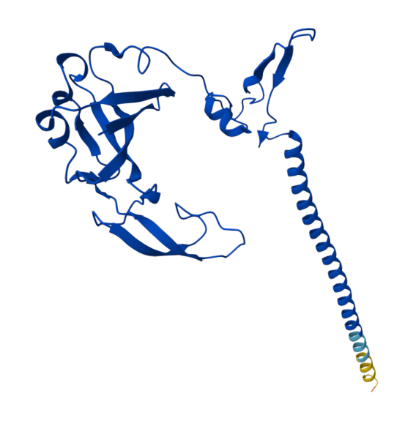
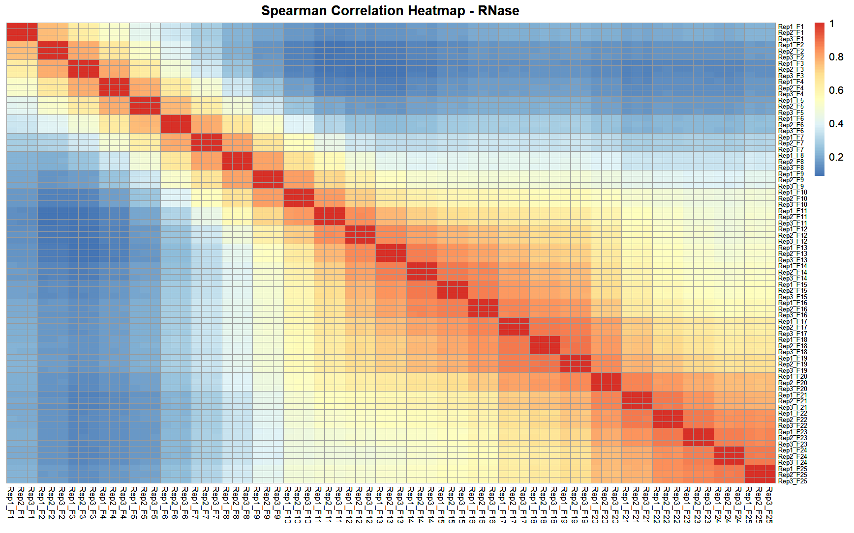
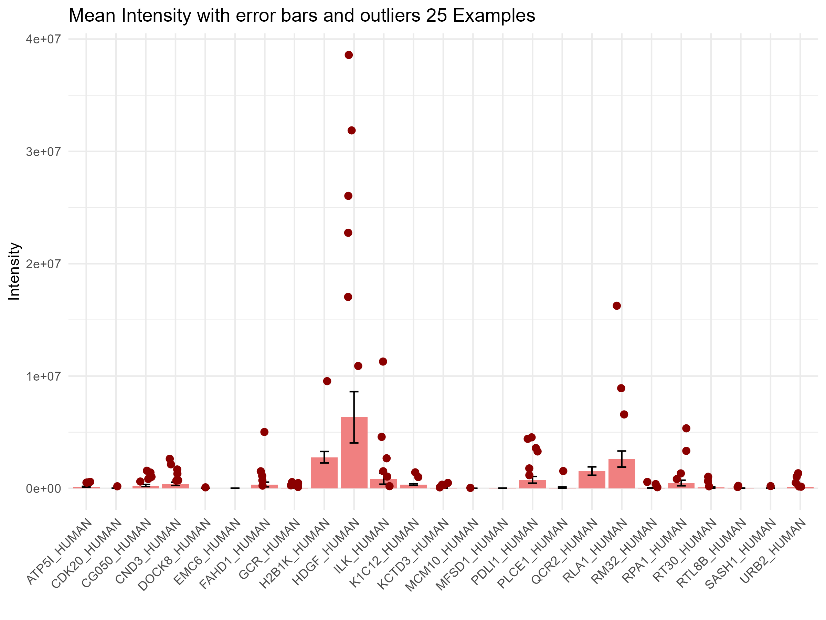
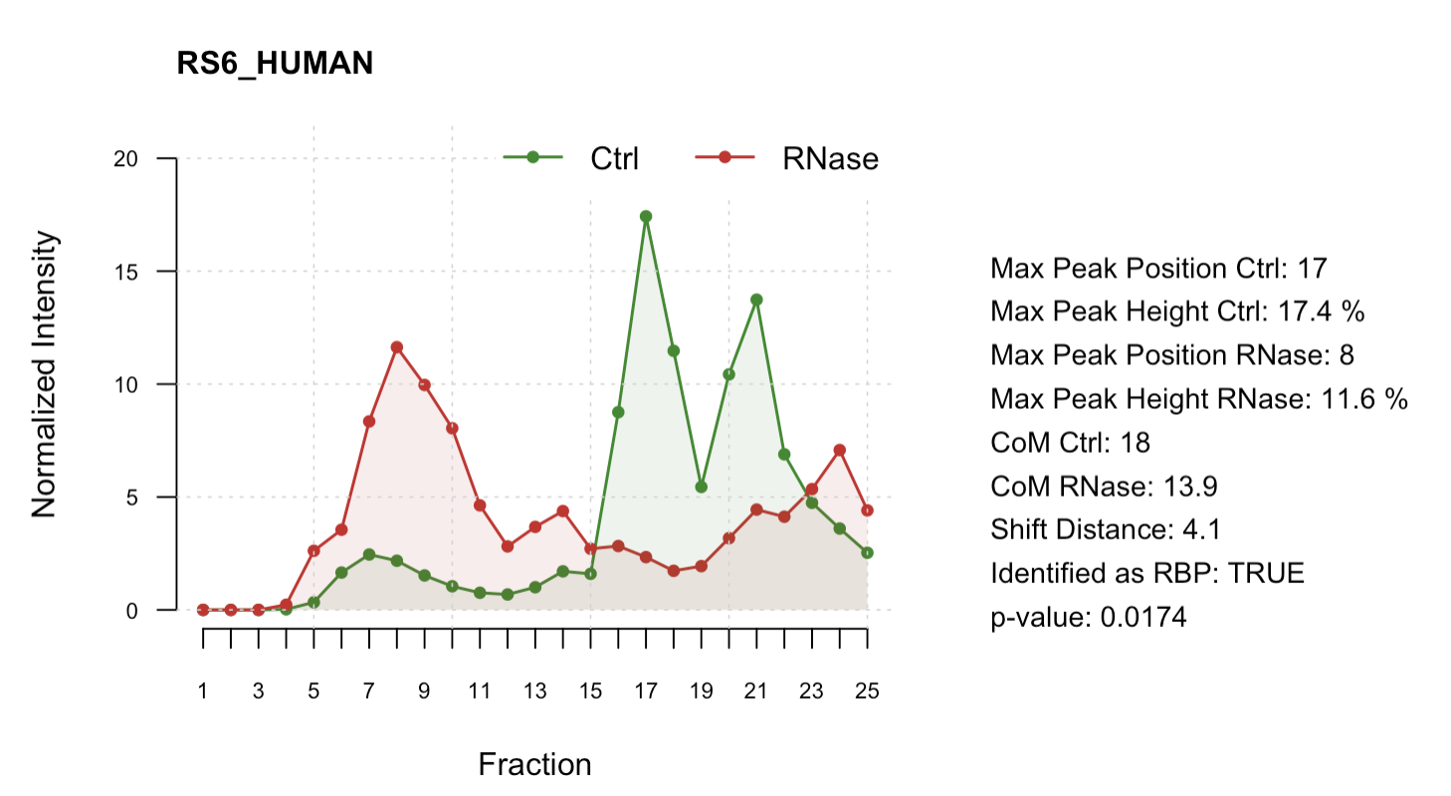
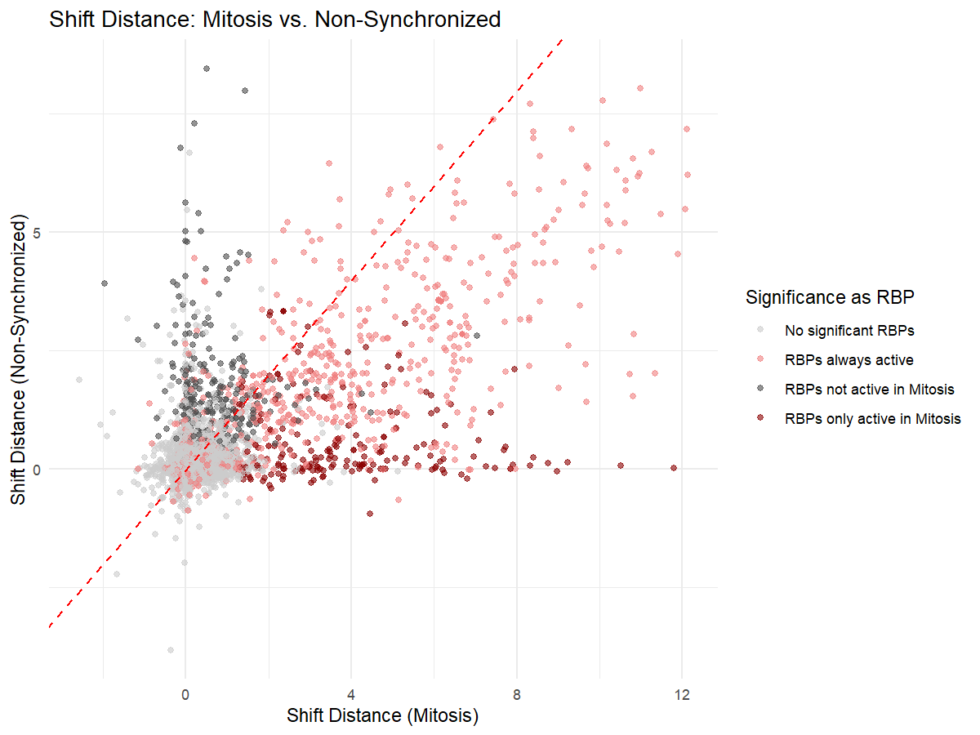
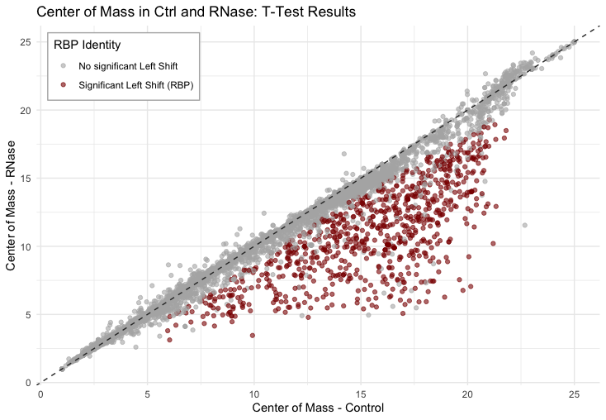
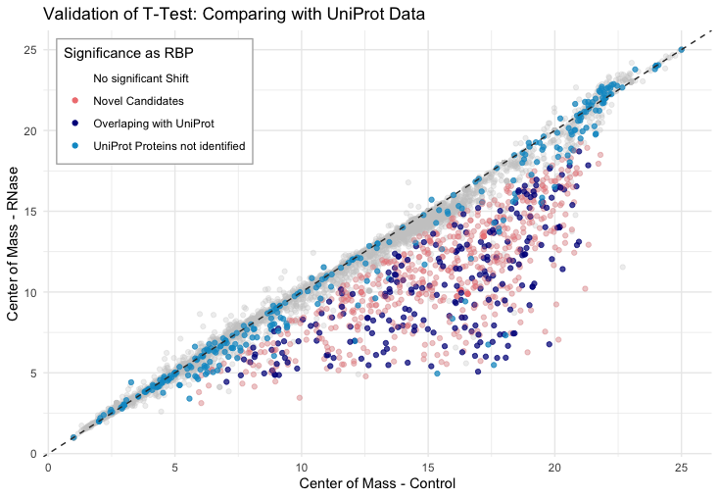
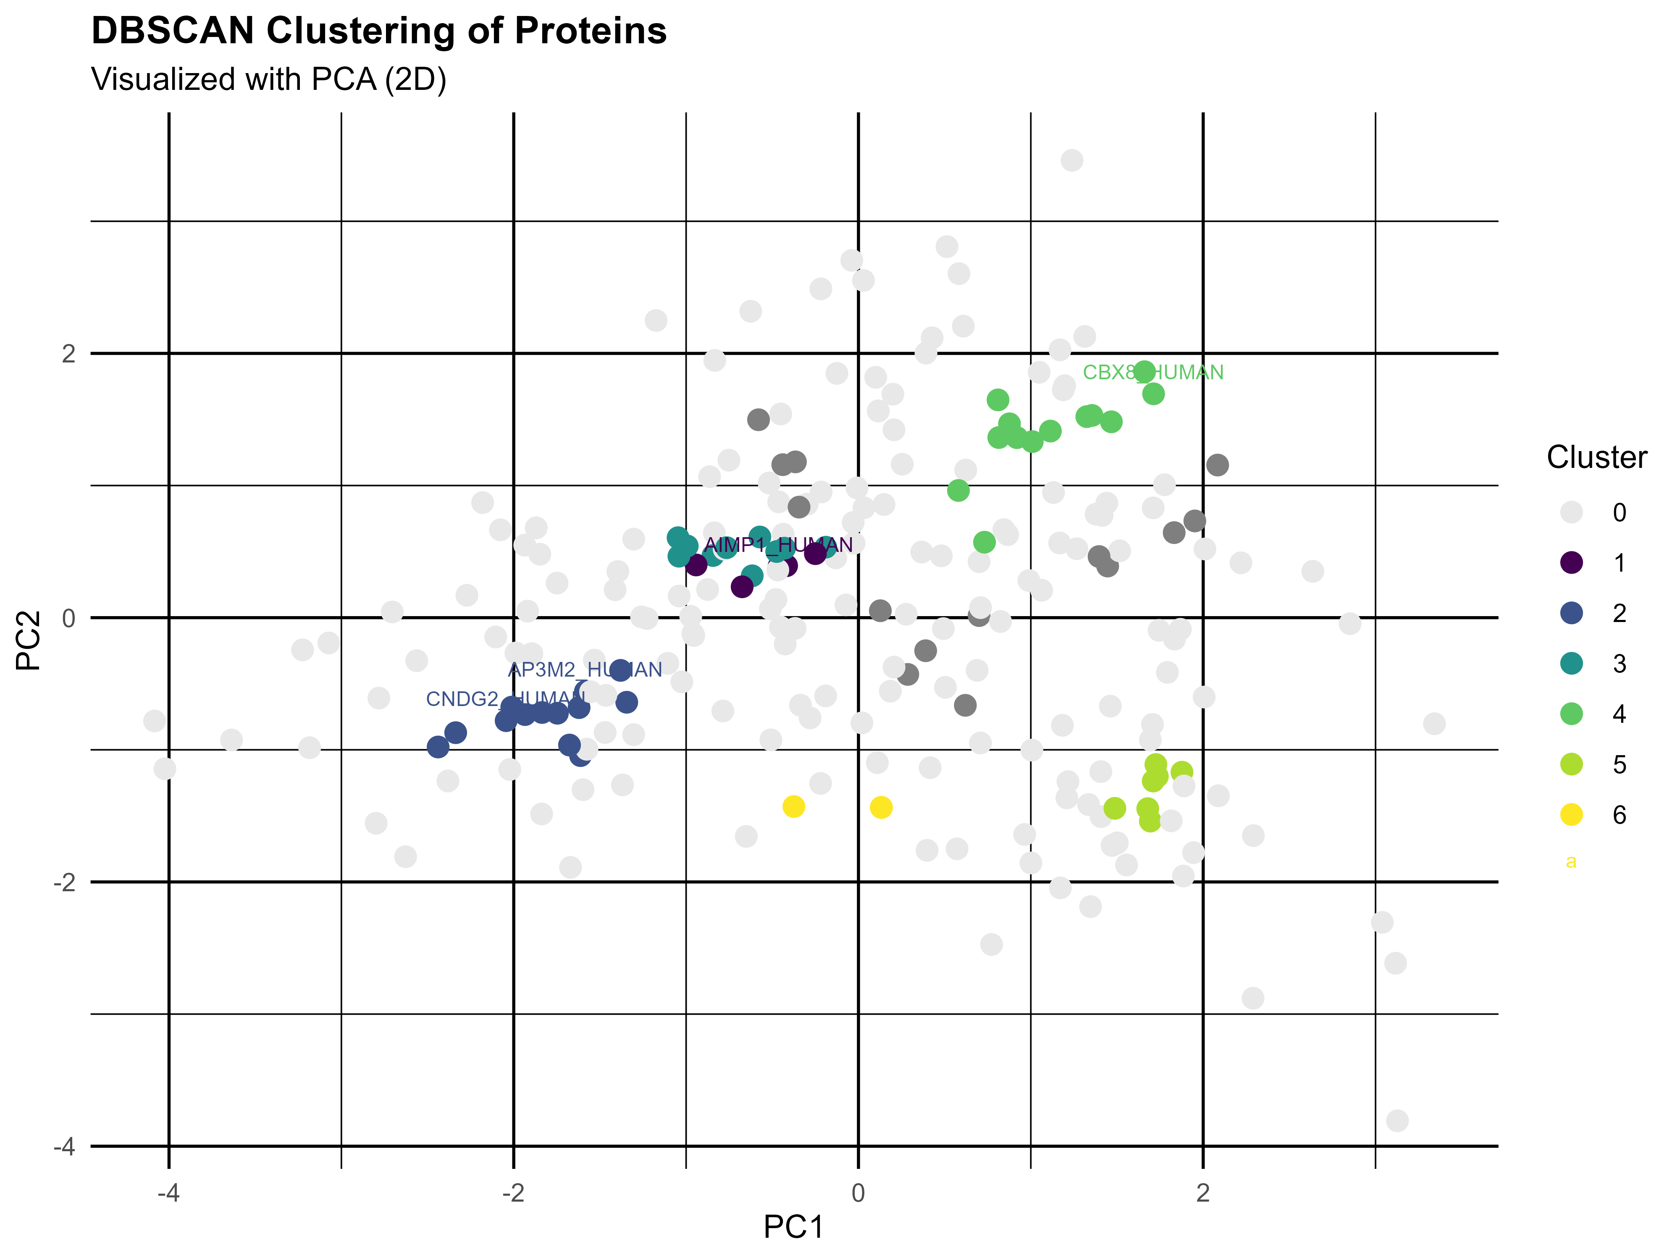
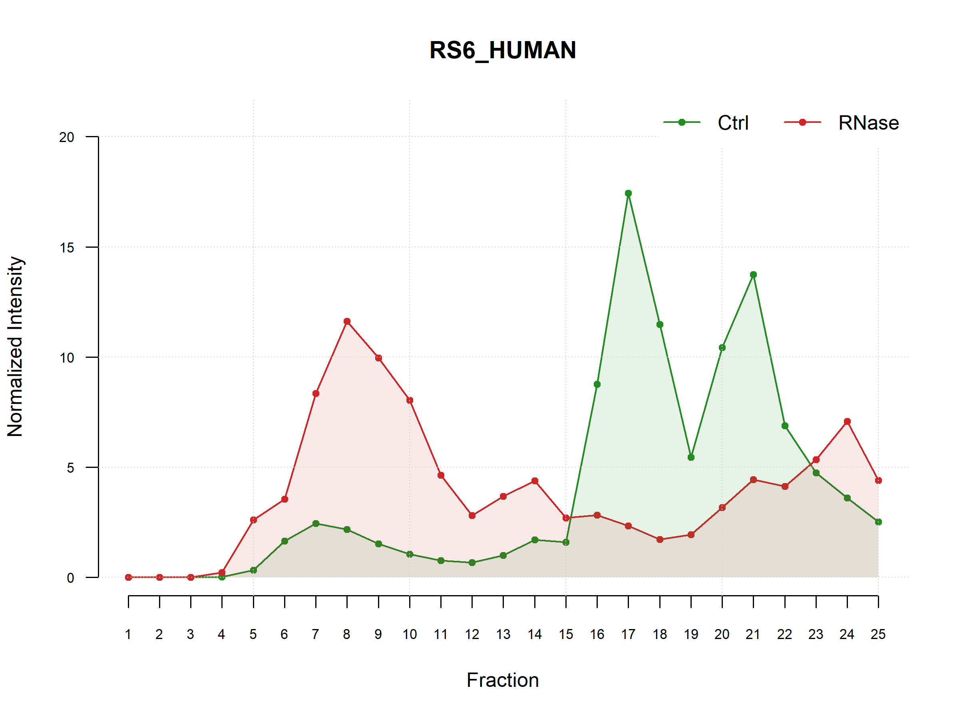
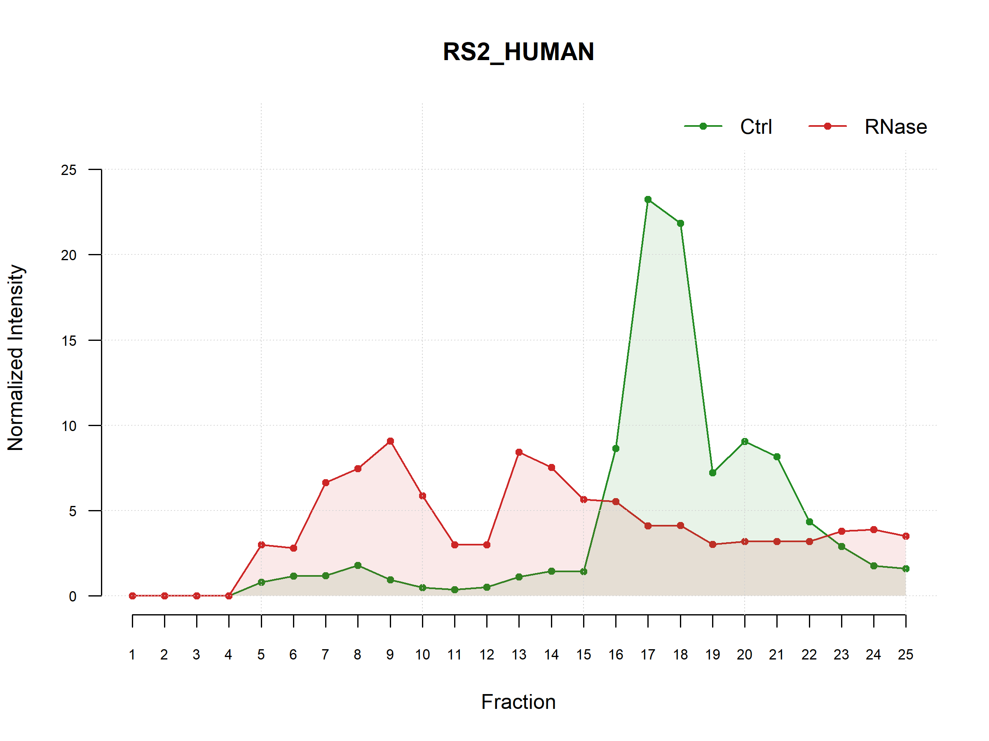
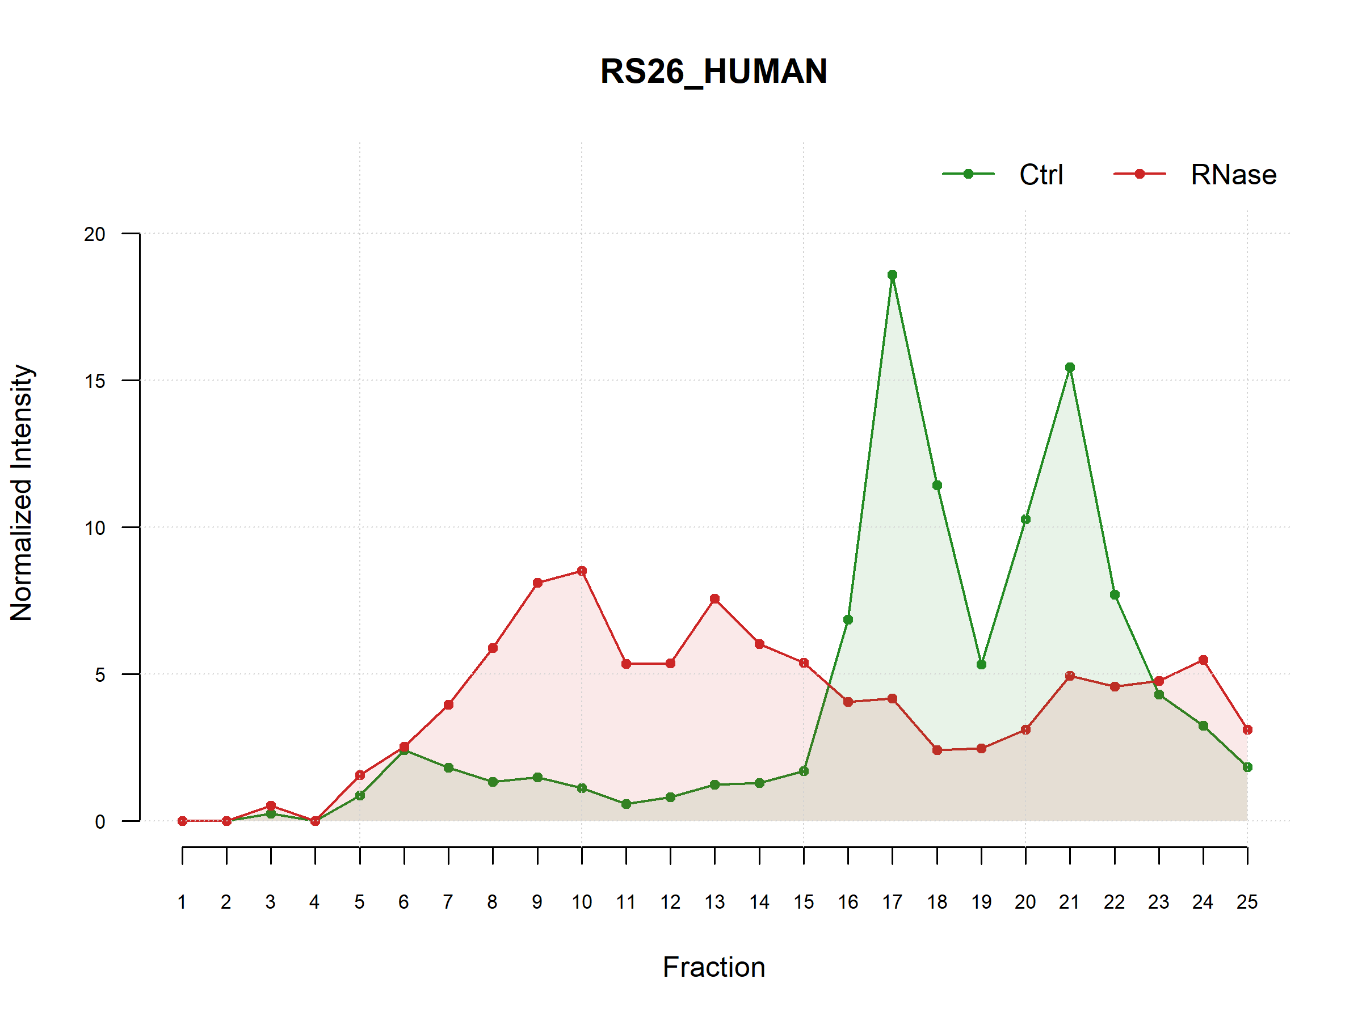
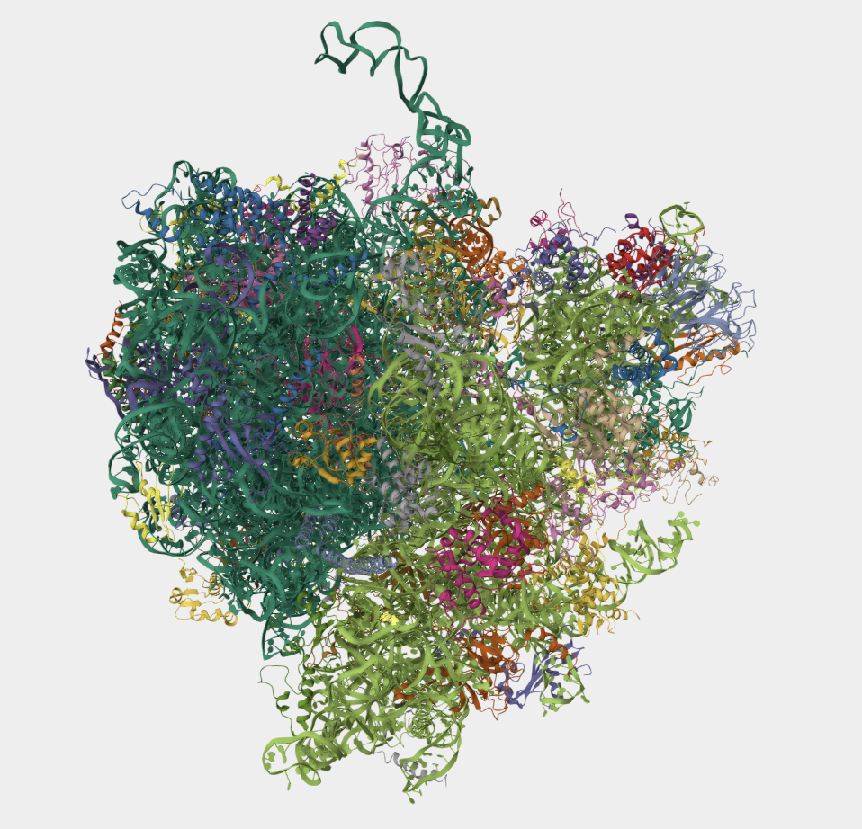
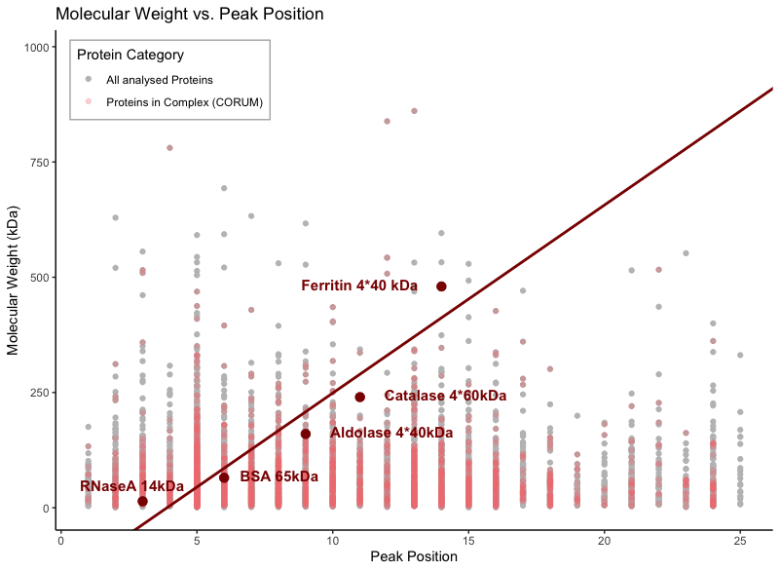
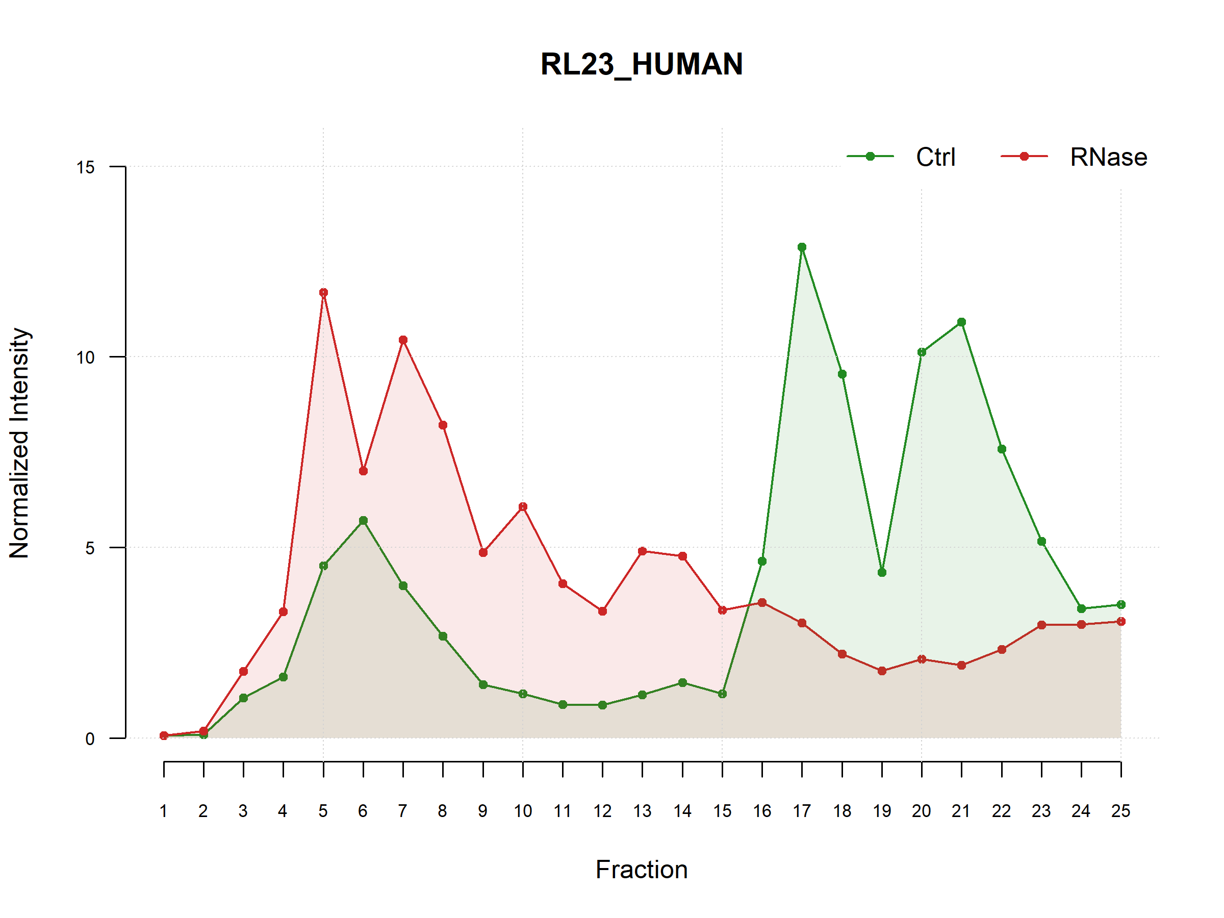
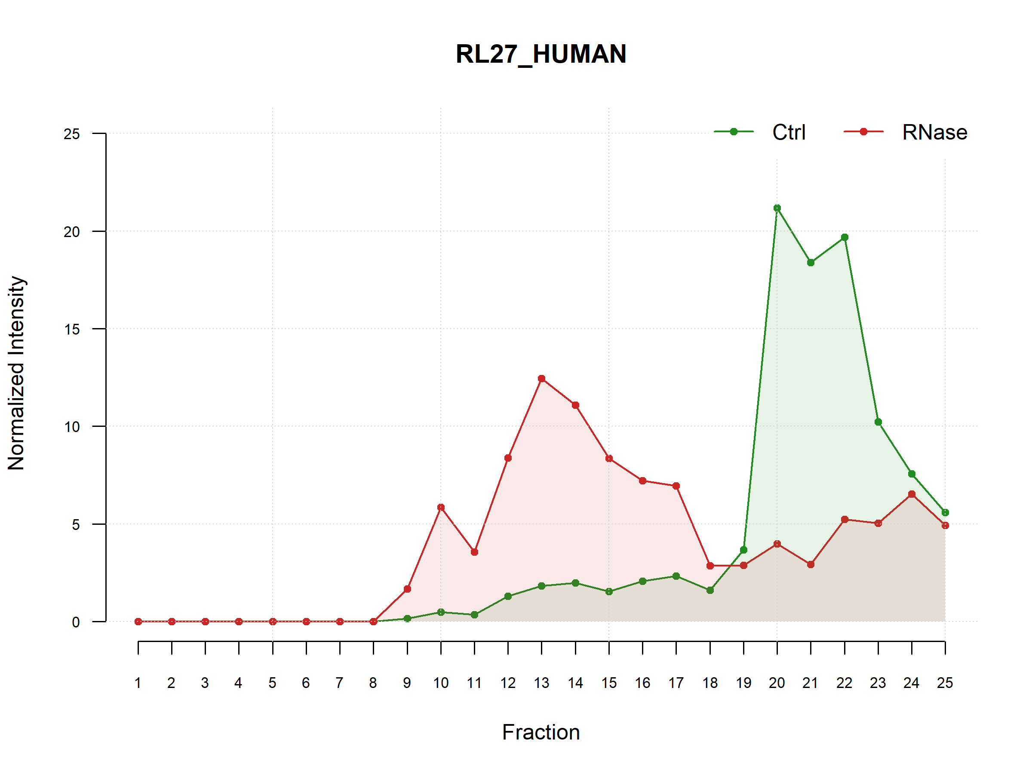
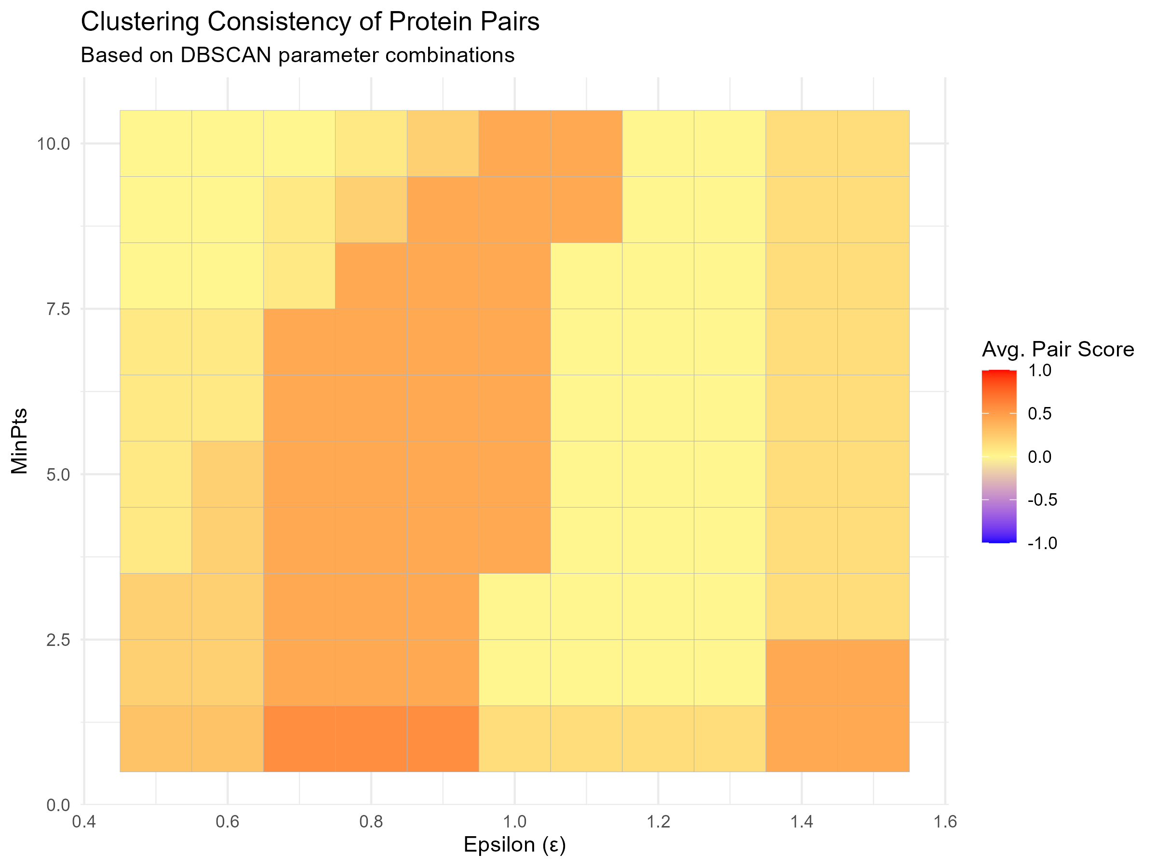
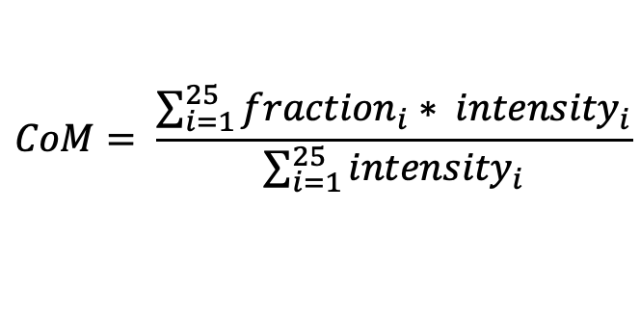
RiboSix –Story of an RNA-Binding Protein
Proteome-wide screen for RNA-dependent proteins particularly relevant in mitosis
The world of RBPs
In a small space called HeLa, there are many small molecules working together creating
one unit. They are going through many seasons giving their all to make it work, but not
necessarily everyone is working during every season. This is what makes living there for
them so beautiful, after a lot of hard work many of them can gather their energy. One season
is called mitosis and this is the season of our little protein RiboSix. So, join us on his journey to
discover the village of HeLa.
Our Goal: Hunting RNA-Binding Proteins in the Deep
The main goal of our project was to identify RNA-binding proteins (RBPs) in mitotic HeLa cells. To achieve this, proteins were fractionated with and without RNase treatment. Each sample was separated into 25 fractions, and protein intensities were measured using mass spectrometry in triplicates.
To uncover potential RBPs, we performed the following key steps:
Reproducibility analysis
Normalization of the data
Peak characterization
Shift analysis, where a left shift in the RNase condition indicates RBP behavior
To gain deeper insights, we extended the analysis by:
Identifying RBPs specifically active during mitosis
Clustering peak characteristics to reveal potential complexes
Performing linear regression to predict molecular weight from peak data
Hi, that’s me :)
Reproducibility Analysis: Am I real?
To verify the reproducibility of the triplicates in our dataset, Spearman correlations were calculated between all replicate–fraction combinations. The resulting correlation coefficients (r-values) were visualized as two separate heatmaps - one for the RNase treatment (Fig. X on the right) and one for the control condition.
Reproducibility is indicated by high correlations within corresponding fractions across replicates, which should appear as prominent diagonal patterns in 3×3 blocks on the heatmaps. This diagonal correlation structure was evident in both treatments.
Normalization: Finding the right fit for the day
Information about Data
Total number of Proteins:
Number of Fractions: 25 Fractions
Overall maximum intensity: 1514642849 (au.?) representing signal strength
Overall minimum intensity: 0
Number of Na: 0
How we adapted our data for our analisis
Averedging over all Triplicates
Normalizing to 100: each protein is scaled so that the distribution within the Ctrl and RNAse conditions each sums to 100 (for every Protein)
Fig. X Reproducibility heatmap (RNase, Spearman correlation): Heatmap displays pairwise Spearman correlation coefficients between all replicate–fraction combinations under RNase treatment. High correlations within 3×3 diagonal blocks indicate strong reproducibility across corresponding fractions.
Shift Analysis: Finding my species
Descriptive Analyses – That’s how I look like
Peak Analysis: For each protein profile, up to 6 peaks were identified using a slope-based function on all normalized values for control- and RNase-treatment. (Treshold : 3% of maximal signal intensity)
Fig. X Mean protein intensities across 25 fractions under control conditions: Bar plot showing the average intensity for 25 randomly selected proteins measured across 25 fractions in the Ctrl condition. All Reps were averaged already. Each bar represents the mean intensity per protein, with error bars indicating the standard error of the mean (SEM) across fractions. This visualization highlights the variability in abundance profiles among different proteins across the cellular gradient.
Shift Characteristics Protein distributions were summarized using the Center of Mass (CoM), calculated as the weighted average across all fractions.
$$Shift distance =CoM Ctrl −CoM RNase$$
Fig. X Intensity profile of RS6 : Plot shows normalized signal distributions as well as extracted descriptive parameters such as peak positions, peak heights, and shift distance, t-test results.
Identification of Mitosis-Specific RBPs: Clocking in for the season
Left shift: distance > 0 ; Right shift: distance < 0 ; No shift: distance ~ 0
$$CoM= \frac{\sum_{i=1}^{25}{{fraction}_{i}∗ {intensity}_{i}}}{\sum_{i=1}^{25}{{intensity}_{i}}}$$
Comparative Shift Analysis
To investigate RNA-binding protein (RBP) activity beyond mitosis, we applied the same shift analysis pipeline to non-synchronized HeLa cells. For each protein, shift distances were calculated using center of mass (CoM) values derived from normalized signal distributions across all replicates. Normality was evaluated using the Shapiro–Wilk test, and statistical significance was determined by a one-sided t-test against a defined threshold.
This scatterplot visualizes the resulting shift distances for each protein, comparing mitotic and non-synchronized conditions. Each point represents a protein and reflects its condition-specific RNA dependence. The red dashed identity line marks equal shifts across both cell states.
Statistical Analysis – Do I have a connection with RNA?
T-Test: To statistically assess RNA dependence, we computed shift distances from CoM values across all replicates. A Shapiro-Wilk test was performed to confirm normality. If normally distributed, a one-sided t-test was used to assess whether the mean shift exceeded 1.
Out of 7159 analysed Proteins, 794 exihibited a significant left shift with RNase Treatment and where classified as RBPs (RNA-dependend).
Fig. X Visual Presentation of T-Test Results: Using a scatterplot of CoM-Ctrl and CoM-RNase to visualize shift distance and direction.
Fig. X Results and Limitations of Shift Sginificance Testing: Outcome of t-test and pipeline evaluation for all proteins, with representation of all excluded proteins.
Fig. X Comparative Shift Scatterplot (Mitosis vs. Non-Synchronized): Scatterplot displays shift distances derived from center of mass (CoM) values for all proteins under both conditions. Each point represents one protein, color-coded by statistical significance. The red dashed identity line marks equal shift behavior; proteins below the line show mitosis-specific leftward shifts, suggesting RNA dependency unique to mitosis.
Validation of Test Results – Comparing with UniProt
We used UniProt as a reference to identify proteins previously annotated as RNA-binding or RNA-interacting. UniProt lists 3,114 human proteins with RNA-binding function based on experimental data and literature. Of these, 543 were present in
Proteins falling below this line show significant RNA dependency exclusively during mitosis, suggesting that their activity is tightly linked to this specific cellular phase. In total 237 of the previous determined RBPs fall below this line. One of them is RiboSix, so indeed mitosis appears to be his active season.
our dataset, and 230 were correctly identified as RNA-dependent (hit rate: 42.4%). The remaining 564 RNA-dependent proteins detected in our analysis might represent novel RBP candidates.
Identified RBPs
UniProt RBPs
Complex Analysis: Finding Friends
564
230
313
DBSCAN :
is a clustering algorithm that considers point density and distance.
ε (epsilon): The maximum distance between two points to be considered neighbors.
MinPts: The minimum number of neighbors (within ε distance) to form a core point, border points are those within ε of a core point.
Fig. X Novel Candidates and known RBPs: Intersecting between previously noted UniProt RBPs analysed in our sample and RBPs identified by this pipeline
Linear Regression: Determining my weight
Hypothesis: In theory, heavier proteins migrate to deeper fractions in a sucrose gradient, so we therefore hypothesized, that a protein‘s peak position after RNase treatment might reflectits molecular weight. Monomeric molecular weights were retrieved from UniProt. To illustrate the expected relationship, we included five standard reference proteins from Caudron- Herger et al. (2019) with known mass and elution positions.
Choosing parameters
To validate the efficiency in clustering we created a heatmap with a specific scoring logic. We adjusted our DBSCAN to ε = 0.7 and MintPts = 4.
However, most proteins did not follow the expected trend!
Choosing a control : - there I am again
40S Ribosomal Complex: A complex that, according to CORUM data, exists and includes 4 proteins from our RBS (ribosome binding site) during mitosis positive control
The proteins UIMC1_HUMAN and LPPRC_HUMAN were used as negative controls
Fig. X Proteins in 2D Pca showing results from clustering method DBSCAN: Only Proteins from RBPs in Mitosis where clustered. Dimension reduction on Data from Ctrl : COM and Peak hight. ε = 0.7 and MintPts = 4.
Results: Predicting molecular weight by maximal peak position
Spearman Correlation: ρ = 0.014, p = 0.25
Linear Regression: R² = 0.00017, p = 0.26 (F-Test)
Further Analysis:
All tests we repeated using the Center of Mass (CoM) instead of peak position.
We also tested the hypothesis that many proteins may remain in RNA-independent complexes after RNase treatment, which could distort elution profiles. To test this, we removed all 2200 proteins listed in the CORUM* database.
No improvement in correlation or regression
Outcome: - did I find my Family?
From 40S Ribosomal Complex: 3 out of 4 proteins where clusterd together (cluster 4)
From Nop56p-associated pre-rRNA complex: 4 out of 9 where clusterd together.
Total number of Proteins in cluster 4: 13
Disscussion:
Elution does not only depend on size, but also on shape and density, so peak based features might be to simplistic. Plus CORUM does not reflekt all protein interactions, that might influence elution.
Fig. X Relation of monomeric molecular weight and maximal peak position : Scatterplot of all analyzed proteins, showing their monomeric molecular weight (UniProt) versus maximal peak position in the RNase condition. Red line shows expected linear trend based on five reference proteins (Caudron-Herger et al., 2019).
* CORUM is a curated database of experimentally validated protein complexes in mammals.
Fig. X Heatmap of accuracy for comibantions of Parameters for DBSCAN: Accuaracy calculated on pos. and neg. controls, from ε (0.5-1.5) and MintPts (1-10). Lower and higher ε lower the accuracy.
Main FIndings
40S ribosomal Comnples

