Slide 1
Sprint retrospective
PoliTo – Sotware Engineering II – Team 9

Slide 2
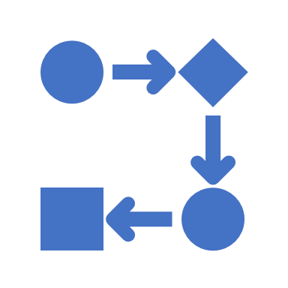
Process

Slide 3
Macro statistics
Stories committed | 6/6
Total story points committed | 26

Slide 4
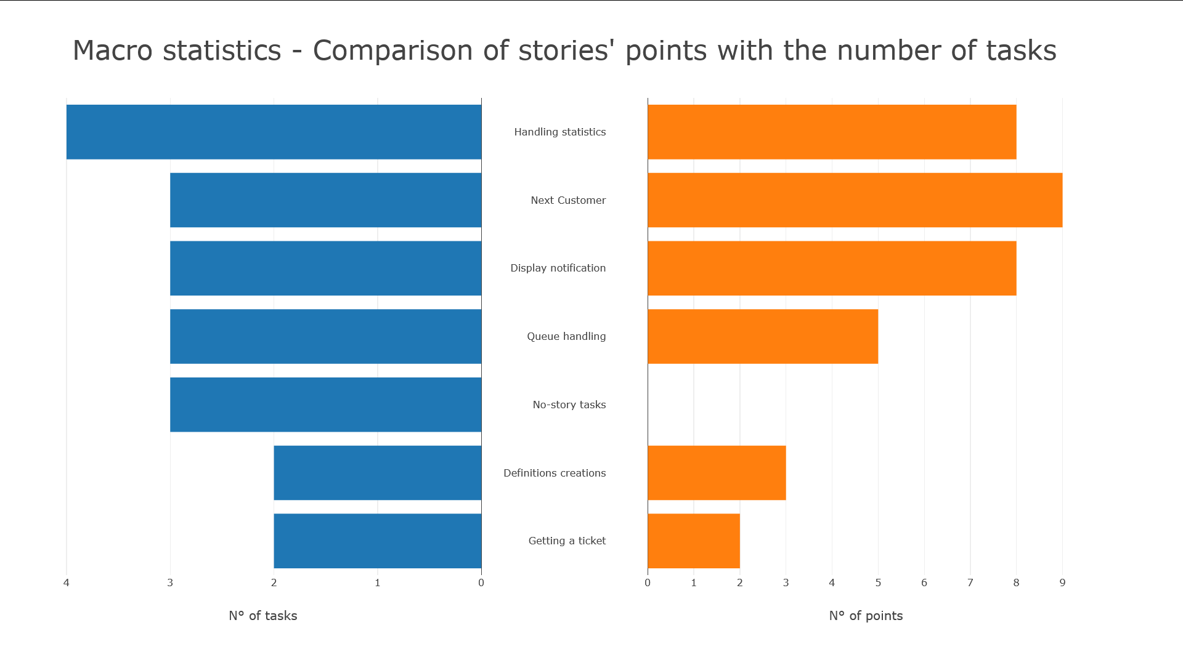

Slide 5
Macro statistics
Number of hours planned for sprint | 52
Number of hours spent for sprint | 41
Total task estimation error | 1,3
Actual hours per task: average Actual hours per task: standard deviation | 1.4 3.8

Slide 6
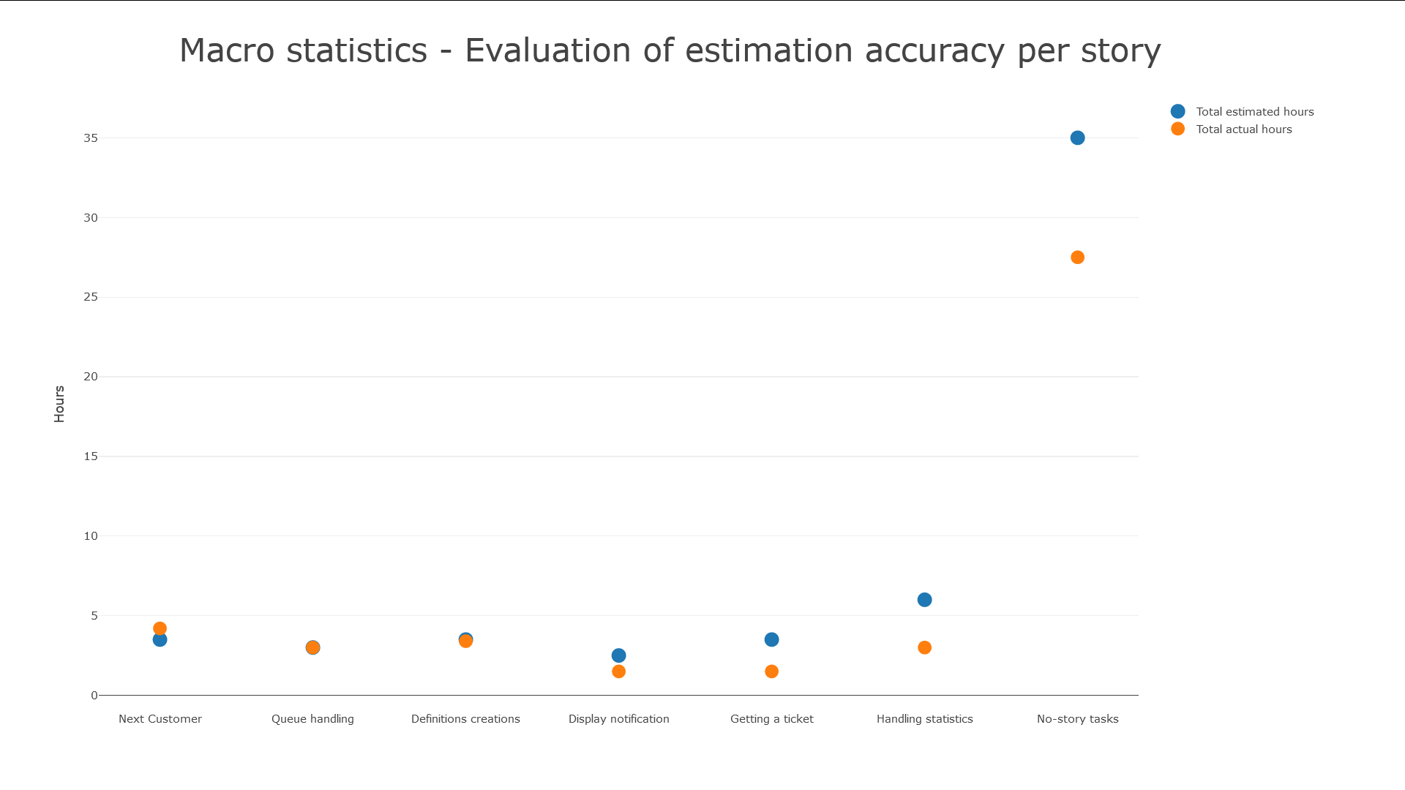
Notes:
The rightmost group of tasks (not really a story) collects so many hours if compared to each of the stories because we, as a team, worked all toghether; stories instead were developed by a single person separately.
The total estimation error proves the general overestimation brought out by the chart.
A more fine-grained analysis by considering tasks would reveal a notable variation of effort spent for each task.

Slide 7


Quality

Slide 8
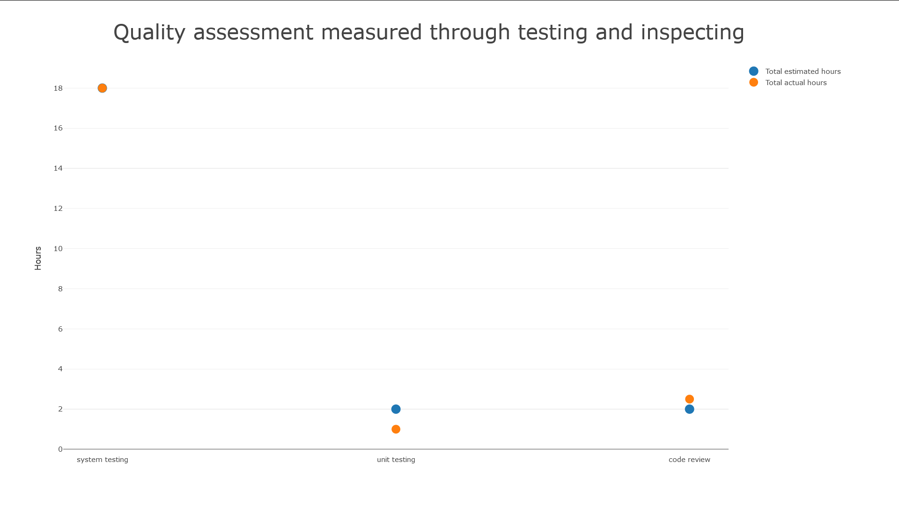
Notes:
System testing is the large part of quality improvement, along with some code beautification and separate testing of queries.

Slide 9
Final considerations
Reflections about estimation errors: General overestimation
Lessons learned: Communication, Teamwork, Adaptability, Dependability
Proposals for next sprint: - Less dependencies between teammates’ tasks - Using same tools ( IDE, Programming language version, etc) so teammates can help and be helped in configuration and usage - More consistency between document and code sources ( i.e. name of methods )

Slide 10
One thing we are proud as a team:
« A solid communication that lead us to solve problems and value members’ opinions »

Slide 11
Appendix

Slide 12
Stories' data
Story ID | # Tasks | Points | Total hrs estimated | Total hrs spent
1 - Definitions creations | 2 | 3 | 3,5 | 3,4
2 – Getting a ticket | 2 | 2 | 3,5 | 1,5
3 – Queue handling | 3 | 5 | 3 | 3
4 – Next Customer | 3 | 9 | 3,5 | 4,2
5 – Display notification | 3 | 8 | 2,5 | 1,5
6 – Handling statistics | 4 | 8 | 6 | 3
No-story tasks
Task ID | Total hrs estimated | Total hrs spent
1 – Creating project structure | 12 (2 per person) | 6 (1 per person)
2 – Database design | 1 | 0,5
3 – Testing and bug fixing | 22 (4 per person) | 21 (4 per person)

