Slide 1
Sprint retrospective
PoliTo – Sotware Engineering II – Team 9

Slide 2
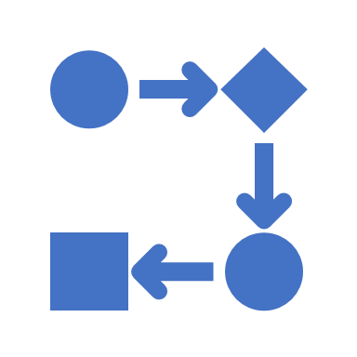
Process

Slide 3
Macro statistics
Stories committed | 6/6
Total story points committed | 26
Number of hours planned for sprint | 52
Number of hours spent for sprint | 41

Slide 4
Stories
Story ID | # Tasks | Points | Total hrs estimated | Total hrs spent
1 - Definitions creations | 2 | 3 | 3,5 | 3,4
2 – Getting a ticket | 2 | 2 | 3,5 | 1,5
3 – Queue handling | 3 | 5 | 3 | 3
4 – Next Customer | 3 | 9 | 3,5 | 4,2
5 – Display notification | 3 | 8 | 2,5 | 1,5
6 – Handling statistics | 4 | 8 | 6 | 3
No-story tasks
Task ID | Total hrs estimated | Total hrs spent
1 – Creating project structure | 12 (2 per person) | 6 (1 per person)
2 – Database design | 1 | 0,5
3 – Testing and bug fixing | 18 (3 per person) | 18 (3 per person)
Hours per task: ≈ 1.4 , (Standard deviation) 3.8
Total task estimation error: 1,3

Slide 5


Quality

Slide 7
Final considerations
Reflections about estimation errors: Understimation of project testing and bug fixing. Overstimation of many minor tasks and project structure.
Lessons learned: Communication, Teamwork, Adaptability, Dependability
Proposals for next sprint: - Less dependencies between teammates’ tasks - Using same tools ( IDE, Programming language version, etc) so teammates can help and be helped in configuration and usage - More consistency between document and code sources ( i.e. name of methods )

Slide 8
One thing we are proud as a team:
« A solid communication that lead us to solve problems and value members’ opinions »

