Slide 1


Signal Doctor
Michele Gennari
n° 0000832608
February 16° 2024
An Android Noise and Signals Measurement Application
A project for Mobile Application Languages course in Computer Science degree, UniBo

Slide 2

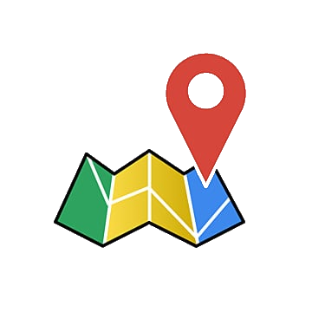
Introduction
Signal Doctor is a native Android mobile application. It builds upon the project specifications for the LAM course exam. Its main uses are:
Measuring environment noise, cellular connectivity signal strength and WiFi signal strength.
Presenting to the user a map for each measurement type, reporting measurements quality within geographic areas.

Slide 3
Application Requirements

Slide 4
Application Requirements
Measurements
App can measure noise, cellular signal strength, and Wifi signal strength
One-time measurements
Periodic background measurements every N time interval, where N is set by the user
Users must be notified when there are no measurements taken at their location, or when measurements are too old

Slide 5
Application Requirements
Measurements Map
Map keeps track of user location
One map overlay per measurement type
Overlays must divide map into areas which neither overlap or leave gaps
Overlays paint areas with a colour representing average quality of last X measurements taken there, where X is set by the user
Users must be notified when there are no measurements taken at their location, or when measurements are too old

Slide 6
Improved Application Features

Slide 7



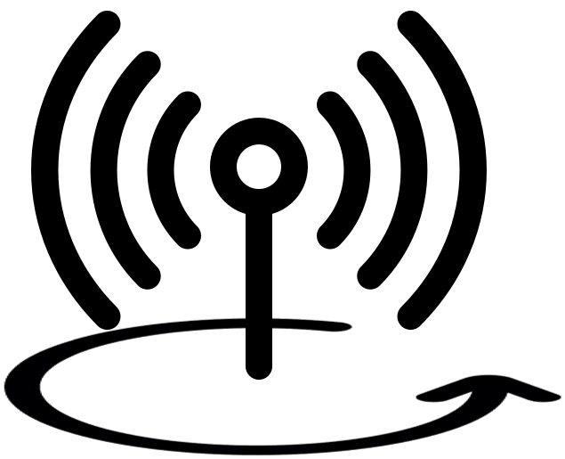
Improved Application Features
Online and Offline Modes
Measurements can be sent on a back-end server shared by clients, and map can merge offline and online data to paint areas
Fine-grained Map Area size
Areas change their size when user zooms in and out on the map
Location search bar
Users can navigate to a specific location on the map
Background measurements service
Background measurements are performed by a service that runs even when app is closed

Slide 8
Application architecture

Slide 9
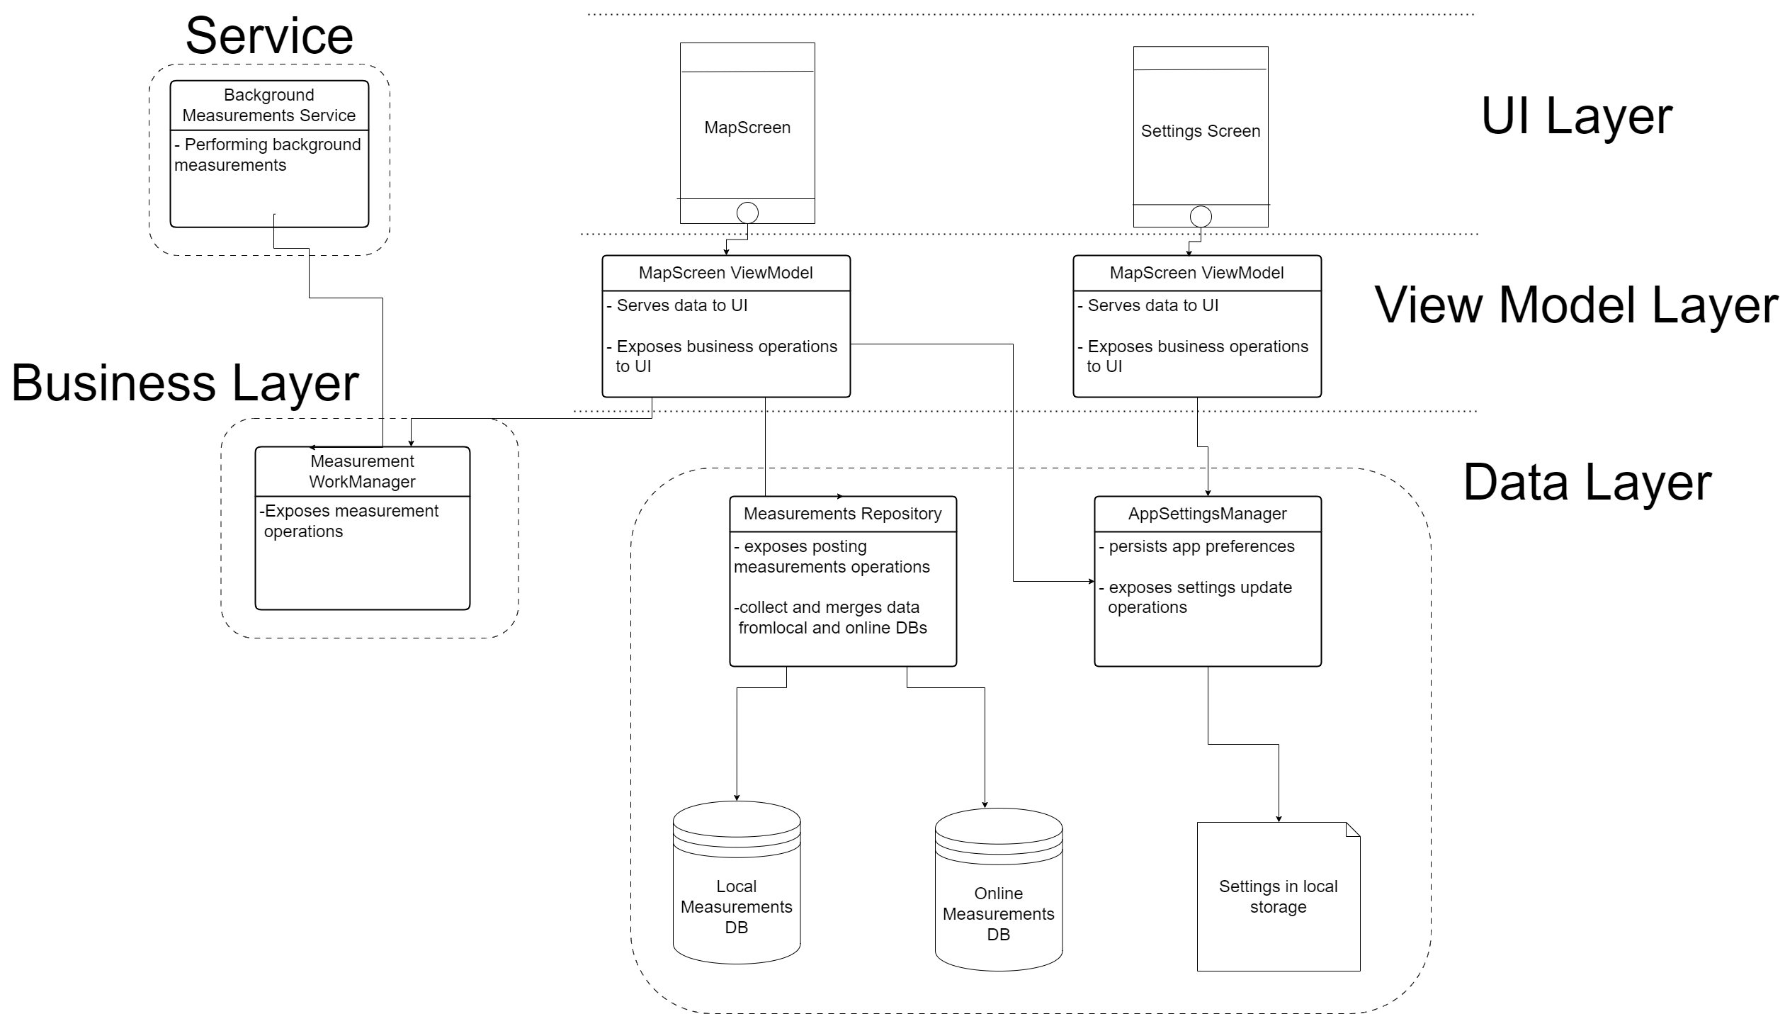
Application Architecture

Slide 10
Application Design & Implementations

Slide 11

Application Design and Implementations
General design choices and Implementations
Design | Implementation
Reactive to data updates | Kotlin Flows & Coroutines
Navigate through screens | Compose Navigation

Slide 12

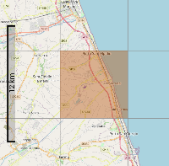
Application Design and Implementations
Measurements Map with Fine-grained areas
- Library: OSMdroid
Check if it’s between bounds
- Main idea:
Map tiles as areas to colour
Measurements data is stored along with the max zoom’s map tile index of where the measurement was taken
When drawing tiles, map overlays compute tile bounds in form tile indexes, and add to the average only those measurements that are within those bounds

Slide 13
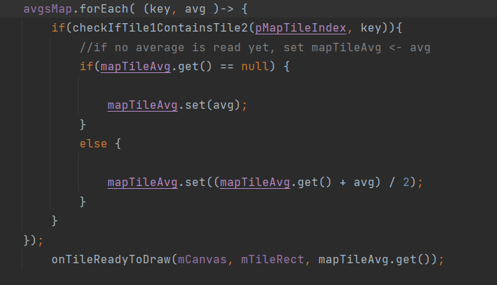
Measurements Map with Fine-grained areas
Application Design and Implementations
Measurement associated
with map tile index
When drawing map tile, computes average quality
with measurements within tile bounds
Colour is a gradient between
bad and good quality colours

Slide 14
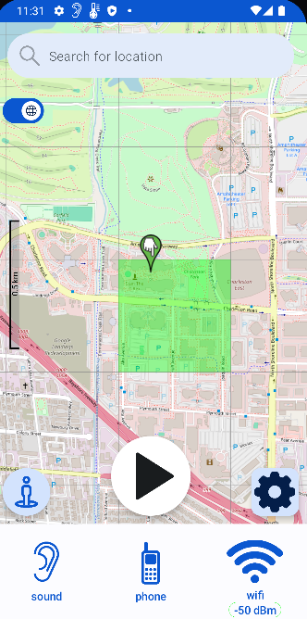
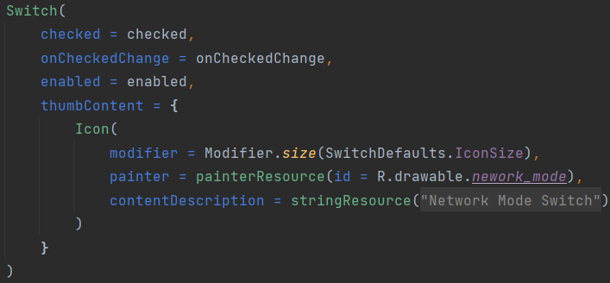
Application Design and Implementations
UI Screens
Framework, Library and API: Compose, Material and Kotlin StateFlows
- Why?:
App should look polished but minimalistic and material offers ready-to-use UI elements
Smooth reaction to data changes

Slide 15
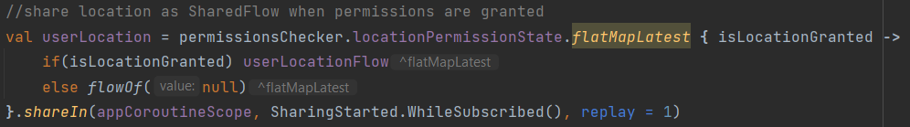
Application Design and Implementations
Location Updates
- Libraries: Kotlin SharedFlows and Google’s FusedLocationProvider
- Why?:
App constantly keeps track of location to show and produce consistent information/data, and that is an expensive operation
SharedFlows, as their name suggest, share geo location among app components that need it, with a single location updates operation

Slide 16

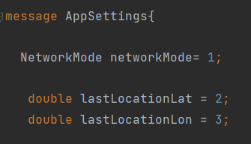
Application Design and Implementations
App Settings
- Libraries: Kotlin SharedFlows and Proto DataStore
- Why?:
We talked about pros of SharedFlows earlier
Protobuff ensures type safety, since kotlin generates classes form messages definitions

Slide 17


Application Design and Implementations
Measurements Repository
 | Local Database |  | Online Database
Library | Room |  | Firebase Relatime DB
Why? | Easy declarative approach |  | Easy to set up server
 | One entity definition serves for both Integrated with Flows: don’t need to actively ask for data
Base entity properties | UUID (for merging), Value, Date, Tile Index
Queries | Post measurement, get measurements, get averages relative to tile indexes

Slide 18


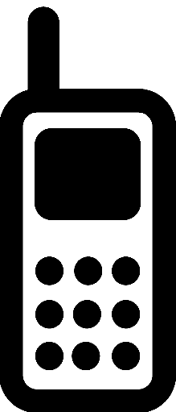
Application Design and Implementations
Measurements Operations
- Main library: WorkManager
- Why?: Operations survive app lifecycle
Measurement | Noise | Wifi Signal | Phone Signal
Libraries | Media Recorder, FFmpeg | Connectivity Manager | Telephony Manager
Standard used | LUFS | RSSI

Slide 19
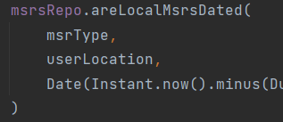
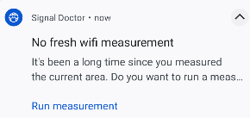
Application Design and Implementations
Expiration/Absence of Measurements
- Main Idea:
Repository tells us if there are no valid measurements in current location and whenever condition it’s true, we send a notification
Notification has a button that launches a pending intent to a broadcast receiver, which in turn ask WorkManager to run a measurement
If true

Slide 20
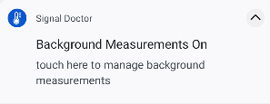
Application Design and Implementations
Background Measurements
-Problem
Work manager that launches periodic work could have been enough, but users should be aware of whether background measurements are running or not
-Solution: Foreground Service
App uses a lifecycle-aware service class, LifecycleService, that listens to data changes indipendently and starts/stops measurements accordingly

Slide 21
Conclusions
Bibliography
—. Kotlin coroutines on Android . n.d. https://developer.android.com/kotlin/coroutines.
—. Kotlin flows on Android . n.d. https://developer.android.com/kotlin/flow.
Federico Montori, Luca Sciullo. "Virtuale.unibo." LAM Project 2023. n.d. https://virtuale.unibo.it/mod/resource/view.php?id=1149343.
ffmpeg.org. FFmpeg Filters Documentation. n.d. https://ffmpeg.org/ffmpeg-filters.html#ebur128-1.
ITU-R. Audio levels and loudness. 11 2023. https://www.itu.int/dms_pubrec/itu-r/rec/bs/R-REC-BS.1770-5-202311-I!!PDF-E.pdf.
MapTiler. Tiles à la Google Maps, Coordinates, Tile Bounds and Projection. n.d. https://www.maptiler.com/google-maps-coordinates-tile-bounds-projection/#3/15.00/50.00.
Wikipedia. Received signal strength indicator (RSSI). n.d. https://en.wikipedia.org/wiki/Received_signal_strength_indicator.

