Slide 1
Modeling Sasquatch: a species distribution modeling tutorial
Elise Hellwig
Developed by: Robert Hijmans
Based on: Lozier, J. D., Aniello, P. & Hickerson, M. J. J. Biogeogr. published online. doi:10.1111/j.1365-2699.2009.02152.x (2009).

Slide 2
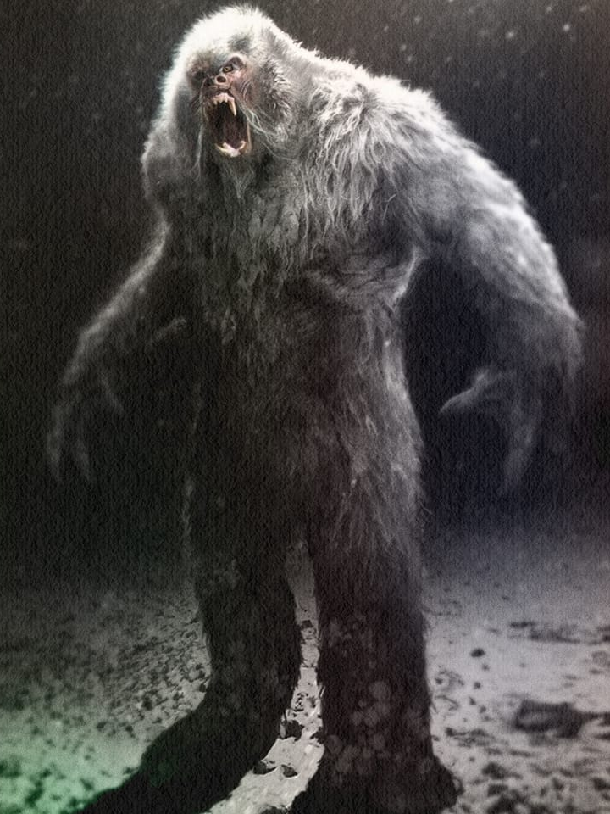
Outline
Before we start
Readying the data for analysis
The actual modeling
Cart Model
Random Forest
Predicting to other places and times

Slide 3

System Requirements
R or RStudio
R packages
raster
dismo
rpart
randomForest
maps
Bigfoot siting data (bigfoot.csv)
An internet connection or Bioclim data

Slide 4
Disclaimer for tidyverse users…
Some tidyverse functions mask functions in raster and randomForest:
raster::extract() randomForest::combine()
raster::select() randomForest::margin()
In order to force R to use the raster or randomForest version of the function use the double colons like above or just don’t load the tidyverse.

