Slide 1
Box Office Insights: Identifying Successful Movie Trends for Microsoft's New Movie Studio

Slide 2

Project Overview
The project involves analyzing data from various sources to help Microsoft's new movie studio identify the most successful film genres, key factors that contribute to a movie's success, and audience demographics. The project aims to provide actionable insights and recommendations to create a movie portfolio and execute marketing strategies for the studio's success in the highly competitive movie industry.

Slide 3

Business Understanding
Microsoft is launching a new movie studio but lacks knowledge of successful films in the industry. The challenge is to explore the market and identify popular genres, ratings, actors, directors, and factors that contribute to a movie's success. This will enable the studio to make informed decisions when creating its own movies and increase its chances of success in a highly competitive industry.
Goals
Identify successful movie genres and their audience demographics
Determine key factors contributing to a movie's success
Develop a strategy for creating a movie portfolio and executing marketing campaigns based on the data analysis.

Slide 4

Data Understanding
The data sources utilized for this project are
movies_budgets.info
rt_movie_info.info
tmdb__movies.info
Challenges
Some of the challenges faced when reviewing the datasets to use was the common identifier column “ID” was not homogenous across the data sources meaning it could not be used to merge data across the data sources.
Data Cleaning
The data was cleaned by changing data types to floats, checked for outliers for data skewing, but they were needed and not dropped, dropped columns that had alot of missing data,columns not needed in the analysis and checked for missing values

Slide 5

Data Analysis
Key findings
From the analysis done on the datasets, it can be evidenced that
Adventure, Action, and Drama are the three top most profitable genres in the film industry
Films with a higher worldwide gross revenue are likely to have a higher profit margin
Films with a higher rating tend to have a higher profit margin
In the next slides, the above is visually demonstrated

Slide 6
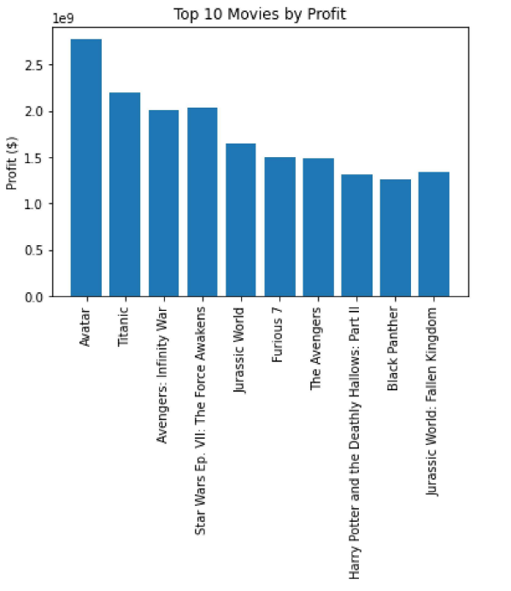
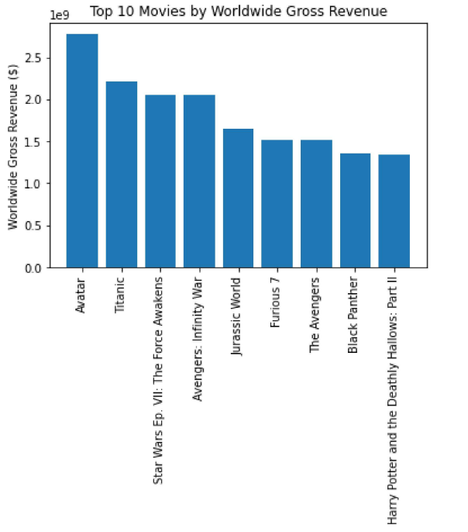
Worldwide Gross Revenue Vs Profit Analysis
The above shows the top 10 movies by profit and worldwide gross revenue. The movies in the top 10 are big blockbusters and have earned significant profit, ranging from 1-1.3B$. It is evident that the movies that have earned the highest profit have also grossed the most worldwide revenue

Slide 7
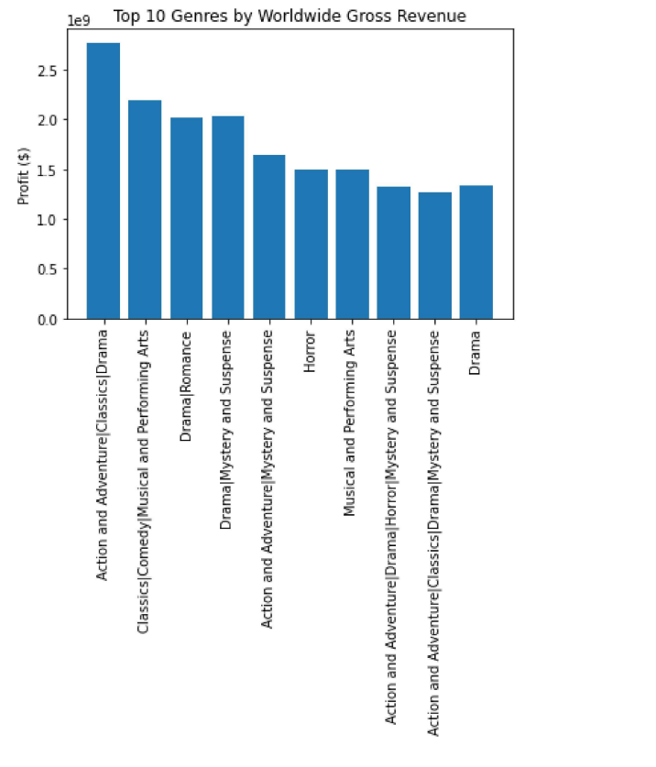
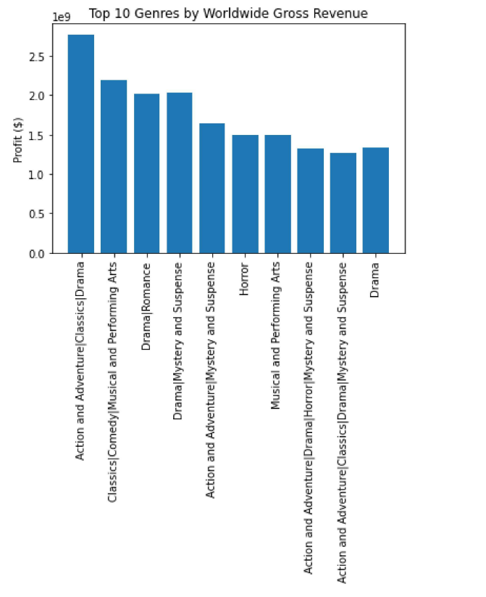
Genre Revenue and Profit Analysis
The graphs above show that the “Action and Adventure” genre has the highest profit and grossed the highest revenue worldwide, followed by “Drama”,”Comedy” “Animation”,” and “Fantasy”. The profits of the other genres in the top 10 are relatively low compared to these top 5 genres.

Slide 8
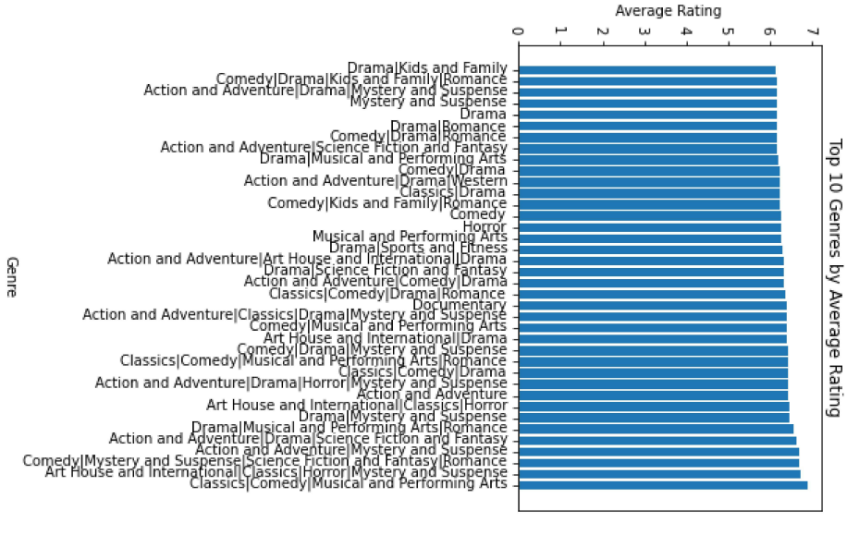
Vote Average Rating Analysis
We observe that Action, Adventure, Drama and Comedy have relatively good rating and votes together with having better reviews and profits. These genres are more likely to be more successful in the movie industry

Slide 9

Next Steps
Microsoft should hence adopt the below as next steps towards their venture
Consider investing in the production of adventure, action and drama movies as they have proven to be the most profitable genres
Invest in films with high world wide gross revenue as they can yield high profit margins
Producing films with higher rating can lead to higher profit margins through creating high quality films that appeal to audiences.

Slide 10

Thank You, Any Questions?
Presented by Michelle Mwendwa
Contact:
Email: michelle.mwendwa@student.moringaschool.com
Linkedin URL : link

