Slide 1
Classifying Reddit Subreddits
r/atheism vs. r/catholicism
Michelle Cheung
April 8, 2018

Slide 2
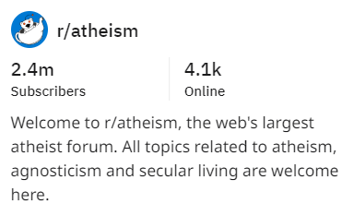

Problem
Gather Data
Explore Data
Model with Data
Evaluate Model
Conclusion

Slide 3
Problem
Gather Data
Explore Data
Model with Data
Evaluate Model
Conclusion
Source of Data
https://www.reddit.com/r/atheism.json
https://www.reddit.com/r/Catholicism.json
Python Reddit API Wrapper: PRAW

Slide 4
Problem
Gather Data
Explore Data
Model with Data
Evaluate Model
Conclusion
Missing Data
‘selftext’ column
Identify Features for Model
‘title’ and ‘selftext’
Clean Data
remove numbers
remove punctuation

Slide 5
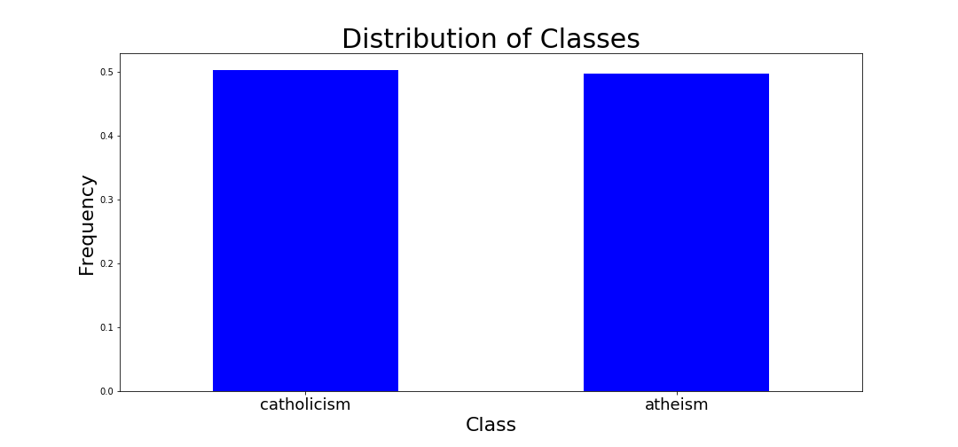
Problem
Gather Data
Explore Data
Model with Data
Evaluate Model
Conclusion

Slide 6
Problem
Gather Data
Explore Data
Model with Data
Evaluate Model
Conclusion
Lower case text
max_features (2000)
Remove stop words
Additional ‘stop words’
just | https
like | time
people | feel
know | does
don | really
think | say
ve | want
new | said
going | did
make | day

Slide 7
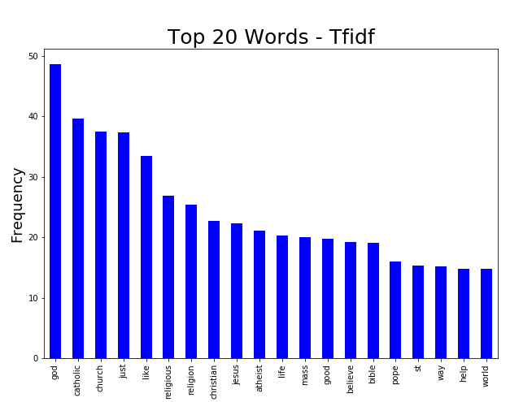
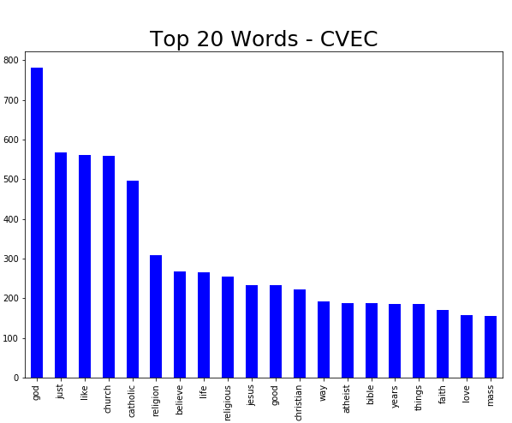
Problem
Gather Data
Explore Data
Model with Data
Evaluate Model
Conclusion

Slide 8
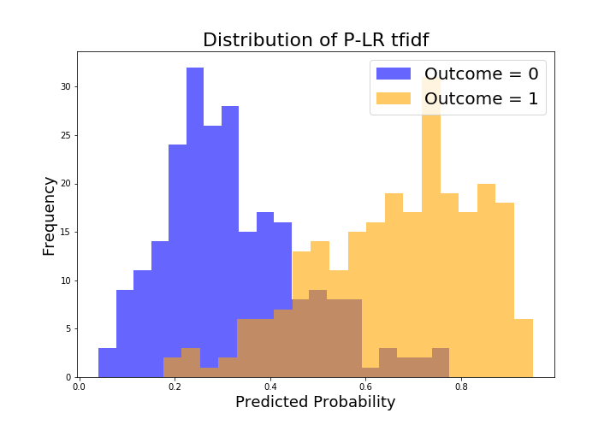
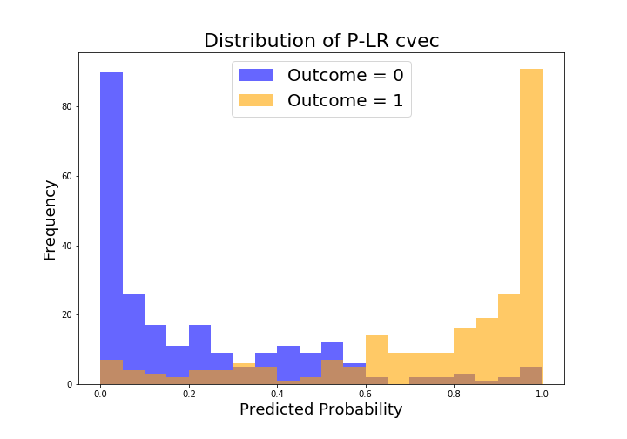
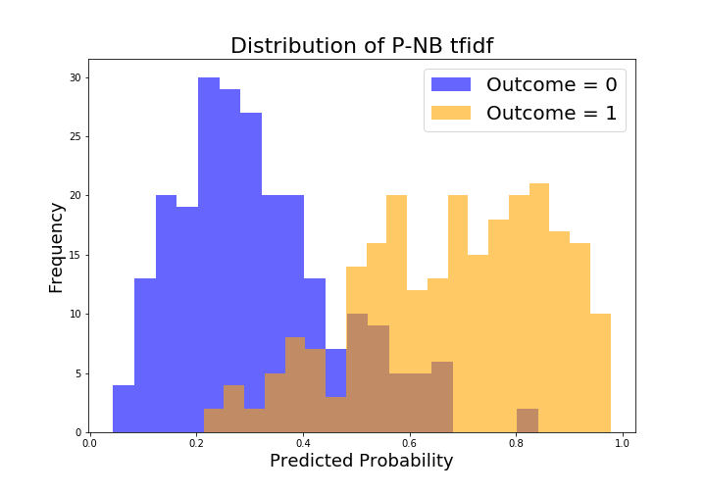
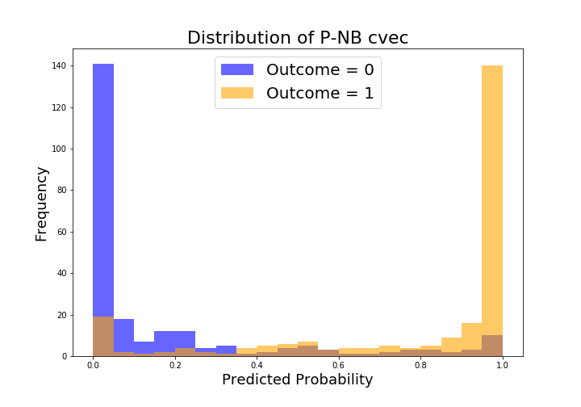
Problem
Gather Data
Explore Data
Model with Data
Evaluate Model
Conclusion

Slide 9
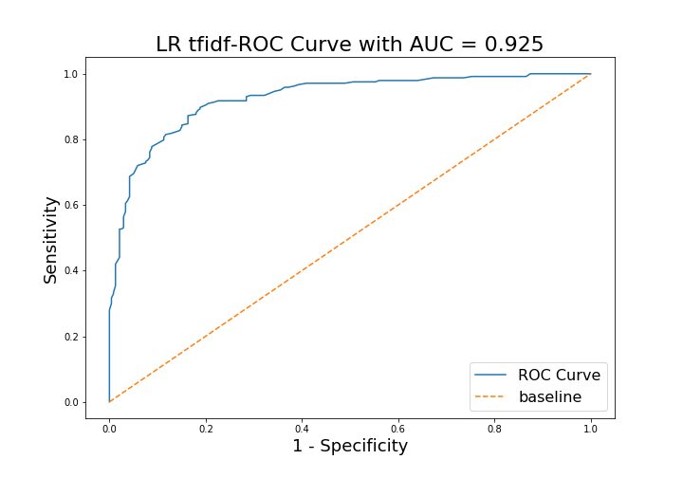
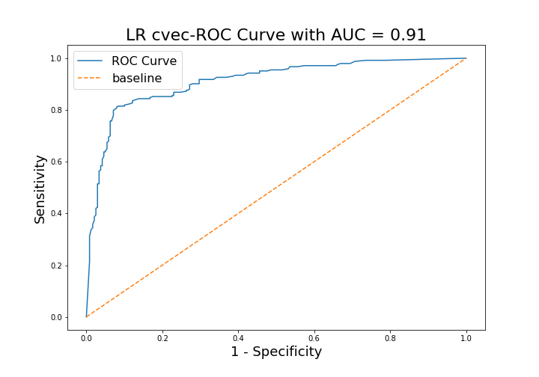
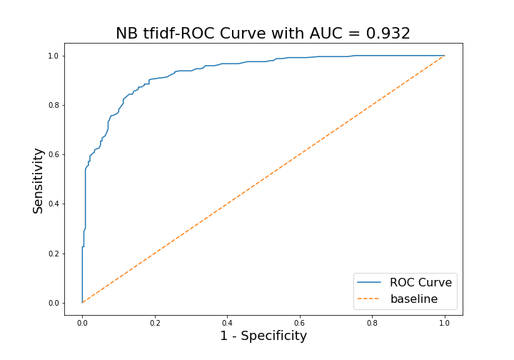
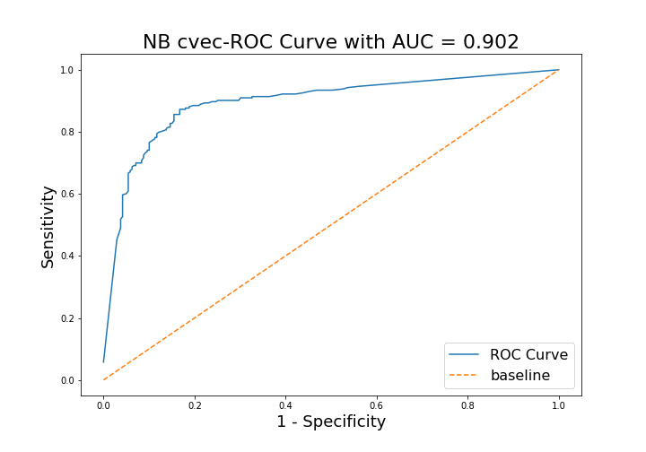
Problem
Gather Data
Explore Data
Model with Data
Evaluate Model
Conclusion

Slide 10

Problem
Gather Data
Explore Data
Model with Data
Evaluate Model
Conclusion
Accuracy Scores

Slide 11

Problem
Gather Data
Explore Data
Model with Data
Evaluate Model
Conclusion
Accuracy Scores
ROC Scores
Overfit Models
gather additional data
Gridsearch
best hyperparameters
Shuffle data for train and test sets
Same data used for all train sets

