Slide 1

payment link | ebiller

Slide 2
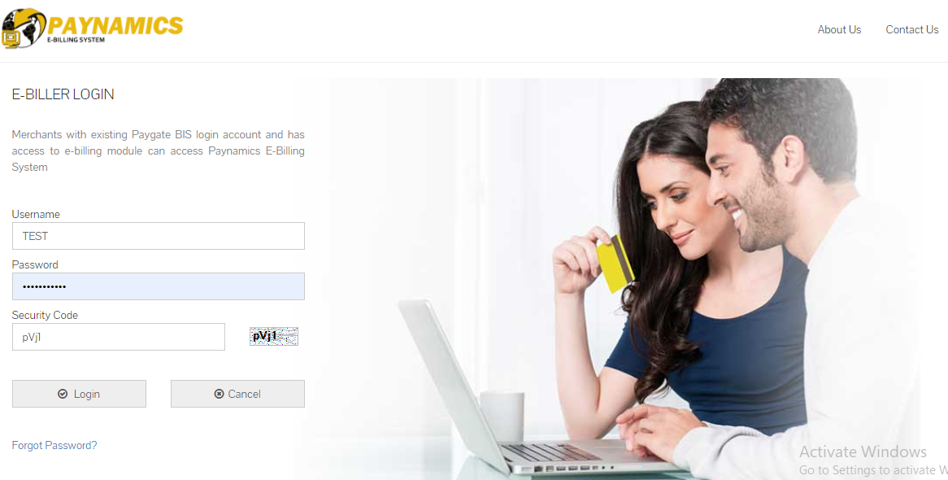
Log on using your assigned username and password (case sensitive)

Slide 3
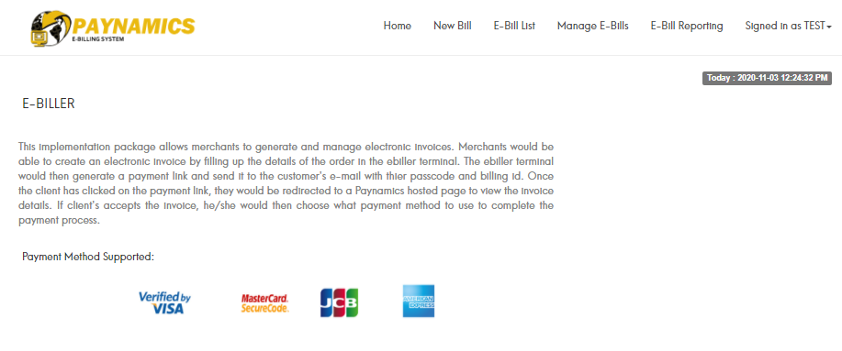
Click “New Bill”

Slide 4
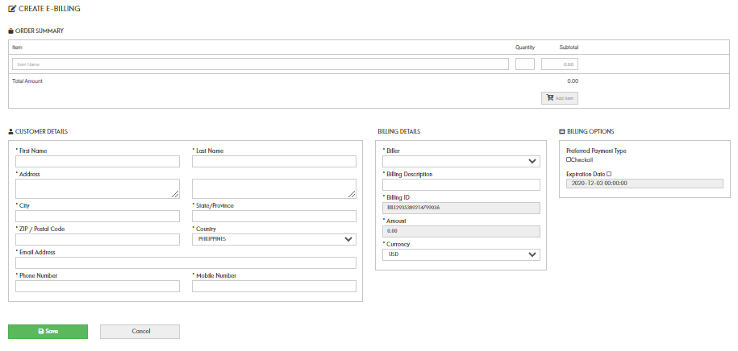
Complete the form and click save button

Slide 5
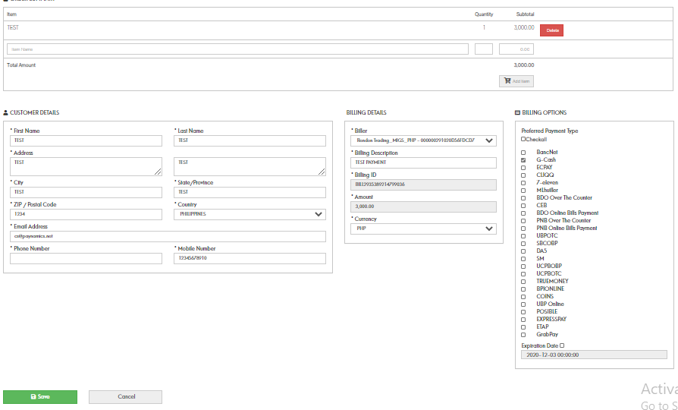
Complete the form and click save button

Slide 6
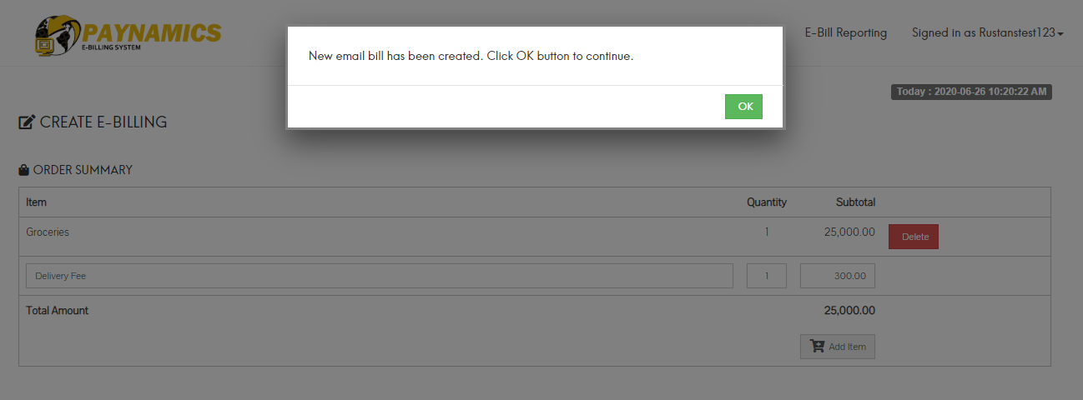

Slide 7
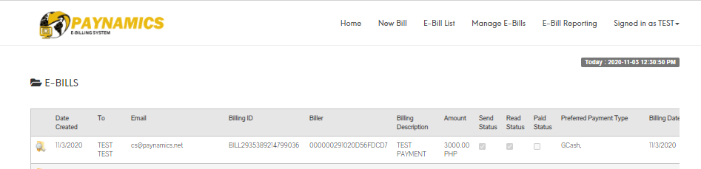
Merchant can view the payment link status

Slide 8
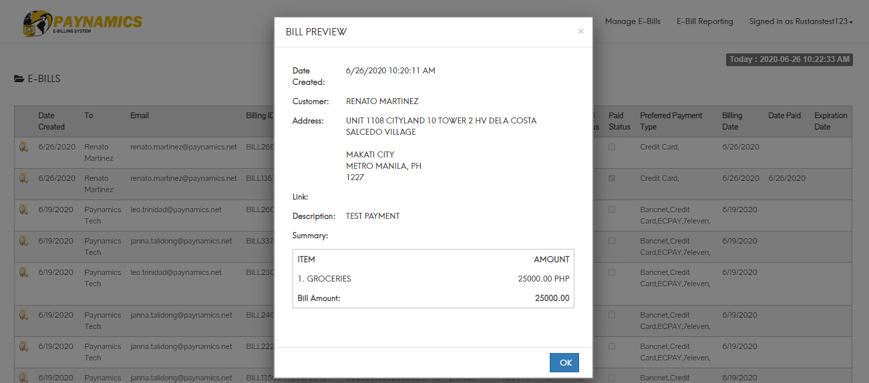
Merchant can view the payment link status

Slide 9
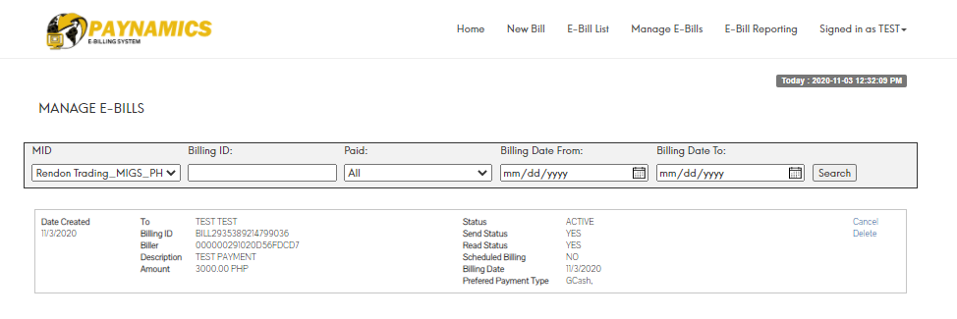
Merchant can cancel/delete unpaid payment link

Slide 10
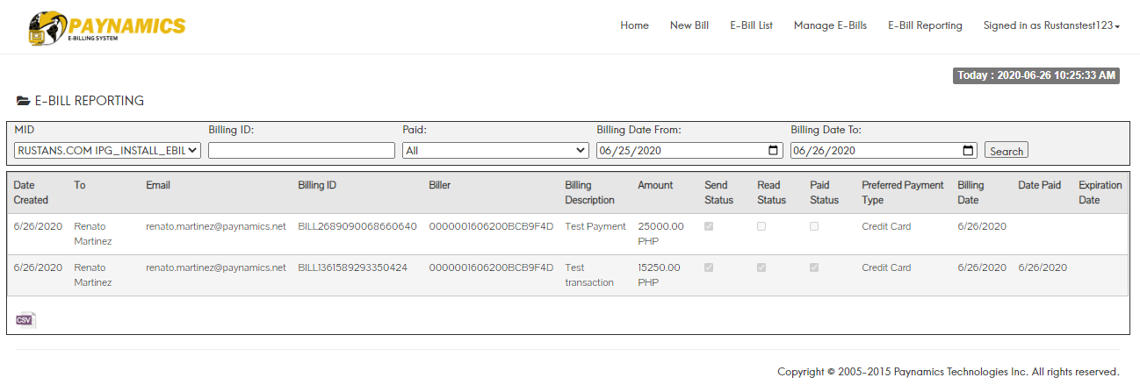
Merchant can download reports (limited to user)

Slide 11
Customer’s window

Slide 12

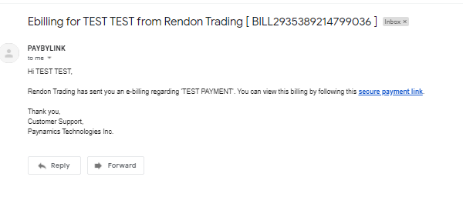
Customer will receive the payment link via email or sms

Slide 13
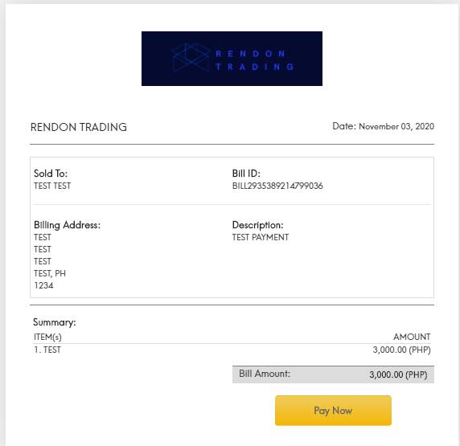
Billing is displayed

Slide 14
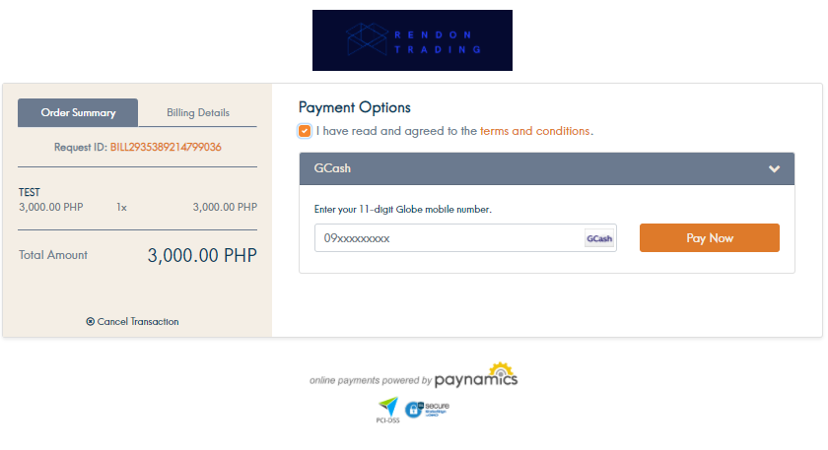
Customer completes the payment

Slide 15
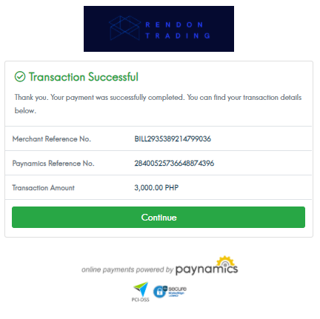
Transaction result is displayed after payment
Customer will receive sms/email for the payment acknowledgment

Slide 16
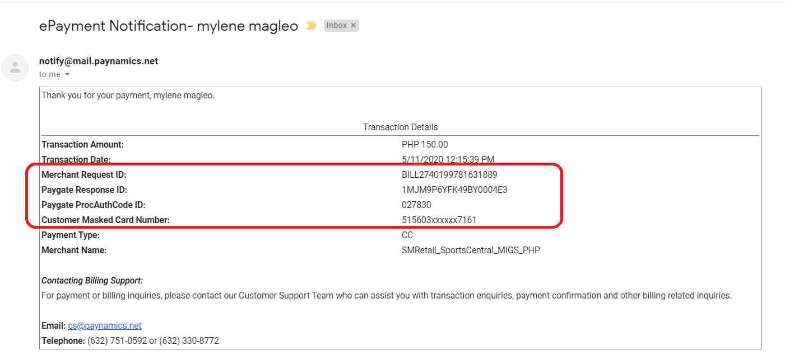
Payment Acknowledgment(Email)

Slide 17
Finance view

Slide 18
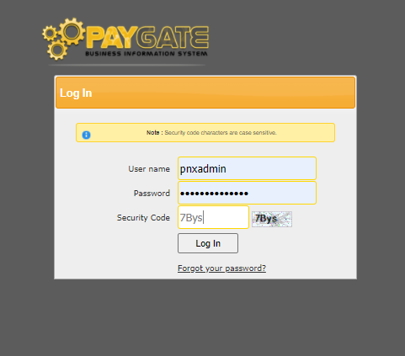
Log on to https://ptibis.paynamics.net/paygate/default.aspx

Slide 19
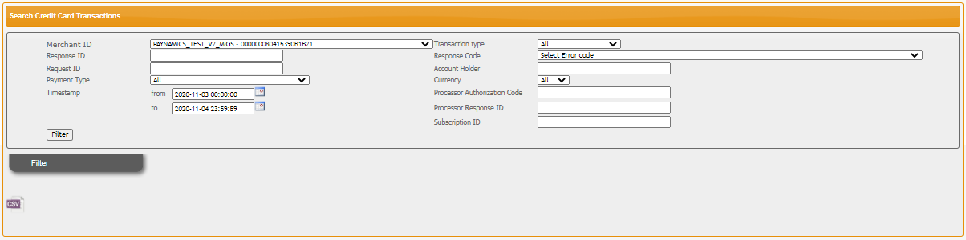
Select MID, specify date range and click filter

Slide 20
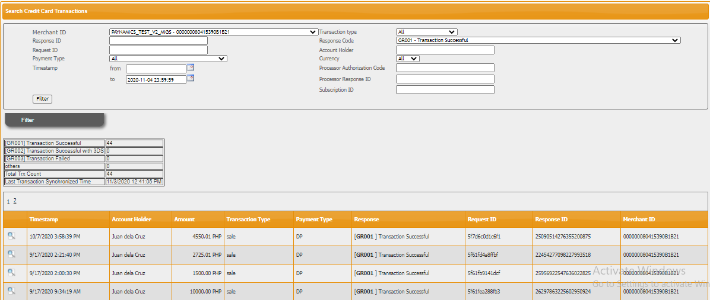
Select MID, specify date range and click filter

Slide 21
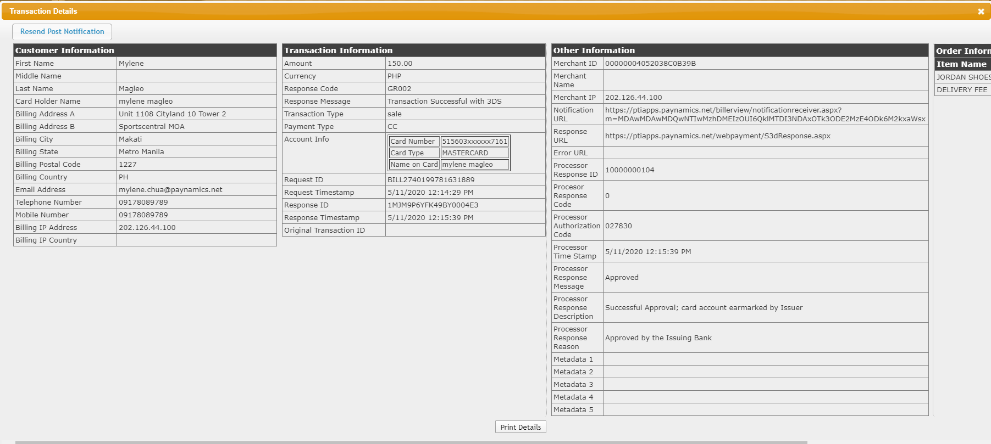
Select MID, specify date range and click filter

Slide 22
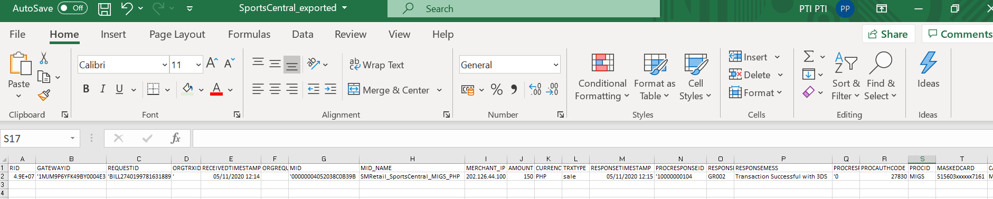
Exported file sample

