Slide 1
Simulation and Comparison of
Dynamic NN-Descent for k-NN Graph Construction
Reproducing and evaluating Wang, Zhao, Xiao, Yao & Zhang (IEEE Transactions on Big Data, 2025)
Michelle Feliciano & Ujjwal Rana
CSCE 5300: Introduction to Big Data and Data Science

Slide 2
MOTIVATION
The Problem: Building a k-NN Graph
A k-NN graph stores, for every point in a dataset, the indices of its k closest points — the index structure behind vector databases, image retrieval, and recommendation systems.
Computing it exactly compares every point against every other point: O(d·n²) time.
At a million to a billion points, exact construction is not feasible — practical systems build an approximate k-NN graph instead, trading a small accuracy loss for tractable time and memory.
Graph quality is measured as Recall@k: the fraction of each point's true k nearest neighbors that the approximate graph actually finds.

Slide 3
RELATED WORK — PART 1
Existing Methods: Divide-and-Conquer
1
Split the dataset into small subsets
2
Build an exact/near-exact k-NN graph for each subset independently
3
Merge the sub-graphs, then refine
Fast in practice — each subset is small enough to search exhaustively.
Not fully generic — the partitioning strategy (recursive bisection, random-projection trees, LSH) needs assumptions about the data distribution or distance metric.

Slide 4
RELATED WORK — PART 2
Existing Methods: NN-Descent and Its Variants
No data partitioning at all — starts from a random k-NN graph and iteratively refines it.
Heuristic: “a neighbor's neighbor is likely also a neighbor” — nodes compare against their current neighborhood (“local-join”) and keep only the closer pairs found.
Generic and metric-agnostic — no assumption about data distribution, unlike divide-and-conquer methods.
Dominant in practice: the top-1 and top-3 winners of the 2023 SIGMOD k-NN construction competition were built on NN-Descent.
This is the family the paper studied in this project belongs to — and directly improves on.

Slide 5
BACKGROUND
Classic NN-Descent — and Its Memory Problem
G
H
R
The k-NN graph
under construction
Sampled old/new
neighbors per round
Reverse neighbors
of H
H and R are each the same size as G — so NN-Descent's extra memory grows linearly with dataset size, on top of the graph itself.
Two-step iteration: (1) Sampling — draw old/new neighbors into H and record reverse relationships in R; (2) Local-join — compute distances for sampled pairs, keep the closer ones.
Also requires thread synchronization within each iteration, capping multi-thread throughput.

Slide 6
THE PAPER'S CONTRIBUTION
Dynamic NN-Descent — The Key Idea
Why keep H at all?
The old/new neighbor list H holds is already sitting in G, which is being updated continuously anyway.
Remove H
Cap R
Sample directly from the live graph G at the moment a node is processed — only a small temporary cache needed.
Keep an incomplete reverse-neighbor list (capped at smpN entries); drain and rebuild it as the single continuous loop visits each node.
Result: no “batch boundary” between rounds — sample, then join, then move to the next node, all in one loop. No synchronization point left to remove.

Slide 7
THE METHOD, STEP BY STEP
Algorithm 1: One Node at a Time
1
Sample up to 3·smpN old and smpN new neighbors from the current node's neighborhood in G
2
Register this node as a reverse neighbor of each sampled neighbor (capped at smpN)
3
Mark the sampled “new” neighbors as “old” — they've now been used
4
Merge in this node's own accumulated reverse neighbors, then clear them
5
Local-join: compute distances for new–new and new–old pairs; keep the closer ones in G

Slide 8
WHY IT MATTERS
Space Complexity
O((k + 4·smpN)·n)
O((k + 2·smpN)·n)
Classic NN-Descent
Dynamic NN-Descent
Removing H and capping R cuts extra memory by 2·smpN per node — a gap that widens linearly as the dataset grows.

Slide 9
AT MILLION-TO-HUNDRED-MILLION-POINT SCALE
Results Reported in the Paper
6.7×
~30%
~20s
less extra memory than classic NN-Descent, at matched quality
faster than classic NN-Descent (K in the practical 40–200 range)
to build a high-quality graph for a 10-million-point dataset (GPU)
On the GPU, Dynamic NN-Descent also outperformed the leading existing GPU-based construction methods while using substantially less GPU memory.

Slide 10
ASSESSMENT
Advantages and Limitations
Advantages
Limitations
Lower memory, no accuracy penalty
Better multi-thread scaling (no sync barrier)
Generic — metric- and distribution-agnostic
Delayed reverse cross-matching is a heuristic, without its own formal convergence guarantee
Speed advantage is specifically a multi-thread/GPU benefit
High-intrinsic-dimensionality data still needs more iterations or larger K

Slide 11
WHERE THIS MATTERS
Possible Applications
1
Vector databases & RAG systems
2
Multimedia / image retrieval
3
Recommendation systems
4
Deep metric learning & classification
5
Any memory-constrained similarity index

Slide 12
SECTION 6 OF THE REPORT
My Simulation: Setup
Implemented from scratch in Python (paper: C++/CUDA) — both algorithms share the same graph structure, random init, and distance function for a fair comparison.
SIFT — same as the paper
Synthetic — different
10,000 real SIFT descriptors
128 dimensions, L2 distance
Matches the paper's own benchmark family
10,000 points, sklearn make_blobs
100 dimensions, 25 clusters
Independent of the paper, seeded for reproducibility
Both algorithms: K = 20 neighborhood size, 15 rounds. Metrics: Recall@10, construction time, extra memory (tracemalloc) — same conventions as the paper.

Slide 13
ALGORITHM 1 TRANSLATED TO PYTHON
The Core Loop, In Code (1 of 2)
for step in range(n * iterN):
i = step % n
O = _sample_upto(old_ids, 3 * smpN, rng)
N = _sample_upto(new_ids, smpN, rng)
# register reverse neighbors, cap at smpN
for u in O: R_old[u].append(i) # if room
for u in N: R_new[u].append(i) # if room
# merge in i's own reverse neighbors, then clear
O = merge_unique(O, R_old[i]); R_old[i] = []
N = merge_unique(N, R_new[i]); R_new[i] = []

Slide 14
ALGORITHM 1 TRANSLATED TO PYTHON
The Core Loop, In Code (2 of 2)
# local-join: new-new and new-old pairs
for u1, u2 in candidate_pairs(N, O):
d = squared_l2(vectors, u1, u2)
graph.try_insert(u1, u2, d)
graph.try_insert(u2, u1, d)

Slide 15
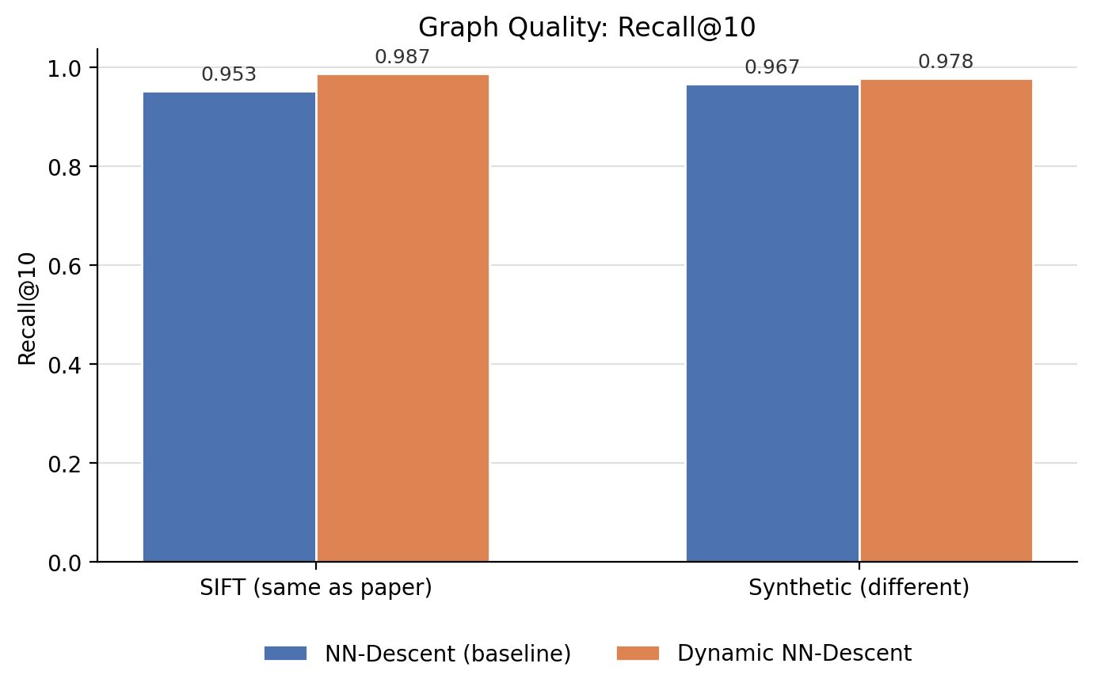
RECALL@10 — SAME METRIC THE PAPER USES
My Results: Graph Quality
Dynamic NN-Descent matched or beat the baseline on both datasets — and fully converged (0 remaining updates) while classic NN-Descent had not.

Slide 16
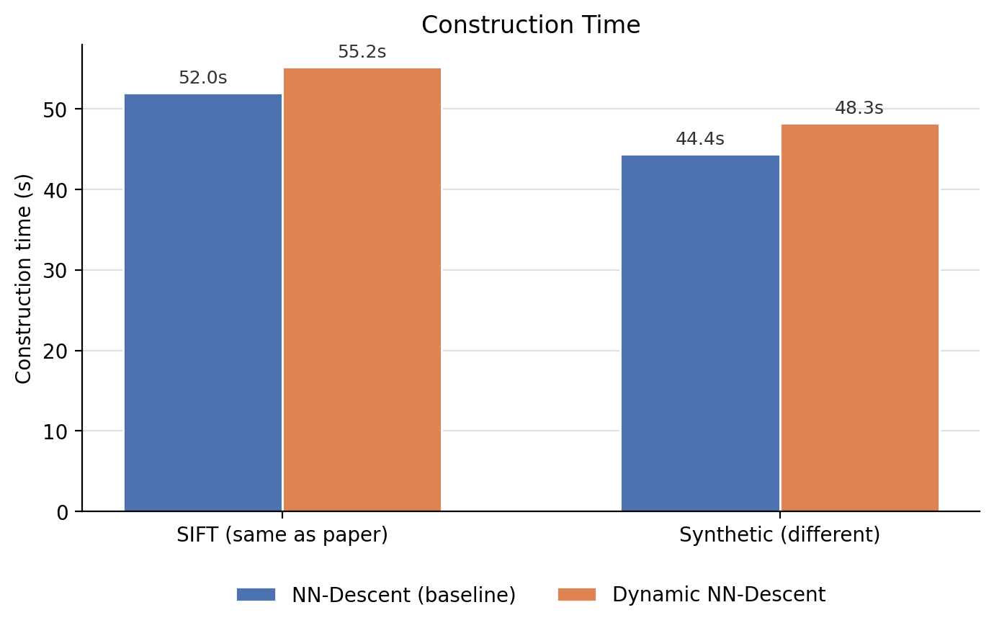
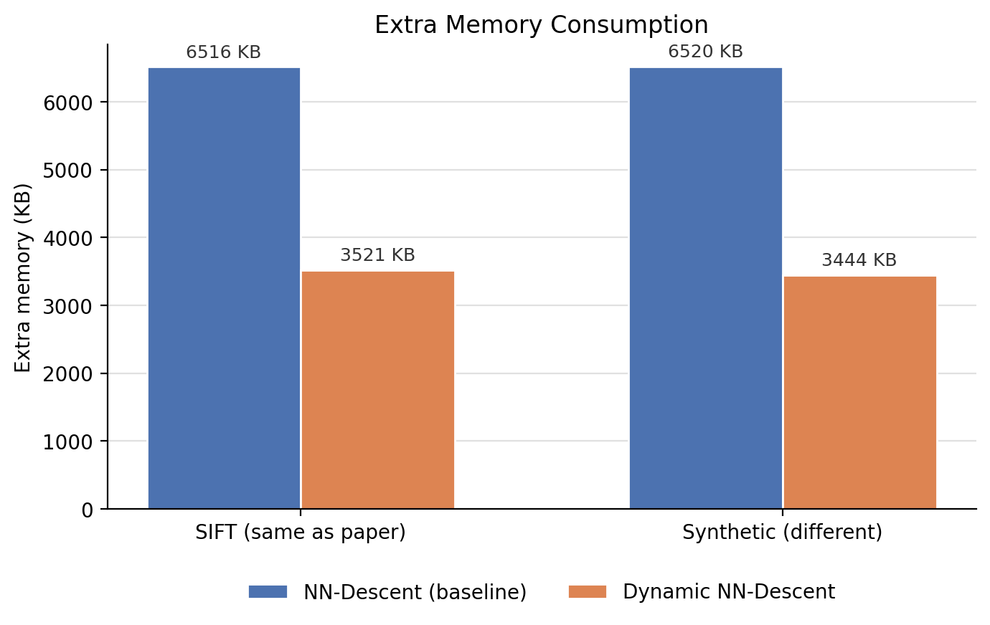
THE PAPER'S OTHER TWO METRICS
My Results: Time and Memory
Dynamic NN-Descent used 46–47% less extra memory on both datasets, at comparable construction time.

Slide 17
DISCUSSION
How My Results Compare to the Paper
Quality: matches the paper — Dynamic NN-Descent reaches equal-or-better Recall@10 and fully converges.
Memory: same direction as the paper (46–47% less vs. the paper's 85% at million-scale) — smaller in absolute terms because the paper's advantage scales with n, and this simulation is ~1000× smaller.
Time: the one place results diverge — the paper's speed advantage comes specifically from removing a multi-thread synchronization barrier. This simulation is single-threaded Python, so there is no such barrier to remove, and the two algorithms take comparable time.
A multi-threaded or GPU implementation is the natural next step to reproduce the paper's speed claim directly.

Slide 18
Conclusion
98.7%
46–47%
2 / 2
Recall@10 on SIFT (vs. 95.3% baseline)
less extra memory than classic NN-Descent
datasets where Dynamic NN-Descent matched or won
An independent, small-scale reproduction supports the paper's core claim: Dynamic NN-Descent is a strictly better memory/quality trade-off than classic NN-Descent, with its full speed advantage realized under multi-threaded or GPU execution.

Slide 19
References
[1] J.-F. Wang, W.-L. Zhao, S. Xiao, J. Yao, and X. Zhang, “Dynamic NN-Descent: An efficient k-NN graph construction method,” IEEE Transactions on Big Data, vol. 11, no. 2, pp. 879–886, Mar./Apr. 2025.
[2] W. Dong, C. Moses, and K. Li, “Efficient k-nearest neighbor graph construction for generic similarity measures,” in Proc. 20th Int. Conf. World Wide Web, 2011, pp. 577–586.
[5] Y. Malkov and D. A. Yashunin, “Efficient and robust approximate nearest neighbor search using hierarchical navigable small world graphs,” IEEE Trans. Pattern Anal. Mach. Intell., vol. 42, no. 4, pp. 824–836, Apr. 2020.
[8] maknee, “sift1m,” Hugging Face Datasets, 2024. Available: https://huggingface.co/datasets/maknee/sift1m
Full reference list (9 sources) in the accompanying project report.

Slide 20
Thank You
Questions?

