Slide 1
AEMR CASE STUDY
AEMR Outage & Reliability Analysis
Executive Presentation
Michelle Fore
September 26, 2026
Notes:
Thanks for having me. I’m going to walk you through what the outage data says about reliability in this market, where the energy loss is concentrated, and what I’d do about it.
But before the numbers, let me set up the problem.
The American Energy Market Regulator, or AEMR, is responsible for keeping the country’s domestic energy network reliable, with as few disruptions as possible. In the industry, a disruption is called an outage, and it happens when an energy provider takes a generating unit offline.
Not all outages are equal. There are four types - Consequential outages come from something outside the provider’s control, like a downed transmission line. Opportunistic outages are quick maintenance done within 48 hours. Scheduled outages are planned in advance and run longer. And forced outages are the unplanned ones, where a provider promised to supply energy and suddenly can’t.
Over 2016 and 2017, management noticed a high volume of outages being submitted and asked two questions. First, what does the data say about energy stability and market outages? Second, where are energy losses concentrated, and what does that say about reliability?
I answered those using AEMR’s outage data for 2016 and 2017, approved outages only, since cancelled or rejected ones don’t affect the grid. I’ll walk through both questions, then close with four recommendations. The short version is that forced outages are growing, and most of the energy loss comes from three providers, so the fix can be targeted.

Slide 2
EXECUTIVE SUMMARY
Forced outages are outpacing the market, and three providers, GW, AURICON, and MELK, drive most of the resulting energy loss.
Each of those three losses traces back to one specific, fixable facility failure, which is what makes this an operational problem, not just a market-wide trend.
1,622
74.7%
~60%
forced outages in 2017,
up 28% from 2016
of all approved 2017 outages
were forced (up from 65.5%)
of forced-outage energy loss
held by just 3 providers
Key findings
Forced outages grew 28% while every other outage type combined fell 18%, so the mix is shifting toward the one type AEMR penalizes.
AURICON and GW alone logged more forced events than the next five providers combined.
Three facilities, GW's BW1_GREENWATERS_G2, AURICON_PNJ_U1, and MELK_G7, each map to one specific failure and are the fastest lever to cut total energy loss.
2
Notes:
If you only remember one slide, make it this one. Three numbers. Forced outages hit 1,622 in 2017, up 28%. They’re now 74.7% of all approved outages, up from 65.5%. And about 60% of the energy lost to forced outages comes from just three providers: GW, AURICON, and MELK.
Think about how a grid operator runs a day. Supply has to match demand every minute. A scheduled outage is a plant coming offline for maintenance in a mild month, with other plants lined up to cover it. Nobody notices. A forced outage is a unit tripping offline on a hot afternoon when everyone’s running air conditioning. No cover is lined up, so the operator scrambles to bring other plants online, and if enough units trip at once, you get rolling blackouts.
Forced outages are those trips. In 2017 they grew 28%, while every other outage type combined fell 18%.
Which providers matters most. Each of those three providers’ (W, AURICON, MELK) traces back to one specific facility failure. That’s what turns this from a market trend into an operational problem we can act on.
Let me show you how I got there, starting with the market-wide picture.

Slide 3
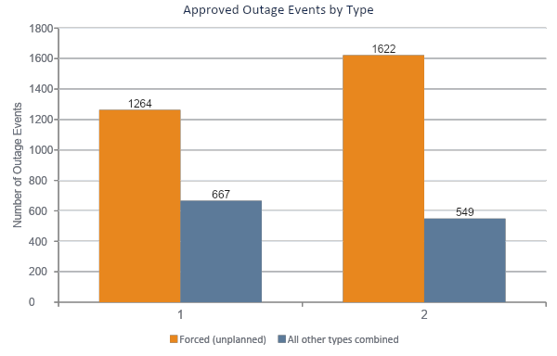
PART I | ENERGY STABILITY & MARKET OUTAGES
Forced outages grew 28% in 2017 while every other outage type combined declined 18%.
What changed
Total approved outages rose 12.4% (1,931 → 2,171).
Forced outages, the only type AEMR penalizes, rose 28.3% (1,264 → 1,622).
Every other outage type combined fell 17.7% (667 → 549).
2016
2017
3
Notes:
Total approved outages rose 12.4%, from 1,931 to 2,171. That sounds like a modest increase. But look underneath it. Forced outages rose 28.3%, while every other type combined fell 17.7%.
So the headline number hides the real story. The market isn’t just having more outages. It’s swapping the manageable kind for the dangerous kind.

Slide 4
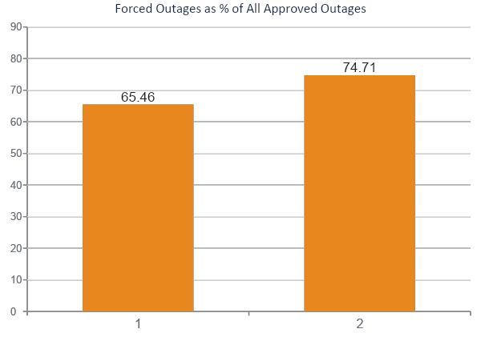
PART I | ENERGY STABILITY & MARKET OUTAGES
Forced outages' share of the market jumped 9.3 percentage points in one year, from 65.5% to 74.7%.
Why this matters to AEMR
Forced outages are the only type AEMR penalizes, because they hit the grid with no warning and no planning window.
A 9.3-point jump in one year means a growing share of the market's disruptions are exactly the unplanned kind AEMR exists to prevent.
Because only forced outages threaten grid security, participant risk scoring was refined to weight forced-outage frequency and duration only, not planned or opportunistic maintenance.
2016
2017
4
Notes:
Here’s the same trend as a share of the market. Forced outages went from 65.5% to 74.7% of all outages in one year.
Why do I focus on forced outages only? Because they’re the only type AEMR penalizes. They hit the grid with no warning and no planning window. Planned and opportunistic maintenance doesn’t threaten grid security, so I refined the risk scoring to weight forced-outage frequency and duration only.

Slide 5
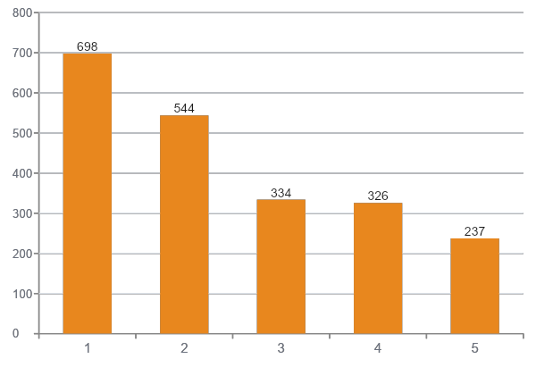
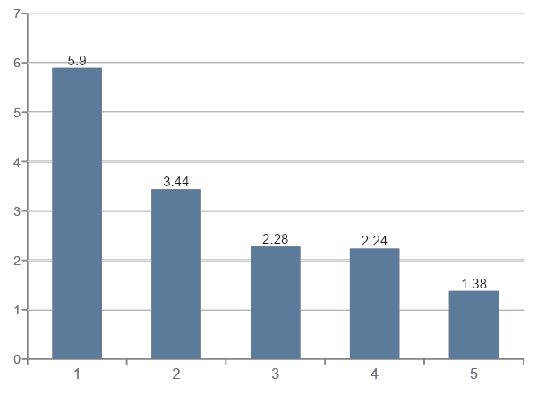
PART I | ENERGY STABILITY & MARKET OUTAGES
A handful of providers drive most forced-outage volume; a different handful runs the longest outages.
Most forced events (2016–2017 combined)
Longest average forced outage (days, by facility)
AURICON
GW
MELK
AUXC
TRMOS
EUCT
WGUTD
MELK
ENRG
COLLGAR
So what: AURICON and GW need a frequency-focused compliance review; EUCT, WGUTD, and MELK need a duration-focused root-cause review. One risk score can't fix both problems.
5
Notes:
Now, who is driving this? There are two different problems here, and they have different culprits.
On the left, most forced events: AURICON and GW lead by a wide margin. On the right, longest average forced outage by facility: EUCT, WGUTD, and MELK.
Picture two generating units, both with a forced outage problem. The first trips offline almost every day. Each trip is a quick reset, and it’s back on the grid within a couple of hours. The second trips only a few times a year, but each time it needs a major repair and stays offline for weeks.
An operator would manage those very differently. The first unit has a reliability problem. It’s the kind of thing you fix with protection-system settings, maintenance practices and compliance follow-up, and the question is why it keeps tripping. The second has a recovery problem. The question is why repairs take so long, which means the accruing the parts, the crews and engineering and the work to fix it. The grid also experiences them differently. The frequent tripper forces the operator to reshuffle supply again and again. The long-outage unit takes capacity out of the market for weeks, right when the margin is thin.
In our data, AURICON and GW are the first unit and EUCT, WGUTD and MELK are the second. Both are forced outages, but one score for both would hide the difference, and the fix is different for each.
So AURICON and GW need a frequency-focused compliance review. EUCT, WGUTD, and MELK need a duration-focused root-cause review.
Frequency and duration tell us who’s unreliable. Energy loss tells us who’s costing the market the most.

Slide 6
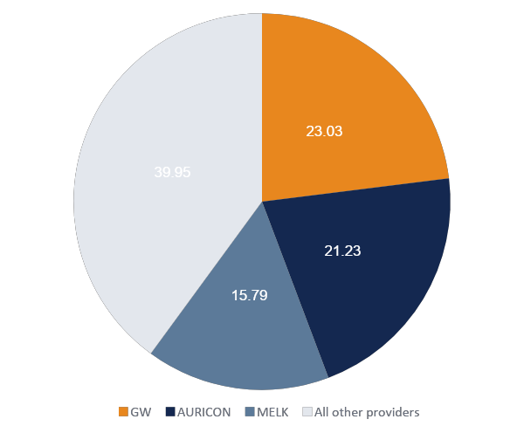
PART II | ENERGY LOSSES & MARKET RELIABILITY
Three providers, GW, AURICON, and MELK, account for roughly 60% of all energy lost to forced outages.
Reading the concentration
GW: 23.0% of all forced-outage energy lost across 2016–2017.
AURICON: 21.2%.
MELK: 15.8%.
Combined, 3 of roughly 20 active providers hold 60% of the market's total energy loss from unplanned outages.
6
Notes:
GW accounts for 23% of all forced-outage energy lost across 2016 and 2017. AURICON accounts for 21.2%, and MELK for 15.8%. Together, three providers out of roughly 20 hold 60% of the loss.
If you’ve heard of the 80/20 rule, this is that idea in action. A small share of providers drives most of the problem. That’s how we should approach reliability. They don’t need to upgrade every circuit on the network. We rank the worst performers by the outage megawatts they cost, and put crews and capital into the top few first.
So, let’s do that here and the list is short. Three providers account for 60% of the loss, and the other 17 share the remaining 40%. So the right response isn’t a market-wide crackdown. It’s a worst-performers list, and we already know who is at the top of it
So, concentration tells us where to look. The next slide shows what we find when we look.

Slide 7
PART II | ENERGY LOSSES & MARKET RELIABILITY
The losses trace to three specific, fixable failures, not vague underperformance.
GW
AURICON
MELK
BW1_GREENWATERS_G2
AURICON_PNJ_U1
MELK_G7
28,687.5 MW
6,033.9 MW
1,100.0 MW
top forced-outage cause, by energy lost
top forced-outage cause, by energy lost
top forced-outage cause, by energy lost
Operational issues caused a real-time forced outage
Full unit trip
Safety issues
The single largest cause of energy loss in the entire dataset, bigger than AURICON's whole forced-outage total.
A single point-of-failure event, consistent with an equipment or protection-system issue at one unit.
Smallest of the three, but a safety-flagged cause warrants review independent of its size.
7
Notes:
The best part of this analysis is that the losses aren’t vague. Each one traces to a specific facility and cause.
GW’s BW1_GREENWATERS_G2: 28,687.5 MW lost to an operational issue that caused a real-time forced outage. That’s the single largest cause of loss in the entire dataset, and it’s bigger than AURICON’s whole forced-outage total.
AURICON_PNJ_U1: 6,033.9 MW from a full unit trip. That’s a single point-of-failure pattern, consistent with an equipment or protection-system issue.
MELK_G7: 1,100 MW, the smallest of the three, but the cause is safety-related, so it deserves review regardless of size.

Slide 8
RECOMMENDATIONS
Four actions to cut forced-outage risk
Each action maps directly back to a finding in this analysis.
1
Audit the 3 concentrated facilities first
2
Split compliance from root-cause review
Open corrective-action reviews at GW's BW1_GREENWATERS_G2, AURICON_PNJ_U1, and MELK_G7, the sources of ≈60% of forced-outage energy loss.
Run a frequency-focused compliance track for AURICON and GW, and a separate duration-focused engineering review for EUCT, WGUTD, and MELK.
3
Report forced-share, not just outage totals
4
Refine the participant risk model
Add “% of outages that are forced” as a standing reliability metric; it moved 9.3 points in one year while total volume looked only modestly worse.
Score risk on forced-outage duration and frequency only, since planned, opportunistic, and consequential outages don't threaten grid security.
8
Notes:
Four actions, and each one maps back to a finding.
One: audit the three concentrated facilities first. That’s where roughly 60% of the loss lives, so it’s the highest return on effort.
Two: split the review into two tracks. Frequency-focused compliance for AURICON and GW, duration-focused engineering review for EUCT, WGUTD, and MELK.
Three: report forced-share as a standing metric. It moved 9.3 points in a year while total volume looked only modestly worse. If we’d only tracked totals, we’d have missed it.
Four: refine the risk model to score on forced-outage duration and frequency only, since the other types don’t threaten grid security.

Slide 9
APPENDIX
Data source & methodology
Data source
Outage type definitions
Table: AEMR_Outage_Table
Period covered: calendar years 2016–2017
Filter applied throughout: Status = Approved (cancelled/unapproved outages excluded)
Key fields used: participant_code, facility_code, outage_reason, description_of_outage, start_time, end_time, energy_lost_mw
Duration calculated via JULIANDAY(end_time) − JULIANDAY(start_time), rounded to 2 decimal places
Forced: unplanned, catches AEMR by surprise. The only type AEMR penalizes.
Consequential: caused by an event unrelated to the provider (e.g. a downed transmission line).
Opportunistic: proactive maintenance completed within a 48-hour window.
Scheduled (Planned): reported in advance, expected to run longer than 48 hours.
9
Notes:
All data comes from the AEMR outage table, calendar years 2016 to 2017, approved outages only. Duration is calculated from start and end timestamps.

