Slide 2
—
Define the problem
What is the problem that your app is solving?
Help the people be more aware of the cases of COVID-19 around the World and in every country.
Spread awareness and exposes the truth of the significant cases of infected globally.

Slide 3
—
App Vision example
FOR people of all ages
WHO needs to be aware of the virus that the world is experiencing right now
THE CVD19 Tracker IS An app that will spread awareness
THAT will show statistic analysis regarding the world’s population who are affected by the virus UNLIKE the other tracker data will be more updated
OUR PRODUCT will help encourage people to have more positive attitude and reduce risk of spread of coronavirus

Slide 4
—
App Vision
FOR people of all ages
WHO needs to be aware of the virus that the world is experiencing right now
THE CVD19 Tracker
IS An app that spread awareness about the virus by sharing the below facts sheets
THAT will show statistic analysis regarding the world’s population who are affected by the virus
UNLIKE the other tracker data will be more updated
OUR PRODUCT will help encourage people to have more positive attitude and reduce your risk of the coronavirus infection

Slide 5

—
Persona
Background
Likelihood of engagement People will engage in app:
Easy to find online
People who doesn’t search much in the internet instead will rely on the app
Past experience: People who already experience getting sick of COVID-19 and people who doesn’t want to get sick
Values: People who wants to be more aware of whats happening
Motivation: To help keep safe their family members to be more aware
Add photo here of personwho represents your persona
Biography
Name: All ages
Age: as early as 12 (since most kids are yet to be vaccinated
Location: Global
Demographics
People of all ages, vaccinated or not
Engagement obstacles
People will not engage if:
Data are not update and accurate
Data are outdated
Goals and aspirations People who are busy with life and doesn’t have time to search much.

Slide 6
—
Create a feature set
What are the essential features you’re going to build into your app?
An app that spread awareness, by showing the statistics analysis of infected, recovered and deceased of a certain country. Prevent the spread of COVID-19 (coronavirus) by letting the people over the world to protect yourself and decreases the risk that you will infect people in your community and around the world.

Slide 7
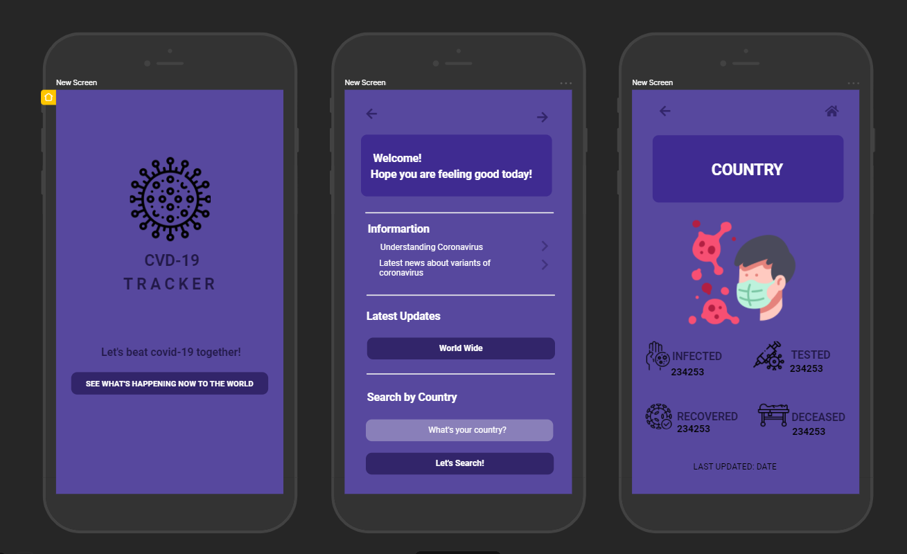
—
App wireframes
Create wireframe diagrams which demonstrate how the app in your Final Project will look and how it will work.

Slide 8
