Slide 1
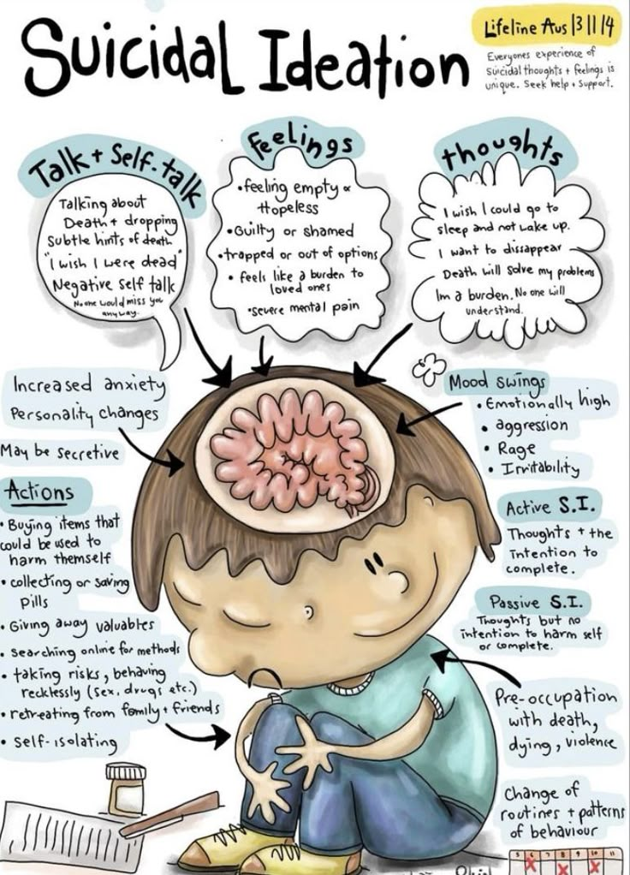
introduction
introduction

Slide 2

SUICIDAL IDEATION DETECTION
Objective:
Detecting Suicidal Ideation from Social Media Posts to Support Early Mental Health Intervention..

Slide 3
INTRODUCTION
The Problem:
Solution
Tools & Data
Build a machine learning system using NLP and Neural Networks to detect suicidal language in Reddit posts,
Public Reddit data (anonymized)
NLP preprocessing (tokenization, lemmatization, TF-IDF)
Models: Logistic Regression, Forest, Neural Networks
Many individuals at risk of suicide express distress in online posts—but these signals often go unnoticed or are detected too late.

Slide 4
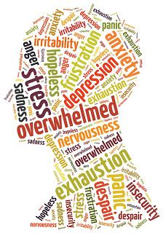

Content
Data
1.
Process Steps
2.
Results
3.
Conclusion & Recommmendations
4.

Slide 5

DATA Description of the data and relevant variables
The dataset was obtained from Kaggle and contains 232,074 Reddit posts, each labeled as either suicide or non-suicide. The final dataset includes two useful columns: text (the Reddit post) and class (the target label). The dataset is perfectly balanced, with each class making up 50% of the data—116,037 suicide posts and 116,037 non-suicide posts. This balance helps prevent bias toward one class during model training.
Key characteristics and tools used:
Data Composition:
text: the Reddit post content
class: target label (suicide or non-suicide)
50% suicide, 50% non-suicide
Preprocessing Tools:
NLTK for tokenization, lemmatization, stopword removal
TF-IDF Vectorizer to convert text into numerical features

Slide 6
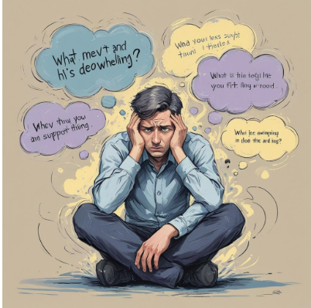
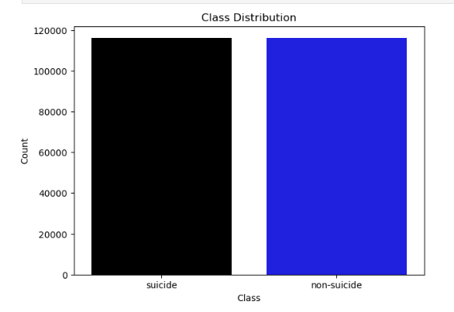
Suicide vs Non-Suicide Distribution
a fairly balanced class distribution, though there's a slight tilt toward the non-suicide class.

Slide 7
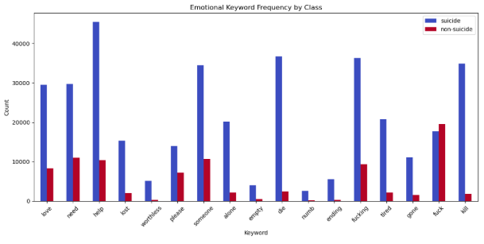
Emotional Keyword Frequency by Class
Common in Suicidal Posts
Words like “die,” “kill,” “ending” show strong signs of suicidal intent.
Words like “alone,” “empty,” “numb” reflect feelings of isolation or despair.
Common in Non-Suicidal Posts
Words like “someone,” “love,” “need” indicate emotional or relational expression.
Expletives like “fuck,” “fucking” are more common but used to express frustration, not self-harm.

Slide 8
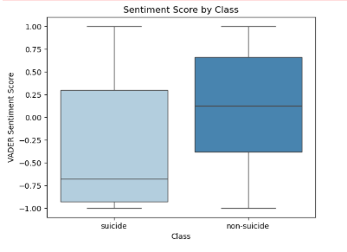
Sentiment Score by Class
Suicidal posts carry a consistently more negative tone, with median sentiment around –0.5, compared to medians near 0.0 for non-suicidal content.

Slide 9
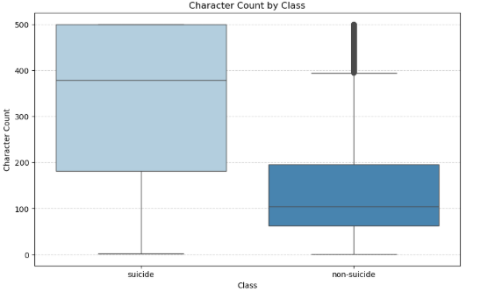
Character Count by Class
Suicidal posts are consistently longer than non-suicidal ones and show much wider variation in length. Most messages expressing suicidal thoughts exceed the length of typical posts. In contrast, non-suicidal messages remain relatively short and uniform.

Slide 10
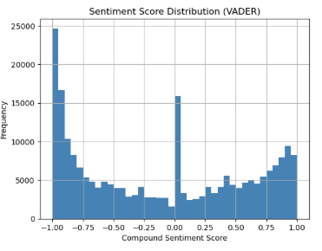
Sentiment Score Distribution
A large peak at negative values (around -1.0) shows many strongly negative posts—likely enriched for suicidal content.
A central peak near 0.0 indicates a substantial share of neutral or mixed-sentiment content.
A smaller positive peak suggests fewer overtly positive posts.

Slide 11
SUICIDAL IDEATION DETECTION
4. Model Building
.
1. Data Collection
1.
Source: Kaggle 232,074 Reddit posts labeled as “suicide” or “non-suicide”
Logistic Regression
Support Vector Machine (Linear SVC)
MLP Neural Network
Tuned LSTM (GridSearch)
2. Data Cleaning $Feature Engineering
5. Model Evaluation
Lowercased text, expanded contractions
Removed stopwords
Tokenized and lemmatized (NLTK)
VADER sentiment
TF-IDF + SVD
Evaluated the models using accuracy, precision, recall, F1-score, ROC-AUC score, confusion matrix, and ROC curve visualization.
SUCCESS
3.EDA
Top Emotional Keyword Frequency by Class
Sentiment Score by Class (VADER)
Overall Sentiment Score Distribution
Character Count Comparison by ClassClass Distribution (Suicidal vs Non-Suicidal posts)
6, Interpretation
actionable insights for targeting interventions

Slide 12
RESULTS
Tuned LSTM
Logistic Regression
mlp_model
SVM
6
Accuracy : 0.933561
Precision : 0.944772
Recall : 0.920969
F1-score : 0.932718
AUC : NaN
Accuracy : 0.937425
Precision : 0.936878
Recall : 0.938062
F1-score : 0.937469
AUC : 0.937425
Accuracy : 0.933920
Precision : 0.942104
Recall : 0.924675
F1-score : 0.933308
AUC : 0.981054
Accuracy : 0.928433
Precision : 0.923162
Recall : 0.934672
F1-score : 0.928881
AUC : 0.976766

Slide 13
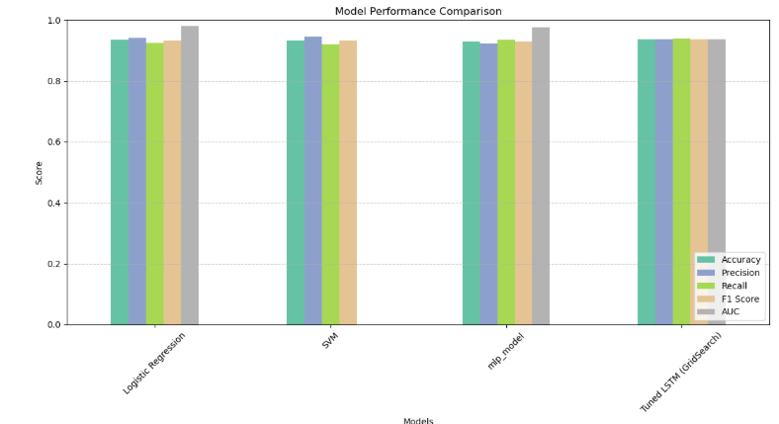
EVALUATION
Logistic Regression is ideal for transparency and interpretability, but likely underperforms on nuanced signal capture.
SVM excels when precision is critical — suggesting it's good at saying "yes" only when very confident, which reduces false positives.
Neural Network shines in balanced performance, especially in F1 Score and AUC — key for tasks where both recall and sensitivity matter (e.g., mental health predictions)

Slide 14
CONCLUSION
Suicidal posts exhibit significantly more negative sentiment and contain strong predictor keywords (e.g., “kill myself,” “worthless”), validating emotional intensity as a core signal.
Structural cues—longer text, frequent first-person pronouns, and negations—reinforce these emotional signals, highlighting depth of personal disclosure.
Sequence modeling with the tuned LSTM adds a ~1% F1 uplift over bag-of-words approaches, proving that word order matters for nuanced ideation detection.
All models achieve high precision and recall (F1 ≥ 0.93); the LSTM leads at 0.94 F1, while logistic regression delivers the highest separability (AUC ≈ 0.98) and interpretability.
Low false-negative rates (<8%) ensure most at-risk posts are flagged, confirming the pipeline’s suitability for real-time human-in-the-loop screening and timely intervention.

Slide 15

LIMITATIONS
Data Bias: Reddit posts skew toward younger, English-speaking, tech-savvy users, limiting cross-platform and demographic generalization.
Label Simplification: A binary suicidal vs. non-suicidal tag masks passive ideation, fluctuating risk, and recovery phases.
Context Loss: VADER sentiment and basic tokenization miss sarcasm, metaphors, and cultural idioms, leading to misclassifications.
Language Drift: Rapid evolution of slang, memes, and shorthand requires ongoing retraining to maintain accuracy.

Slide 16
RECOMMENDATIONS
Integrate transformer-based embeddings (e.g., BERT, RoBERTa) to capture deeper semantics and evolving slang.
Expand labels to multi-class or continuous risk scores, reflecting gradations of ideation and urgency.
Implement a human-in-the-loop review: flagged posts are triaged by trained counselors, reducing harm from misclassifications.
Continuously monitor model performance and retrain on new data to adapt to language drift and emerging patterns.
Conduct fairness audits to ensure no demographic group is disproportionately misclassified.

Slide 17


