Slide 1


Paper, Rock Scissors
How to build
game using Power Apps
https://powerapps4kids.com/

Slide 2

Paper, Rock and Scissors
Introduction
Michelle Wong
Microsoft 365 Consultant
Focus on Microsoft Teams, Power Apps & Power Automate
User adoptions / Trainer / speaker on events
LinkedIn.com/In/MichelleWongNL (LinkedIn)
@MichelleWongNL (Twitter)

Slide 3
Paper, Rock and Scissors
Step 1
Idea, prototype, images and resources
Step 2
Create the app
Background tile
Insert images
Add the logics & codings
Step 3
Testing
Step 4
Add new features or adjust
Step 5
Play, share & have fun ✨

Slide 4
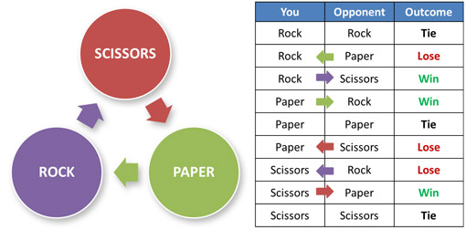
Paper, Rock and Scissors
Step 1
Idea, prototype, images and resources

Slide 5
Paper, Rock and Scissors
Create the app:
Functions
Set
IF
Shuffle
First
https://www.youtube.com/powerapps4kids/videos
Nice to have
Game results counts
Add in sound effects

