Slide 1

Welcome to the Team!

Slide 2
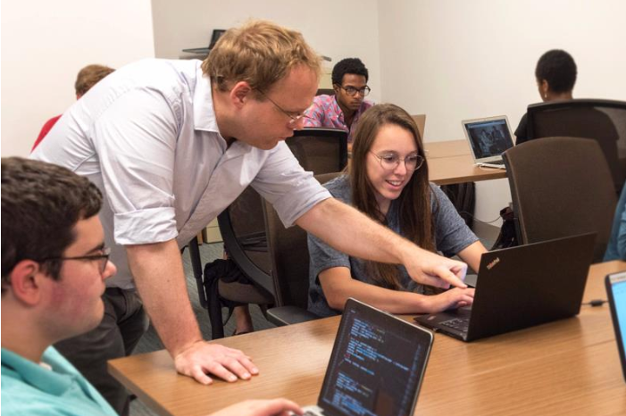
Welcome!..........
Who are you?!?!
Name
Program & Year
Favorite Place to Eat Lunch
Crazy Fact

Slide 3
Okay...but who are we?!?!?
Your Team Leader Info Goes Here
Your Team Leader Info Goes Here
Your Team Leader Info Goes Here
And maybe some pics!
And maybe some pics!
And maybe some pics!

Slide 4
Expectations
Standard Hours: Mon-Fri, 9am-5pm
1 hour for lunch
Start Date - End Date
Holidays
List ‘O Holidays
Requesting Time Off
To request 1 day or part of day, please give 1 week notice
To request 2+ days, please give 2 weeks notice
If you are sick (and able), Slack us
No Paid Time Off :(
Communication Expectations
Always be on Slack at work
On days when you can’t find us, Slack when you arrive and leave
Please keep an eye on Slack when you are at lunch
Slack to call in sick
Slack, Slack, Slack, Slack, Slack
You are not expected to be on Slack when you are not at work, but I may post informational notifications so check Slack if you have questions

Slide 5
Expectations
Bring a laptop and charger every day (we can provide either with some notice)
Dress Code: Casual/”Smart Casual”
Nice jeans, t-shirts, hoodies are fine
Please do not wear wrinkled, holed, stained clothes
Please do not wear sleeping/workout clothes such as sweat pants, pajama pants
Recommend you bring a sweater or jacket, the office can get very cold
If you are unsure, ask
Personal Belongings:
If you would like to keep one or two things at the office, ask us to arrange a place

Slide 6
What to do when you have a question
Ask [insert supervisors]
Ask a teammate
Check Trello/documentation
Post in Slack general chat
Google errors or Stack Overflow are a very good resources
Check software specific forums
Check Github issues
Post on SO, Forums or Github issues
Ask [insert supervisors] to ask PI

Slide 7
Please be respectful of your workspace and your colleagues!

Slide 8
Space Rules
Conversation in a low voice is fine
Please always use headphones
Take phone calls into the conference room or outside
Follow the impressive list of rules on the wall in the kitchen
Please don’t eat any especially fragrant or messy foods in the space
Please throw any food waste away in the kitchen trash or a trash outside
If you would like to have a loud and exciting working session, ask [insert supervisors] to book you a room
Feel free to use the breakout rooms if they are not reserved
Erase whiteboards when you are done

Slide 9
Quick Tour

Slide 10
[Insert current semester] Projects

Slide 11
Project Title
Project Description
Project Requirements
1 [Insert Role Title] Intern x X hours
Project Owners

Slide 12
(Sample Slide 1)
Philly American Sign Language Project
This project will project will create an online resource for the Philadelphia dialect of American Sign Language. We will augment existing Omeka themes and plugins to serve the video recordings and archival collections of Philly ASL signs.
Project Requirements
1 CMS/PHP Intern x 140 hours
1 Design/PHP Intern x 140 hours OR 2 Design/PHP Interns x 70 hours
Jami N. Fisher and Meredith Tamminga
(Linguistics)

Slide 13
(Sample Slide 2) Contemporary Cultural Destruction Project
This project will combine text analysis techniques for positively identifying news articles mentioning cultural destruction with data visualization and CMS development to produce an interactive map for exploring data on damage to cultural heritage sites.
Project Requirements
1 Python/Django Intern x 140 hours
1 Design Intern x 140 hours OR 2 Design Interns x 70 hours
1 Mapping/Javascript Intern x 140 hours
Brian Daniels (Anthropology) & Penn Cultural Heritage Center

Slide 14
Getting Started

Slide 15
Slack
[Insert Slack URL]

Slide 16
Github
[Insert Team Github URL]

Slide 17
Project Management
Trello (Sasha’s Crew Only)
Open Science Framework

Slide 18
Working Envs
Development - [Insert Env, ex. Digital Ocean]
Production - [Insert Env, ex. Reclaim Hosting]

Slide 19
Timesheets
[Insert details about reporting hours]

Slide 20
Installs
For Windows Machines:
PuTTY
https://www.putty.org/
Atom
https://atom.io/
RemoteFTP plugin
Filezilla
https://filezilla-project.org/
For Macs & Linux:
Atom
https://atom.io/
RemoteFTP plugin
To connect to server:
ssh user@11.11.11.11
To transfer files:
scp /path/to/source-file user@host:/path/to/dest-folder/
^^ all one line

Slide 21
Activity
Background resources:
[Insert URL to Team’s past project webpage]
Reference the team Github account, project snapshots (from this slideshow), and list of team members
Break into 2 teams: Design Team and Implementation Team
Create a team page on Github pages using Jekyll:
https://guides.github.com/features/pages/
Page must have:
Team list
Upcoming projects - description only
Launched/past projects - Link to site, github repo, and description
Bonus points: create a new team logo

