Slide 1

Basics of Versioning with Git
Download this slide deck and more at:
https://github.com/upenndigitalscholarship/tktk

Slide 2
Goals
Understand the process of versioning in research, and the role of Git and Github
Visualize the stages of the versioning process
Learn the basic commands used to get started working with Git and Github

Slide 3
Getting Started
Everyone
Create an account at https://github.com/
Download Atom from https://atom.io/
Windows Users
Mac & Linux Users
Download and Install: https://gitforwindows.org/
During install, make sure the following are selected:
Use Git from the Windows Command Prompt
Checkout Windows-style, commit Unix-style line endings
Use Windows’ default console window
Set “HOME” env variable
Open Start Menu and type cmd
Type setx HOME “%USERPROFILE%”
From Start, open Git Bash
Go to https://sourceforge.net/projects/git-osx-installer/files/
For maverick users, click “Download Latest Version”
For snow-leopard users, scroll down to git-2.2.1-intel-universal-snow-leopard.dmg
Download and install
Open your Terminal (found in Applications -> Utilities)

Slide 4

What is versioning in research?
Versioning is tracking every change to a file, when it was made, and by whom
Versioning software streamlines this process
Versioning makes it easy to roll back or reset a previous version of a file
Git versioning allows two different people to work on the same file and easily merge changes
Git encourages large collaborative communities, easy data sharing, software customization, and project cloning

Slide 5


Versioning Vocab
Clone - To copy another user’s project to your personal computer (like downloading it)
Fork - To copy another user’s project to Github, preserving a tracked connection to the original source
Reset/Rollback - To return your personal copy of a project to a specific state
Commit - To bundle a series of file changes in your local copy of a project into a single, labelled package for sharing
Merge - To combine two copies of a file that have been edited by different users, resolving any conflicts
Push - To upload your local commits/changes to an upstream repository (remote, shared storage)
Pull - To download commits/changes from others to your local copy of a project (a merge always follows a pull)
Project - (for the purposes of this workshop) a folder that contains all the files related to a research project
Git - file versioning software program that can be used to version/track your projects
Github - file repository website which uses Git to remotely store (and share!) your projects
Local Repository - the folder on your personal computer where a copy of a Git tracked project is stored
Upstream/Remote Repository - a remote copy of your Git tracked project hosted on a website such as Github

Slide 6
Visualizing a Git Project
Unstaged
(Git knows nothing)
Staged
(Git knows about it)
Local Repository
Upstream Repository
Stash
git add
git commit
git push
git pull
Your Personal Computer
Remote

Slide 7
Git Workflow Basics: Starting/Joining a Team Project
git init
(Start a Project)
Edit files!
git pull
git add --all
git commit -m “message”
git push origin master
git clone
(Join a Project)

Slide 8
Git Workflow Basics: Daily Work Cycle
git pull
Edit files!
git pull
git add --all
git commit -m “message”
git push origin master

Slide 9
Git Workflow Basics: Useful Tips
git status
(show files unstaged and staged files)
git config
(set your user info in your workspace)
git diff
(show difference between unstaged and staged)
git log
(show commit history)
git pull
Edit files!
git add
git commit
git push
git reset --hard [commit]
(clear uncommited changes and reset working space to specific commit - may require stash)

Slide 10
Helpful Websites
Git Cheatsheet: https://education.github.com/git-cheat-sheet-education.pdf
Understanding the Branch -> Commit -> Pull Request Workflow: https://guides.github.com/introduction/flow/
Visualizing Git: http://ndpsoftware.com/git-cheatsheet.html
Git Readme Template: https://gist.github.com/sashafr/47e274d252d3d1b9144458be677517b3
Markdown Cheatsheet: https://github.com/adam-p/markdown-here/wiki/Markdown-Cheatsheet
Online Git Textbook: https://git-scm.com/book/en/v2

Slide 11
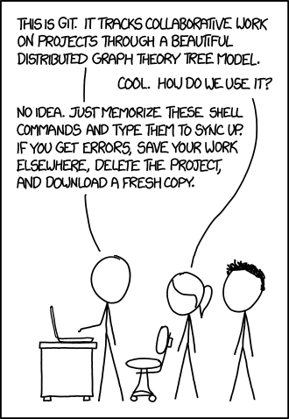
Thank you!
Download this slide deck and more at:
https://github.com/upenndigitalscholarship/tktk
https://xkcd.com1597/

