Slide 1
Command Line Basics
Download this slide deck and more at:
https://github.com/upenndigitalscholarship/tktk

Slide 2
Goals
To understand the basic concepts and components of the Command Line Interface
To feel confident that, when you encounter instructions that include CLI commands during your research, you can determine what they do and how to use them
To be able to “debug” problems when trying to run CLI commands
To be aware of CLI resources online and at Penn

Slide 3
Getting Started
Windows Users
Mac & Linux Users
Download and Install: https://gitforwindows.org/
During install, make sure the following are selected:
Use Git from the Windows Command Prompt
Checkout Windows-style, commit Unix-style line endings
Use Windows’ default console window
Set “HOME” env variable
Open Start Menu and type cmd
Type setx HOME “%USERPROFILE%”
From Start, open Git Bash
Open your Terminal (found in Applications -> Utilities)
Eat Chocolate

Slide 4

What is a Command Line Interface???
One method of interacting with computer programs, through commands
You type these commands in a program called the “shell”
Other methods of interacting with computer programs:
Clicking on something on the screen with a Mouse
Selecting something on a Touch Screen with your finger
You can do many of the same things using both the command line and a mouse!!

Slide 5
$ echo “Hello World”
Hello World

Slide 6
File Systems

Slide 7
$ cd ~
cd = Change Directory, go to a specific folder location
~ = Your Home Directory, the shortcut to your home folder

Slide 8
What am I doing when I type this???
Remember that the Command Line Interface is a “method of interacting with computer programs, through commands”
By typing the cd command, I am running the cd program, which moves me to a new location on the computer
I can “run” the same program by opening a file system navigation window and clicking on a folder

Slide 9
$ pwd
/c/Users/sashafr
pwd = Present Working Directory, gives you your current location

Slide 10
$ ls
AppData/
Desktop/
Documents/
...
ls = List everything in the current folder

Slide 11
What is all this good for?
These are just a few commands that can help you navigate a the file system on your computer
With these commands:
You can move to specific folders (also called directories)
View the contents of folders/directories
View the location of files
These are very important tools for when you need to run a script
Before you can run the script, you may move to the folder that contains the script
You may need to tell a script where certain files you want to modify are located

Slide 12
$ ls -a
$ ls -t
$ ls -l
$ ls -al
-a = List all files, even hidden ones
-t = List files in order of last modified
-l = List file details (I remember it as “list long”)

Slide 13
Options
Commands can have “options”
Options can be chained, ie ls -al
These are ways of changing the behaviour of the command
For example:
ls lists contents of the current directory
ls -a list all contents of the current directory, including hidden files

Slide 14
Let’s go back to cd...

Slide 15
$ cd ~
cd = Change Directory, go to a specific folder location
~ = Your Home Directory, the shortcut to your home folder

Slide 16
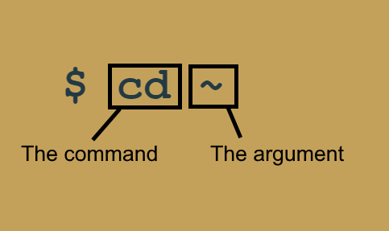
Arguments
Commands (and options!) can also have arguments
These are more information to tell the command how to do what it needs to do

Slide 17
So how can I get to another folder??!?

Slide 18
Relative v. Absolute Paths
These are two ways of telling cd where you want to go
Absolute Paths
Always start with a /
Tell cd where to go, starting from the “root” of your computer
Using ~/Documents is an Absolute Path because ~ is a shortcut for the absolute path to your home directory
Relative Paths
Do NOT start with a /
Tell cd where to go, starting from the directory you are currently in

Slide 19
$ cd /c/Users/sashafr
$ cd ~
$ cd Documents
<- absolute
<- absolute
<- relative

Slide 20
Handy Tip!!
Pressing Tab while typing a file location will try to autocomplete the file name!
Double tapping Tab after typing cd will display all directories that start with what you have typed so far!

Slide 21
Handy Tip!!!
Pressing the Up arrow will scroll through your recent commands!!!

Slide 22
$ cd .
$ cd ..
. = the current directory
.. = the parent directory

Slide 23
$ mkdir

Slide 24
Whoops!
Sometimes if you can’t remember the options or arguments to a command, you can look them up using the manual!
From the command line:
Type [command] --help
In your internet browser:
https://linux.die.net/

Slide 25
$ mkdir workshop
mkdir = creates a new directory
workshop = name of the new directory

Slide 26
$ touch demo.txt
touch = for the purposes of this workshop, it creates a new file
demo.txt = name of the new file to create

Slide 27
$ cp demo.txt demo2.txt
cp = copies a file
demo.txt = name of the file to copy
demo2.txt = name of the new copy of the first file

Slide 28
$ mv demo.txt ./..
mv = moves a file
demo.txt = name of the file to move
./.. = location to move the file to

Slide 29
$ mv ./* ~/Documents
mv = moves a file
./* = using the * means “everything”, so this means
everything in the current folder
~/Documents = location to move the file to

Slide 30
$ rm demo.txt
rm = PERMANENTLY FOREVER deletes a file
demo.txt = name of the file to obliterate

Slide 31
$ rm -R ./workshop
rm = PERMANENTLY FOREVER deletes a folder
-R = Recursive, must be used to delete a folder
./workshop = name of the folder to obliterate

Slide 32
$ cat greeting.txt
cat = prints out contents of a file
greeting.txt = name of file to print out

Slide 33
Command Line Adventure Activity!
Download:
https://github.com/upenndigitalscholarship/tktk/raw/master/activities/adventure.zip
**Once you have downloaded the activity, you should open your shell and use the shell and only the shell for the remainder of the activity
To begin: In the shell, navigate to where you downloaded the zip file, unzip the file, and enter the adventure directory! Your goal is to locate the dragon! While navigating through this adventure, map your “journey” (draw the file tree) on the marker board. You will periodically encounter rogue .txt files. Be sure to read their contents!!!

Slide 34
Input and Output

Slide 35
$ echo “Hello World!” > greeting.txt
echo = writes out or “echoes” the argument
“Hello World!” = the text to write
> = redirects the output of a program
greeting.txt = to file to write the output to

Slide 36
$ cat greeting.txt > farewell.txt
cat = prints out contents of a file
greeting.txt = name of file to print out
> = redirects the output of the cat program
farewell.txt = name of file that cat is redirected to

Slide 37
$ cat greeting.txt >> farewell.txt
cat = prints out contents of a file
greeting.txt = name of file to print out
>> = redirects the output of the cat program and appends!
farewell.txt = name of file that cat is redirected to

Slide 38
$ grep “Hello” greeting.txt
$ wc greeting.txt --lines
grep = finds and prints each instance of a string in a text file
wc = prints newline, word, and byte counts for each file

Slide 39
$ grep “Hello” greeting.txt | wc --lines
grep = finds and prints each instance of a string in a text file
wc = prints newline, word, and byte counts for each file
| = (called a pipe) takes output from one command
and gives it as input to another command

Slide 40
$ sudo [command]
$ clear
sudo = run a command as the “super user”
clear = clear your console

Slide 41
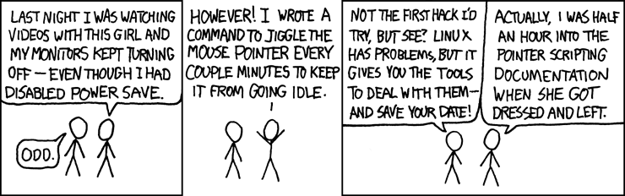
Thank you!
Download this slide deck and more at:
https://github.com/upenndigitalscholarship/tktk
https://xkcd.com/196/

