Slide 1
Back-end – Data base design Michelle tan
Purpose
Documentation
Sub-system Interactions
Wahoo Bay Data Base can get data from science Stream API and store in local database.
Store users' info into database from front end
Fish base data can send data to front end.
Draw.io Database Design.
SQL database store and retrieve data.
IntelliJ IDEA environment. Use Spring Boot create
REST API.
Front-end: user register and verified with the token. Users' data will store in Database.
Database: Have users , role , token site Data, SourceData, Fish Data entities .
Query data from Wahoo bay web1 store into sitedata and data source table in local Database system.
Michelle Tan

Slide 2

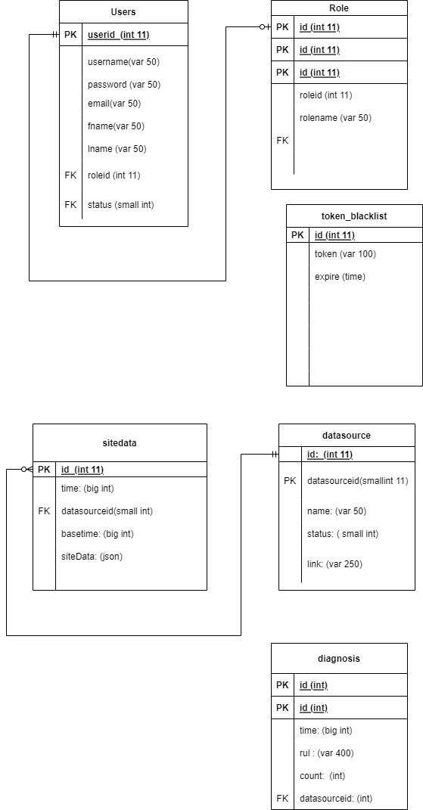

Data base design diagram

Slide 3
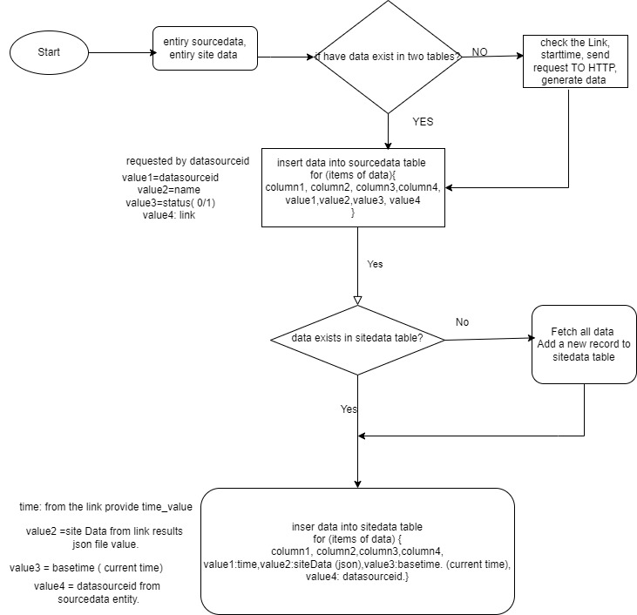
Data base – generate data logic design
Michelle Tan

Slide 4

Back-end – data base
Create tables in database . From REST API subsystem user registered , can store data into database user's table. Create site Data table and SourceData tables. Get store all data from Science-Stream API . VS Spring boot REST API controller.
query data from science stream Wahoo bay site 1 API and store all data into local database.
Front End can retrieve backend data, analysis and visualization
Michelle Tan

Slide 5

Back-end – data base API challenges MICHELLE
KNOW
Learning Swagger formatting and professional API documentation
Learning how to use Spring Boot
Learning how query data from API link
Learning How to implement JWTs with Spring Boot
Learning How to implement code in Spring Boot.
Post method , provide data

Slide 6
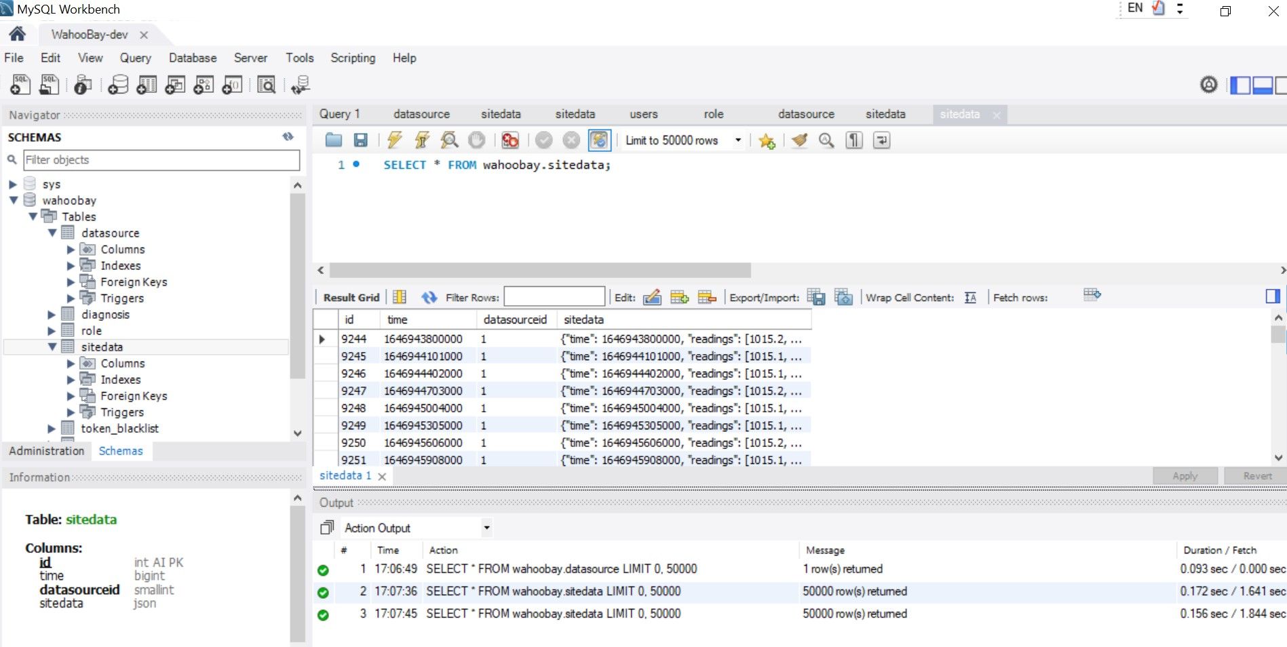
Back-end – User Database Mason
Michelle Tan

Slide 7

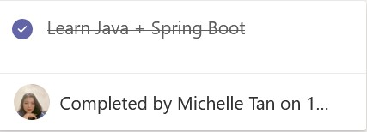
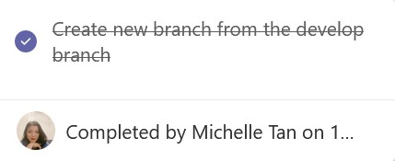
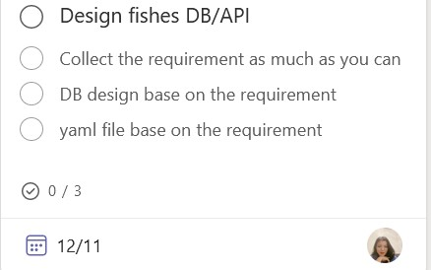
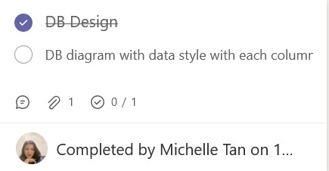
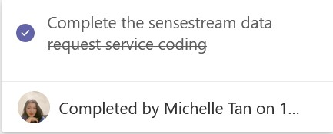
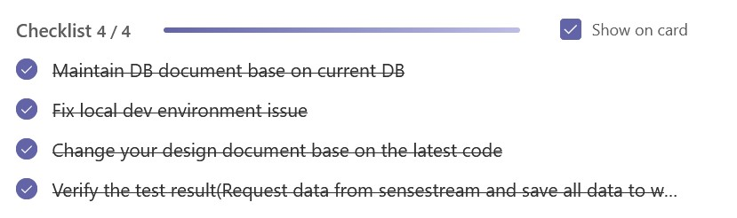
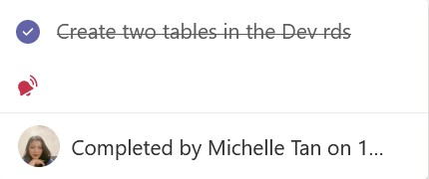
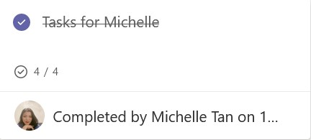
Back-end - USer api and Database Tasks Mason
Completed
To do
Mason Collins

Slide 8
demo YouTube link: https://youtu.be/EyKVPIDbEJw
Michelle Tan

