Slide 1




Data Analytics Challenge 2022 Case Competition
Team Exception

Slide 2
OBESITY: DRIVERS AND RELEVANCE
Prevent childhood obesity
Societal responsibility
Genetics, physiology, environment, job and education, and brain activity
Unequal distribution of access to health care, healthy food, and physical activity opportunities
Notes:
societal responsibility

Slide 3
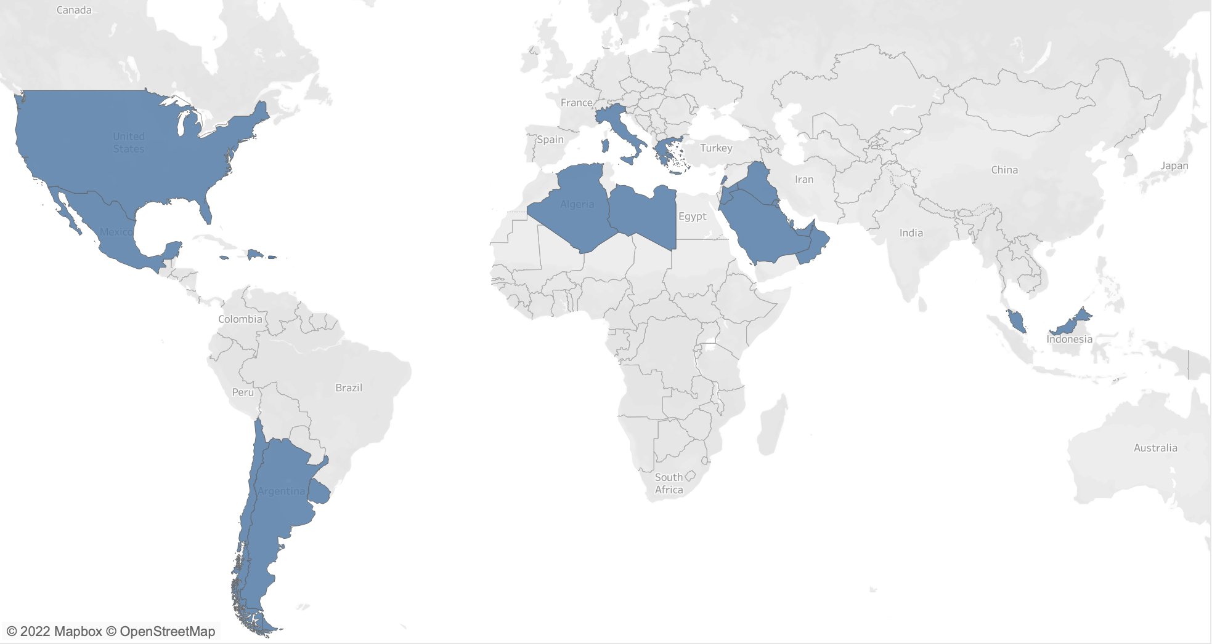
> 1 MILLION CITIZENS
25
COUNTRIES
THE FIRST LAYER OF FILTERING

Slide 4
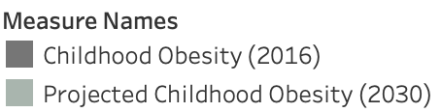
ACTUAL vs. PROJECTED OBESITY RATE
HIGHEST EXPECTED GROWTH
THE FIRST EXTERNAL FACTOR

Slide 5
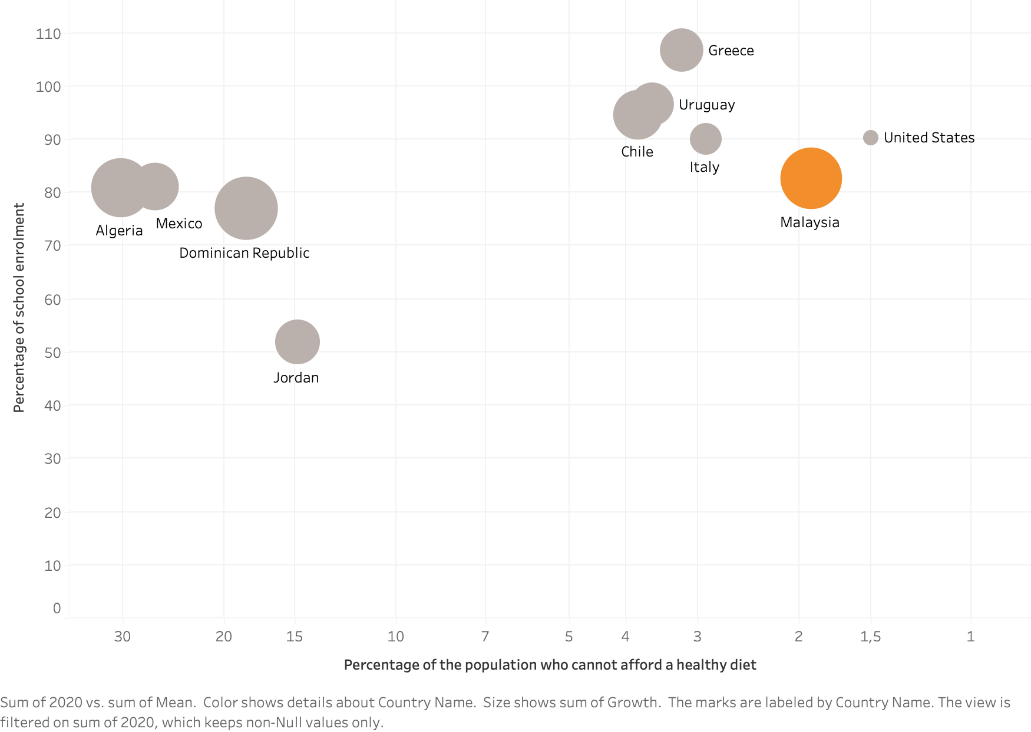
EDUCATION
A HEALTHY DIET
THE SECOND & THIRD EXTERNAL FACTOR
Notes:
- the next two factors which we considered are education and the affordabiltiy of a health diet
education in terms of the percentage of chilrdren enrolled in school. which in depicted on the y axis
on the x axis shows if the population can actually afford a healthy diet.
The sewwetspot on this scatterplot is the top right hand corner.
and

Slide 6
124%
Saudi Arabia
159%
Kuwait
135%
Malaysia
MOBILE SUBSCRIPTIONS
128%
Italy
132%
Qatar
134%
Oman
127%
New Zealand
186%
United Arab
Emirates
131%
Chile
131%
Uruguay
THE FOURTH EXTERNAL FACTOR
Notes:
FLOW OF INOFMRATION IS MOST IMPORTANT
- USE TOLLS THEY CAN USE THEMSELVES TO LEARN
- TOP 10

Slide 7
THE IDENTIFICATION PROCESS
EDUCATION
HEALTHY DIET
MOBILE SUBSCRIPTIONS
HIGHEST PROJECTED GROWTH
25 countries
MALAYSIA

Slide 8


Drivers of childhood obesity in
MALAYSIA

Slide 9
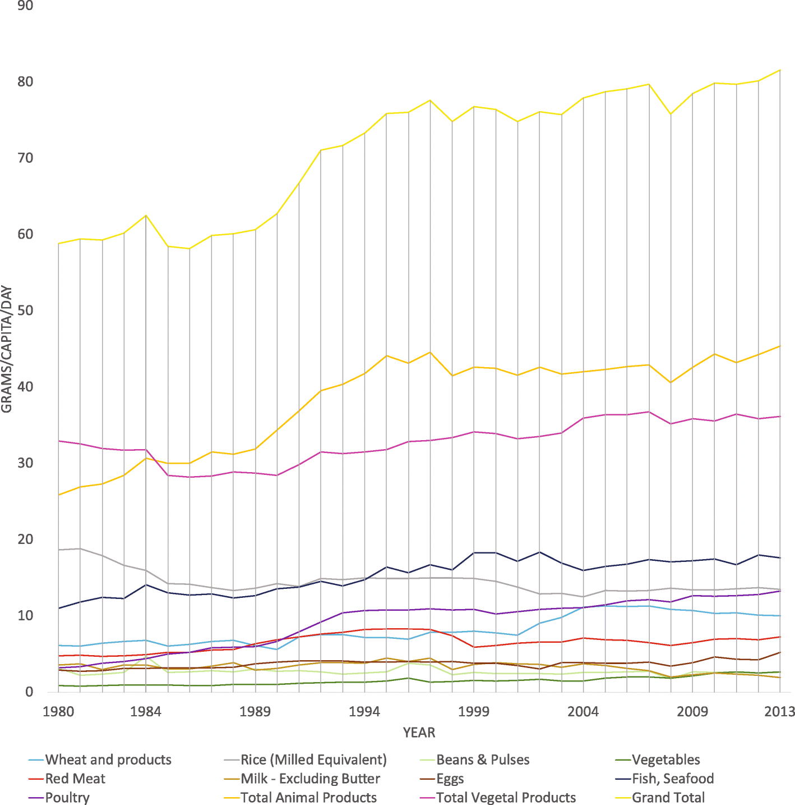
THE NUTRITION TRANSITION (1)
Economic development and prosperity throughout Asia leading to greater access to calories, but disproportionately in animal products –
"Total availability of calories per capita per day in Malaysia was estimated at 2430 kcal in 1961 and increased to 2923 - 2990 kcal in 2007, a 20% increase over 40 years”
Source: A Review of Adult Obesity Research in Malaysia (https://www.researchgate.net/publication/311262188_A_review_of_adult_obesity_research_in_Malaysia)
Notes:
https://bmcnutr.biomedcentral.com/articles/10.1186/s40795-020-00348-5/figures/2

Slide 10
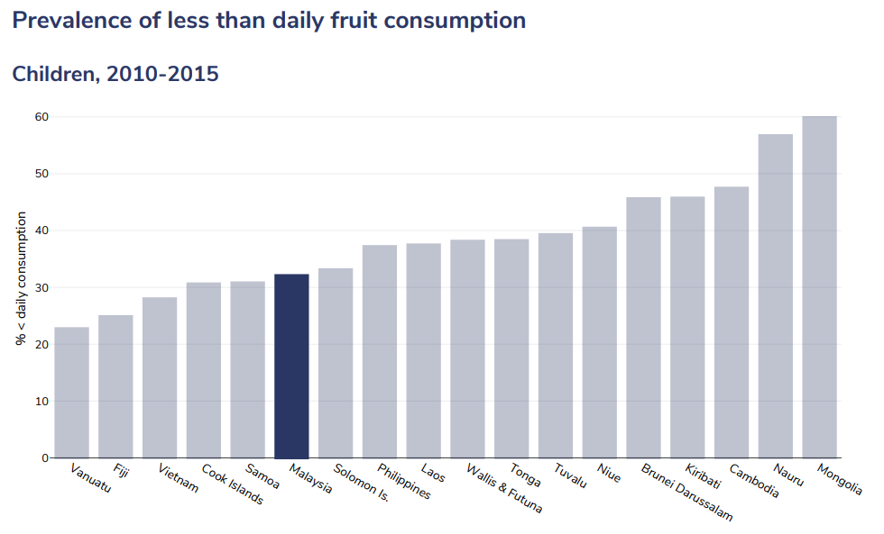
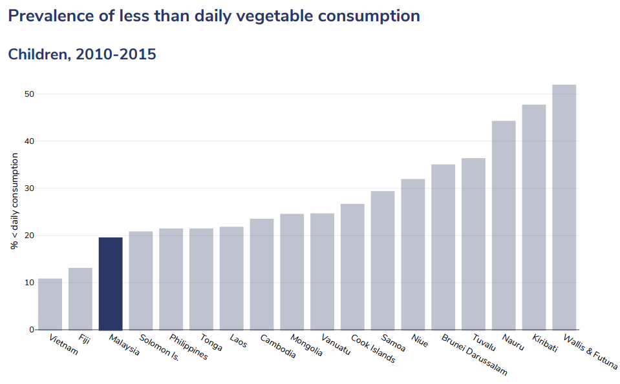
POOR DIETARY HABITS FROM CHILDHOOD (2)
Source: A Review of Adult Obesity Research in Malaysia (https://www.researchgate.net/publication/311262188_A_review_of_adult_obesity_research_in_Malaysia)
Notes:
Source: https://data.worldobesity.org/country/malaysia-130/drivers.pdf

Slide 11
A LAISSEZ-FAIRE POLICY EFFORT (3)
No taxes on unhealthy foods
No subsidies on fruits, vegetables or general healthy products
Almost zero marketing restrictions
No mandatory limits on trans-fats
Misleading nutritional labelling – limited information value
Source: Who Do Not Read and Understand Food Label in Malaysia? Findings from a Population Study - https://www.researchgate.net/publication/323773946_Who_Do_Not_Read_and_Understand_Food_Label_in_Malaysia_Findings_from_a_Population_Study
Notes:
Source: Who Do Not Read and Understand Food Label in Malaysia? Findings from a Population Study - https://www.researchgate.net/publication/323773946_Who_Do_Not_Read_and_Understand_Food_Label_in_Malaysia_Findings_from_a_Population_Study

Slide 12
How can Novo Nordisk drive change in MALAYSIA?

Slide 13
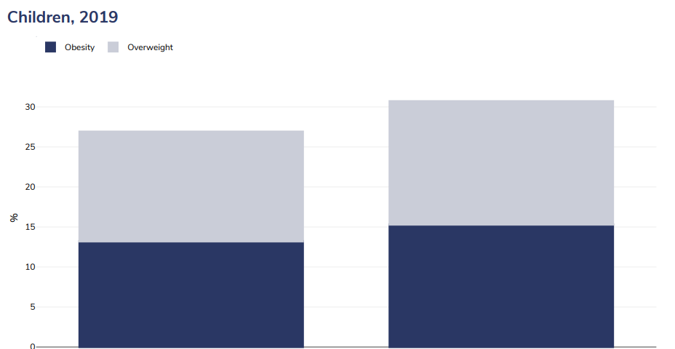
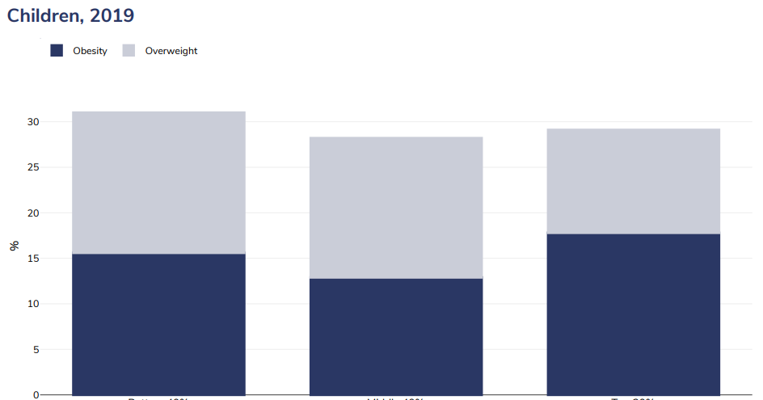
HOW TO TARGET AN EDUCATION PROGRAMME (1)
In urban environments:
Cognizant of socio-economic and cultural circumstances:
Rural
Urban
Bottom 40%
Middle 40%
Top 40%

Slide 14
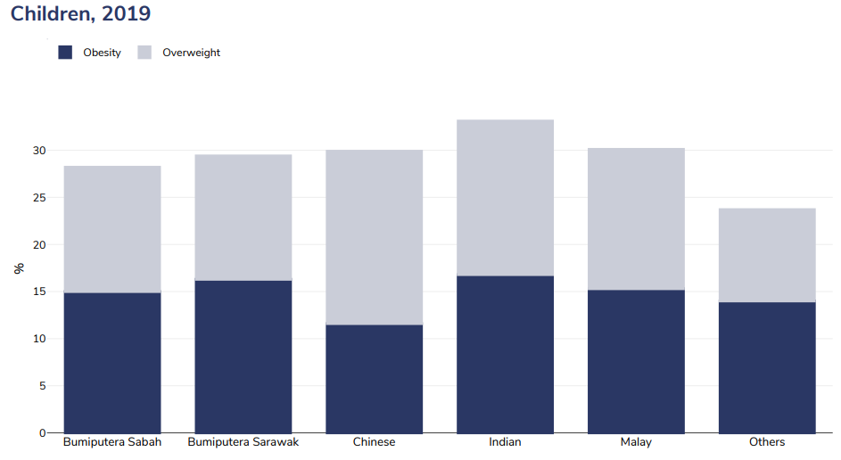
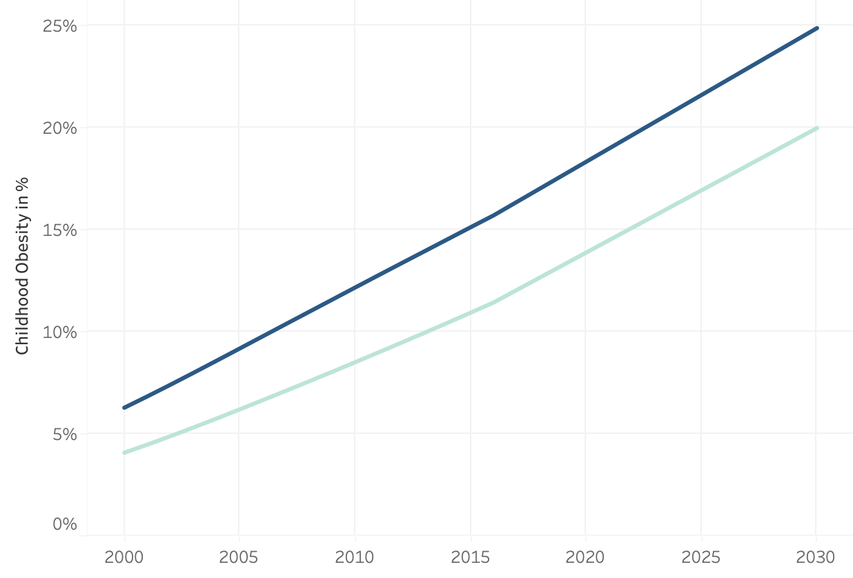
HOW TO TARGET AN EDUCATION PROGRAMME (2)
In ethnically and culturally appropriate ways:
For the right age group - 'flatten the curve':
Current prediction for Childhood Obesity in Malaysia

Slide 15
The programme
A comprehensive education programme:
In schools – targeting the youngest (5-9 y/o) - where prevalence of obesity is highest
In urban, rather than rural, environments – where obesity rates are highest
Targeting families in the bottom quartile of household income – where obesity rates are highest
For parents:
Nudging personal decision-making around diet when the government doesn't make it easy
Working with local stakeholders – role of 'community pharmacists' in disseminating information
Cost:
Numerous studies across the US and Europe on sustainable programs guiding children towards healthier choices average ~$30 per student, per year
(source: https://academic.oup.com/heapro/article/34/6/1141/5138277)
Notes:
Suriani et al. (2015) - surveying obese working women - 'lack of knowledge' was the most common reason cited for not eating healthily (Source: Suriani I, Khadijah S, Khalib AL, et al. Barriers to food quantity intake control and healthy eating among overweight and obese working Malay women in public service. International Journal of Public Health and Clinical Sciences 2015; 2(3): 81-93)

Slide 16
How can we measure THE SUCESS?
Success = sustainability
Is obesity under the projected WHO level?
We are flattening the curve: no quick fixes!
Survey data pre and post intervention
Measure the children’s BMI once every year

Slide 17
THANK YOU
Team Exception

